Slide 1
ATM Project
By: Crypto Coders
Benjamin Larsen
Darien Thomas
Peter Keres
Robin Geven

Slide 2
User Stories
Users should be able to transfer cash
Users should be able to withdraw money
Users should be able to view their balance
Admin Users should be able to create new atm cards
Admin users should be able to view atm machine status

Slide 3
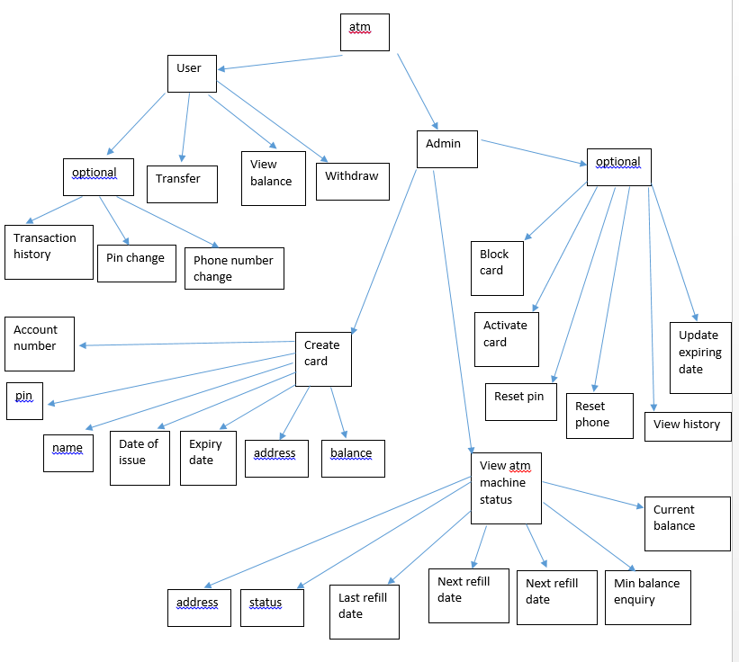
Project Design
The atm has User and Admin accounts.
User accounts can transfer funds, view balance, and withdraw money.
Admin accounts can create cards, and view atm machine status.

Slide 4
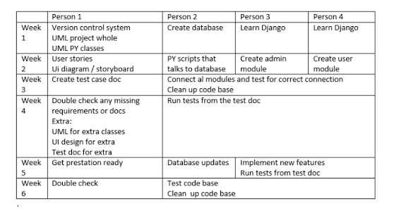
Plan
Started with assigning each person to different tasks, and creating a schedule for each person.
Below are how we split up the work between each person.

Slide 5
Project Management
We used GitHub with several different branches so we could upload code without committing it to the main branch.
We used Discord as a means to communicate with each other and shared non code related documents to each other on there.
We used trello to keep each other updated with progress and what still needed to be done.

Slide 6
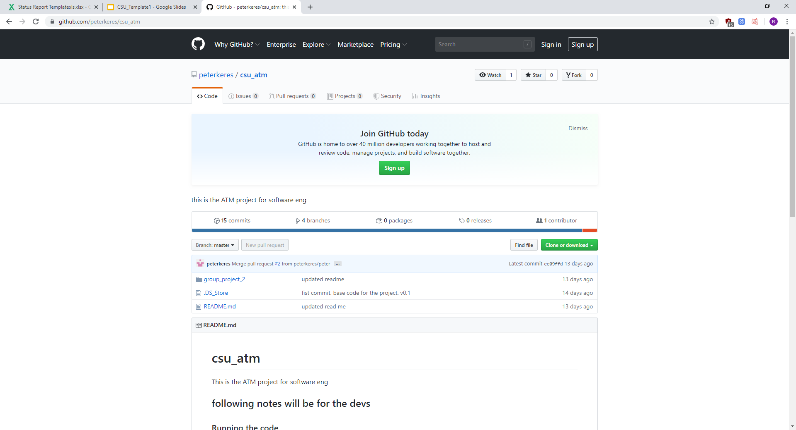
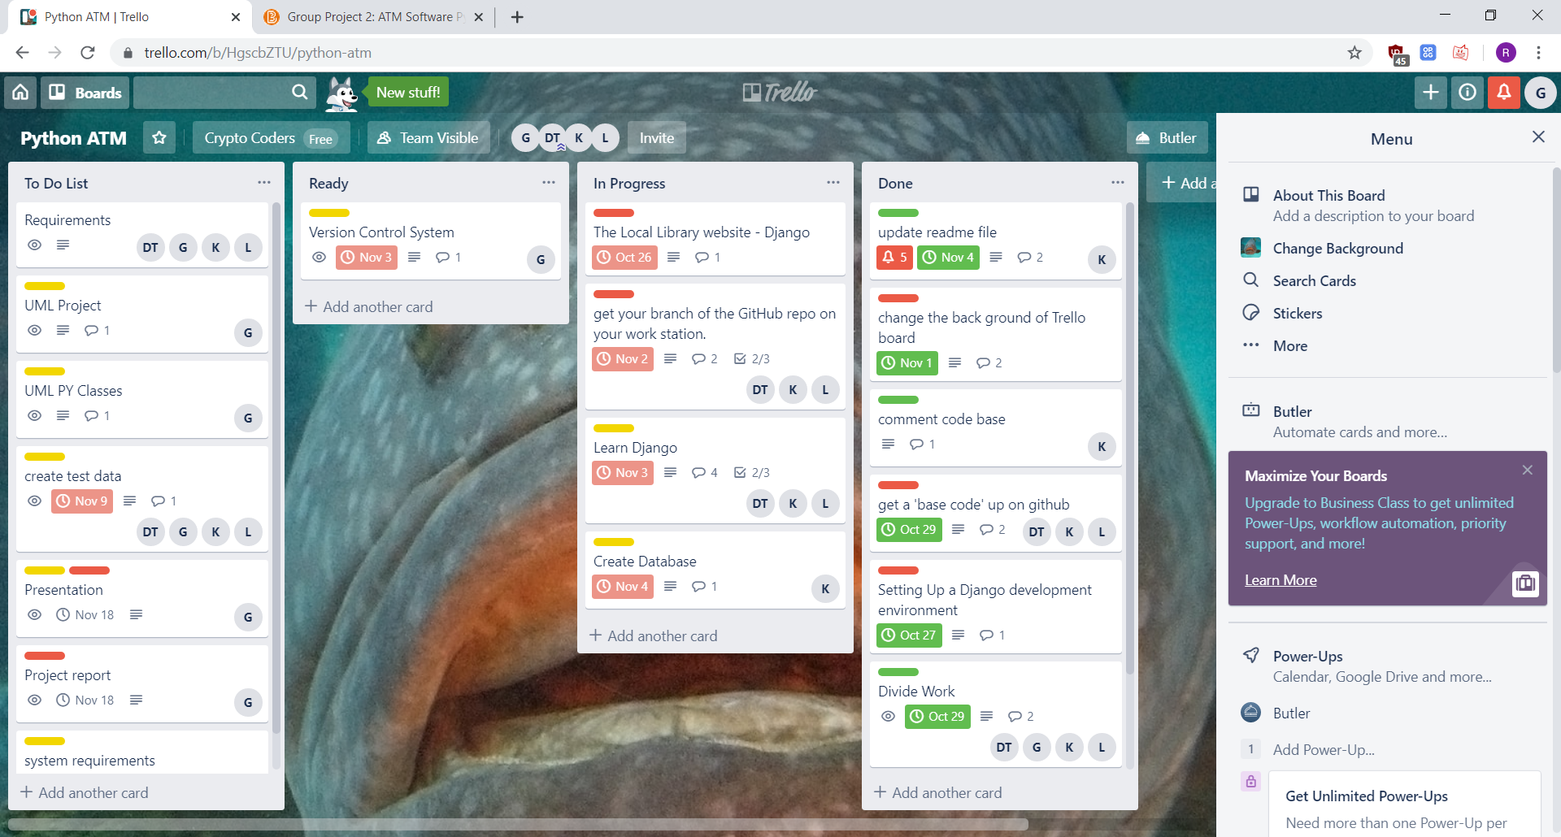
Project Management Screenshots

Slide 7
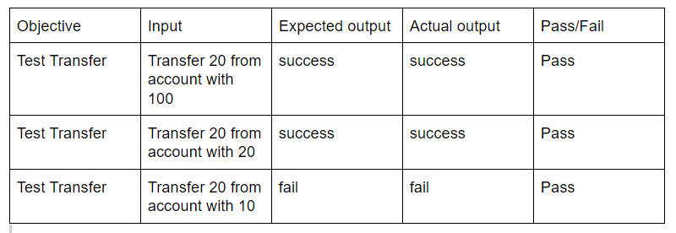
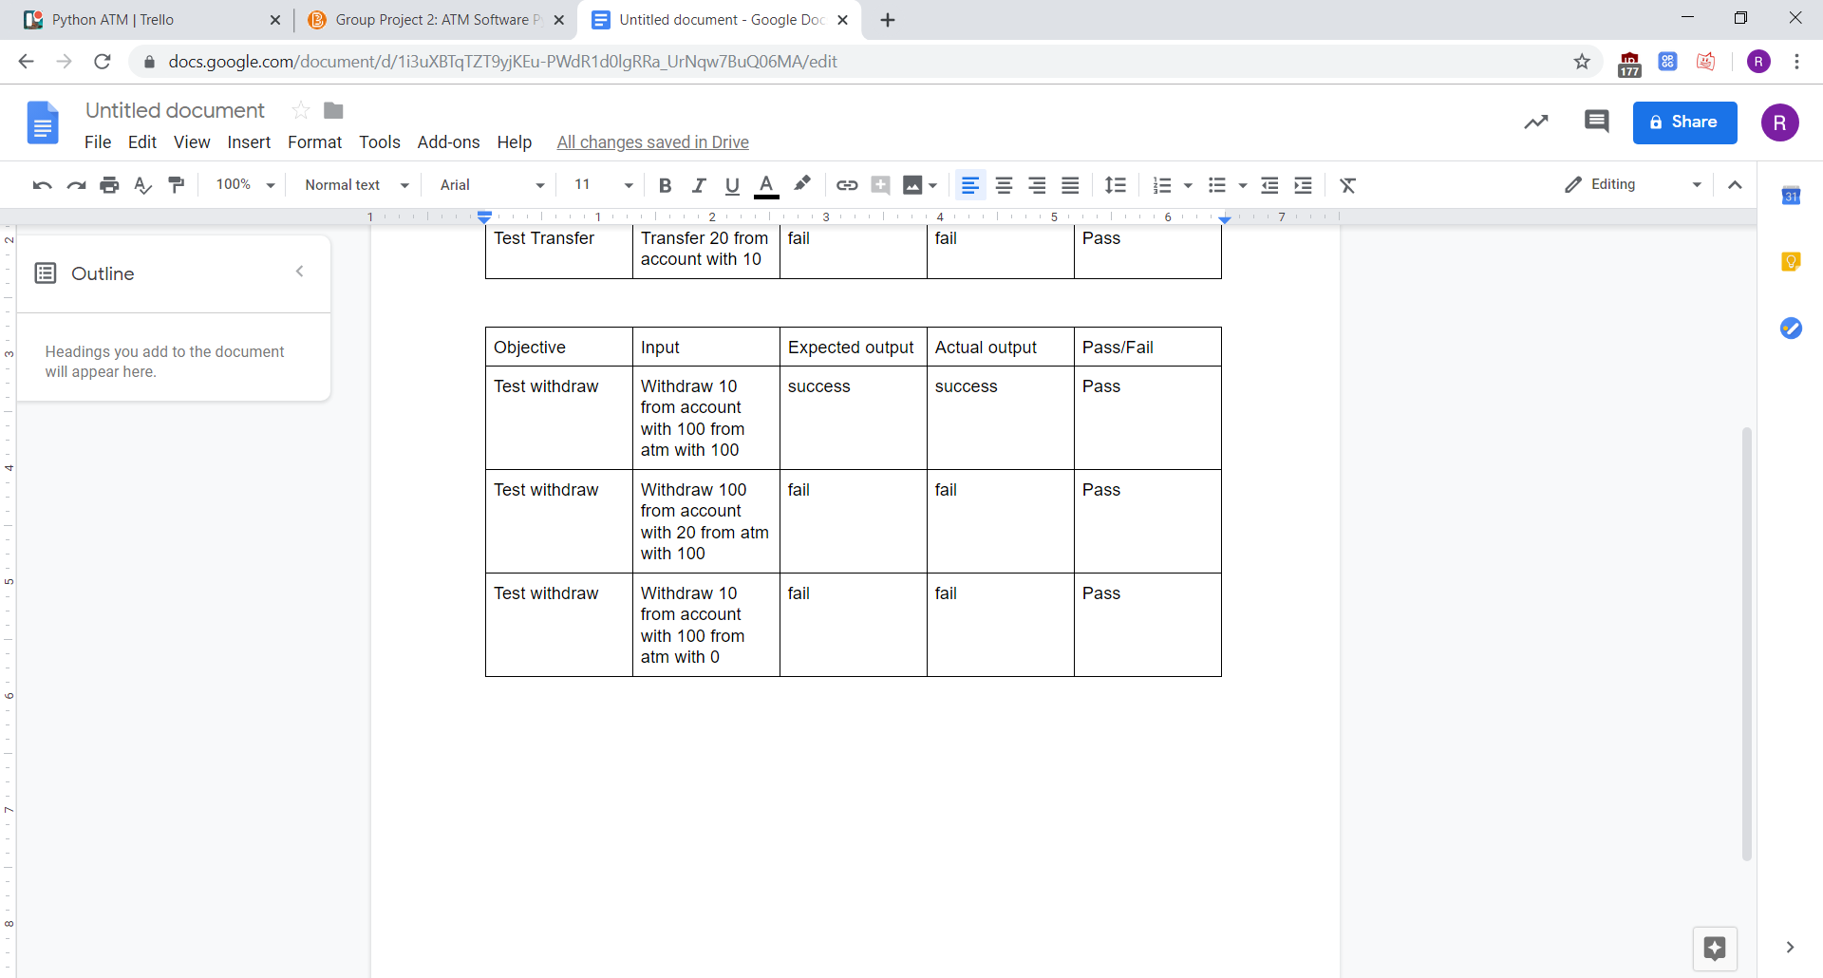
Testing
objective | input | Expected output | Actual output | pass/fail
Admin view | Atm status | “active” | “Active” | pass
Admin view | Atm address | “Over by cct” | “Over by cct” | pass
Admin view | Atm last fill date | 06/22/19 | 06/22/19 | pass
Objective | input | Expected output | Actual output | pass/fail
Admin new card | Pin > 4 characters | error | error | pass
Admin new card | Date issued | Today's date | Today's date | pass
Admin new card | Two factor status | “active” | “active” | pass

Slide 8
Demo/Questions

