Slide 1
Facial Recognition
Peter Keres & Maidel Fletes

Slide 2
Previous Work

Slide 3
According to research, done by Shred-it, 40% of business executives state employee negligence is the root cause of their security breaches.

Slide 4
Employee Negligence
Leaving their computer on and unlocked
Employees sometimes leave sensitive documents open while on break
Leaving doors unlocked that should always be locked

Slide 5
Issues with Current Systems
Lock & Key or Key Fob System
  Keys or key fobs have the risk of beings stolen.
  No data is kept on attempted entrances. (Lock & Key)
  New keys or key fobs must be made for new doors.
  User may loss key/key fob.

Slide 6
Scope Of Our Project
Allows user in/out of facilities with facial recognition.
Sends notification of attempted intruders.
Database of authorized personnel kept
Users click button in order to begin facial recognition process.

Slide 7
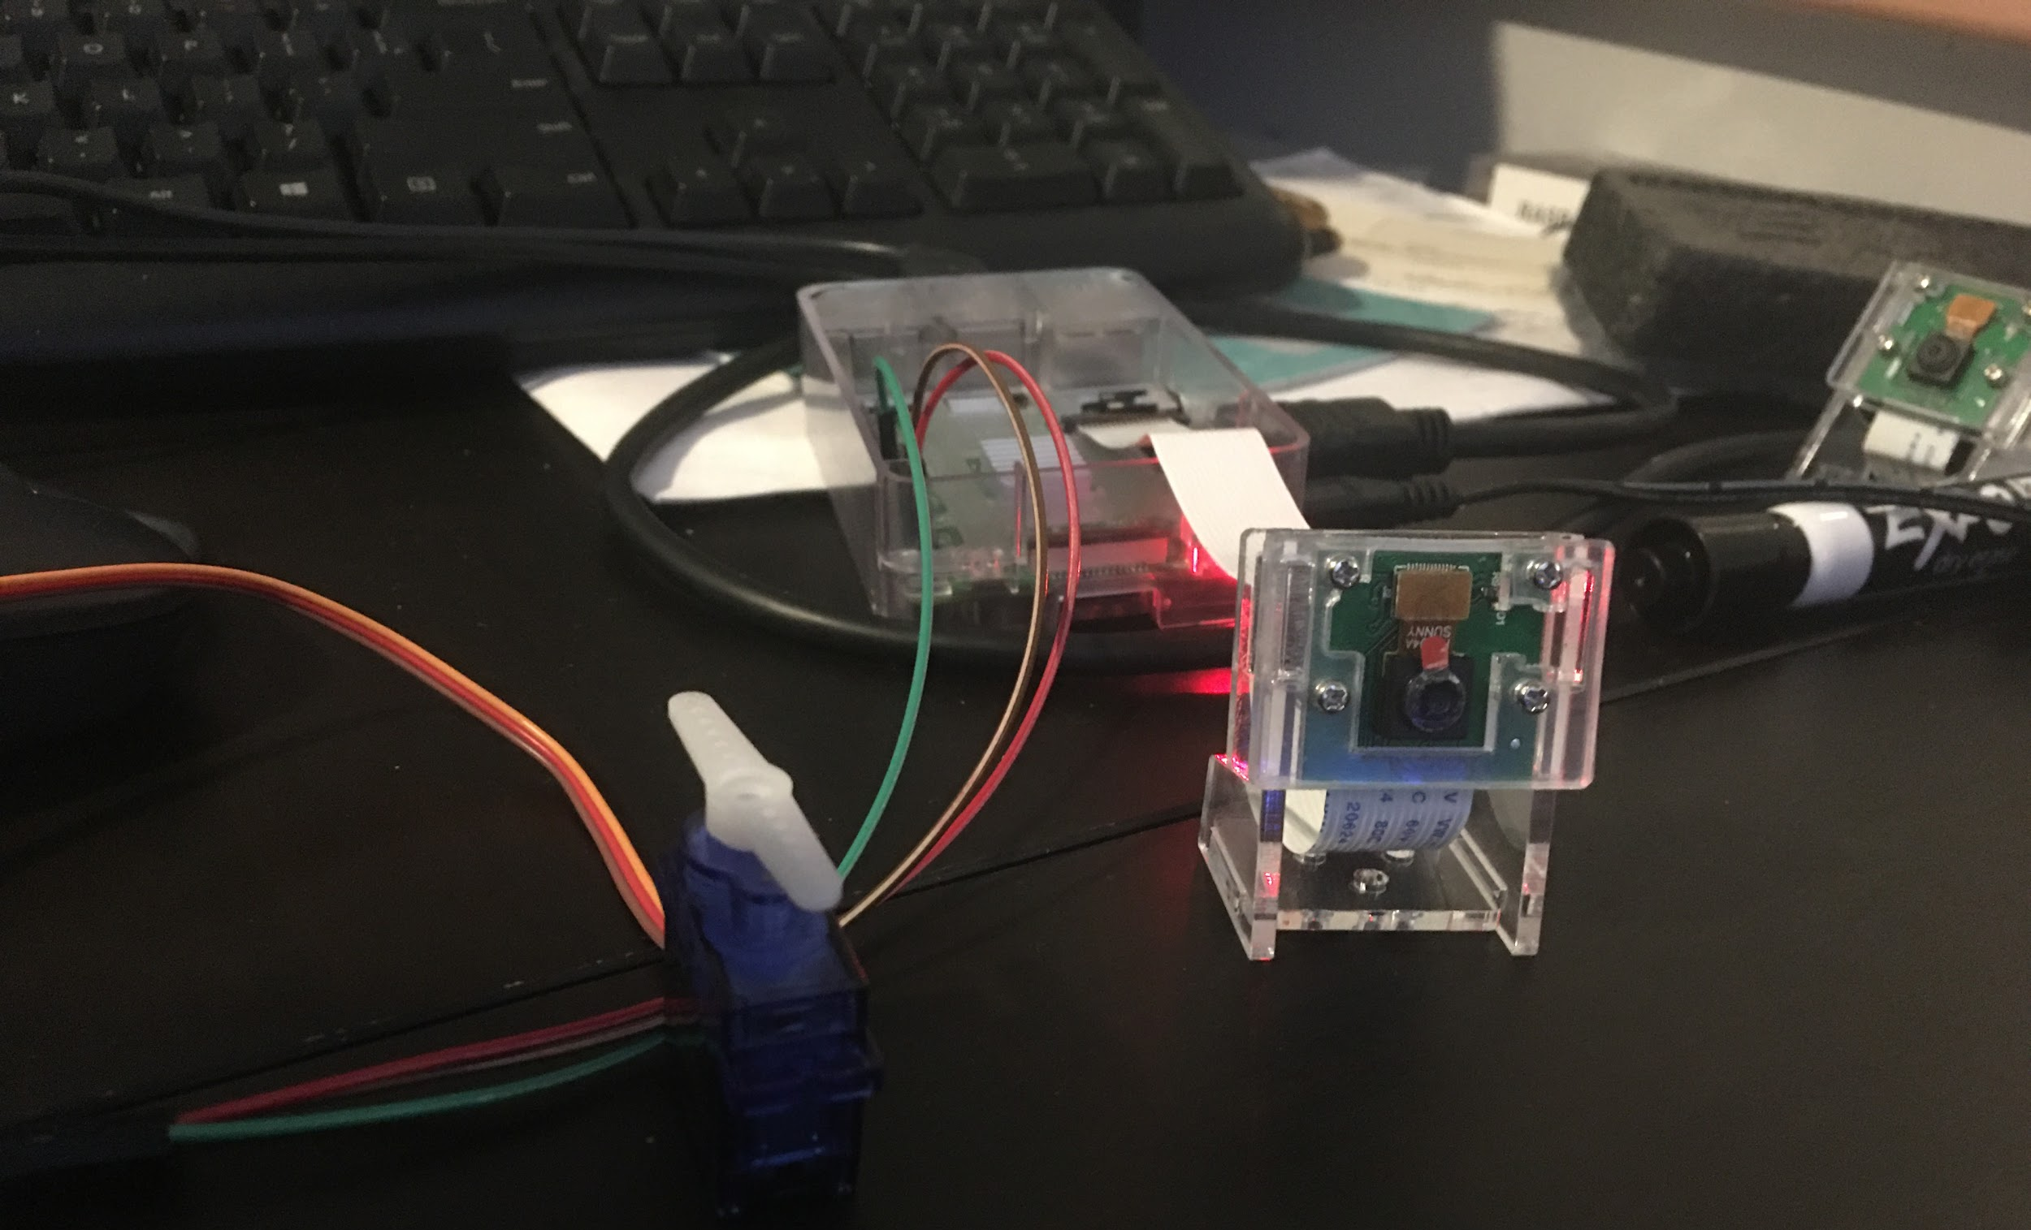
Our System
Definitions
Facial Recognition - creates template of targets face and compares it to pre existing images of a face(s) known.
Aimed for smaller businesses; Allowing them to use facial recognition technology on a cheaper budget.

Slide 8
System Design & Activities

Slide 9

Current Status: How It Works

Slide 10
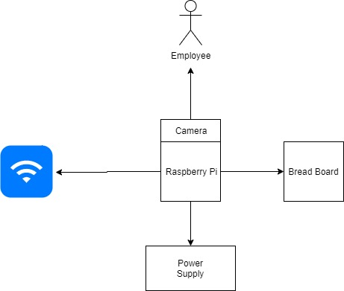
System Design
A diagram of the initial set up of our design

Slide 11
Key Concepts: Creating Our System

Slide 12
Step 1:
Materials & Libraries
2 raspberry pie. Model 3B
Servo motor
2 pi cameras
Ethernet cable
1 Button
2 led lights
GPIO
Open CV
SMTPLIB

Slide 13
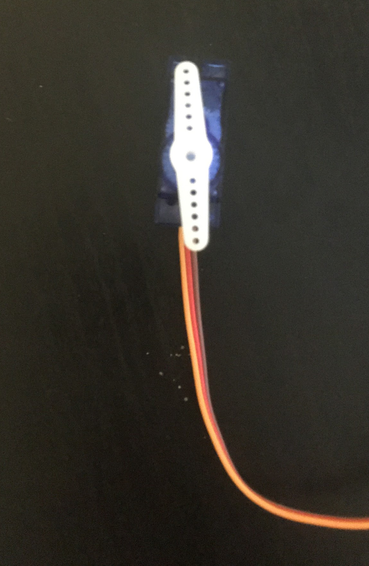
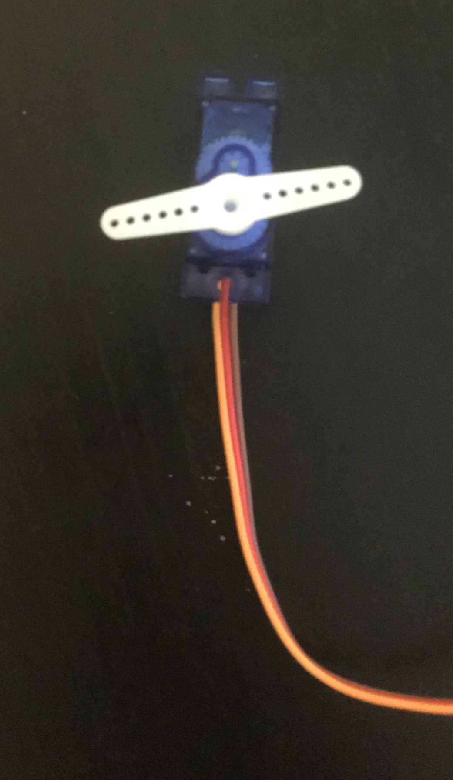
Step 2: Lock Simulation
Unlocked State
To simulate a locked and unlocked door we used a servo
Locked State

Slide 14
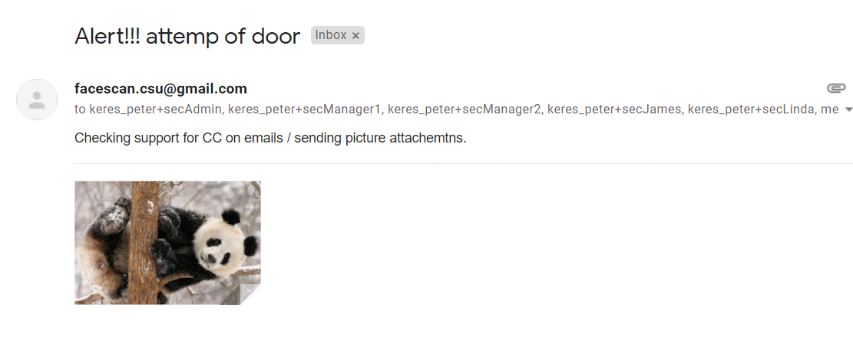
Step 3: Email Notification

Slide 15
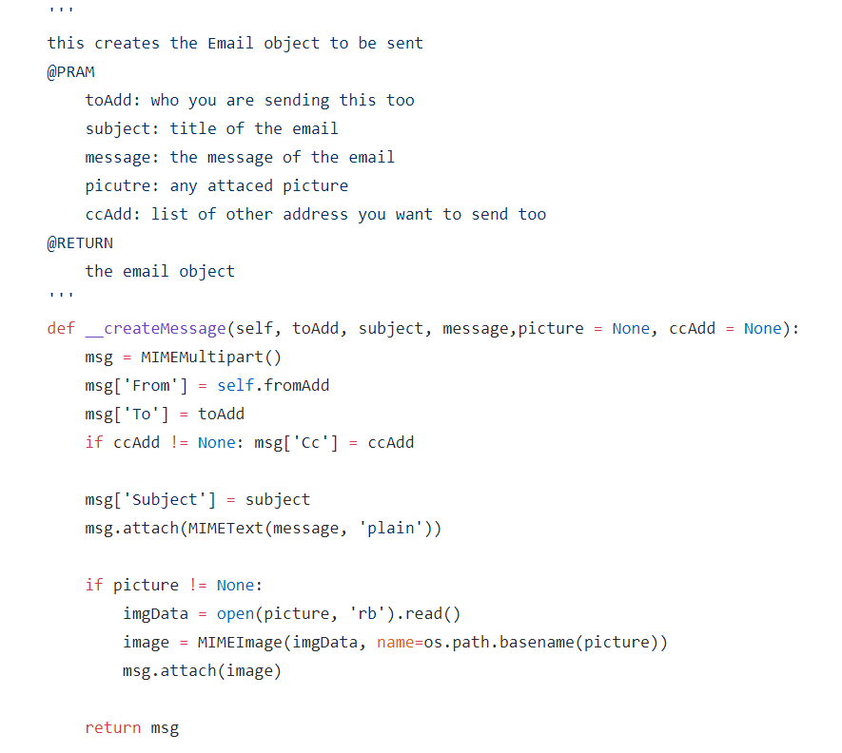
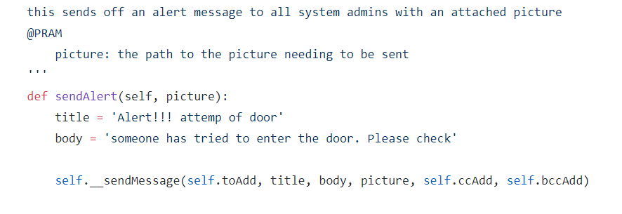
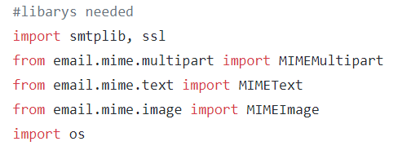
Email Notification Code

Slide 16
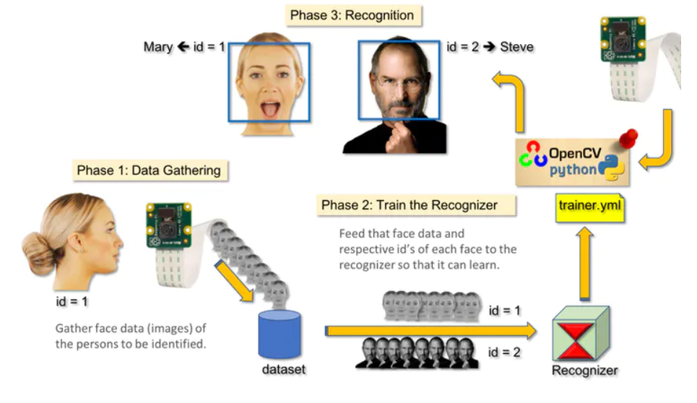
Step 4: OpenCV
OpenCV is library that contains more than 2,500 algorithms. These algorithms can be used to detect and analyze faces.

Slide 17
Installing OpenCV
OpenCV 4
Step 1: Install and download the
following packages:
cmake
libjpeg
libpng
libtiff
libavcodc
libavformat
libswscale
Step 2: Download OpenCV 4 library
Step 3: Make a virtual environment for python 3
Step 4: Make a cmake file to configure and install openCV 4
Step 5: Change the settings on raspberry Pi so the Pi uses more SD space for swapping fles.
libv41
libxvidcore
libx264
libgtk-3
libcanberra
libatlas-base
python3
numpy

Slide 18
Installing OpenCV Cont
Note: As of earlier in the year, you can install OpenCV with pip install OpenCV 4.
For this project we did not use this tool so we have no tested this process.
Step 6: Tie your OpenCV 4 installation to the virtual environment
Step 7: Finished!

Slide 19
Challenges
Getting servo to rotate
  Frequency and amount of pulse
Gmail security settings
  Allow ‘less secure app setting’
Lighting effects results
Adjusting the parameters to lower the amount of false positives received

Slide 20
Technical Merit
Gained the experience in creating a project from the ground up.
Have experience with:
  OpenCV
  SMTP
  Python
  Constructing circuits
Gained the ability to present work we have created to others.
  ACM Conference

Slide 21
On-Going Work
Creating a clocking in/out system which when granted access communicates with database.
Storing failed attempts at door in order to look for patterns.
Allowing the system admin to override ungranted accesses.
Adding 2 factor authentication with fingerprint scanner

Slide 22
Conclusion: Lessons Learned
OpenCV installation tends to take a long time.
Libraries are great tools when creating projects.
Time management
Conferences offer a great opportunity to receive helpful feedback on research projects.

Slide 23
Abstract
Technology has become increasingly part of our daily lives from conducting work on our laptops to measuring our sleep cycle with wearables. With advanced technology being introduced into our lives the topic of security is more prevalent than ever. Various companies have taken action to enhance security by incorporating various practices; Some assign their employees credentials to monitor company access. However, security measures to ensure confidentiality can be reinforced utilizing biometrics. Our prototype allows employees in/out of facilities with facial recognition technology; Most facial recognition technology has the capability to grant and deny users access, however, no data is kept on the intruders. Our prototype notifies the system administration of the intruder via email.

Slide 24
Hamann, Kristine, and Rachel Smith. “Facial Recognition Technology: Where Will It Take Us?” American Bar Association, 2018, www.americanbar.org/groups/criminal_justice/publications/criminal-justice-magazine/2019/spring/facial-recognition-technology/.
Kaelin, Mark. “More than 40% of Reported Security Breaches Are Caused by Employee Negligence.” TechRepublic, TechRepublic, 26 Jan. 2019, m www.techrepublic.com/article/over-40-of-reported-security-breaches-are-caused-by-employee-negligence/.
OpenCV.org. “About.” OpenCV, 2019, opencv.org/about/.
Ravi, and Bonzadog. “Raspberry Pi Servo Motor Interface: How to Control a Servo Motor?” Electronics Hub, 20 Feb. 2018, www.electronicshub.org/raspberry-pi-servo-motor-interface-tutorial/.
Rosebrock, Adrian. “Install OpenCV 4 on Your Raspberry Pi.” PyImageSearch, 28 June 2019, www.pyimagesearch.com/2018/09/26/install-opencv-4-on-your-raspberry-pi/.
MJRoBot. “Real-Time Face Recognition: An End-to-End Project.” Hackster.io, 11 July 2018, www.hackster.io/mjrobot/real-time-face-recognition-an-end-to-end-project-a10826.
GitHub:
https://github.com/peterkeres/face_rec_csu
Work Cited

Slide 25
Demonstration

