Slide 1
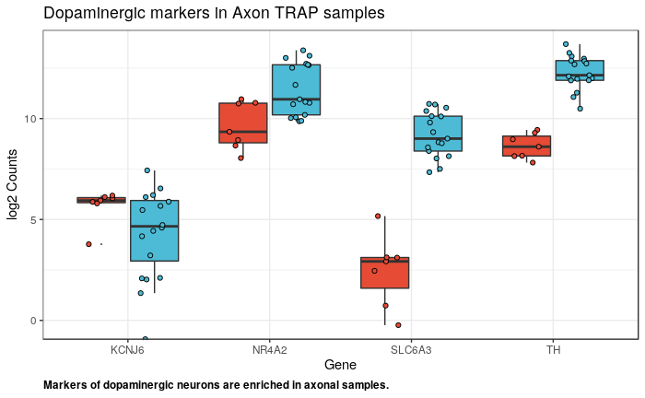
Marker enrichment confirmation
RT-PCR enrichment of dopaminergic markers agrees with RNAseq counts

Slide 2
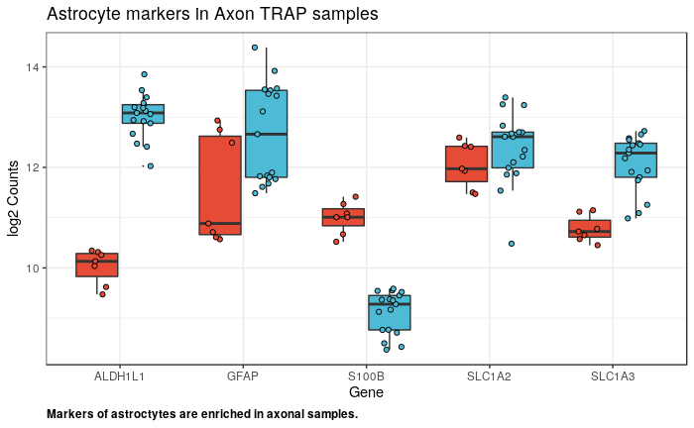
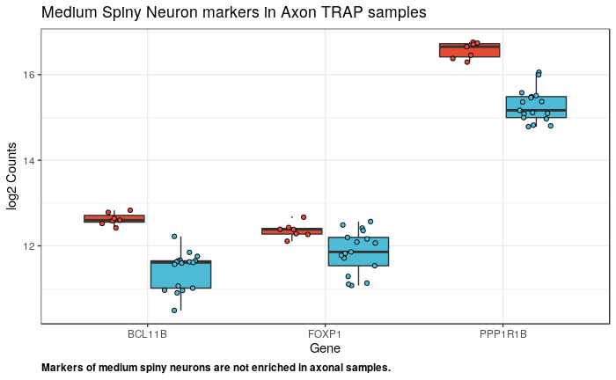
Non-target cell type markers
2 - Considerations:
Control TRAP in 4 Cre-ve mice yielded no RNA.
The yield of RNA from Cre+ve striatum ranges between 15 and 40 ng (approaching the range obtained from midbrain (50 ng - 100 ng)).
Striatal eGFP-L10a protein is 1/20th midbrain amount: This may be greater than expected for an axonal-specific protein
1 - Potential causes:
Cre expression in non-dopaminergic cells
non-specific binding of striatal transcripts
coprecipitation of astrocyte ribomes/RNA (Dougherty/Sakers, 2017)
exchange of ribosomes/cDNA between neighbouring cells (Dougherty/Sakers, 2017)

Slide 3
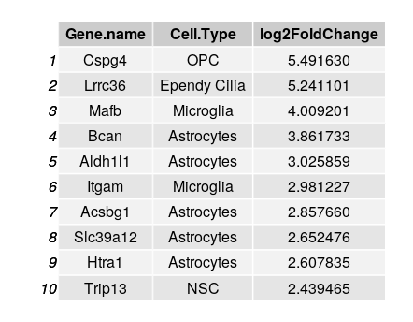
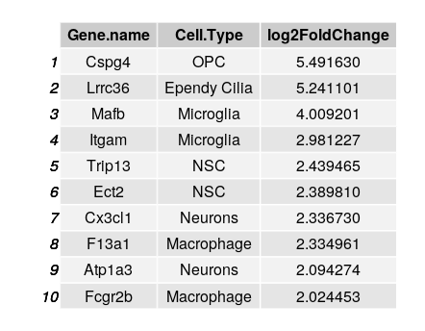

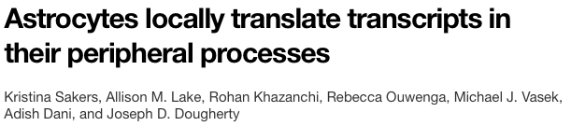

Adding striatal marker gene information
*
*
Ranking of single cell-derived marker genes of striatal cell types by their log fold-enrichment in axon samples
An astrocyte TRAP dataset was used to filter axon-enriched genes. 526/3838 (13%) were removed.
* TRAP/Ribotag datasets available

Slide 4
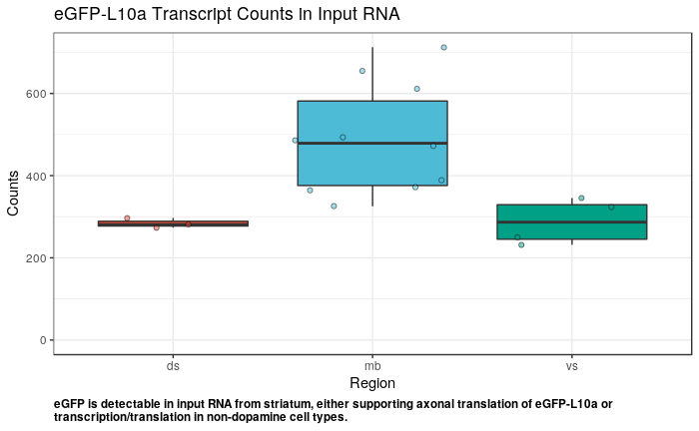
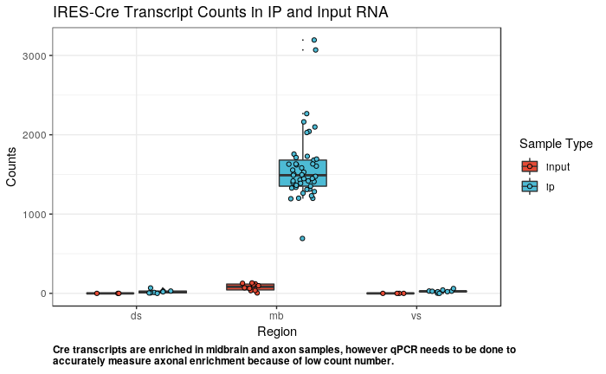
Transgene expression in midbrain and striatum

Slide 5
Plan
Further filtering to exclude microglia/macrophage-enriched genes from analysis
Confirmation of Cre enrichment by qPCR
Positively select a subset of genes classed as dopamine/axon specific
Sequence-centric analysis (alternative splicing/motif enrichment in axonal transcripts versus soma)
Quantitative analysis of expression (e.g. differential expression) may be possible if cell type composition can be sufficiently explained

