Slide 1
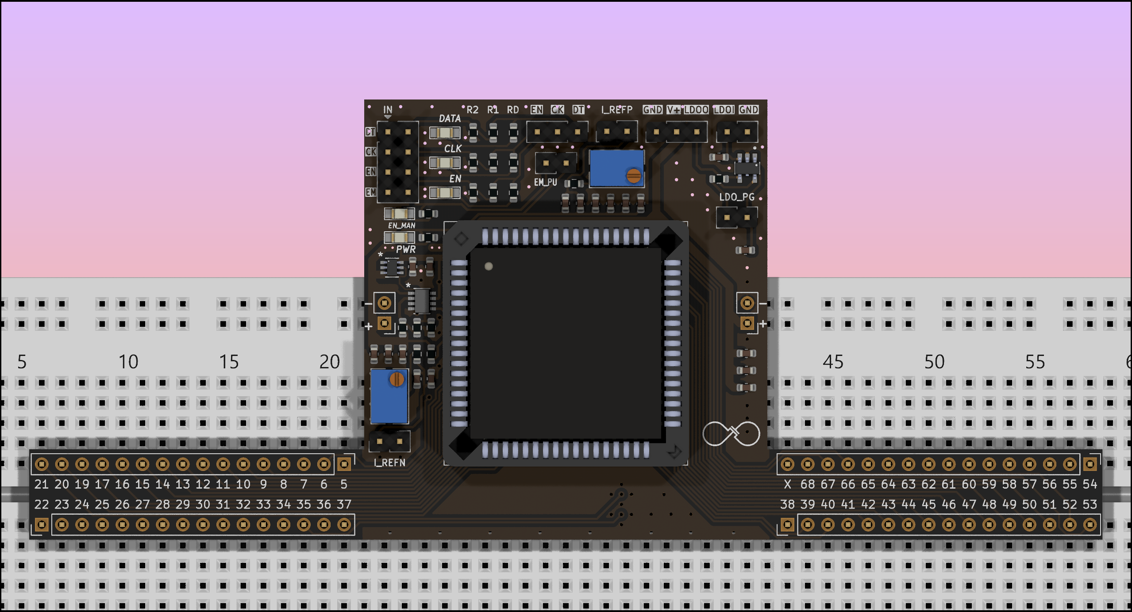
CLK from DIO
DATA from DIO
Jumper to manually Enable the chip
(after programming)
Jumper to connect DATA to chip
Jumper to connect CLK to chip
Jumper to connect EM to chip

