Slide 1

Mission 6- Peter’s Presentation by Peter Kim peterk@missionreadyhq.com

Slide 2



Overview
Task 1-2: My Curriculum Vitae.
Task 3: My LinkedIn Profile.
Task 4: Interview Questions.
Task 5: My Github Profile.

Slide 3
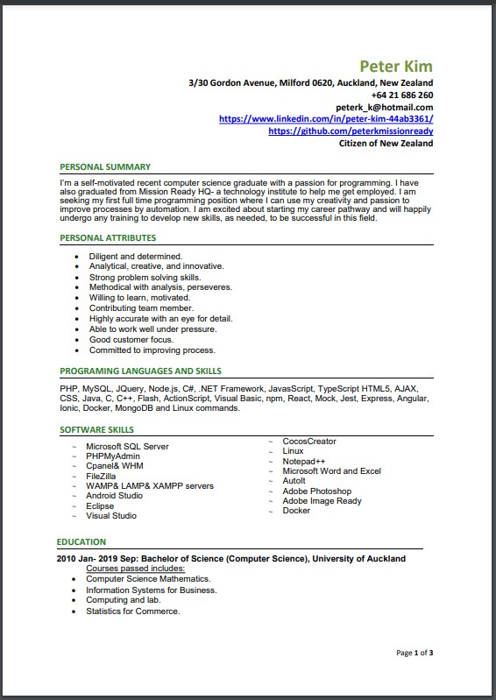
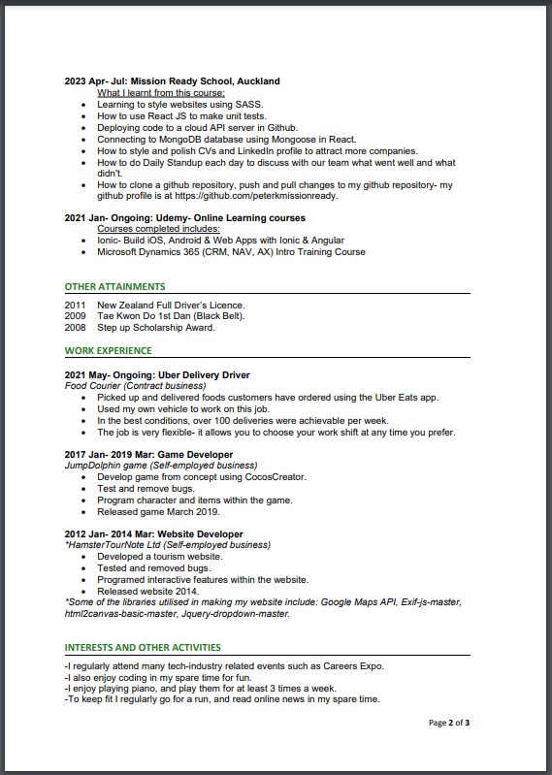
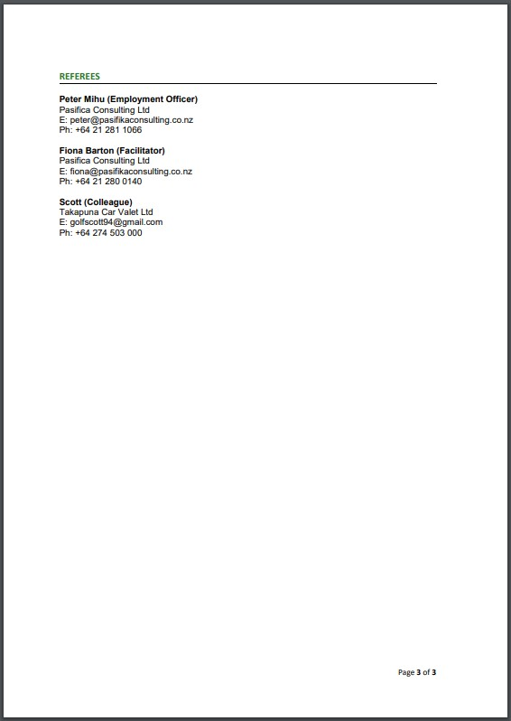
Task 1& 2: My Curriculum Vitae
The link to my CV is at:
https://github.com/peterkmissionready/Mission6/blob/main/Peter%20Kim_Resume.pdf ,
and it is also at the Task 1 of the M6.doc I submitted on Friday.

Slide 4
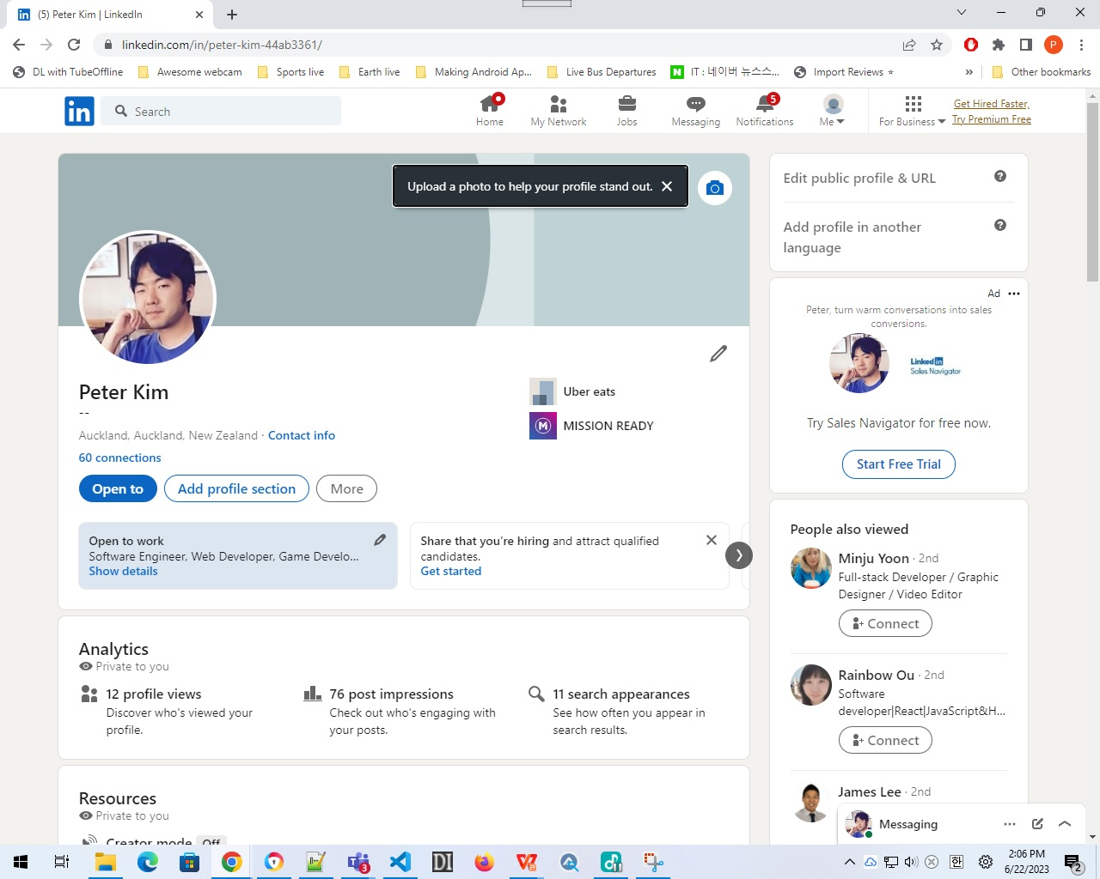
Task 3: My LinkedIn Profile
My LinkedIn profile shows the summary, basically showcasing almost the same skills as my CV I have presented in my previous slide. Link to my LinkedIn profile is at:
https://www.linkedin.com/in/peter-kim-44ab3361/

Slide 5

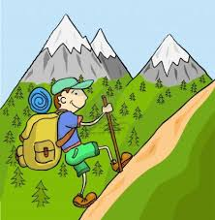

Task 4: Interview questions, Question 1:
1. Can you tell me about yourself?
My name is Peter, I've graduate from the University of Auckland with a Computer Science major in the year 2019, and I've been upskilling myself with IT tools and skills from additional courses such as Udemy, Youtube, and finally from Mission Ready HQ School. I have released some reliable websites, my Github profile and my LinkedIn profile to showcase my skills. In my spare time, I like going for a run, reading online news, hiking and playing piano.

Slide 6
Task 4, Question 2:
2. What is your biggest weakness?
Sometimes I overestimate a task that is assigned to me has been completed and fulfilled. An example of this was when I was hired as a casual pick-packing job, I was assigned to move packages into containers. At one point I believed that the container was full and could no longer be filled with any more packages. But a co-worker next to me that this container could be filled with more items. I did as he told and learnt that he was right about this. The container could be squeezed shut and I assumed no major damage were made inside these packages by doing so. I know it’s good to work on something without receiving any corrections from managers or co-workers and better, even to perhaps do next tasks in the work without being instructed to do so, and so, I always try to work in this manner.

Slide 7

Task 4, Question 3:
3. Tell me about an instance when you overcame a challenge, and describe what have you learnt from that experience (use the STAR format).
Situation: As a food delivery driver, there was a time when I had to reverse out of a driveway after completing a delivery to this customer's house. I saw that while I reversed, I was blocking the path of other drivers.
Task: I knew that I had to reverse out quickly so that I won't create this traffic mess, but not too quick that if I hit a car, I'll have to pay to the owner of this car to compensate for this damage or scratch. Last time I did it, while rushing to reverse my car to avoid discomfort of people waiting me to reverse out, I had to pay $350 to the owner.
Action: I reversed out slowly, taking my time, looking at all directions making sure I had enough space to reverse more if I'm reversing until I had enough space to turn to the direction of the road for my next delivery. It doesn't matter if drivers are complaining at me for how slowly I try to move out of a driveway, all it matters is that I reversed out safely to avoid hitting any cars to avoid spending unneessary cost to compensate for any damage or scratch I made if I ever happen to hit a car again.
Result: After I finished moving out of a driveway, I was moving freely to the direction I wanted to go. No complaints were made from other drivers. No one could make any claims I hit any cars because I didn't, and I could drive without any more doubts. Although, I try to avoid any hits or accidents as much as possible by walking as I observe around what's behind the car, this could even make it more safer if I invest to install a rear-view camera to my car so that this would detect if small objects such as a dog has crossed my path behind me; which wouldn't be able to be spotted by any rearview mirrors or through windows.

Slide 8
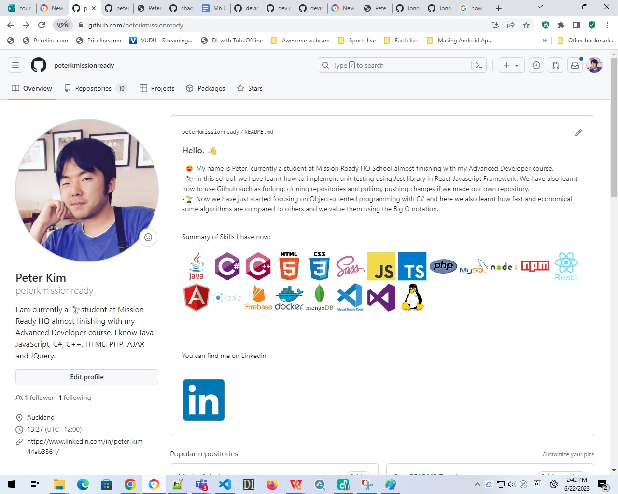
Task 5: My Github Profile
My Github Profile shows the projects I’ve accomplished whilst studying at our Mission Ready HQ school. I was able to complete most of the Mission Assignments. For Mission 4, I was struggling with deploying my project to the Github Cloud Server, required for Task 5.
The link to my Github Profile is at:
https://github.com/peterkmissionready

Slide 9


Thank you for watching my presentation!
I hope I passed my Mission 5 and 6.
I believe I’ve answered all parts to this Mission- talking about my CV, my LinkedIn profile, the inverview questions and my Github profile.
Due to time constraints, my presentation had to be limited to no more than 5 minutes.
The link to this presentation slide is at https://github.com/peterkmissionready/peterkmissionready/Mission6.pptx.

