Slide 1

Mission 6- Peter’s Presentation by Peter Kim peterk@missionreadyhq.com

Slide 2



Overview
My Curriculum Vitae.
My LinkedIn Profile.
My Github Profile.

Slide 3
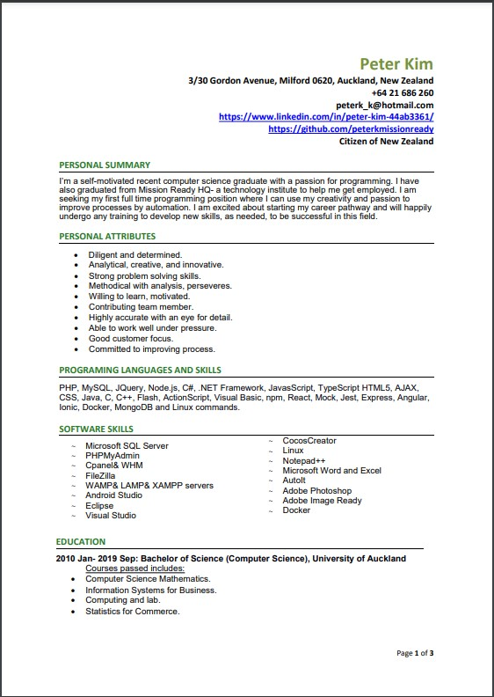
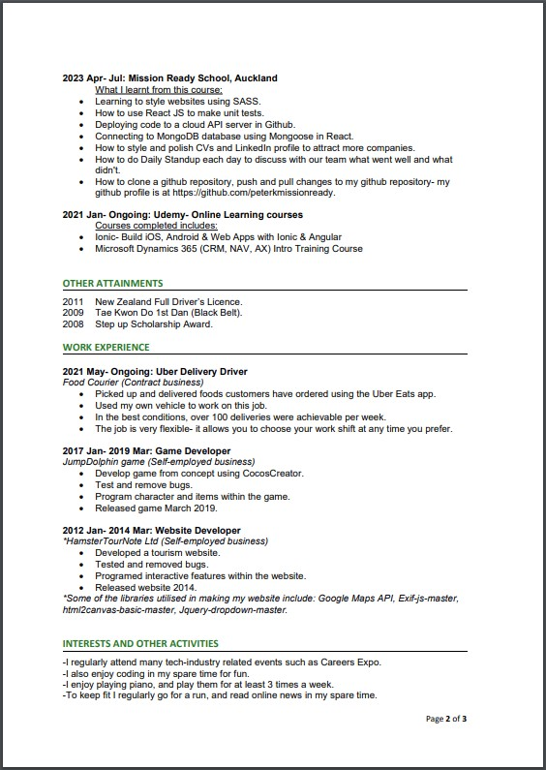
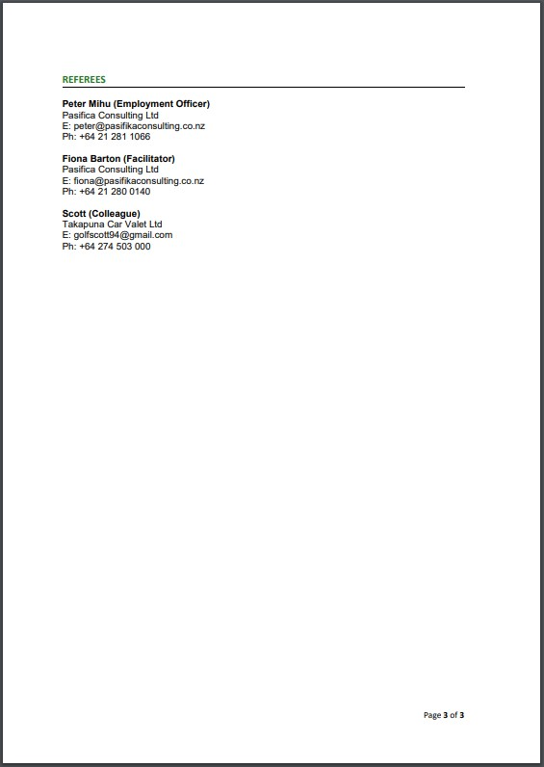
My Curriculum Vitae
Link to my CV is at:
https://github.com/peterkmissionready/Mission6/blob/main/Peter%20Kim_Resume.pdf

Slide 4
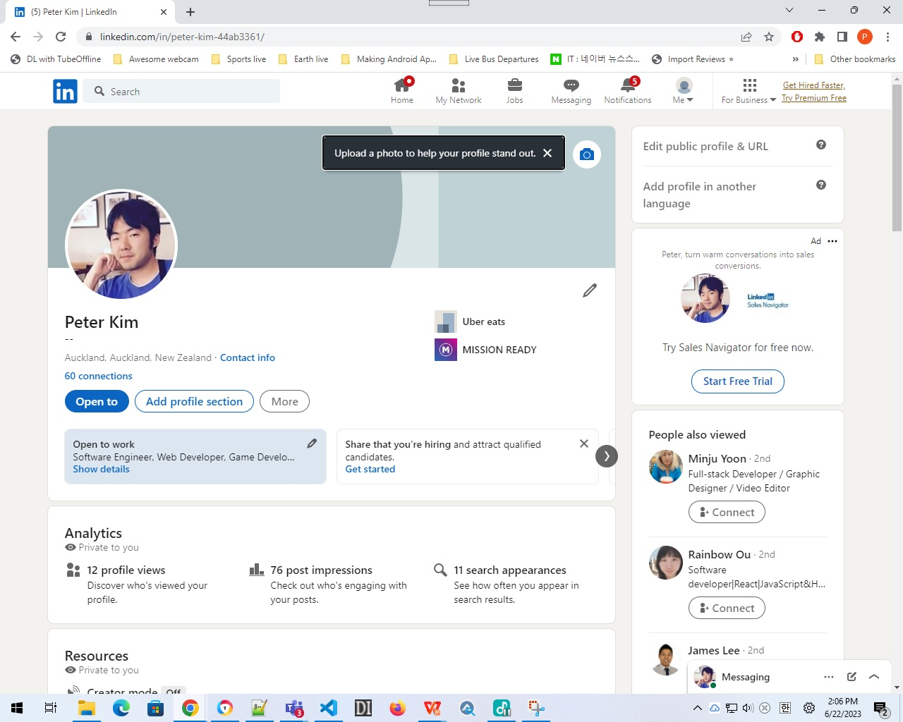
My LinkedIn Profile
My LinkedIn profile shows the summary, basically showcasing almost the same skills as my CV I have presented in my previous slide. Link to my LinkedIn profile is at:
https://www.linkedin.com/in/peter-kim-44ab3361/

Slide 5
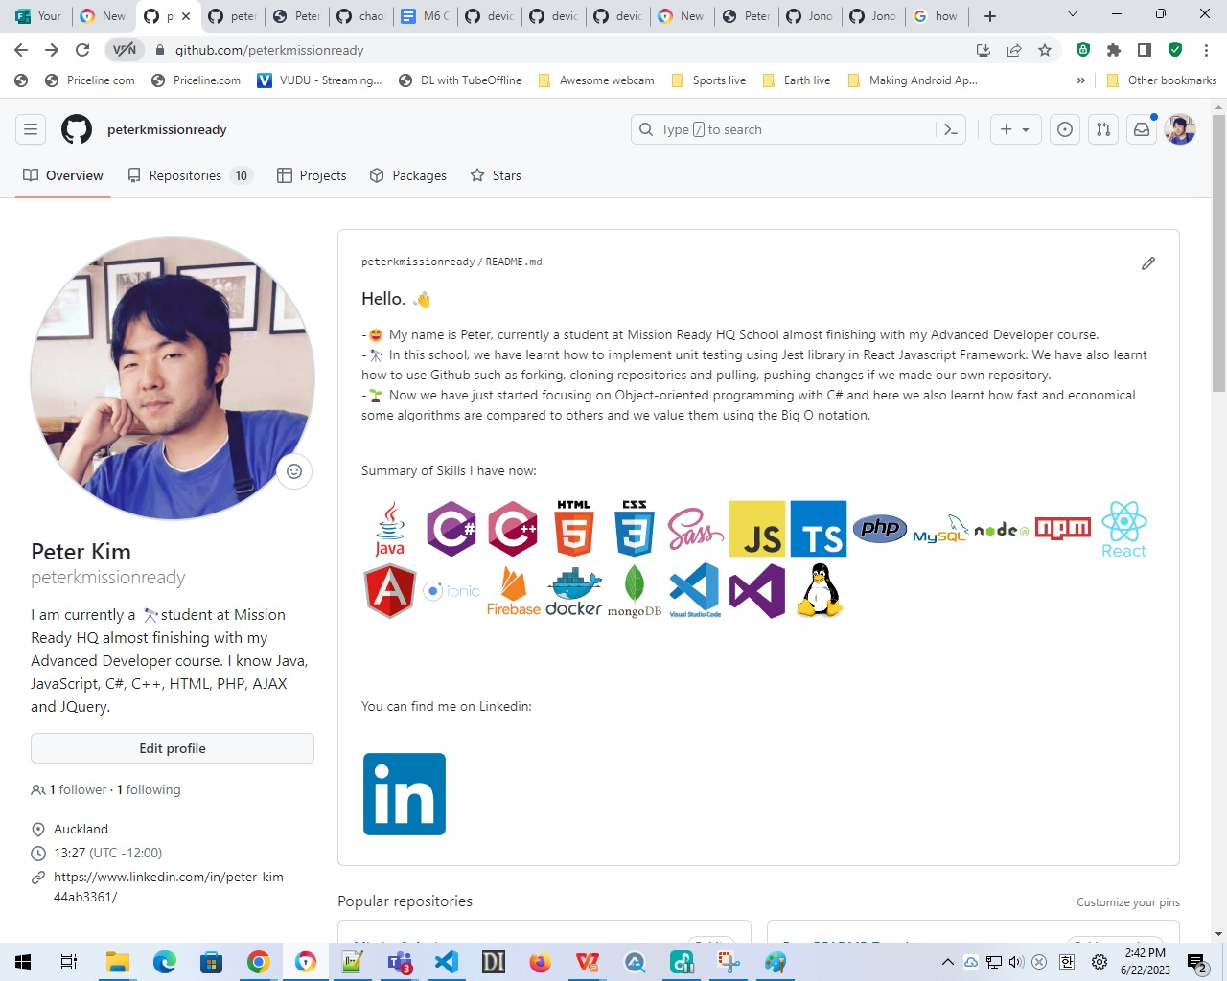
My Github profile
My Github Profile shows the projects I’ve accomplished whilst studying at our Mission Ready HQ school. I was able to complete most of the Mission Assignments. For Mission 4, I was struggling with deploying my project to the Github Cloud Server, required for Task 5.
The link to my Github Profile is at:
https://github.com/peterkmissionready
.

Slide 6


Thank you for watching my presentation!
I hope I passed my Mission 5 and 6.
I answered all parts to this Mission- talking about my CV, my LinkedIn profile and my Github profile. The Task 6 for this Mission 6 didn’t tell us to show or send in any of CV Checklist, Daily Standups or the Interview Questions in Task 3 for this so I hope I won’t be marked down for this.
Due to time constraints, my presentation had to be limited to no more than 5 minutes.
The link to this presentation slide is at https://github.com/peterkmissionready/peterkmissionready/Mission6.pptx.

