Slide 1

Developing Lightning Components
Peter Knolle
January 29, 2016
Notes:
Source code: https://github.com/peterknolle/contactSearch
Note to presenter: Some of the slides that contain code can be skipped in favor of presenting the code directly in the Developer Console while you explain it.

Slide 2
Agenda
Lightning Component Framework Overview
Comparison to Visualforce
Pieces of the Component Bundle
Event definition and usage

Slide 3
Lightning Component Framework
Built on open source Aura Framework
Event driven
Component based
Notes:
The Lightning Component framework is a UI framework built to make developing functionality simple and quick. It is an event driven, component based framework which means that the pieces of functionality are grouped into components and communicate with each other and the system by responding to our firing events. This type of design leads to highly reusable, loosely coupled components which makes using components in many different contexts possible.

Slide 4
Different Than Visualforce
Component-centric (Single page application)
Visualforce is page-centric
Client-side (JavaScript) centric
Visualforce much more server side templating
No view state!
Notes:
Visualforce is the traditional page-centric web application where users navigate from page to page to accomplish their tasks. Template code (e.g., standard components / <apex/> tags) is processed on the server and HTML is sent to the client Lightning Components are executed on the client within a single page. Component interactions are dynamic and data needed from the server is fetched from server by the component (client). There is no view state. State is managed by the framework.

Slide 5
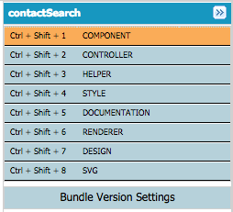
Component Bundle
Component – Markup
Controller – JavaScript
Helper – JavaScript
Renderer – JavaScript
Style – CSS
Design
SVG
Documentation
Notes:
The Lightning Component Bundle defines the entirety of the component. Together, the different files all make up the Component. Salesforce automatically takes care of managing names and grouping the component pieces for you. This makes the codebase easier to navigate. Other JavaScript frameworks (e.g., Angular with Angular 2) are moving towards being much more component centric.

Slide 6
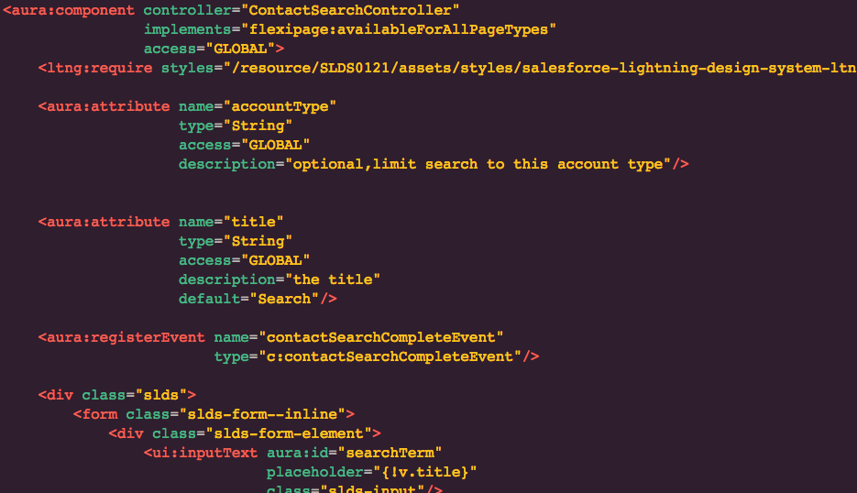
Component Markup
File: <component-name>.cmp
Only required piece of a bundle
Contains mix of HTML and other components
Notes:
The component markup is the core of the component. It defines the attributes of the component and the events that the component may interact with as well as the markup that should be rendered.

Slide 7
Attributes
Specified on the component
Get or set from the attribute set / “v” value provider
component.get(“v.title)
component.set(“v.title”, “Hey”)
{!v.title}
Two way binding
Notes:
Attributes are the values of a component. In JavaScript they are accessed from the “v” (attribute set) value provider. The most significant aspects of attributes is the two-way binding. Two-way binding means that the attribute is automatically updated by the framework whenever something changes that affects its value and anything that needs to be rerendered because of that change is automatically rerendered. For example, if a user submits a form and a ui:inputText on it is hooked up to an attribute, the attribute will automatically have its value set. No DOM parsing!

Slide 8
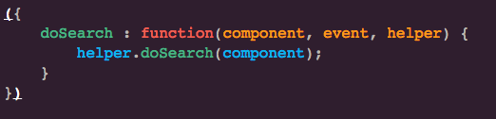
Controller
File: <component-name>Controller.js
Responds to user initiated and system generated events
Collection of JavaScript functions
Notes:
The controller contains event handler functions that respond to user initiated events such as button clicks or keyboard presses and system generated events such as loading completed or component initialization starting. Controller functions should not do too much work (other than controlling) and should call methods on the “helper” to perform the business logic and interact with Salesforce. Do not confuse this with the Apex controller for server side actions. Note that when talking about controllers in Lightning make sure that it is understood which controller is being referenced: The JavaScript controller or the Apex controller.

Slide 9
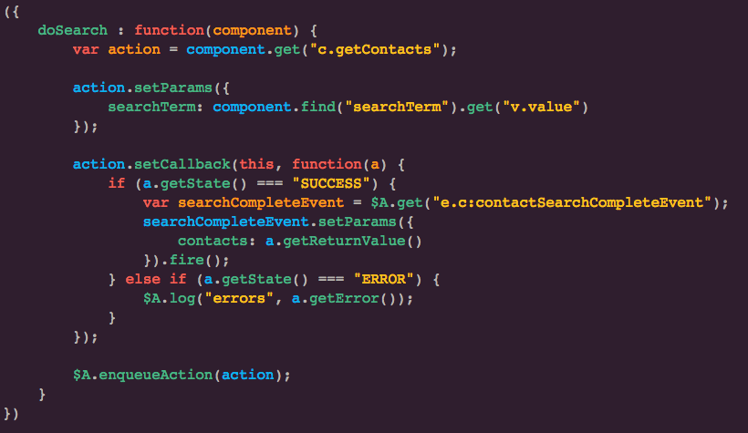
Helper
File: <component-name>Helper.js
Contains JavaScript that can be shared within the component and its sub components
Notes:
The helper is a collection of JavaScript functions (just like the controller) that can be reused within the component and any subcomponents. It is where business logic should reside within a component. The helper can be called by any method of the renderer or controller. Typically, you’ll always have at least the component markup, the controller, and the helper in any non-trivial component. But, what about styling? Surely devs would supply CSS with all components!!!??? Not so fast. With the Salesforce Lightning Design System (SLDS) available, your component may not need its own CSS.

Slide 10
Events
Application or component-level
User or system generated
Component registers which it can fire
Component declares which it can handle
Notes:
Events are a fundamental key part of the framework. Components communicate with each other and the system through events. Components remain loosely coupled by using events as their means of communication. This allows components to be reused in a variety of situations and/or with a variety of different components without needing to know directly about any of the other components.
Application level events follow the traditional publish subscribe model
Component level events can be consumed by the component that fires them itself, its container, or (recently added) a component that the event may be bubbled up to according to the bubbling rules.

Slide 11
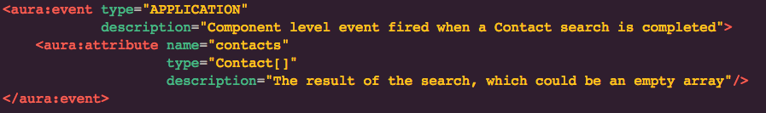
Event File
File: eventName.event (you choose event name)
Either “COMPONENT” or “APPLICATION” level
Define attributes (event shape)

Slide 12
Event Example
Contact search component registers that it fires an event
<aura:registerEvent
name=”contactSearchCompleteEvent” type="c:contactSearchCompleteEvent"/>
Some other component handles the event with a controller method
<aura:handler event="c:contactSearchCompleteEvent"
action="{!c.handleContactSearchComplete}"/>

Slide 13
Server-side Controllers (Apex)
Controller attribute on the component
Methods annotated with @AuraEnabled
Methods must be static
No view state!
Notes:
If you are familiar with @RemoteActions then you already know @AuraEnabled. In fact, you can annotate methods as both @RemoteAction AND @AuraEnabled. The controllers are stateless (no view state). One thing to watch out for is that the return types must be @AuraEnabled. Standard and Custom objects are, but not all internal Salesforce Apex classes are at this time (e.g., SelectOption). You may create your own class with its own @AuraEnabled properties if neede be.

Slide 14
Calling Apex Example
Notes:
The Apex controller actions are retrieved from the “c” (controller) value provider which also contains the event handlers in the JavaScript controller. The communication is asynchronous. The typical pattern is as follows:
Obtain a reference to action from “c”
Set parameters on the action (optional)
Specify the call back with behaviors that will
If it is a success, fire an event (or update an attribute)
If it is an error, handle it
Enqueue the action to be sent to the server.

Slide 15
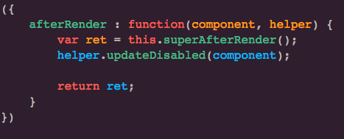
Renderer
File: <component-name>Renderer.js
Override default framework rendering
If you need to modify the DOM, here’s where to do it
Notes:
The renderer is a collection of JavaScript functions (like the controller and helper). The renderer allows you to write code that ties into the rendering lifecycle of a component. If you need to perform any DOM manipulation, the renderer is the place to do it.

Slide 16
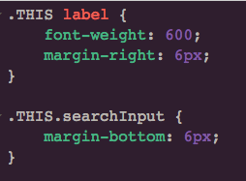
Style
File: <component-name>.css
Contains CSS rules
Vendor prefixes handle automatically!
See the SLDS (http://www.lightningdesignsystem.com/)
Notes:
* The style piece of the bundle allows CSS rules to be applied to the component.
* The rules are kept local to the component. What does this mean? Imagine if you had two components each with a CSS rule for label elements on your page. If the system just took the CSS rules from the bundle and applied them to the page there would be a conflict with those two, resulting in the last one winning out. The .THIS syntax is used to address it. The framework automatically places a component identifier into the generated markup and rule to avoid those conflicts.
Before you attempt to style your component yourself you should check the SLDS – this is especially true if you are trying to make a component that matches the look and feel of the Lightning Experience.
<ltng:require styles="/resource/SLDS0121/assets/styles/salesforce-lightning-design-system-ltng.css"/>
SLDS is available as an unmanaged package to install
Design tokens are in developer preview, currently. They allow you to specify a single variable value and then reference the variable (not the value) in your CSS.

Slide 17

Design
File: <component-name>.design
Used by the App Builder
Must be present to show in the App Builder
Specifies attributes that can be set
Notes:
Allows the label shown on in the App Builder to be set and any global attributes on the component to be set. At a minimum the label should be specified so that users have a friendly name displayed to them for the component. If there is no label specified the components name is displayed (e.g., contactSearch). The design:attribute support a couple of different data types at this time. If a component has a global required attribute with no default it must be specified in the design file. Note that not all attributes need to be able to be specified in the design file. There may be attributes that are only used internally to the component.

Slide 18
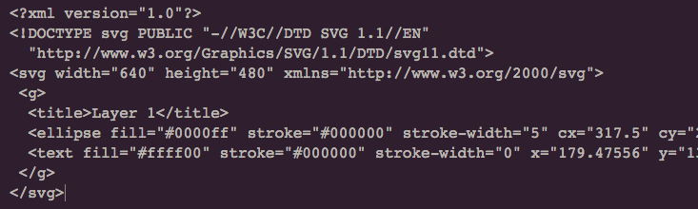
SVG
File: <component-name>.svg
Used by the App Builder as the icon for the component
Notes:
The svg is used by the App Builder and Community Builder as an icon for the Component. It is useful to have something in here to differentiate your component. Obviously, if you are developing for the component exchange you’ll use your own custom branding, but it can also be useful for internal / unmanaged components to aide users in differentiating and recognizing the various component in your org. There free tools such as Google SVG Edit (http://svg-edit.googlecode.com) that can be used to easily create SVGs.

Slide 19
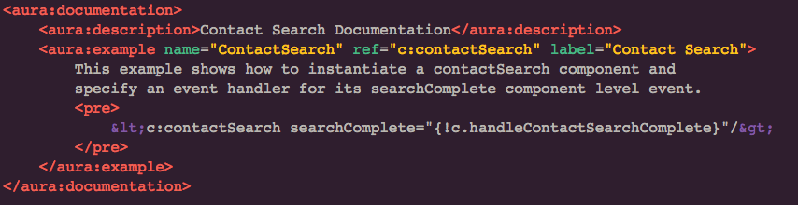
Documentation
File: <component-name>.auradoc
Gives the ability to provide example usage
Part of generated docs at https://<yourDomain>.lightning.force.com/auradocs
Notes:
You may provide example usages of your component here and it will appear

Slide 20
Review
Lightning Component Framework Definition
LCs vs. VF
Component Bundle
Events
Notes:
Briefly state what was covered to reinforce it.

Slide 21
More
Trailhead Lightning Components module: http://sforce.co/1JFoaJl
Lighting Components Developer Guide http://sforce.co/1qFXr1b
Get an org and try it out!https://developer.salesforce.com/

