Slide 1

Docker - layers & daemons

Slide 2

Flashback from the last session
Containers leverage a lot of features and primitives available in the Linux OS. The most important ones are namespaces and cgroups.
Containers are isolated from their Host on many levels
Linux rules

Slide 3
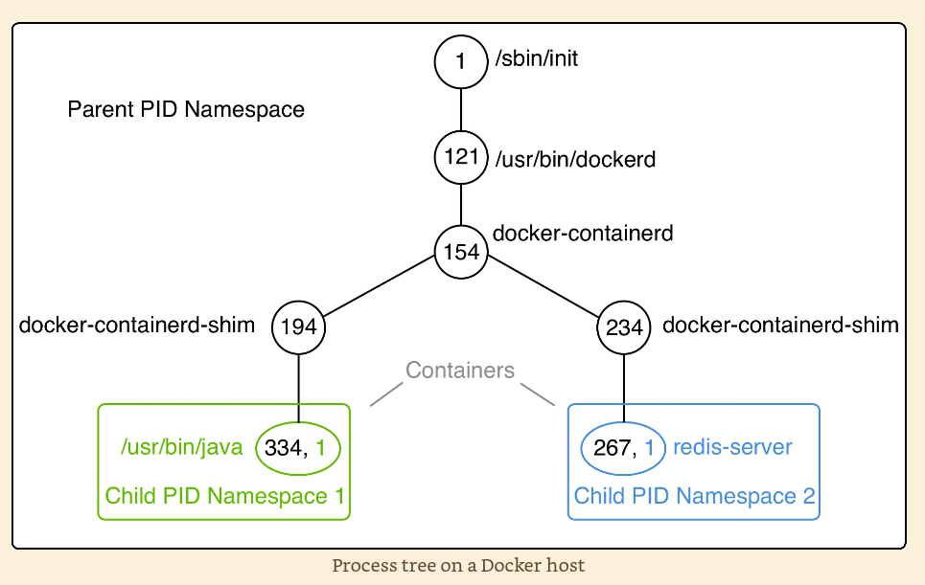
Namespaces

Slide 4
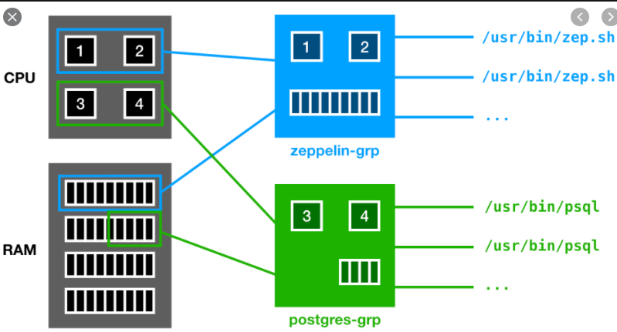
CGroups

Slide 5
Standards
https://opencontainers.org/

Slide 6
Alternatives to docker, container runtimes:
“Rocket”, RKT - 10% – acquired by RedHat (supports Docker and appc images)
Mesos containerizer - 4% - Apache (supports Docker and appc images)
LXC – 1% – Canonical, lxc image format …and lesser players…
https://www.ionos.com/digitalguide/server/know-how/docker-alternatives-at-a-glance/

Slide 7
Docker architecture
Registry
(of images)
Docker CLI client
Docker REST API (1.4)
Docker daemon
- Very high-level thing
K8S
Directly
Use that
C o n t a i n e r d
gRPC
- High-level thing
runc
- Low-level thing
CGroups
Namespaces
Union FS
Layer
Layer
Layer
Linux
container
containerd-shim
container
containerd-shim

Slide 8
Create Dockerfile
FROM centos:7 base OS image
RUN yum install -y wget installing wget command COPY file.txt / copy file to the image
Build the image:
docker image build -t my-centos . !!! Here check /var/lib/docker/overlay2
Run the container: docker run -i my-centos wget https://upload.wikimedia.org/wikipedia/commons/3/35/Tux.svg
Enter the container shell:
docker exec -it <container id> bash
Check container FS: df -Th
eog!!!

Slide 9
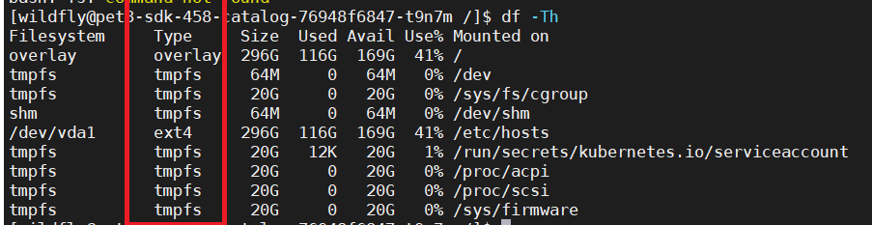
Let’s check FS type
ls -l /var/lib/docker/overlay2
On each layer:
diff - contains the changes that made in this layer above the previous layer
ls -l /var/lib/docker/overlay2/l – symbolic links folder (links are shortcuts to real long-name directories)

Slide 10
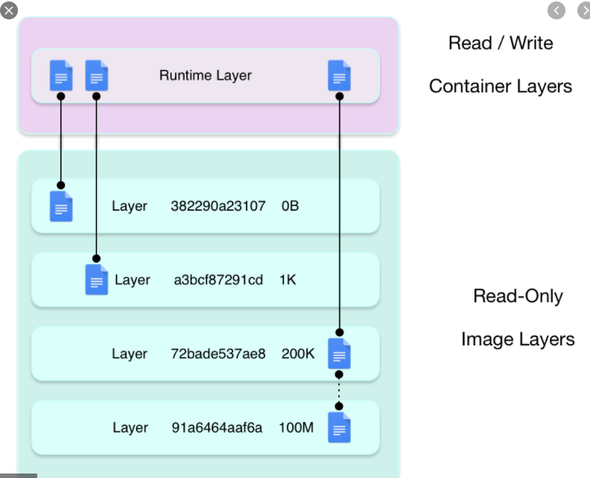
UnionFS/AUFS/ OverlayFS “Union filesystem”

Slide 11
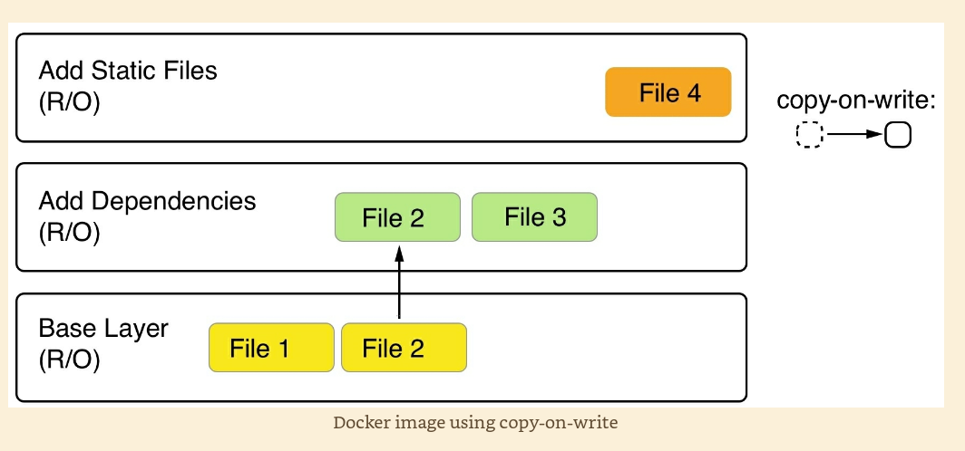
Copy on write

Slide 12
Image composed of immutable layers(r/o)
Image is an immutable object(r/o)
Running container creates a thin mutable (r/w) layer on top of image layers

Slide 13
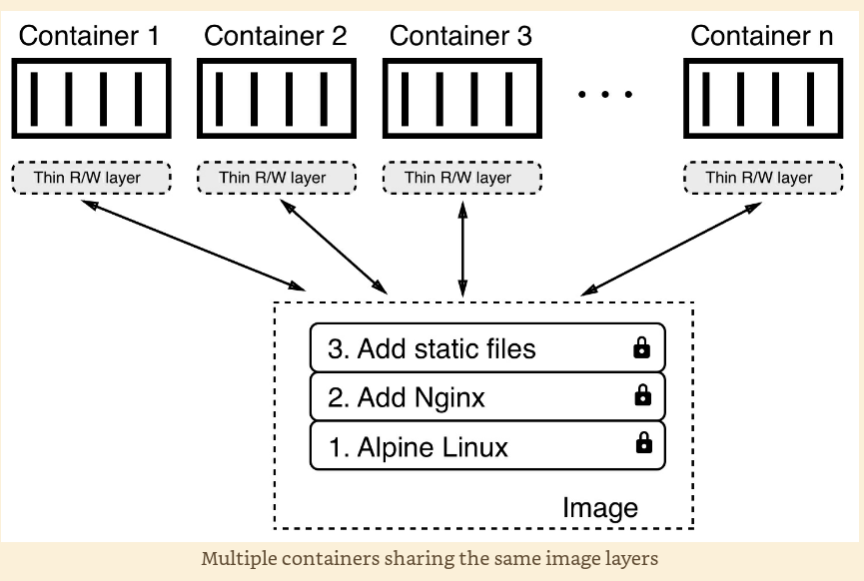
Immutable content is shared between containers

Slide 14
Graph drivers for the Union file system
Most useful drivers: overlay2 and overlay
They control how layers data really stored on the host
Consolidates images for container to mount them into the root filesystem in the “mount namespace”.

Slide 15
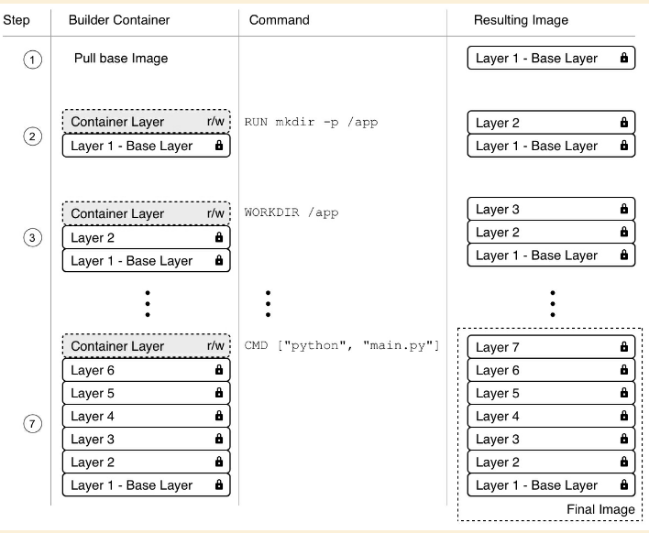

Slide 16
Some rules for image building
If some layer changed – all layers after that layer should be rebuilt - so frequently modified layers should not be in the top of Dockerfile
Less layers – better – less work for a graph driver – sooner startup

Slide 17
Each layer is a living organism (or rather dead fossil, that once lived) And if it adds changes - lesser levels will be rebuilt
FROM node:9.4
RUN mkdir -p /app
WORKDIR /app
COPY . /app - problematic thing (cause it may modify the image)
RUN npm install - long operation
CMD ["npm", "start"]

Slide 18
About commands – later…
More important things to see now: runc containerd

Slide 19
Docker architecture
Registry
(of images)
Docker CLI client
Docker REST API (1.4)
Docker daemon
- Very high-level thing
K8S
Directly
Use that
C o n t a i n e r d
gRPC
- High-level thing
runc
- Low-level thing
CGroups
Namespaces
Union FS
Layer
Layer
Layer
OS
container
containerd-shim
container
containerd-shim

Slide 20
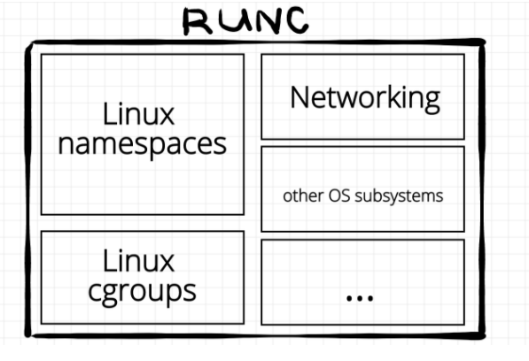
runC (“creates container runtime”)
A tool to spawn isolated process (container) in the OS.
rootFS
Running container
JSON with
Parameters
OCI bundle

Slide 21
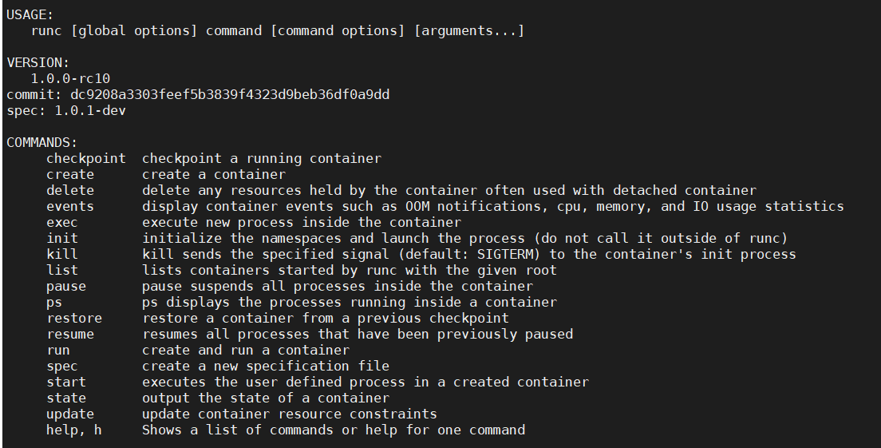
runc API

Slide 22
containerd
Daemon that provides API to manage multiple containers
This is sort of “container orchestrator”
Start/Stop/Report Status of a container(using ranc)
Image management(push, pull)
Storage management (layered FS and images metadata)
Cross Container Networking Management (some aspects of that)
Tasks management(“create container”- is a task)
In short: manage containers without a need to touch low level linux interfaces

Slide 23
To read more…
https://iximiuz.com/en/posts/implementing-container-runtime-shim/
https://iximiuz.com/en/posts/journey-from-containerization-to-orchestration-and-beyond/#container-runtimes
https://medium.com/@BeNitinAgarwal/docker-containers-filesystem-demystified-b6ed8112a04a

