Slide 1
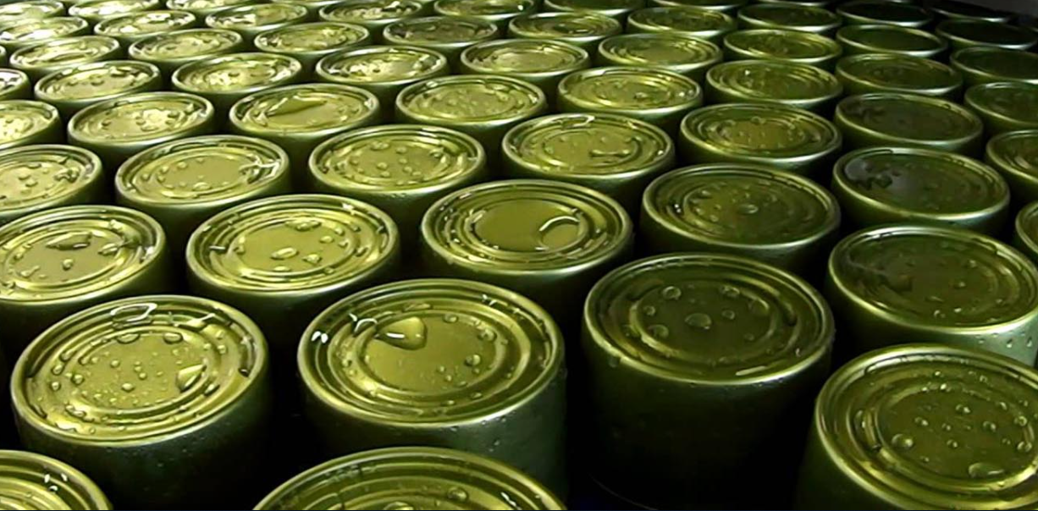
CONTAINERS
….
INCEPTION

Slide 2
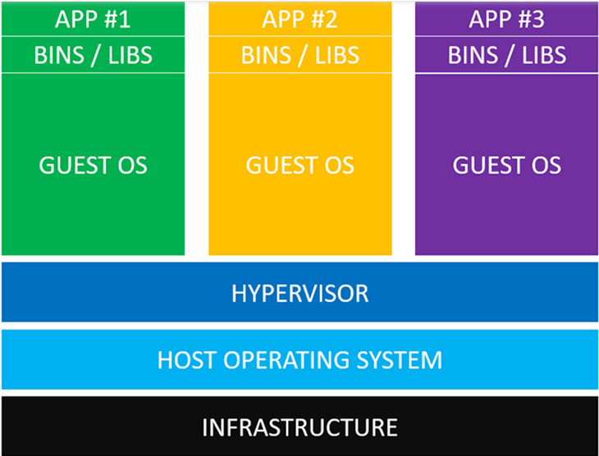
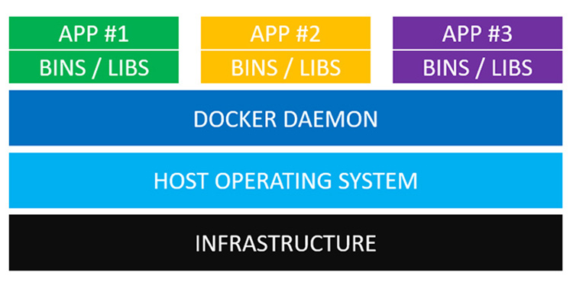
VMs vs Containers – find a difference!
VM(VMWare, VirtulBox, etc)
Docker Containers

Slide 3
Quick Jump into docker image file…
We know that docker is sort of container
We know that Dockerfile is an image descriptor for the container
We know that FROM… means that the image based on some “base” image.

Slide 4
But we have that:
Look at Dockerfile of cbnd catalog
vim /home/cbnd/work/catalog/Dockerfile
FROM registry1-docker-io.repo.lab.pl.alcatel-lucent.com/alpine:3.8
….
This is not an APP,
this is an OS!!!

Slide 5
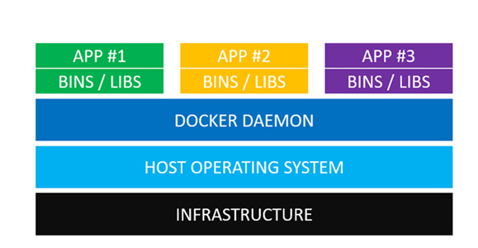
So, do they DARE to lie to US???
FROM registry1-docker-io.repo.lab.pl.alcatel-lucent.com/alpine:3.8

Slide 6
VMs vs Containers - NO DIFFERENCE????
VM(VMWare, VirtulBox, etc)
Docker Containers
Docker Daemon

Slide 7

There is a dirty secret here, people..

Slide 8
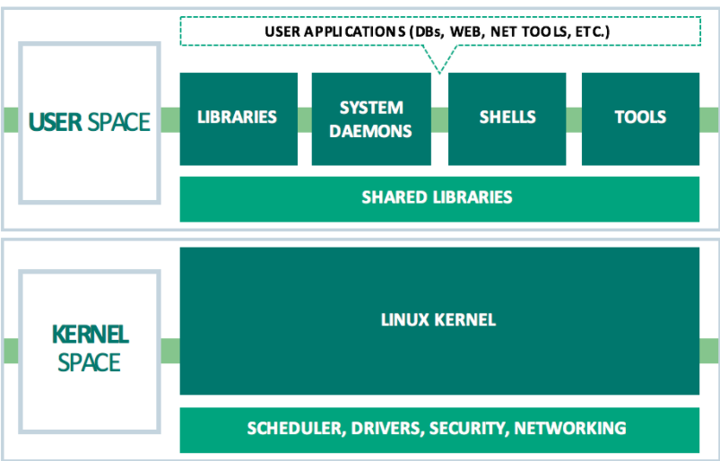
Kernel is a physically separated project!
CentOS, Ubuntu, Fedora, SuSE, RH, Debain…
Mainline: https://github.com/torvalds/linux
Linux kernel
development team
Stable: https://git.kernel.org/pub/scm/linux/kernel/git/stable/linux.git/
!!!only Linus can actually merge code to the mainline tree!!!

Slide 9
So, what strange forms it could take:
Stable Kernel
Maintained by Kernel Team
Upstream kernel
Debian Kernel
Downstream kernel
Debian OS
Ubuntu older Kernel
Ubuntu Latest Kernel
Downstream kernel
Mint OS
Ubuntu OS

Slide 10
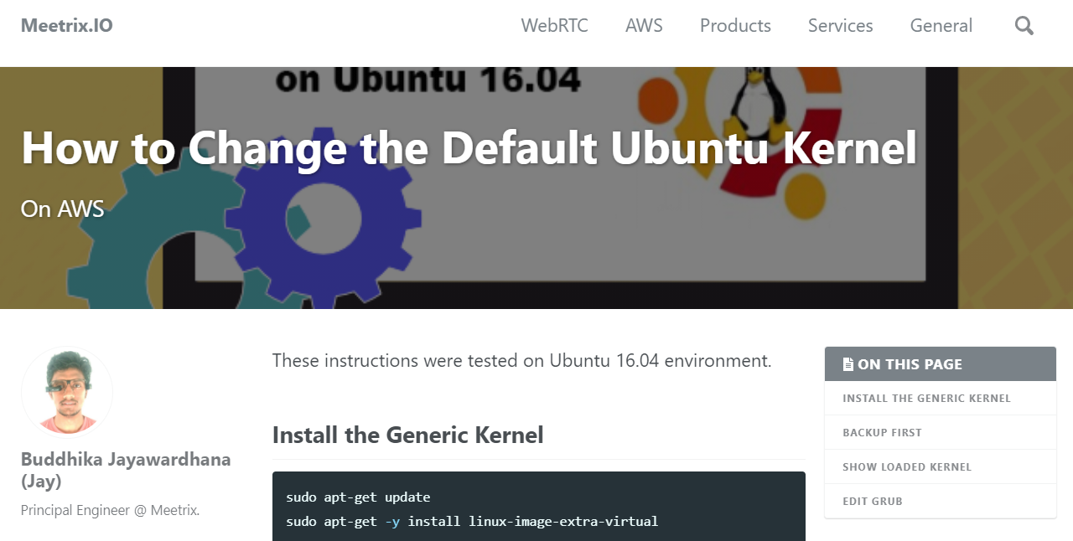
Bottomline: You can change Kernel

Slide 11
Kernel and User spaces – separated on many levels
Time
User Space
Java
Java
thread
5..50
Signals (sort of “API” from user to kernel address space)
Fast and slow
signals
Kernel Space (The boss)
Owner of all the Hardware, Scheduler, IPC,
Have all the priorities to access HW
OS
kernel
thread
0..5
HARDWARE

Slide 12
VMs vs Containers – The difference is found!
VM(VMWare, VirtulBox, etc)
Docker Containers
User space OS
User space OS
User space OS
Host operating system Kernel

Slide 13
But: anyway, there is s question here: So how can we possibly have several USER SPACES running on the single host OS kernel, do not they confuse each other?

Slide 14
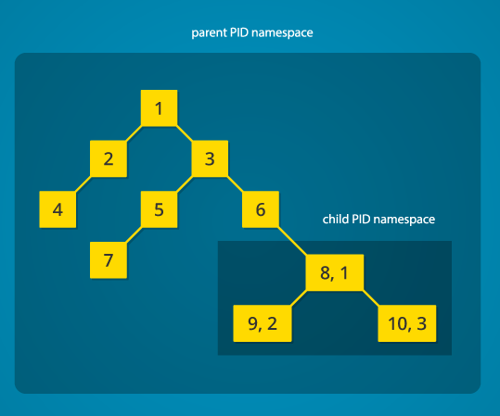
Linux process tree…is a forest…
System call:
pid_t child_pid = clone (… CLONE_NEWPID …);
Process namespace,
OR
PID namespace

Slide 15
PORT:80
?

Slide 16
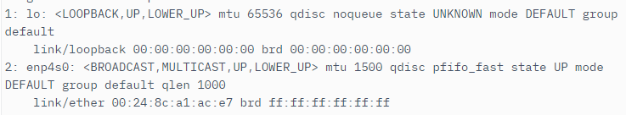
Network namespace,
OR
Net namespace
System call:
pid_t child_pid = clone (… CLONE_NEWPID| CLONE_NEWNET …);
Let’s run the command: ip link
In each namespace:
In original namespace:
In the child namespace:

Slide 17
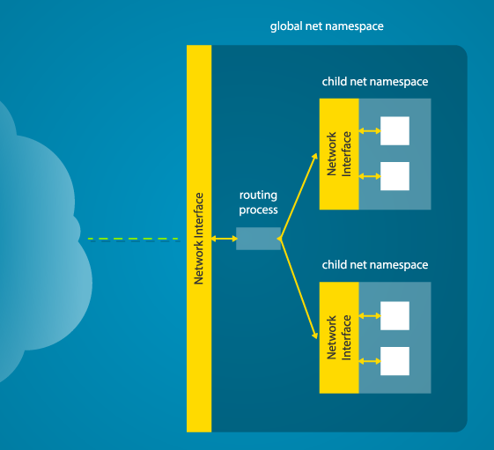
ip link add name <Real_Interface> type veth peer name <child_v_nic> netns child_pid
A router (a routing process)
Connected to the PHYSICAL NIC
Will rout the traffic between N
Virtual network interfaces
Each serving separate network
And separate process tree…

Slide 18

What about mount pints?
But this is the device
methadata
findmnt
/ /DEV/VDA1 ext4 rw,relatime,data=ordered
For me it looks like that
File System Type

Slide 19

JAIL IT!
chroot system call – introduced in 1979 This was coined “chroot jail”
/home/guy/pocket/let_it_be_root
Very first attempts to containerize apps were using this chroot jail…
It was good, but not so good… it affects only / mountpoint and allows use other resources like CPU, RAM, NICs, etc..

Slide 20
System call:
pid_t child_pid = clone (… CLONE_NEWPID| CLONE_NEWNET| CLONE_NEWNS…);
“Mountpoints” namespace
Initially started with parent mounts…(my mounts are like in my parent process tree)
But then you can not affect the parent mounts (whatever change I do, it is local mounts change)

Slide 21
There are additional “namespace types”:
“USER” – allows to grant root privileges for a user in the namespace only
IPC – to restrict tools and ways of inter-process communication in this namespace
UTS – define separate host name for the namespace

Slide 22
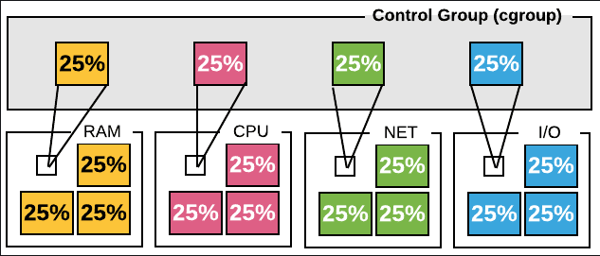
But what with CPU, RAM, IO, Bandwidth? “Noisy neighbor problem”
CGROUPS (CONTROL GROUPS)
- Since kernel version 2.6.24 at 2008
- Started by google devs(Paul Menage, Rohit Seth)
- Versions 1 and 2(much less adopted)
A cgroup is a collection of processes that
are bound to a set of limits or
parameters defined via the cgroup filesystem

Slide 23
CGrups Use cases:
groups can be set to not exceed a configured memory limit
groups may get a larger share of CPU utilization or disk I/O throughput
measures a group's resource usage, which may be used, for example, for billing purposes
freezing groups of processes, their checkpointing and restarting

Slide 24
Try to sun those commands on your linux
systemd-cgls show all cgroups hierarchy
systemd-cgls memory shows resources associated with
the memory controller
cat /proc/<PID>/cgroup show controllers associated with
this process
systemd-cgtop dynamic utilization by groups

Slide 25
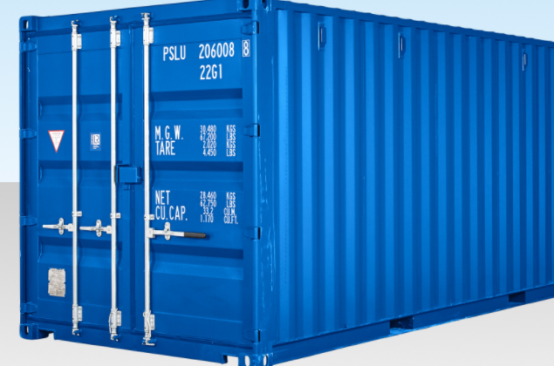
So , what is container in a general sense?
Container is an isolated (from the host LINUX OS) runtime environment.
The isolation established by using standard linux kernel features, such as PID, NET, UTS, IPC, USER namespaces and Control Groups.

Slide 26

"I'd like to be a nice person and curse less and encourage people to grow rather than telling them they are idiots. I'm sorry – I tried, it's just not in me."

Slide 27
Cgroups, suggested reading with illustrations….
https://docs.fedoraproject.org/en-US/Fedora/17/html-single/Resource_Management_Guide/index.html#sec-How_Control_Groups_Are_Organized
https://access.redhat.com/documentation/en-us/red_hat_enterprise_linux/7/html/resource_management_guide/sec-obtaining_information_about_control_groups

