Slide 1

Scala Teaser
A teaser campaign, also known as a pre-launch campaign, is an advertising campaign which typically consists of a series of small, cryptic, challenging advertisements that anticipate a larger, full-blown campaign for a product launch or otherwise important event. These advertisements are called "teasers" or "teaser ads".

Slide 2
Scala is a natural path for Java Developers
Java suffers from the heavy backward compatibility desese and learns from scala
Scala and Java are bidirectionaly compatible
Many cute products have 2 API: java and scala
Functional style becomes popular and scala rocks there
No serious java job without knowledge of scala
It is a natural path for ANY java developer

Slide 3
Running Products in scala
Kafka (high volume logging/messaging)
Akka (actor pattern, distributed computing SaaP)
Spark (stream processing, data processing)
Samza (stream processing)
Finagle (RPC for scalable systems)
GridGain (computation grid)
ADAM (genomics analysis)
...and many others...

Slide 4
How your Java experience considered?
Java
Java
Java
Each bit of it matters

Slide 5
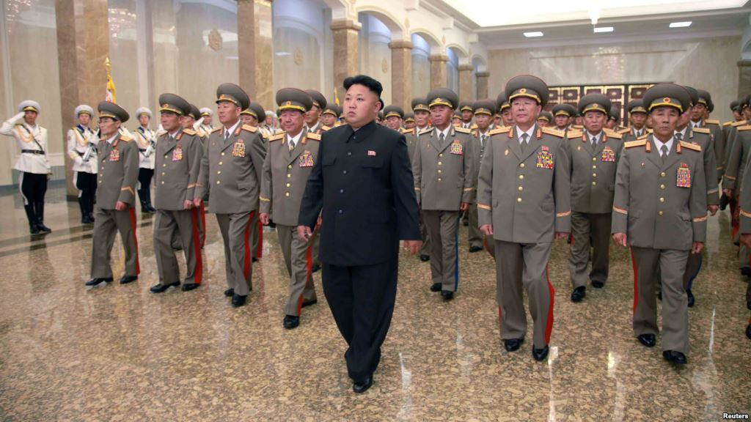
Can you really know something without different view point?
...probably not....

Slide 6








Our jobs is under RISK if we disregard scala!

Slide 7




A company must react
I would not go to company
where they only do
C++ and Java,
no Scala, no Python,
no Closure, no Erlang,
no Ruby...
not even Go...

Slide 8
Functional VS Object Oriented
Java
Scala
Functional Part
Java 8

Slide 9
That means your style will gradually change
Gradually – is a key word
You will be less dealing with objects creation
More with real action

Slide 10
Some basic grammar
def hello(param:String):String={
“Hello “+param
}
val beerCansEachMorning=5
var kisses = 25
kisses=6
a => “Hello “ + a
_ - magic thing

Slide 11
Small but Important difference
Java == is eq in Scala
Java equals is == in scala

Slide 12
Part1
Scala could be started in imperative style...
and used as familiar language for Java developer..
Gradually you will adopt functional style, no hurry...

Slide 13
Create class
class Car (val color:String, val model:String){
def doGaz(level:Int){
println (s"doing gas ${level} times")
}
}
//Singleton patern enforced and static eliminated
object Car{
def drive = println("drive like s static driver")
}

Slide 14
Extensibility and Polymorphism
class HeavyCar (c:String, m:String, weight: Int) extends Car(c, m){
override def checkOil= {
Console println "checking oil in heavy car"
super.checkOil
}
override def toString = {
"heavy track color "+ c + “ weight “+ weight
}
}

Slide 15
Mixin Traits instead interfacing
trait Nice{
def washByHand() = println("washing by hands")
}
…
class Lorry (color:String="black") extends Car (color) with Trolley with Nice{
….
}

Slide 16
Tuple
val t = (4,carh,2d,"BMW")
Tuple1...Tuple22

Slide 17
Scala sees many things like objects
val someV2 = 1+2 - we see it
val someV1 = 1.+(2) - reality
val someL1 = 2::1::Nil - we see it
val someL2 = (Nil.::(1)).::(2) - reality
And functions in scala are really just...
objects.
val f3 :Function3[Int,Int,Int,Boolean] = ( a :Int, b :Int, c :Int ) => (a + b) < c

Slide 18
Part 2: Functional style
But Scala is a functional language...
Object-oriented languages are good when you have a fixed set of operations on things, and as your code evolves, you primarily add new things. This can be accomplished by adding new classes which implement existing methods, and the existing classes are left alone.
Functional languages are good when you have a fixed set of things, and as your code evolves, you primarily add new operations on existing things. This can be accomplished by adding new functions which compute with existing data types, and the existing functions are left alone.

Slide 19
Pure Functional style
Side effects in functions are discouraged or forbidden
(Referential transparency)
Mutable state is discouraged or forbidden
Functions become first class citizens
Frequent use of recursive algorithms
Lazy evaluation is frequent
Pure functional programm is realy rare thing

Slide 20
It looks differently..
for(x<- 0 until 100) yield (x + "-try")
..
tellHelloToPuppy("Mops")
tellHelloToPuppy{"Chops"}
val fibs:Stream[BigInt] = 0 #:: 1 #::(fibs zip fibs.tail).map{ case (a,b) => a+b }
See Part2

Slide 21
Fibonacci sequence problem
Lets drink a cup of scala coffee
0..1...1...2...3...5...8...13...21...34....55.........

Slide 22
Part 3: Scala likes to match ...
Scala does a great job of pattern matching,
  this technique is extreemely effective and used in many practical applications.
  def recruitLinuxDeveloper(candidate:Person)={
  candidate match {
  case BeautifulGirl => say („We are so sorry..“)
  case UglyGuy with BigBelly => say („Hi, dear Sir!“)
  }
  }

Slide 23
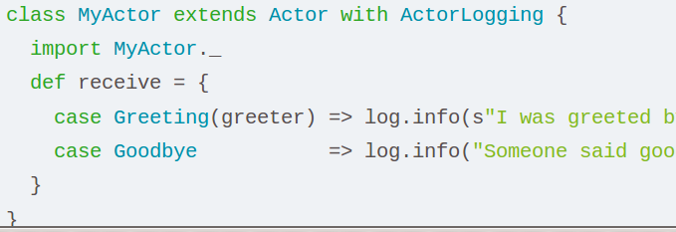
Matching is widely used

Slide 24
Part 4: Variances
Cat extends Animal
List[Cat] , List[Animal]
In Java it would be:
List<Cat> ,List<Animal>
In Java you can not pass list of cats , where list of animals accepted
In java you can not pass list animals, where list
of cats accepted

Slide 25
Scala Type Bounds
B <: A – accept all types B that A or extend A
B >: A – accept all types B that A, or super types of A (parents of A)
+A - COvariance
-containers with A children will be accepted if containers with A accepted
-A - CONTRAvariance
-containers with parents of A will be accepted if containers with A accepted

Slide 26
Co/Contra/variance
LivingThing
FourLegsCreature
Cat
Mice

Slide 27
Part 5. No nulls
Null is in use(to support java), but discouraged
Instead Option trait used
Option has 2 children
Some
None
Let's see how they used in scala

Slide 28
Part 6: Compose Functions
Composition
andThen

Slide 29
Part 7: Closure
You want to pass a function around like a variable, and while doing so, you want that
function to be able to refer to one or more fields that were in the same scope as the
function when it was declared.

Slide 30
Part 8: Partially applied functions
val sum = (a: Int, b: Int, c: Int) => a + b + c
val f = sum(1, 2, _: Int)
See also Curious8!

Slide 31
Part 9: Partial Functions
You want to define a function that will only work for a subset of possible input values,
or you want to define a series of functions that only work for a subset of input values,
and combine those functions to completely solve a problem.

Slide 32

Part 10: Implicit conversions
When you need discover a black cat
in a black room (joke)
Implicit definitions are those that the compiler is allowed to insert into a program in order to fix any of its type errors.

Slide 33
The whole world of actors
That will be postponed till the next Akka meeting
In short: It rocks!

Slide 34
Part 11: Case classes and objects
case class Message(name:String)
case object Message2(salary:Int)
very basic immutable POJOS to
transfer data and avoid a lot of stupid work
Generated: apply method, toString, getters and setters, copy, equals, hashCode

Slide 35
Part 12: Exceptions Handling
There are no checked exceptions in scala
They prefer return value instead

Slide 36
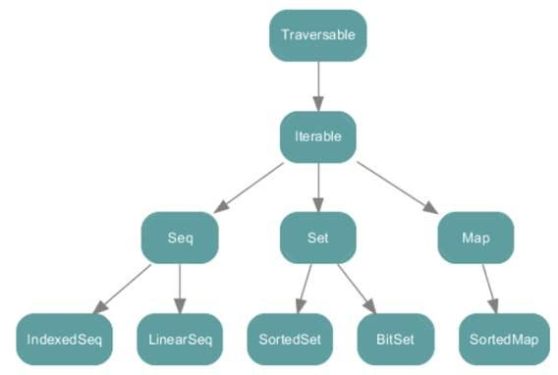
Last Part: Collections

Slide 37
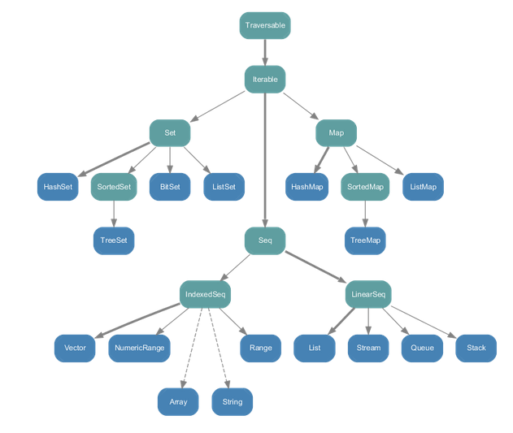
Immutable collections

Slide 38
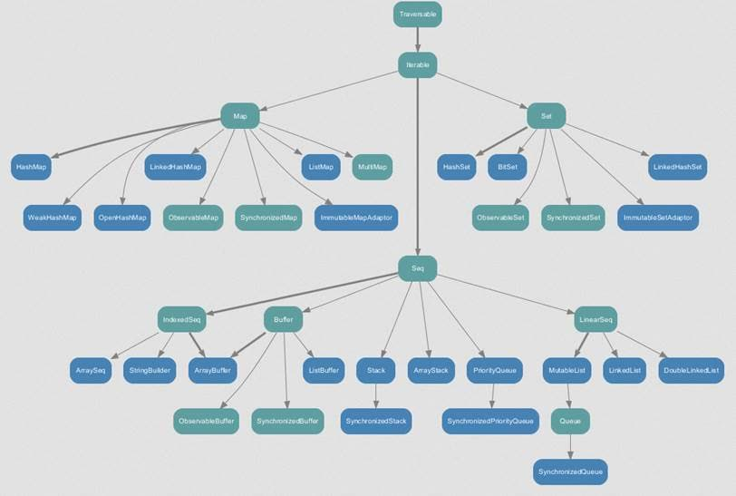
Mutable collections

Slide 39
A huge collection of methods
Filtering
Transforming
Grouping
Informational and Math. Methods
Others..

Slide 40
Books and courses
Scala cookbook recipes for OO and functional programming
Functional programming scala
Functional programmin patterns in scala and closure
“Pragmatic Scala” 10 Day Scala Course
Functional Programming Principles in Scala (coursera.org)

