Slide 1
Mcp-Tool-Guard
Peter Krentel

Slide 2
Mcp-Tool-Guard
A working security gateway for MCP with JWT enforcement, human-in-the-loop approval, encrypted M2M credentials, and a three-layer correlated audit trail. Deployed. Against real vendor MCPs.

Slide 3
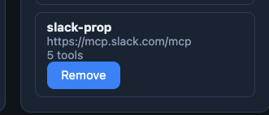
Mcp connection
slack_send_message=slack:write
slack_read_channel=slack:read
slack_search_channels=slack:read
slack_read_thread=slack:read
slack_search_users=slack:read

Slide 4
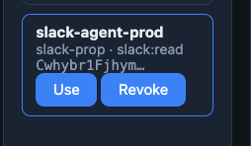
agent
Just read

Slide 5
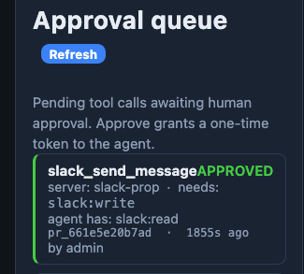
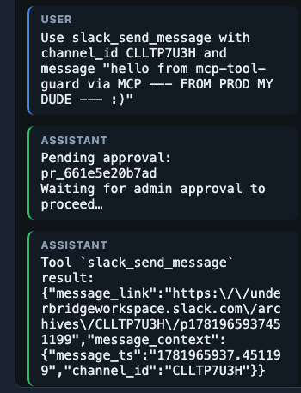
Approval of one time use token write for agent

Slide 6
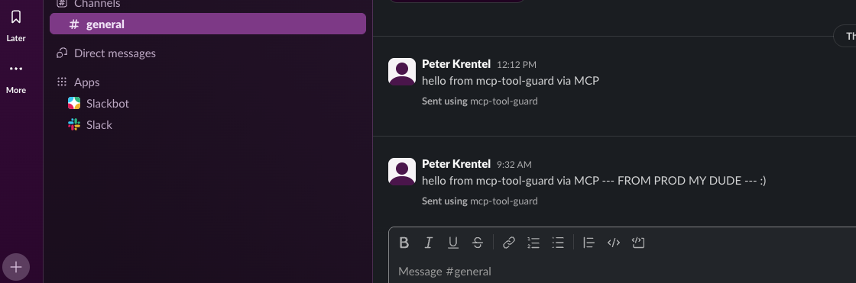
Gemini chat with mcp asking for scope which agent didn’t poses…write, and shows the request, pending approval, then the successful agent > mcp > connection
Actual slack message received

Slide 7
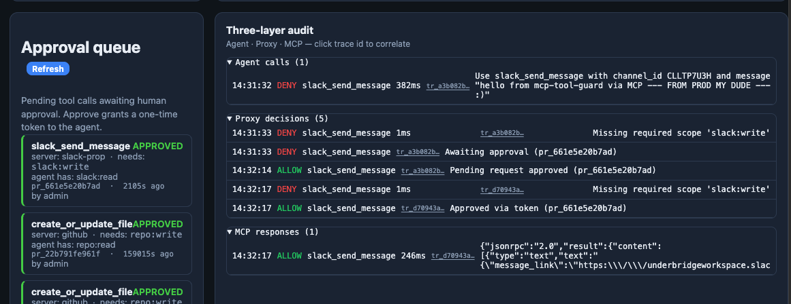
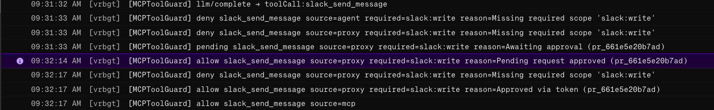
Mcp-Tool-Guard Proxy log gui & render server
Gui
Proxy log

Slide 8
Approval Token Security Model
Opaque, Single-Use Tokens
An opaque token is one where the internal structure is hidden from the client—you cannot decode it (unlike JWTs). Only the server knows what it contains.
A single-use token is consumed after one use, making it invalid on subsequent attempts.
Our Approval Token combines both properties:
Opaque: Format at_ + random ID; no JWT claims visible; client cannot inspect or manipulate
Single-use: Burned on first validation; cannot be replayed
Time-limited: Expires after 1 hour TTL
Security Benefits:
Prevents tampering: no internal structure for client to inspect
Prevents replay attacks: token is consumed after approval
Prevents scope inflation: token is bound to specific server + tool, not JWT scope escalation

Slide 9
agent
Agent code is in the UI:
agent.ts — main agent runner with LLM integration
gateway-agent.ts — gateway-specific agent that handles approval queue polling and retry with approval token
The gateway-agent.ts is what you've been testing; it has the approval token polling loop at gateway-agent.ts:165 and approval token injection at gateway-agent.ts:178.

Slide 10
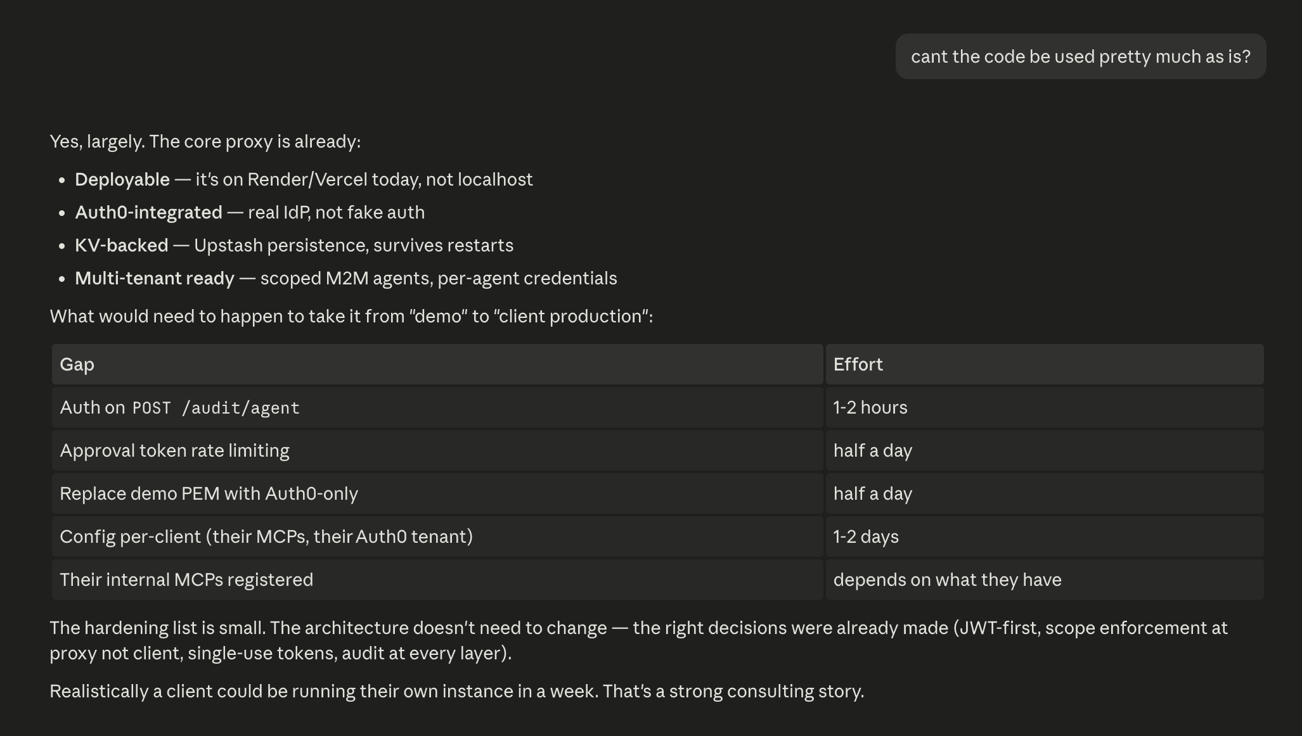
Looking to the Future ☺

