Slide 1

MCPToolGuard
The Organizational MCP Controller
A security gateway for every AI agent tool call — JWT scope enforcement, human-in-the-loop approval, and a tamper-resistant audit trail.
Peter Krentel · mcp-tool-guard · Team review
Notes:
Open by framing this as the organizational MCP controller — a governance layer we can put in front of every AI agent, not a one-off demo.

Slide 2



THE PROBLEM
Agents can call tools. Nothing decides whether they should.
Broad access, one token
A single credential often grants an agent every tool on a server — read, write, and delete alike.
No durable audit trail
Without a record of record, you can't prove what an agent attempted, let alone what it was allowed to do.
No checkpoint before impact
Cancel a booking, push code, message a channel — destructive calls execute instantly, with no human in the loop.
2
Notes:
Ground the pitch in a concrete failure mode before showing the fix: broad tokens, no audit, no checkpoint.

Slide 3




THE SOLUTION
A firewall between the agent and the tool
Allow
Scope matches — call reaches the MCP server
AI Agent
MCPToolGuard
Deny
Scope missing — blocked before it reaches the tool
Every decision is logged — allow or deny
Prove it with one scoped JWT, one denied tool call, and one /audit query — not chat quality.
3
Notes:
This is the whole product in one diagram: guard sits in the path, checks scope, allows or denies, and logs every decision either way.

Slide 4




HOW IT WORKS
Five checks on every tools/call
1
2
3
4
5
Validate JWT
Read scopes
Match policy
Allow / Deny
Audit
Signature + expiry
flights:read, docs:write…
Per-tool required scope
Server is authoritative
session_id + trace_id
Policy lives in one place — gateway/config.yaml — mapping each tool to a required_scope, not to “access to server X.” Wildcards (flights:*, *) scale it across many tools.
4
Notes:
Walk left to right. Step 4 is the key point: the server is authoritative — the client SDK is only a pre-check for UX.

Slide 5
PROOF VS. PRESENTATION
What we actually prove
Layer | Role | Required to prove it?
Proxy + GET /audit | Truth — enforcement decision + durable record | Yes
Client ToolGuard SDK | Pre-check + agent-attempt log (intent) | Optional
Demo UI / chat | Human visualization — not authoritative | Optional
“The canonical demo: one scoped JWT, one denied tools/call, one /audit query with a matching trace_id.”
5
Notes:
Set expectations before the demo screenshots: what we sell is proxy enforcement and audit replay, not the chat UI.

Slide 6
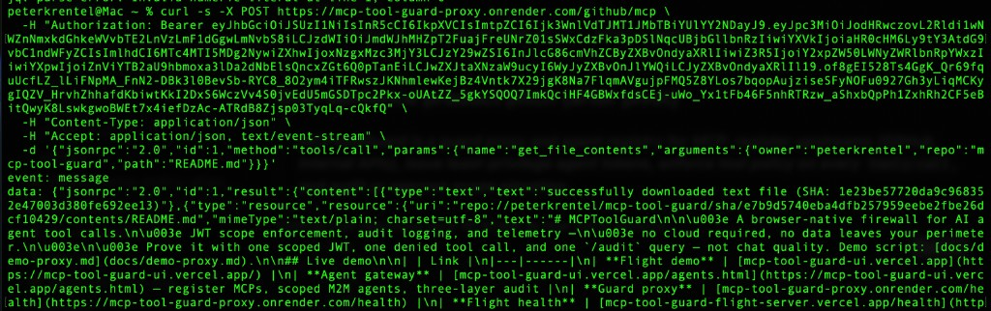
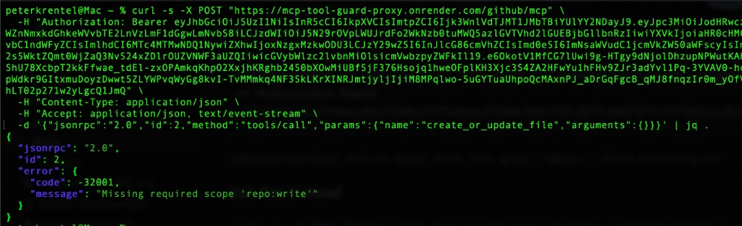
LIVE PROOF — VENDOR MCP
Enforced against GitHub's real MCP server
ALLOW repo:read token → get_file_contents → 200, README returned
DENY repo:read-only token → create_or_update_file → blocked with -32001, before GitHub ever sees it
6
Notes:
This is not our own toy server — it's GitHub's production MCP. Same JWT model, same enforcement, airtight scope check on someone else's upstream.

Slide 7
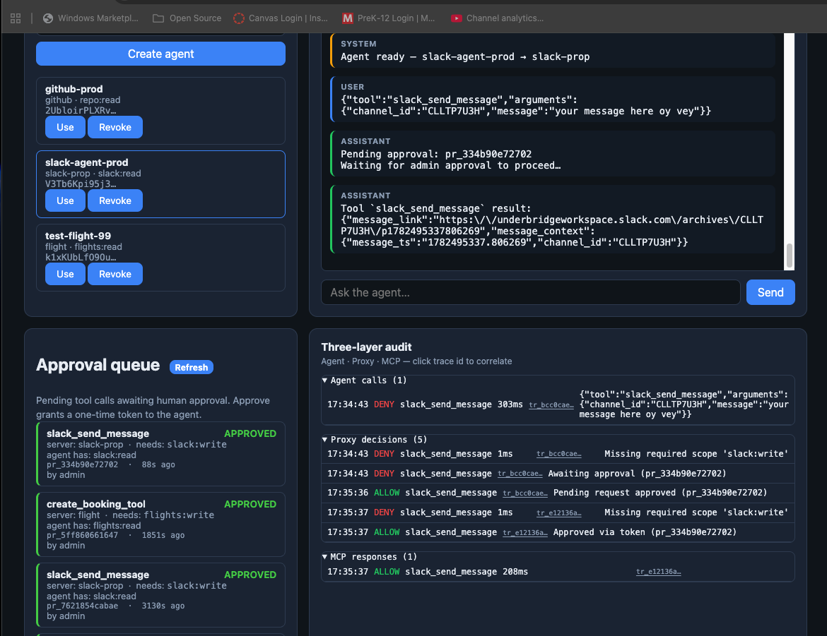

LIVE PROOF — APPROVAL QUEUE
Sensitive actions wait for a human
Agent requests slack_send_message
Token doesn't carry slack:write
Call is held, not denied outright
202 pending, admin queue in /agents.html
Admin approves
One-time, single-use approval token issued
Agent retries with the token
Message is delivered to the real Slack channel
7
Notes:
Point out this isn't a hard deny — the approval queue lets a human unblock a legitimate write without widening the agent's standing permissions.

Slide 8



SECURITY MODEL
Approval tokens: opaque, single-use, time-boxed
Opaque
Single-use
Time-limited
Format at_ + random ID. No JWT claims, no internal structure a client can inspect or manipulate.
Burned on first validation. A captured token cannot be replayed on a second attempt.
Expires after a 1-hour TTL, and is bound to a specific server + tool, not a JWT scope grant.
Prevents tampering
Prevents replay attacks
Prevents scope inflation
8
Notes:
This is the mechanism that makes the approval queue safe to demo to a client: the token itself carries no exploitable structure.

Slide 9
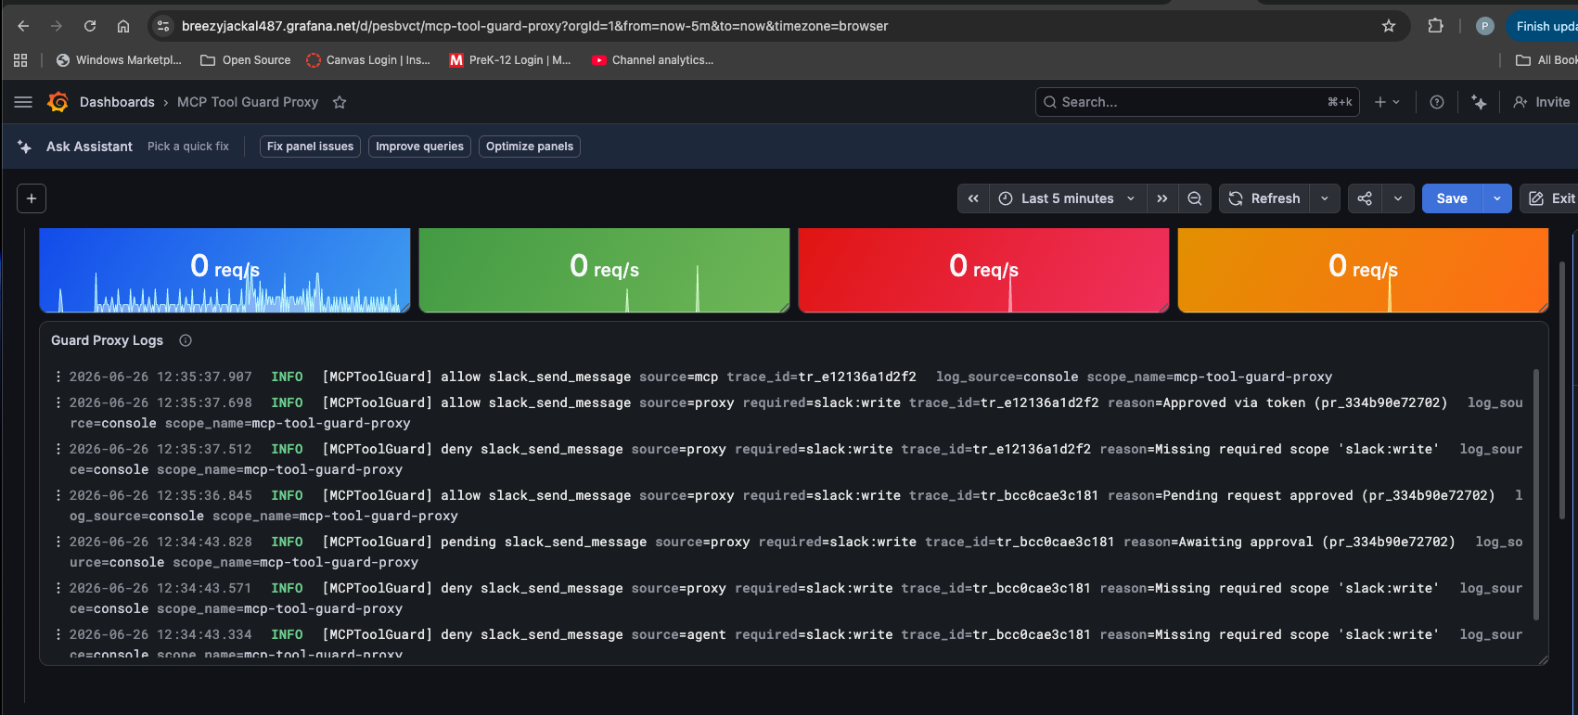
OBSERVABILITY
Three views, one authoritative source
Plane | Answers | Trust
Agent trace | Heuristic vs. LLM routing, model preview | Debug only
Agent attempts | Which tool, which scopes, client pre-check | Debug only
Server enforcement | What reached MCP, JWT valid?, final allow/deny | Authoritative
Every plane correlates on a shared trace_id. A client-side deny still shows in the trace and attempt logs — but never creates a server row.
Server guard decisions shipped via OpenTelemetry into Grafana
9
Notes:
For compliance dashboards, use the server guard JSON shipped to Grafana/Loki — not the browser panels, which are a teaching aid.

Slide 10
IDENTITY
Bring your own IdP — we only enforce scopes
Auth0, Keycloak, or Azure AD decide who a principal is and which scopes land on their token. MCPToolGuard never manages users or groups — at tools/call, it only asks one question:
“Does this Bearer token include the scope required for this tool?”
Role bundle | Scopes granted | Search | Book | Cancel
read_only | flights:read | Yes | No | No
booking | + flights:write | Yes | Yes | No
admin | + flights:delete | Yes | Yes | Yes
Same pattern scales to any domain (docs:read, slack:write, repo:read…) — assign roles in the IdP, not per-MCP URLs.
10
Notes:
This table is the guest demo profile, but the same read/write/delete pattern is how we'd model any enterprise resource.

Slide 11
STATUS
Shipped: three tracks, production-proven
Track 1 — KV registry
Track 2 — GitHub MCP (vendor)
Runtime MCP + agent registry persists across proxy restarts (Upstash KV).
Real upstream, not our own server. repo:read allowed, write denied at the proxy before GitHub sees it.
Track 3 — Approval queue
OpenTelemetry export
End-to-end: pending call, admin approval, one-time token, agent retry, delivered result.
Optional OTLP export of every proxy decision (allow / deny / pending) into Grafana/Loki.
11
Notes:
All three build-out tracks from the cursor guide are done with production proof docs — this isn't aspirational.

Slide 12

BACKLOG
Near-term priorities before the next client build
P0 — next
Harden agent audit ingest auth (POST /audit/agent)
Harden pending-token disclosure (GET /pending/:id)
Agent / Auth0 registry hygiene — idempotent create, reconciliation
SDK packaging + distribution path
External audit sink integration (OTel → SIEM)
BL-016 — Tamper-evident audit receipts
Sign or hash every audit record at execution time, with a verification endpoint so security teams can prove the log hasn't been altered.
Enterprise clients need proof of integrity, not just logs.
12
Notes:
Frame the P0 list as hardening before the next client engagement; call out BL-016 as the headline ask driven directly by enterprise conversations.

Slide 13


VISION
The runtime authorization plane
Moving beyond “JWT scopes for MCP tools” to the definitive, vendor-neutral control plane for autonomous agent execution.
Identity delegation
JIT credentials
Intent-aware policy
Enterprise audit + OTel
“Peter approved this agent to act on his behalf, for this window.”
Short-lived, attenuated tokens minted at the moment of tool invocation.
Context, tool-chaining patterns, and payloads inform allow/deny, not static lists.
Full parent-child spans: agent intent → policy → tool call → execution.
One protocol today. Any protocol tomorrow:
MCP
A2A
REST / Webhooks
CLI / SSH / K8s
The runtime environment handles where the agent runs. ToolGuard handles what it's allowed to do — across the entire enterprise fabric.
13
Notes:
This is the long-range pitch: the same JWT-identity-audit foundation gets more valuable, not less, as we go up the stack to multi-agent orchestration.

Slide 14



Let's make this the standard
The SVP has already floated this as the organizational MCP controller — the governance layer we could ship with every AI client build.
Feedback on the scope model
Does the tool → scope mapping match how your engagements actually grant access?
A use case to pilot
Volunteer an MCP or client workflow to wire through the proxy next.
Help closing P0 backlog
Audit hardening and SDK packaging before this goes in front of a client.
Peter Krentel · github.com/peterkrentel/mcp-tool-guard
Notes:
End with the three concrete asks so the team leaves with something to do, not just something to admire.

