Slide 1
Retrieve the ontology on narrative with AI
OMEGA including Green and Blue
Case: Digital Product Department (MAM)

Slide 2
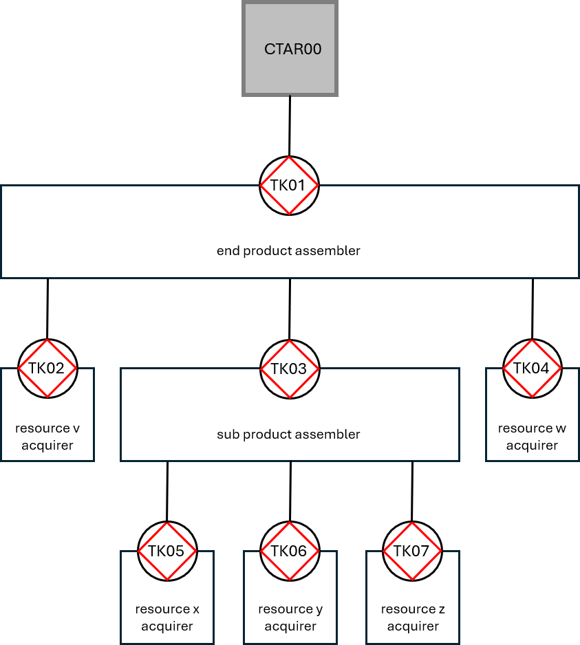
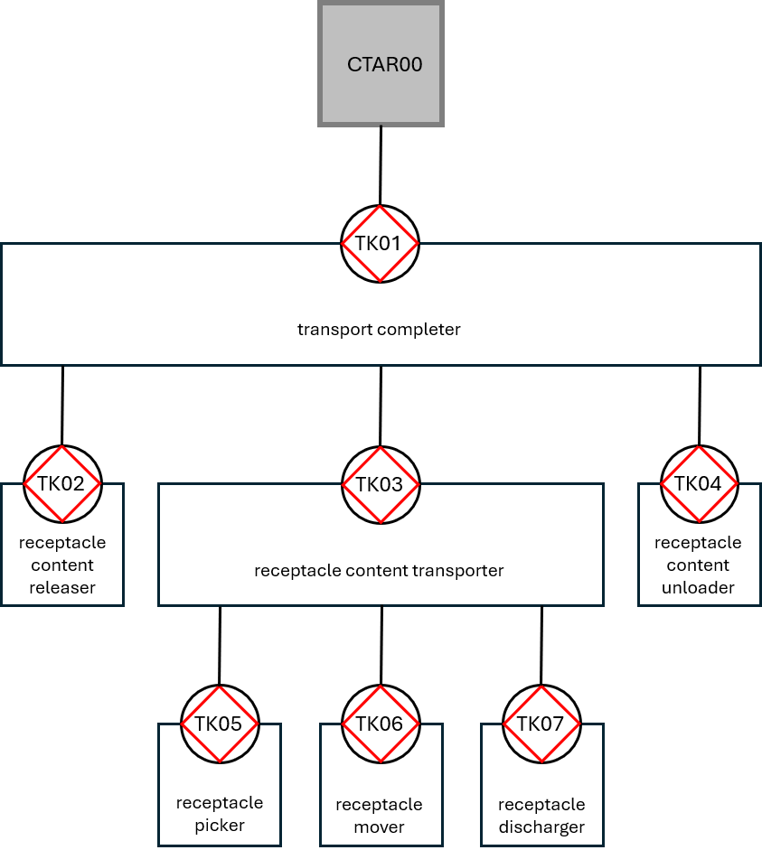
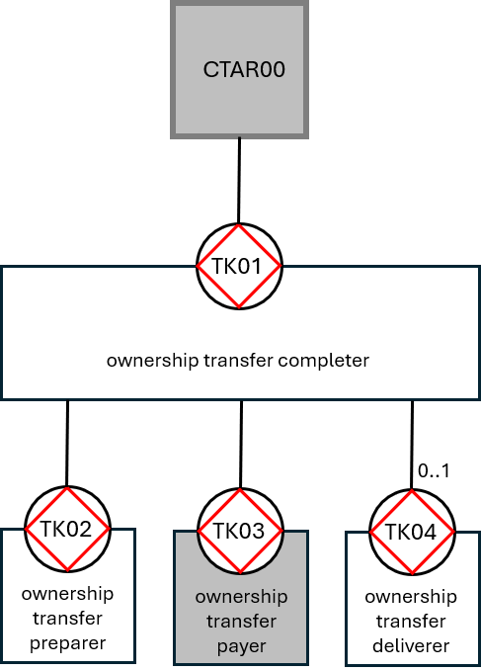
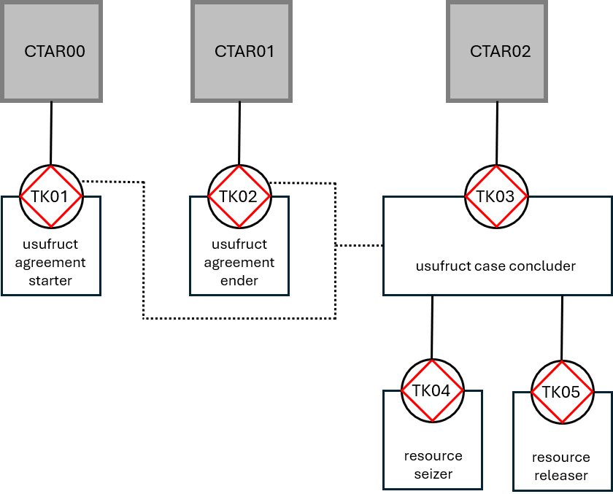
OER step 2 — OMEGA Reference Models
 | Tangible things | Intangible things
Creating and Changing | A1 | B1
Transporting and Storing | A2 | *not applicable*
Transferring Ownership | A3 | B3
Obtaining Usufruct | A4 | B4
1
2
3
4

Slide 3
OER step 2 — OMEGA Reference Model – Creating and Changing
[casekind] = end product
production = assembling
S of [casekind] = sub product
production = assembling
resource v of [casekind] = resource needed for end product
production = acquiring
resource w of [casekind] = resource needed for end product
production = acquiring
resource x of S of [casekind] = resource needed for end product
production = acquiring
resource y of S of [casekind] = resource needed for end product
production = acquiring
resource z of S of [casekind] = resource needed for end product
production = acquiring
Notes:
The skill comes to the conclusion that the narrative contains original transaction kind elements and that those transaction kinds belong to OMEGA Creating and Changing. To be able to fill YAML, you need to discover the construction of our end product. Which sub parts does it need to be assembled and for the total, which resources need to be acquired.
The Intangible form goes for a decision, or a judgement. All situations within DGE, where the executor could decide based on the existence rules, however he is forced to get approval of a higher management level: creating and changing.

Slide 4
OER step 2 — OMEGA Reference Model – Transferring of Ownership
[casekind] = ownership transfer (sale)
production = completing
[casekind] = ownership transfer (sale)
production = preparing
[casekind] = ownership transfer (sale)
production = paying (normal outside focus)
[casekind] = ownership transfer (sale)
production = delivering (optional, so 0..1)
Notes:
The skill comes to the conclusion that the narrative contains original transaction kind elements and that those transaction kinds belong to OMEGA Transferring of Ownership. To be able to fill YAML, you need to discover the construction of ownership transfer. Does it need preparing? Will it be paid, and executor outside the focus? Does it need to be delivered, and do we have the cardinality 0..1?
The Intangible form goes for owner rights, trading shares, bit coins, gold

Slide 5
OER step 2 — OMEGA Reference Model – Transporting and Storing
[casekind] = type of transport
production = completing
receptable content of [casekind] = what is being transported (container content)
production = releasing
receptable content of [casekind] = what is being transported (container content)
production = transporting
receptable content of [casekind] = what is being transported (container content)
production = unloading
receptable of receptable content of [casekind] = what contains the content (container)
production = picking
receptable of receptable content of [casekind] = what contains the content (container)
production = moving
receptable of receptable content of [casekind] = what contains the content (container)
production = discharging
Notes:
The skill comes to the conclusion that the narrative contains original transaction kind elements and that those transaction kinds belong to OMEGA Transporting and Storing. To be able to fill YAML, you need to discover the construction of the type of transporting. Which receptable is used for transporting the content?
Intangible form does exist, however it will be a documental transaction kind

Slide 6
OER step 2 — OMEGA Reference Model – Obtaining Usufruct
[casekind] = type of usufruct
production = concluder
resource of [casekind] = what is being used (car, hotel room, book)
production = seizing
resource of [casekind] = what is being used (car, hotel room, book)
production = releasing
usufruct agreement of [casekind] = what supports multiple use (membership)
production = starting
usufruct agreement of [casekind] = what supports multiple use (membership)
production = ending
Notes:
The skill comes to the conclusion that the narrative contains original transaction kind elements and that those transaction kinds belong to OMEGA Obtaining Usufruct. To be able to fill YAML, you need to discover the construction of the type of usufruct. Which resource is being used? Do we have multiple uses, so we need to support an usufruct agreement? In what way is the usufruct started and how is it ended?
Intangible form is related to SaaS, streaming, so most of DGE’s digital products

Slide 7
Expanding the ontology with Informational

Slide 8
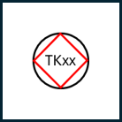
OER — Summary OMEGA Transactor Types
 | Tangible things | Intangible things
Creating and Changing | A1 | B1
Transporting and Storing | A2 | *not applicable*
Transferring Ownership | A3 | B3
Obtaining Usufruct | A4 | B4
1
2
3
4
1
1
1
1
2
2
2
2
3
4
3
4
3
4
5
3
4
5
5
6
5
6
7
8

Slide 9
OER — Summary OMEGA Transactor Types Case Kind
 | Ω | 1 | 2 | 3 | 4 | 5 | 6 | 7 | 8
1 | CC | production manager | end product assembler | resource acquirer (end product) | sub product assembler | resource acquirer (sub product) | - | - | -
product kind |  | managing of products in [period] is done | [end product] is assembled | resource of [end product] is acquired | sub product of [end product] is assembled | resource of sub product of [end product] is acquired | - | - | -
2 | TS | transporting manager | transport completer | receptacle content releaser | receptacle content transporter | receptacle content unloader | receptacle picker | receptacle mover | receptacle discharger
product kind |  | managing of transports in [period] is done | [transport] is completed | receptacle content of [transport] is released | receptacle content of [transport] is transported | receptacle content of [transport] is unloaded
3 | ToO | transferring manager | transferring completer | ownership transfer preparer | ownership transfer payer | ownership transfer deliverer | - | - | -
product kind |  | managing of transfers in [period] is done | [transfer] is completed | [transfer] is prepared | [transfer] is paid | [transfer] is delivered
4 | OU | obtaining manager | usufruct agreement starter | usufruct agreement ender | usufruct case concluder | resource seizer | resource releaser | - | -
product kind |  | managing of obtains in [period] is done | [usufruct agreement] is started | [usufruct agreement] is ended | [usufruct case] is concluded | resource of [usufruct case] is seized | resource of [usufruct case] is released

Slide 10
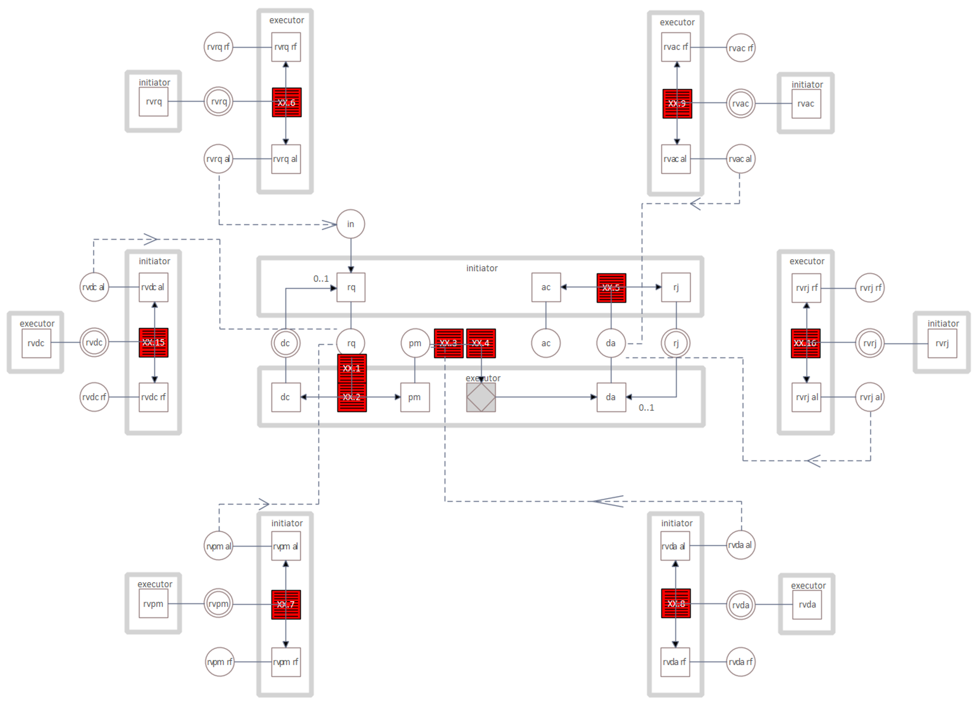
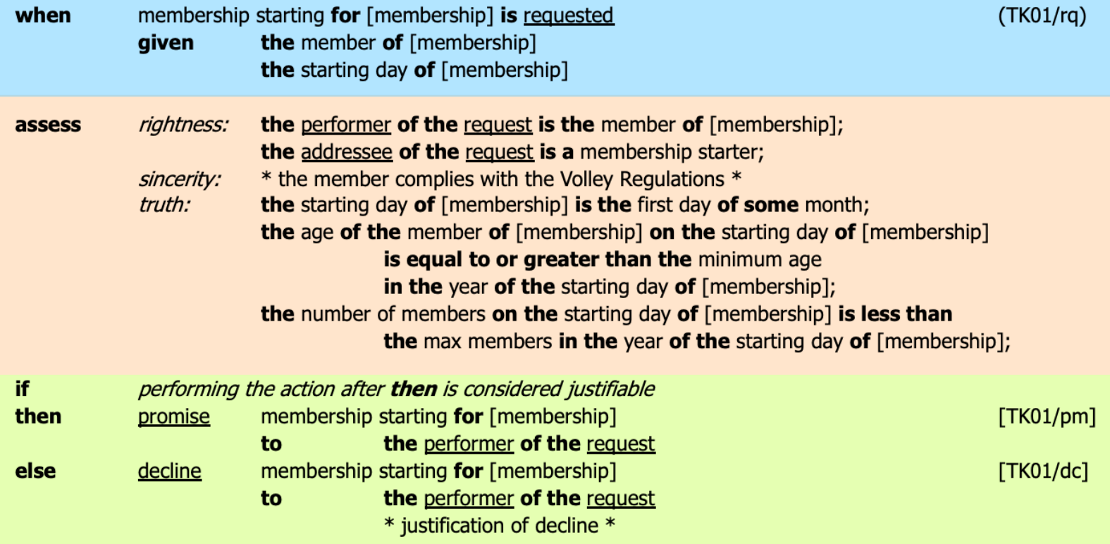
Expanding Informational TARs
TKxx
case kind producer
TKyy
case kind rememberer
TKzz
existence law calculator
for 1 to n

Slide 11
Expanding the ontology with Documental

Slide 12
Expanding Documental TARs
 | Ω | 1 | 2 | 3 | 4 | 5
1 | CC | production manager | end product assembler | resource acquirer (end product) | sub product assembler | resource acquirer (sub product)
product kind |  | managing of products in [period] is done | [end product] is assembled | resource of [end product] is acquired | sub product of [end product] is assembled | resource of sub product of [end product] is acquired
case kind |  | period | end product | acquired end product | assembled end product | acquired resource sub product
storing |  | period | end product | acquired end product | assembled end product | acquired resource sub product
retrieving |  | period | end product | acquired end product | assembled end product | acquired resource sub product
displaying |  | period | end product | acquired end product | assembled end product | acquired resource sub product
TKyy
case kind rememberer
TKaa
TKbb
TKcc
case kind storing
case kind retrieving
case kind displaying
* here we only listed “storing”, “retrieving” and “displaying” however there are much more

Slide 13
Expanding with the “leaf” thought and integrating

Slide 14
OMEGA Reference Models and Leafs
 | Tangible things | Intangible things
Creating and Changing | A1 | B1
Transporting and Storing | A2 | *not applicable*
Transferring Ownership | A3 | B3
Obtaining Usufruct | A4 | B4
1
2
3
4

Slide 15
Example Transfer of Ownership
Ahmed and Mohamed both have a car
Ahmed had a Tesla Model S and Mohemad has a BMW 7
At one day they decide to exchange the cars, Mohamed wants to drive electric, and Ahmed misses the sound of a real combustion engine.
From Ahmeds’ point of view, he buys the car of Mohamed and he pays with his own car. For Mohamed it is just the other way around. He buys the car of Ahmed and he pays with his own car.
They agree to let the car being cleaned before the exchange takes place. The exchange will take place next Monday at Mohameds’ home, so Ahmed will drive his Tesla to Mohamed.

Slide 16
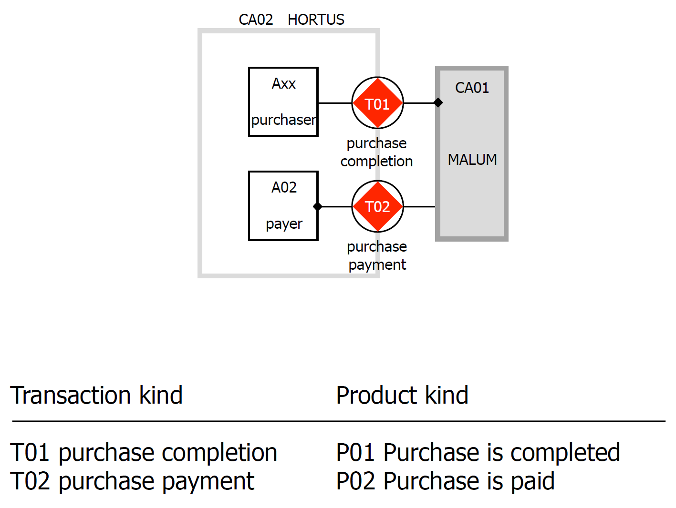
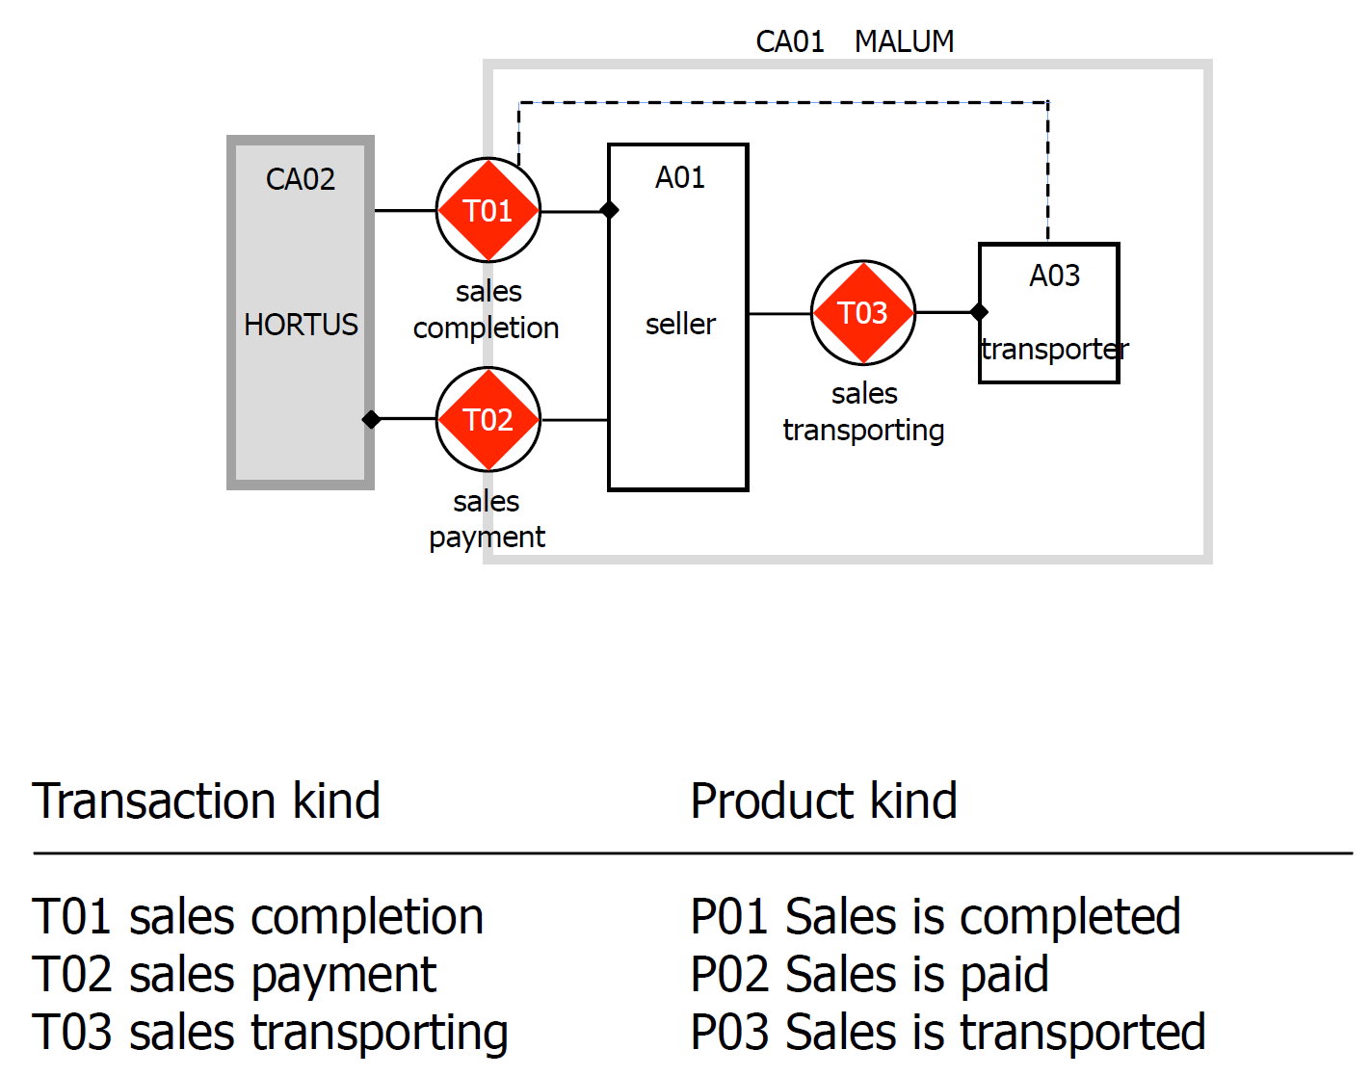
Horus and Malum example (DEMO-3)
HORTUS VIEW
MALUM VIEW
Notes:
In 2014 Jan Dietz introduced the Hortus Malum case, where we can see to views modelled in DEMO3! Hortus initiates a sale with Malum and Malum has to pay for that sale. When we change the focus to Hortus, we see two actorroles appear: the purchaser and the payer. The grey line is in DEMO3 the Scope of Interest, and we know internal transaction kinds and border transaction kinds.
In DEMO4 Jan Dietz changed this. We no longer see network of transaction kinds, we see trees of transaction kinds, with a top transaction kind rounding transactions up. The SoI is no longer shown, what you see on the CSD is the SoI and we introduce the focus. Is the executor role within or outside the focus.

Slide 17
DEMO-3 OCD (equivalent CSD DEMO-4)
MOHAMEDS’
VIEW
AHMEDS’
VIEW
CA01: MOHAMED
CA02: AHMED
ARxx
TK01
TK01
AR01
purchaser
purchase
completing
AHMED
MOHAMED
sale
completing
TK03
AR03
deliverer
AR02
TK02
TK02
payer
seller
purchase
paying
sale
paying
Notes:
In DEMO3 the (executing) actor roles and transaction kinds were drawn separately, although the relationship in the TPT was one – one – one.

Slide 18
DEMO-3 OCD (equivalent CSD DEMO-4)
MOHAMEDS’
VIEW
AHMEDS’
VIEW
purchase
CTAR00
TK00
manager
MOHAMED
TK01
TK01
purchase completer
sale completer
0..1
0..1
TK04
TK02
TK03
TK04
TK02
TK03
purchase preparer
purchase payer
purchase deliverer
sale preparer
sale deliverer
sale payer
Notes:
In DEMO4 the Scope of Interest is the diagram and the focus determines if the executor actor role authority will be in focus, so the ARS belonging to that actor role will be elaborated. Buying in the view of one actor role, will be selling in the view of another actor role. In the end it will be the same Transfer of Ownership. The question is what will happen with the “labels” of the casekind. The payment of the [sale 4711] is the car 1633, with car type “Tesla Model S”. The payment of the [purchase 2988] is the car 2012, with car type “BMW 7”. Also when we look at the initiator role, the sale is initiated by CTAR00 Mohamed, as part of that sale, the sale completer “Ahmed”, initiates TK02, the sale payer (Mohamed).

Slide 19
OFD for both
PRODUCT TYPE
[sale] is completed
[purchase] is completed
1
5
SALE
the product of [sale] is [product]
PRODUCT
PURCHASE
PREPARED SALE
the product of [prepared sale] is [product]
4
[sale] is prepared
PAID SALE
the product of [paid sale] is [product]
the product of [prepared purchase] is [product]
PREPARED PURCHASE
2
4
[sale] is paid
[purchase] is prepared
DELIVERED SALE
the product of [delivered sale] is [product]
the product of [paid purchase] is [product]
PAID PURCHASE
3
2
[sale] is delivered
[purchase] is paid
Notes:
The question is, ontological is TK4 sale preparing different than TK4 purchase preparing?

Slide 20
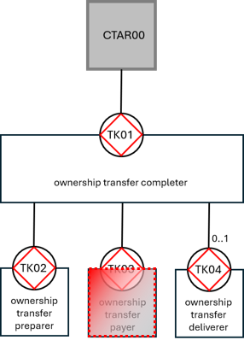
In the exchange of cars example, the leaf is the result of another Transfer of Ownership tree. Same is the case when we let the initiator pay money for it.
It could also be that the initiator and the executor agree on the executor paying in the form of Obtaining Usufruct. As long as the car is in operational possession of the initiator, the executor can make use of the swimming pool and gym of the initiator. The create an agreement for that.
In this case the “payment transaction kind” will be the result of an Obtaining Usufruct within an Usufruct Agreement (intangible Creating and Changing). In this case the product is a use agreement. During that use agreement obtaining ususfruct of the swimingpool and gym is allowed.

Slide 21
OFD for both
PRODUCT TYPE
[sale] is completed
[use agreement] is started
[purchase] is completed
1
5
5
SALE
the product of [sale] is [product]
PRODUCT
the product of [use agreement] is [product]
USE AGREEMENT
USUFRUCT CASE
PREPARED SALE
the product of [prepared sale] is [product]
4
[sale] is prepared
PAID SALE
the product of [paid sale] is [product]
2
the use agreement of [usufruct case] is [use agreement]
[sale] is paid
DELIVERED SALE
the product of [delivered sale] is [product]
the product of [concluded usufruct] is [product]
CONCLUDED USUFRUCT CASE
3
4
[sale] is delivered
[usufruct case] is concluded
Notes:
So, for one TK instance we have a car as product of the product type “BMW 7” and in the other case the product is a signed use agreement. During that period the product type “swimming pool” and “gym” can be made use of.

Slide 22
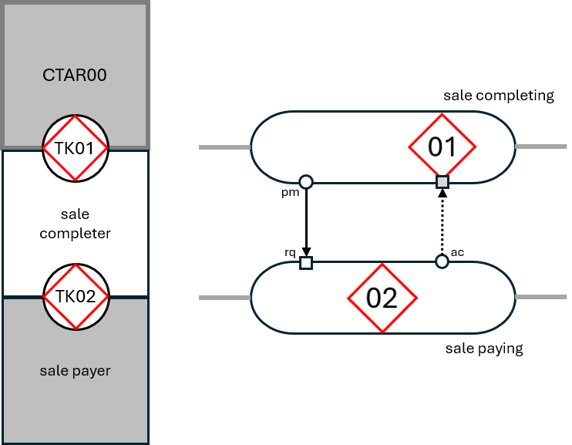
PSD for all trees
The Process Structure Diagram (PSD) contains a compact tree structure on the left side and on the right side the disks of the transaction kind are stretched so the response links and wait links between the coordination acts and facts can be shown.
If nothing is revealed from the narrative the standard structure is response link from the (TK01/pm) to the [TK02/rq] and a wait link between the (TK02/ac) and the [TK01/ex].
The compact tree structure and the transaction kind disks are so aligned, the actor roles on the left side cover the responsible areas of the transaction kinds on the right side.
The product kinds are placed on the transaction kind disk, so the split the order and the result phase. The coordination acts and facts are placed at the right side of the product kind accordingly.
The name of the transaction kind is displayed above or below the transaction kind disk on the right side.

Slide 23

Thank You
شكراً لك
Notes:
…

