Slide 1
Stroke Risk Prediction Analysis
Peter Lee
Springboard Data Science Student
Notes:
Today I’ll be presenting my analysis on Stroke Risk Prediction. The goal of this project was to use machine learning to identify individuals who may be at an elevated risk of stroke

Slide 2
Problem Statement
Stroke is a major cause of death and disability worldwide.
Goal: develop a machine-learning model to identify individuals who may be at elevated risk of stroke.
Use demographic, medical, and lifestyle factors such as age, hypertension, heart disease, glucose level, BMI, and smoking status.
Notes:
According to the World Health Organization, stroke is the third-leading cause of death and disability globally, making it a major public health concern. The goal of this project is to develop a machine-learning model that can identify individuals who may be at an elevated risk of stroke using demographic, medical, and lifestyle factors such as age, hypertension, heart disease, glucose level, BMI, and smoking status.

Slide 3
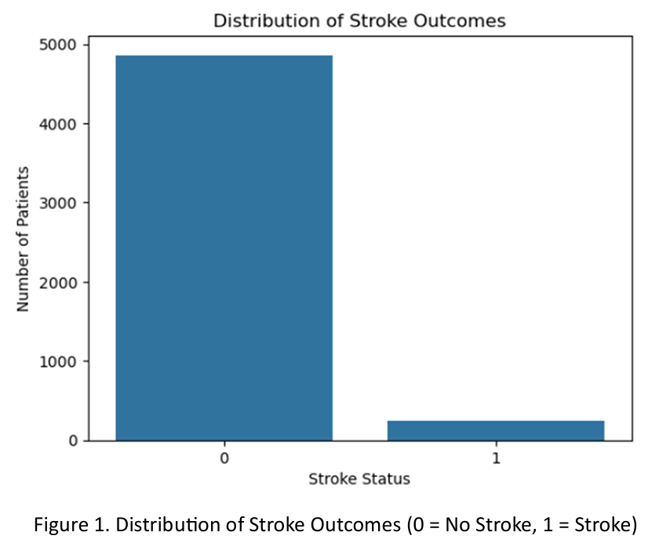
Dataset
Kaggle Stroke Prediction Dataset
5,110 patient records
249 stroke cases (4.9%)
Demographic, medical, and lifestyle features
201 missing BMI values
Target: stroke (0 = No Stroke, 1 = Stroke)
Notes:
For this project, I used a stroke prediction dataset from Kaggle containing 5,110 patient records. The dataset includes demographic, medical, and lifestyle information such as age, hypertension, heart disease, average glucose level, BMI, and smoking status. The target variable indicates whether or not the patient experienced a stroke. One of the biggest challenges with this dataset is class imbalance. Only 249 patients, or about 4.9%, experienced a stroke, while about 95% did not. As you can see from this chart, the stroke cases represent a very small portion of the dataset. This class imbalance became an important consideration when evaluating the models.

Slide 4
Approach
Data Wrangling → EDA → Preprocessing → Model Training → Model Comparison → Hyperparameter Tuning → Final Model Evaluation
Dummy Classifier | Logistic Regression | Decision Tree | Random Forest
Notes:
This slide summarizes my overall approach. I started with data wrangling and exploratory data analysis to understand the dataset and identify important patterns and data-quality issues. I then preprocessed the data and trained four classification models: a dummy classifier, logistic regression, a decision tree, and a random forest. I compared their performance, performed hyperparameter tuning, and then selected the best-performing model for final evaluation on the test set.
I’ll start by showing some of the key findings from the exploratory data analysis

Slide 5
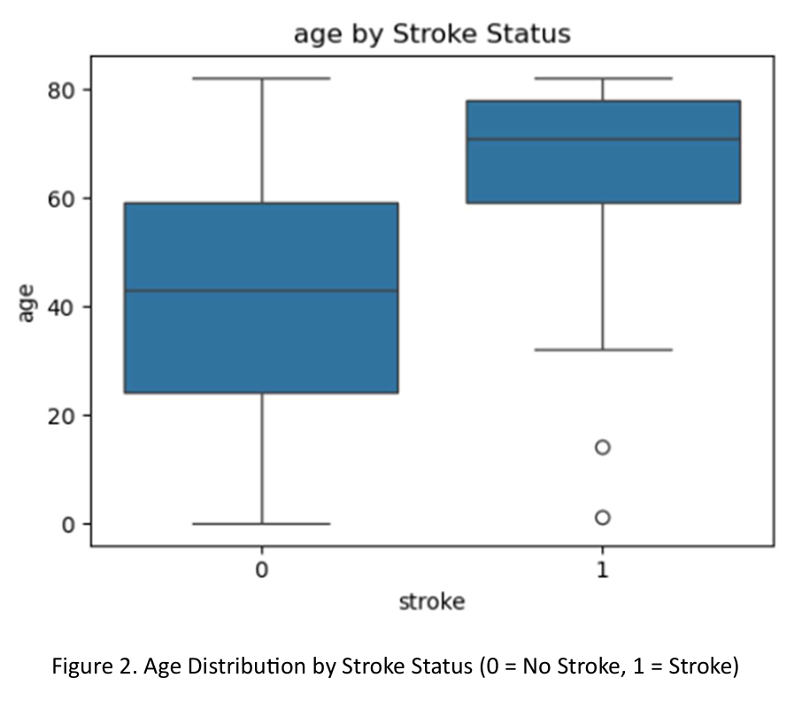
EDA: Class Imbalance & Age
Target distribution: 249 stroke cases (4.9%) vs. 4,861 non-stroke cases (95.1%)
Age by Stroke Status
Notes:
During exploratory data analysis, two patterns stood out. First, the dataset is highly imbalanced, with only about 4.9% of patients having experienced a stroke. Second, age showed a clear association with stroke status, with stroke cases occurring more frequently among older individuals.

Slide 6
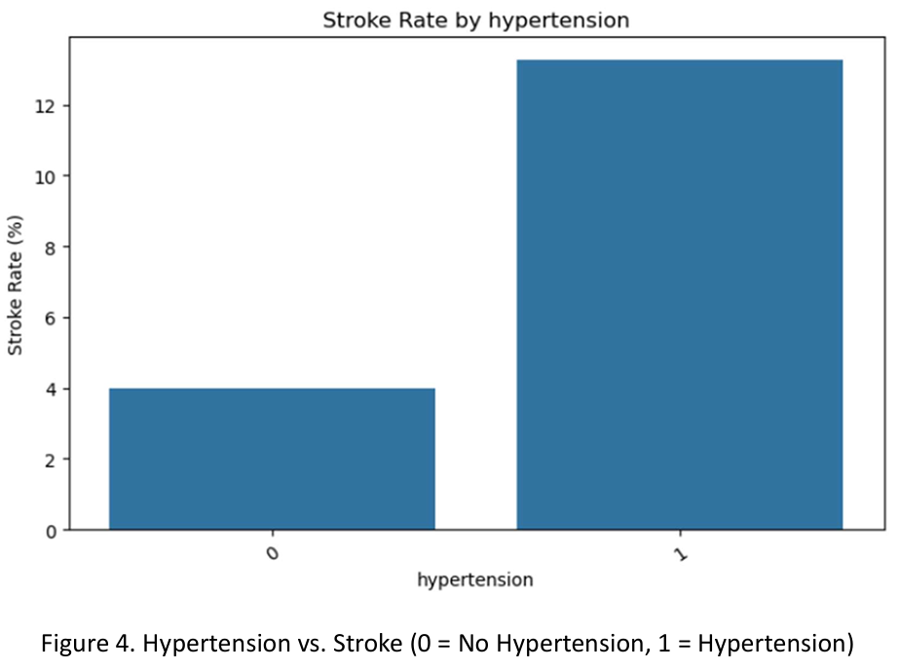
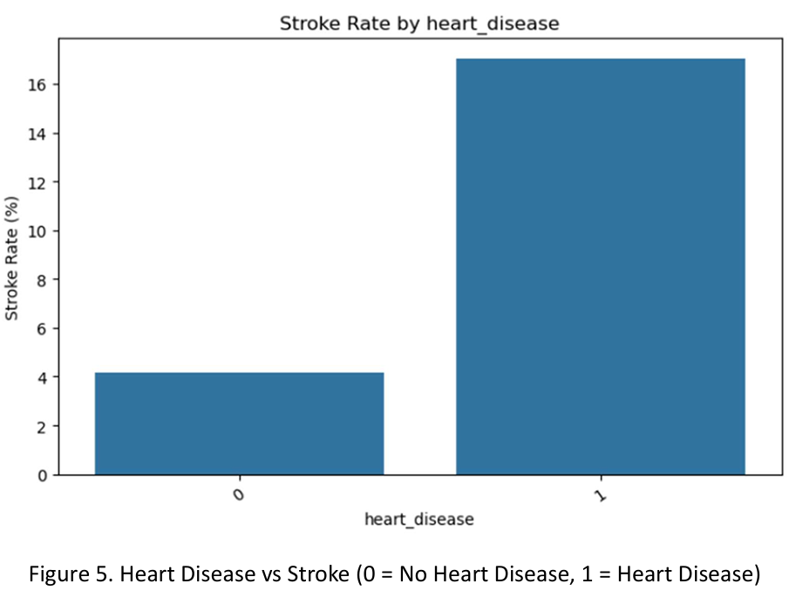
EDA: Other Risk Factors
Notes:
I also examined several medical and lifestyle factors. Stroke rates were higher among patients with hypertension and heart disease. Average glucose levels also tended to be higher among stroke patients. These findings suggested that these variables could provide useful information for the prediction models. Based on these findings, I prepared the data for machine-learning modeling.

Slide 7
Data Preprocessing
Train/Test Split
  80% training / 20% testing
  Stratified by stroke status
Numerical Features
  Median imputation for missing values
  StandardScaler
Categorical Features
  Most-frequent imputation
  One-hot encoding
Binary Features
  Hypertension and heart disease passed through
Pipeline
  Preprocessing fitted on training data
  Same transformations applied consistently to validation/test data
Notes:
Before training the models, I split the data into 80% training and 20% testing sets. Because stroke cases represented only about 4.9% of the dataset, I used a stratified split to maintain approximately the same proportion of stroke cases in both sets.
For the numerical features, I imputed missing values using the median and then standardized the variables. For categorical features, I used most-frequent imputation followed by one-hot encoding. The binary hypertension and heart-disease variables were already numeric, so they were passed through without additional transformation.
Finally, I combined these preprocessing steps into a pipeline so that preprocessing was learned from the training data and applied consistently throughout model evaluation. This also helped prevent data leakage.

Slide 8
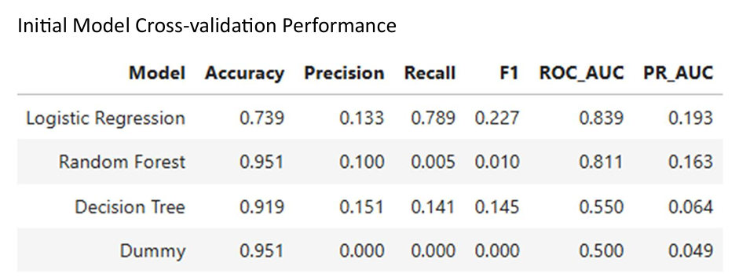
Initial Model Comparison
Notes:
Next, I compared the four models using five-fold stratified cross-validation. Because the dataset is highly imbalanced, I didn't want to select a model based on accuracy alone.
For example, the dummy classifier achieved about 95% accuracy simply by predicting the majority class, but its recall was zero, meaning it failed to identify any stroke cases.
The random forest also achieved about 95% accuracy, but its recall was extremely low at 0.005. In comparison, logistic regression had lower overall accuracy at about 74%, but it achieved a recall of approximately 79%, along with the highest F1-score, ROC-AUC, and PR-AUC among the four models.
Since identifying stroke cases was the primary objective, logistic regression provided the best overall balance of performance
After this initial comparison, I performed hyperparameter tuning to see whether the models could be improved.

Slide 9
Model Tuning & Selection
Model | Recall | PR-AUC
Logistic Regression | 0.789 | 0.193
Tuned Decision Tree | 0.628 | 0.149
Tuned Random Forest | 0.769 | 0.180
Final Model Selected: Logistic Regression
Why? Highest PR-AUC + highest recall among the tuned candidates.
Notes:
After the initial model comparison, I used GridSearchCV to perform hyperparameter tuning, using PR-AUC as the optimization metric because of the class imbalance.
Tuning significantly improved the performance of the decision tree and random forest. The random forest, for example, improved its recall from almost zero to approximately 77%.
However, logistic regression still achieved the highest recall at approximately 79% and the highest PR-AUC at 0.193. Its performance also remained essentially unchanged after tuning, suggesting that the original configuration was already performing well within the parameter range I tested.
Based on these results, I selected logistic regression as my final model.
After selecting logistic regression, I evaluated it one final time on the unseen test data.

Slide 10
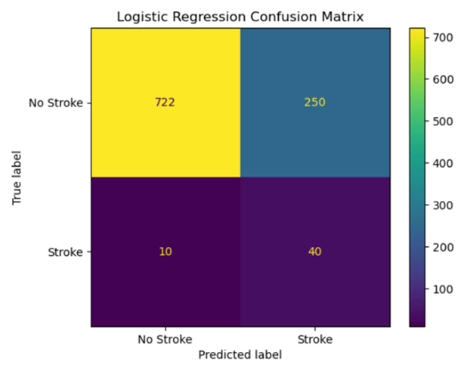
Final Model Performance
Final Model: Logistic Regression – Test Set Results
Metric | Score
Accuracy | 0.746
Precision | 0.138
Recall | 0.800
F1-Score | 0.235
ROC-AUC | 0.844
PR-AUC | 0.268
Identified 40 of 50 stroke cases (80% recall)
Notes:
After selecting logistic regression as the final model, I evaluated it on the unseen test set. The model achieved an accuracy of about 75%, a recall of 80%, and a ROC-AUC of 0.844.
For this project, recall is particularly important. Looking at the confusion matrix, there were 50 stroke cases in the test set, and the model correctly identified 40 of them while missing 10. This resulted in a recall of 80%.
However, there is a tradeoff. The model's precision was only about 14%, and it incorrectly classified 250 non-stroke patients as stroke cases. So while the model was able to identify a large proportion of the stroke cases, it also produced many false positives.
To further evaluate how well the model distinguished between the two classes, I examined the ROC and precision-recall curves.

Slide 11
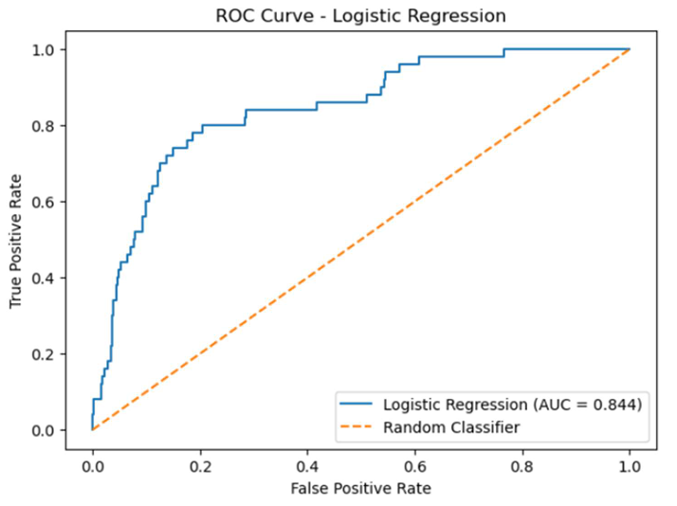
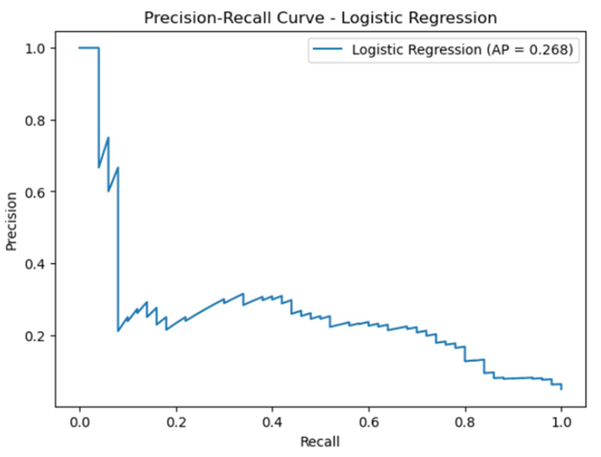
Final Model - ROC & Precision-Recall Curves
ROC-AUC = 0.844
PR-AUC = 0.268
Notes:
I also evaluated the final logistic regression model using the ROC and precision-recall curves. The ROC-AUC was 0.844. This indicates that the model was reasonably effective at distinguishing between stroke and non-stroke cases across different classification thresholds. The PR-AUC was 0.268. This value is lower because precision-recall performance is strongly affected by the class imbalance, with stroke cases representing only about 4.9% of the dataset. The precision-recall curve is especially useful for this project because it focuses on the model's performance for the minority stroke class and shows the tradeoff between identifying more stroke cases and generating more false positives.

Slide 12
Conclusion
Stroke prediction presented a significant class-imbalance challenge
Logistic Regression provided the strongest overall balance of performance
Final model identified 80% of stroke cases
ROC-AUC: 0.844 | PR-AUC: 0.268
High recall came with a tradeoff: low precision and many false positives
Model is better viewed as a potential screening approach, not a diagnostic tool
Notes:
In conclusion, this project demonstrated the challenges of predicting stroke using a highly imbalanced dataset. Although some models achieved higher overall accuracy, logistic regression provided the best balance for identifying stroke cases. On the unseen test set, the final model identified 80% of the stroke cases and achieved a ROC-AUC of 0.844 and a PR-AUC of 0.268. However, this higher recall came with a tradeoff. The model had relatively low precision and generated a substantial number of false positives. Therefore, this model should not be viewed as a clinical diagnostic tool. Instead, the project demonstrates how machine learning could potentially be used as a screening approach to identify individuals who may require further evaluation.

Slide 13
Recommendations
Use the model as a potential screening/decision-support approach, not as a diagnostic tool
Improve precision while maintaining high recall
Experiment with classification-threshold adjustment
Evaluate additional models and class-imbalance techniques
Incorporate additional clinically relevant predictors
Validate performance using larger and more representative datasets
Notes:
Based on the results, there are several opportunities for future improvement. First, the model should be considered a potential screening or decision-support approach rather than a diagnostic tool. One of the main priorities for future development would be improving precision while maintaining high recall. The current model identifies 80% of stroke cases, but it also generates many false positives. Future work could explore adjusting the classification threshold, testing additional machine-learning models and class-imbalance techniques, and incorporating additional clinically relevant predictors. Finally, the model should be evaluated using larger and more representative patient datasets before considering any real-world application.

