Slide 1
Coffee Shop Sales Forecasting & Growth Analysis
Peter Lee
Springboard Data Science Student
Notes:
Today I’ll be presenting an analysis of coffee shop sales data to evaluate whether a 2 to 4 percent increase in sales is achievable for 2026. The goal is to use historical data and modeling to support a data-driven business decision.

Slide 2
Business Problem
Can the coffee shop achieve 2–4% sales growth?
Budget planning for 2026
Need realistic sales expectations
Data-driven decision required
Notes:
The coffee shop is preparing its 2026 budget and wants to determine whether increasing sales by 2 to 4 percent is realistic. Instead of relying on assumptions, they want a data-driven answer based on past performance and predictive modeling.

Slide 3
Dataset
Source: Kaggle
March 2024 – March 2025
Transaction-level data
Target: Revenue per transaction
Notes:
The dataset contains transaction-level sales data from March 2024 to March 2025. Each row represents a single purchase, and the key variable is revenue per transaction. This allows us to analyze both customer behavior and revenue patterns in detail.

Slide 4
Approach
Data Wrangling
EDA
Feature Engineering
Modeling
Business Recommendations
Notes:
I followed a standard data science workflow, starting with cleaning the data, then exploring patterns, building predictive models, and finally translating the results into business recommendations.

Slide 5
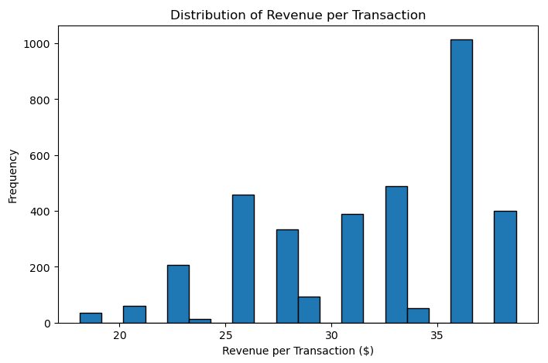
Revenue Distribution
Most transactions are moderate
High-value drinks drive revenue
Notes:
This chart shows the distribution of revenue per transaction. Most purchases fall within a moderate price range, but there are fewer high-value transactions that extend the upper end. This is important because it tells us that while most customers spend similar amounts, premium drinks contribute disproportionately to total revenue. This becomes a key factor when thinking about growth strategies.

Slide 6
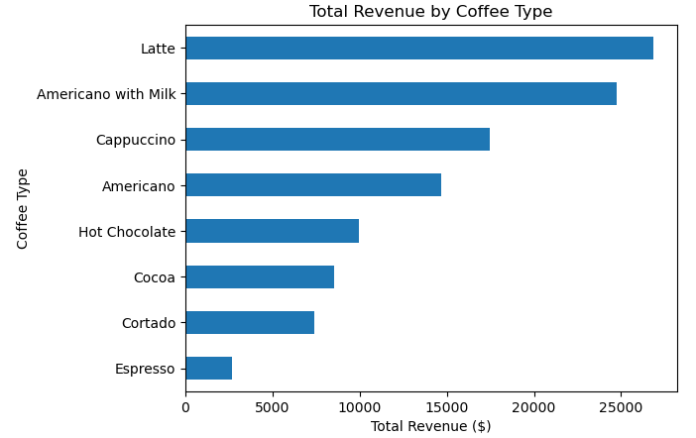
Sales by Product
Lattes, Americano with Milk and Cappuccinos drive revenue
Notes:
When we break revenue down by product, we see that certain drinks—especially lattes, Americano with milk, and cappuccinos—generate significantly more revenue than others. In contrast, drinks like espresso contribute much less per transaction. This tells us that product type is the strongest driver of revenue differences. From a business perspective, this is powerful because increasing sales of high-value drinks can directly impact total revenue.

Slide 7
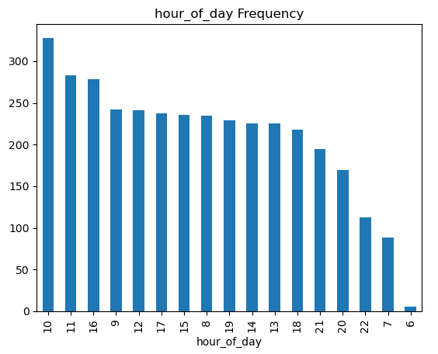
Time-Based Trends
Peak: Morning → Early Afternoon
Notes:
Sales peak during the morning and early afternoon, which aligns with typical coffee consumption patterns. While time of day does influence sales, its impact is smaller compared to product type. This suggests that timing matters—but what customers buy matters more.

Slide 8
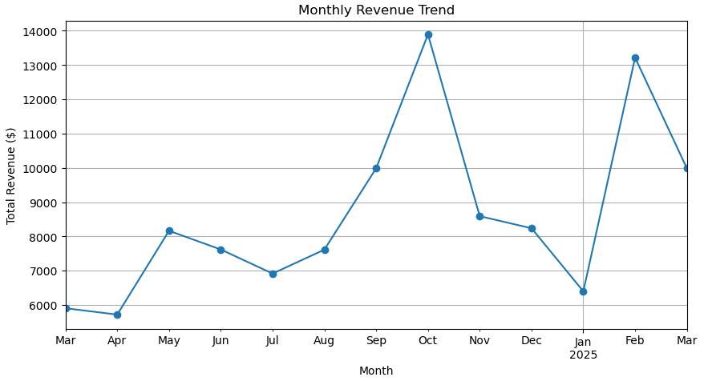
Monthly Revenue Trend
Seasonal variation exists
Notes:
Looking at monthly revenue, we see fluctuations over time, indicating seasonality. Some months perform better than others, while certain periods show noticeable dips. This is important because it means growth is not purely linear—seasonal declines can offset gains. Any growth strategy needs to account for this variability.

Slide 9
Modeling Approach
Linear Regression
Ridge Regression
Random Forest
Notes:
To predict revenue, I tested multiple models including Linear Regression, Ridge Regression, and Random Forest. The goal was to find the most accurate and reliable model for this dataset.

Slide 10
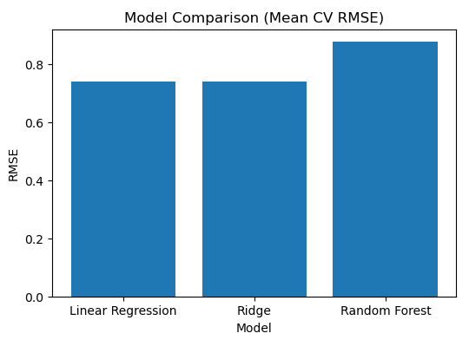
Model Performance
Linear = best choice
Notes:
The results show that Linear Regression and Ridge Regression performed almost identically, with very low error. Random Forest performed worse and showed more variability. This indicates that the relationships in the data are largely linear, meaning a simpler model works just as well as more complex ones. Because of this, Linear Regression was selected as the final model due to its simplicity and interpretability.

Slide 11
Revenue vs Growth Target
Category | Value
Current Avg Monthly Revenue | $8,634
Predicted Monthly Revenue | $8,636
Target (2% increase) | $8,807
Target (4% increase) | $8,980
Notes:
This slide compares current performance, predicted revenue, and the target range. The model shows that current revenue is stable and predictable, but it does not naturally reach the 2 to 4 percent growth target. There is a gap of about 170 to 340 dollars per month. This means growth will not happen automatically—but the gap is relatively small.

Slide 12
Final Recommendation
Growth is achievable—with action
Promote high-value drinks
Optimize peak hours
Address seasonal dips
Only ~$170–$340/month increase needed
Notes:
Based on the analysis, the growth target is achievable, but it requires deliberate action. The most effective strategy is to promote high-value drinks like lattes, americano with milk and cappuccinos. Additionally, optimizing operations during peak hours can maximize revenue, and addressing seasonal dips can stabilize performance throughout the year.
Only ~$170–$340/month increase needed
~1–3 extra high-value drinks/day
The most important takeaway is that the required growth is relatively small. It can be achieved by selling just one to three additional high-value drinks per day. This makes the target realistic and actionable from a business perspective.

Slide 13
Future Work
Time series forecasting
Customer analysis
Pricing strategy
Notes:
Future work could improve this analysis by incorporating time series forecasting, customer-level insights, and pricing strategies to further optimize revenue.

