Slide 1
Microsoft x Grab
BENJAMIN CHEONG CHEE WENG (1922491)
SUYAMPRAKASAM VARADARAJ (1936249)
LUQMAN AMIRUL HAKIM (1932597)

Slide 2
Contents
About the dataset
Exploratory data analysis
Data preparation
Modelling
Reflection

Slide 3
About the dataset
BookingID :trip
Accuracy: accuracy inferred by GPS in meters
Bearing: GPS bearing in degree
Acceleration_x: accelerometer reading at x axis(m/s2)
Acceleration_y: accelerometer reading at y axis(m/s2)
Acceleration_z: accelerometer reading at z axis(m/s2)
Gyro_x: gyroscope reading in x axis(rad/s)
Gyro_y: gyroscope reading in y axis(rad/s)
Gyro_z: gyroscope reading in z axis(rad/s)
Second: time of the record by the number of secons
Speed: speed measured by GPS in m/s
Label: tags to indicate dangerous trip( 0:Normal trip/ 1: Dangerous Trip)

Slide 4
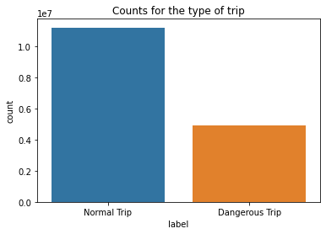
Exploratory data analysis
Most of the trips were labelled a normal trip.
Roughly 50% of the records collected were labelled as a dangerous trip.

Slide 5
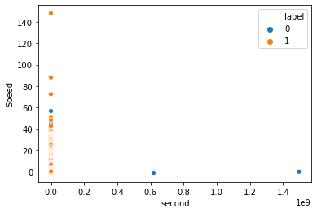
Exploratory data analysis
The top few trips that were labelled as dangerous were travelling very fast

Slide 6
Feature Engineering

Slide 7
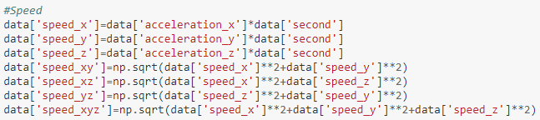
Feature Engineering – Speed Axis
Found the speed of the axis x, y, z.
Found the relationship between the speed in the x and y, x and z, and y and z.
Found the relationship between the axis speed x, y and z.

Slide 8

Feature Engineering – Acceleration Axis
Found the acceleration of the axis x, y, z.
Found the relationship between the acceleration in the x and y, x and z, and y and z.
Found the relationship between the axis acceleration x, y and z.
Able to determine change in the speed of the moving vehicle.
Greater the change, the driver might be moving off quickly or moving quickly.

Slide 9

Feature Engineering - Gyro
Gyroscope is a more stable and accurate way of determining the orientation of the vehicle.
Gyroscope senses the changes in the orientation of the phone and is excellent for measuring for a vehicle.
The x, y and z readings will most likely have a stronger influence on the machine learning models.
Able to determine the Angular velocity

Slide 10
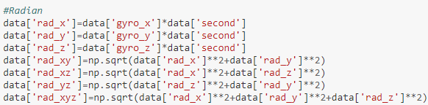
Feature Engineering - Radian
Obtain from the gyroscope axis readings.
Determine the measure of the gyroscope central angle.
Might provide value to the model.

Slide 11
Modelling

Slide 12
Models
Models we hope to do if we had the time:
XGBoostClassifer
Random Forest Classifier
Multi-label Classification

Slide 13
Reflection
This was a pleasant challenge to take up, and gained a lot of experience while tackling with the dataset.
Dataset provided was much larger than we have previously faced.
Shown us how companies retrieve data and use it to improve the services they offer.
Firsthand exposure to how machine learning can give insights and benefit companies

Slide 14
Thank you!

