Slide 1





GRAB – FSRP
The Telematics Dataset
Group 4
Jo Hyunsuh
EV Chua Yee Suan
Timothy Toh

Slide 2
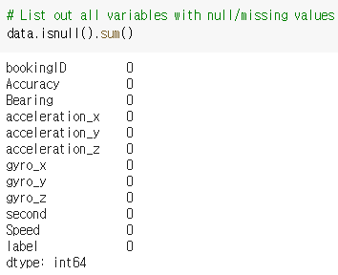
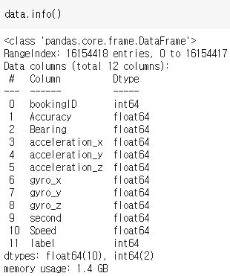
Data Exploration
There are 16135561 trip information
There are 11 columns
All columns are numeric values
There is no null value

Slide 3
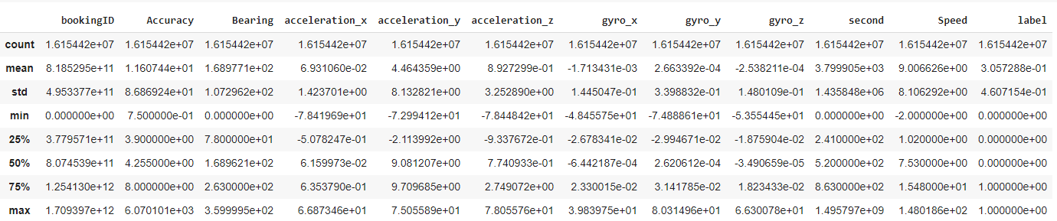
Data Exploration
0 second trips
Extremely long trip times
Negative speed
Impossibly high speed
GPS Accuracy??

Slide 4
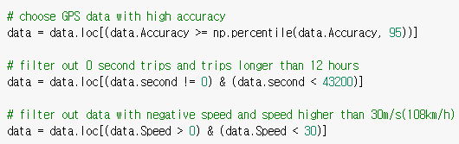
Data Cleansing/ Preparation
Take the trips with 95th percentile of GPS accuracy
Take the trips that are not 0 second long
Take the trips that are shorter than 12 hours
Take the trips that don’t have negative speed
Take the trips that are slower than 30m/s

Slide 5
Feature Engineering
Distance
Speed with axis
Radian with axis
Acceleration
Gyro
Interaction

Slide 6
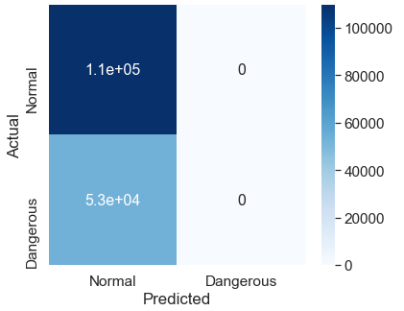
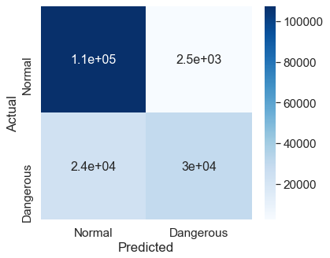

Models
Logistic Regression
Random Forest

Slide 7


Thanks!

