Slide 1
Grab Telematics Dataset Prediction for Dangerous Trip with high probability of accident
Done by: Tan Yu Xuan (p1936137),
Sidharth Vinod (1936252)
Class: 2B11

Slide 2
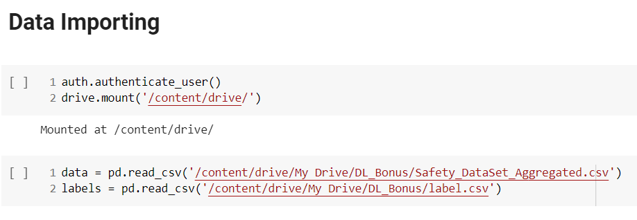
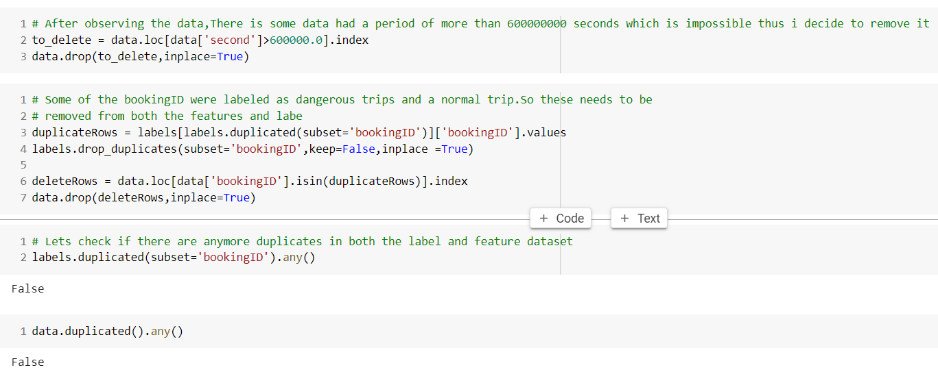
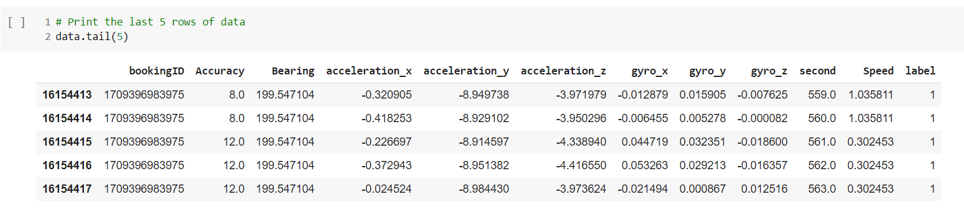
Data Cleaning
Use code to check for duplicated values
Data import
Print Data

Slide 3
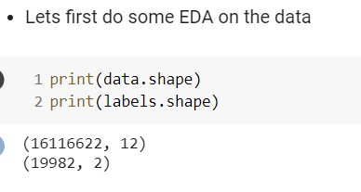
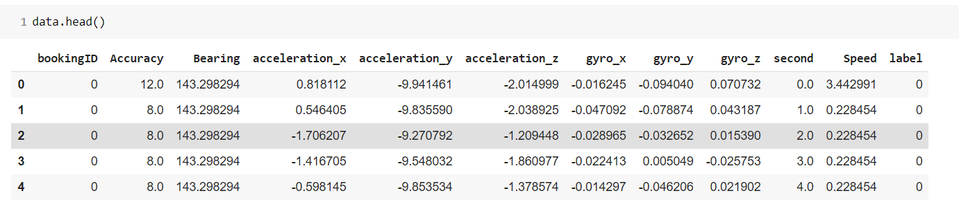
Data Exploration

Slide 4

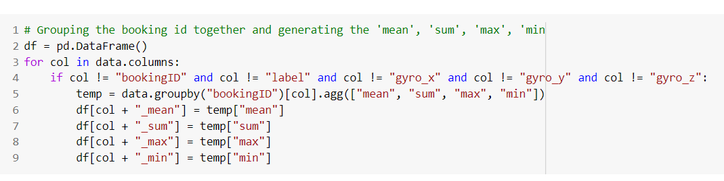
Data Preparation & Feature Engineering
Drop ‘second_min’ as it has no relation to ‘label’
Grouping the booking id and generating mean, sum, max, min

Slide 5
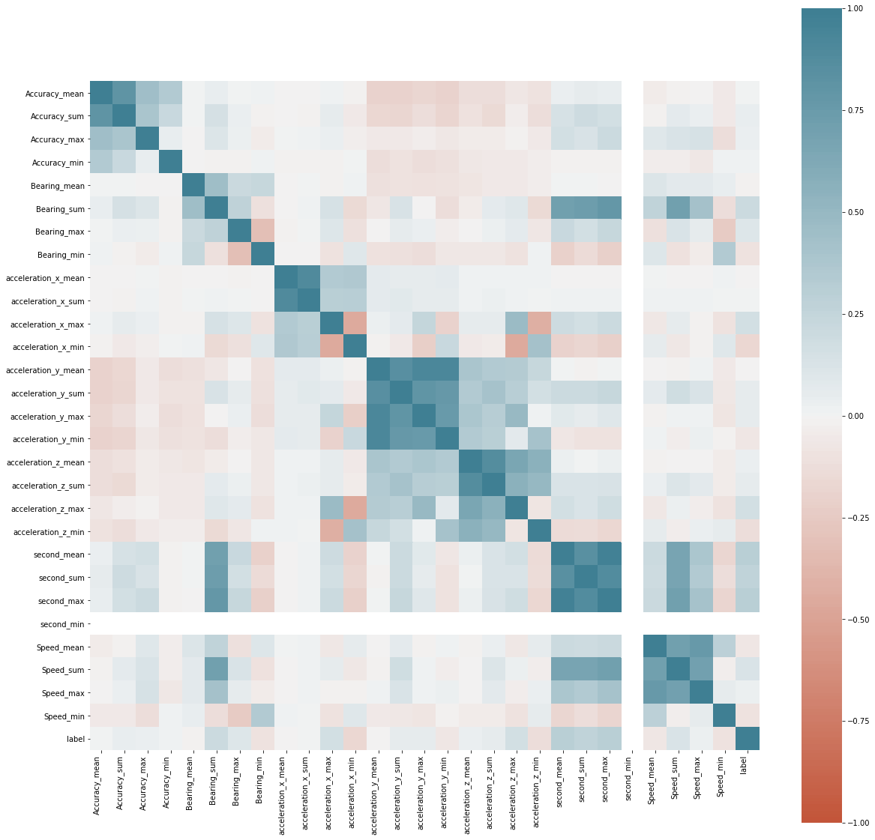

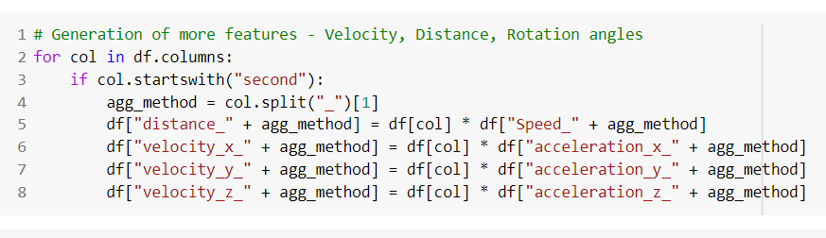
Data Preparation & Feature Engineering
Creating more features, such as Velocity Distance and Rotation Angles
Drop ‘second_min’ as it has no relation to ‘label’

Slide 6
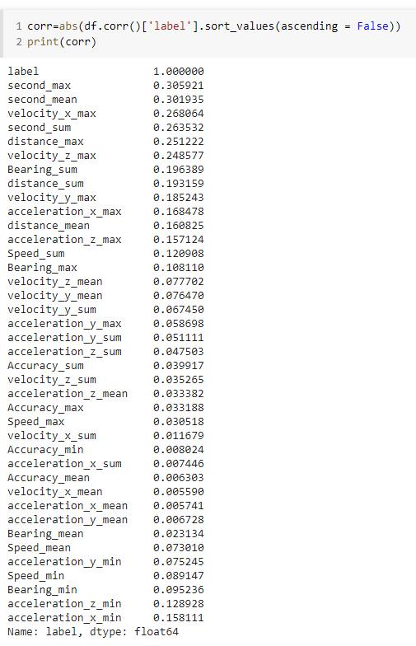
Feature Selection
See which are the features that has the highest correlation to ‘label’
Dropped the lowest 4 features that have the lowest correlation to ‘label’

Slide 7
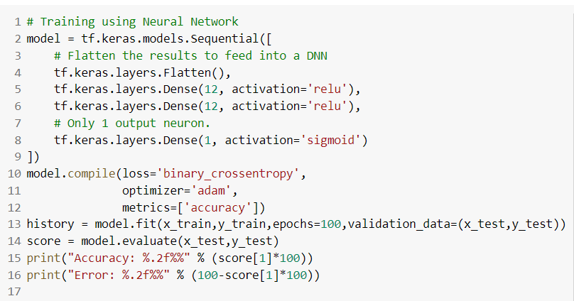
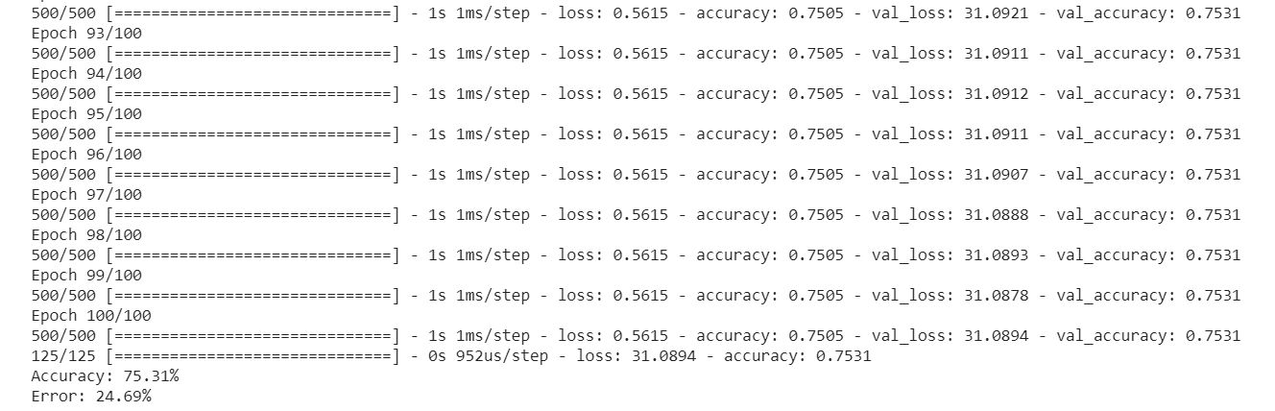
Model Building and Evaluation
Train using Neural Network

Slide 8
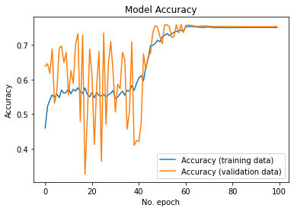
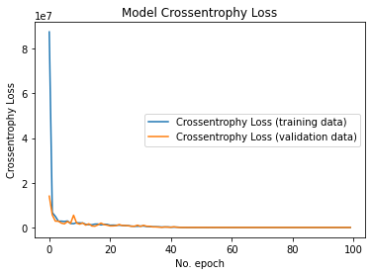
Evaluate Model
See how the model perform throughout the epochs
Can conclude that it does not overfit or underfit.

Slide 9
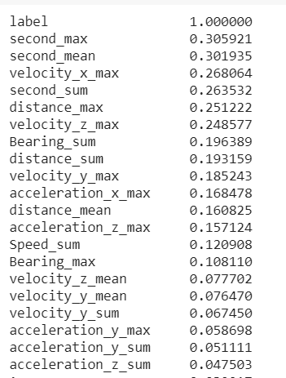
Feature Importance
Check which features are the most important to the model
The top 5 important features are ‘second_max’, ‘second_mean’, ‘velocity_x_max’, ‘second_sum’, ‘distance_max’

Slide 10
Conclusion
In conclusion there are many factors that affects the classification of dangerous trips.
Top 3 factors that make a trip dangerous are ‘second_max’, ‘ ‘velocity_x_max’. second_mean’,
This means that speed that makes a trip dangerous

