Slide 1



Grab Safety Prediction
This Photo by Unknown Author is licensed under CC BY-SA
This Photo by Unknown Author is licensed under CC BY-SA-NC
This Photo by Unknown Author is licensed under CC BY-NC
ＬＩＵ ＤＯＮＧＹＡＮＧ
Ｓｉｌｖｉａｎａ
Ｄｅｏｎ

Slide 2
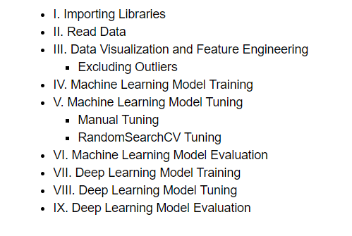
Content Preview

Slide 3
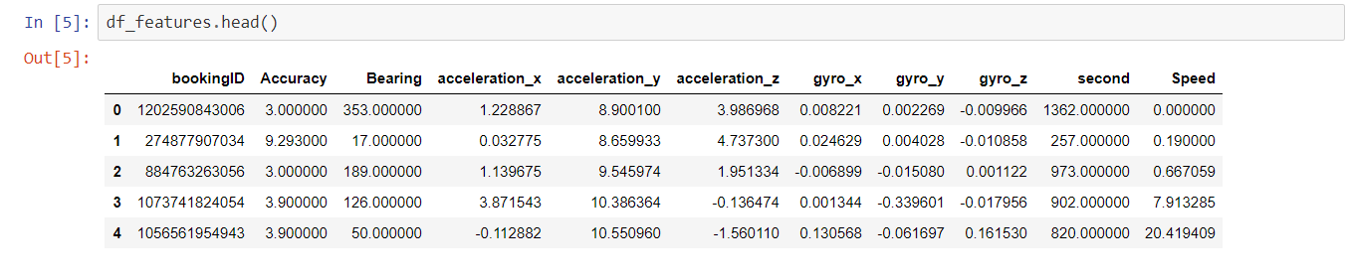
Base On these features, we are to predict whether the trip is safe or not.

Slide 4

The shape of the feature columns.

Slide 5
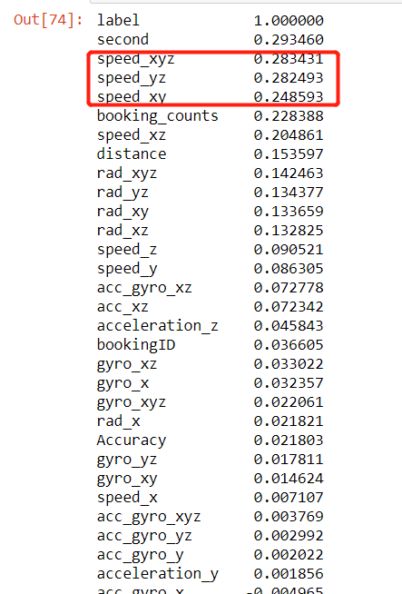
Which feature has a high impact on indicating dangerous trips?

Slide 6
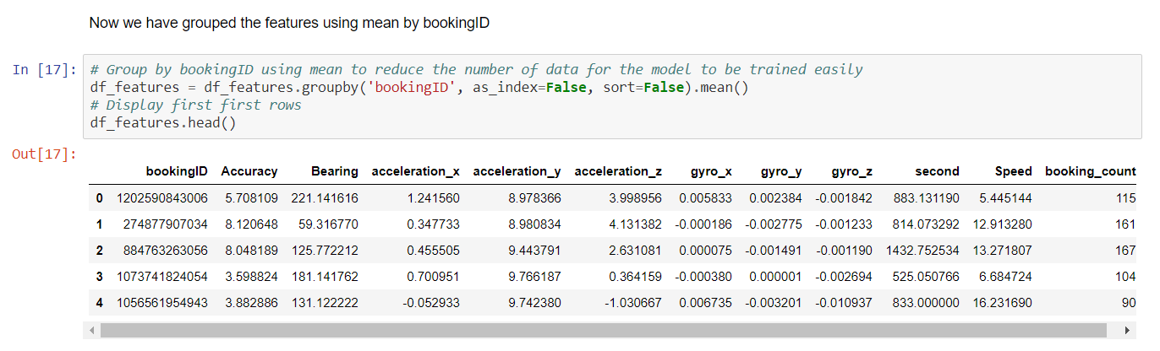
Did feature engineering such as: 1. Dropping Duplicated Label 2. Group the dataset by Booking ID 3. Generating More Feature Columns.

Slide 7
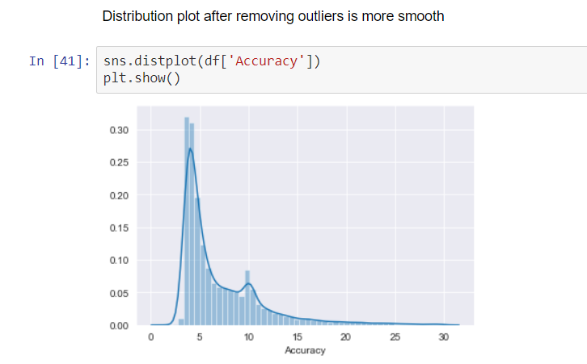
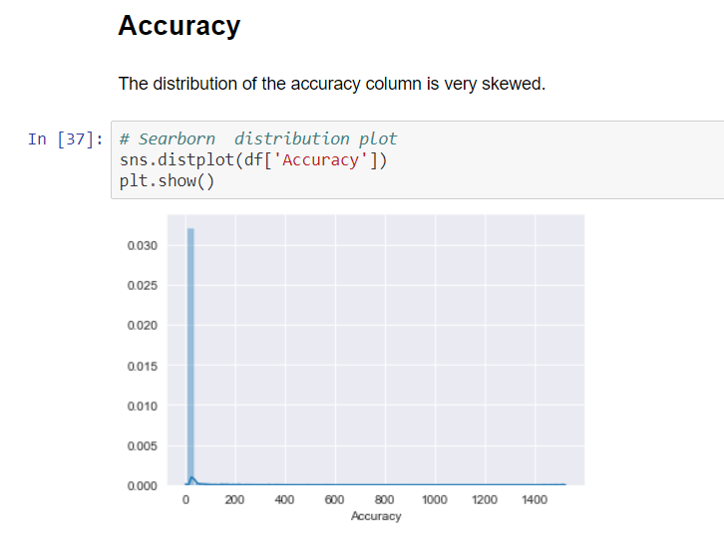
Distribution plot for some columns are very skewed, I removed outliers to make the curve more normalized.

Slide 8
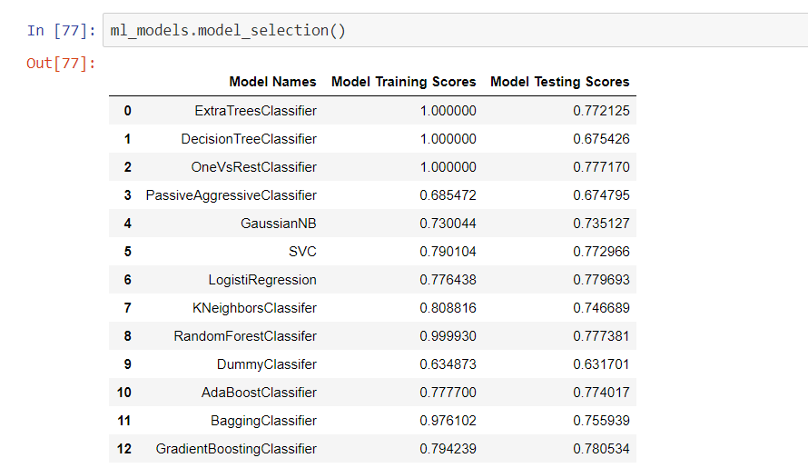
Best Accuracy score is about 0.79 with no overfitting.

Slide 9
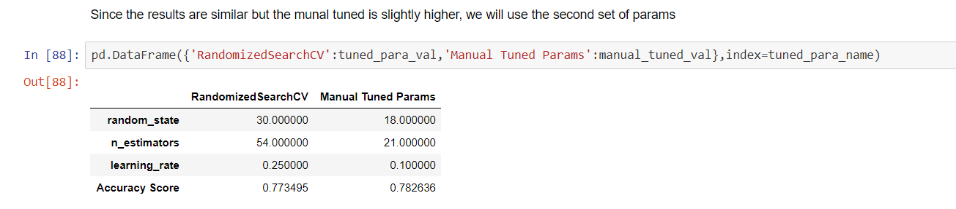
We tune the GradientBoostingCLassifier by using random_search_cv as well as manual tuning so that we can visualize th eprocess of tuning. Though random_search_cv use cross validation to obtain the score which can be lower, we will still choose the manual tune parameters.

Slide 10
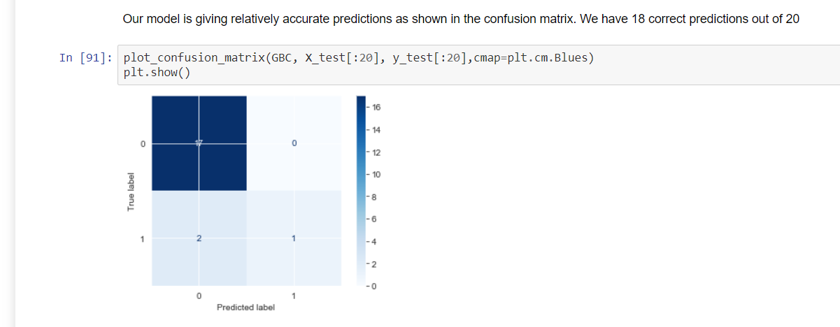
To evaluate the model, I used the tuned model to try to predict first 20 test set, and get 18 correct, which shows again that the accuracy of 79%.

Slide 11
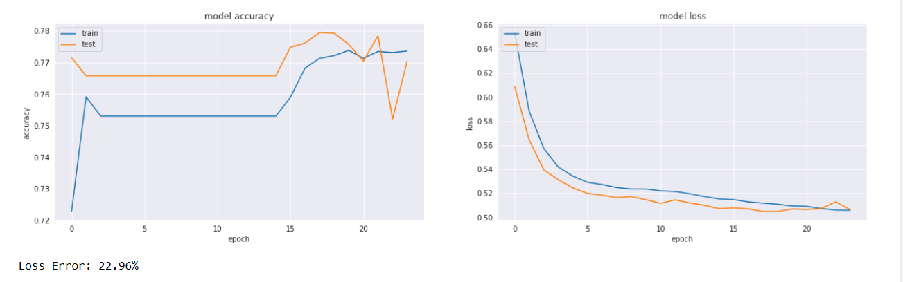
Next, we use a deep learning model to predict the data again. Though the testing curve bounces up and down a bit as it is unbalanced data, it still shows converging as epochs go on. The accuracy for deep learning model is about 0.78.

Slide 12
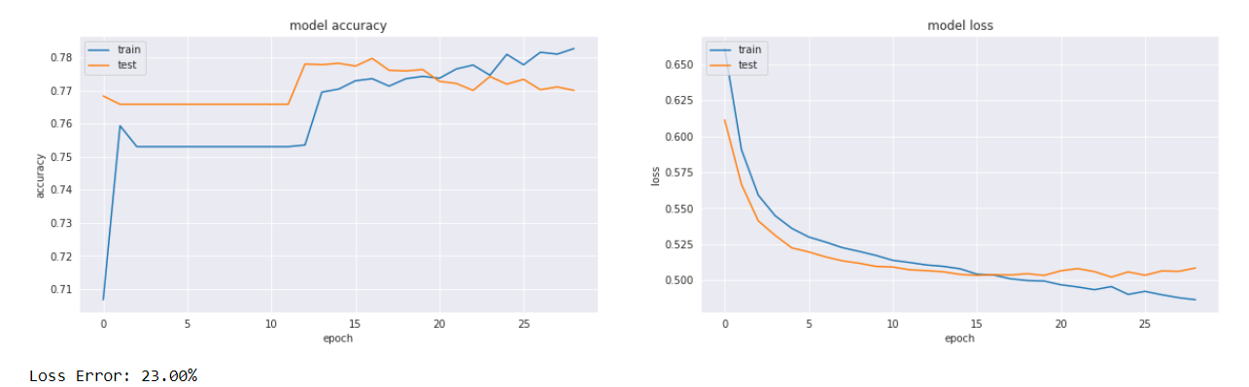
Next, we tune the deep learning model parameters. The curves are more stable after we use tunned parameters, but the tunned parameters could be overfitting a bit as the curves are not converging.

Slide 13

Due to the limit of the GPU power, I only managed to tune for a few parameters. I believe the model can perform better when a more powerful GPU is used and more parameters can be tuned.

Slide 14

This Photo by Unknown Author is licensed under CC BY-SA

