Slide 1
Safety Dataset
Ivan Lee, Keane Ng, Liew Khye Lerk

Slide 2
EDA/ Data cleansing
No null values
20000 unique bookingID values
Removed 18 duplicate records for bookingID

Slide 3
Feature Engineering/Selection
Grouped by bookingID and added mean, sum, max and min to all current features and also removed features gyro_x, gyro_y, gyro_z
Creation of additional features such as Distance and Velocity_x,y and z
Distance was created via Speed * Time(a.k.a Seconds)
Velocity was made via Acceleration * Speed
Selected top 10 features for training based on correlation to label

Slide 4
Model Building
Added Flatten layer
Added Dense layer with 32 neurons and relu activation
Added another Dense layer with 64 neurons and relu activation
Added Dropout layer with 0.2 probability
Added Dense output layer with sigmoid activation function

Slide 5
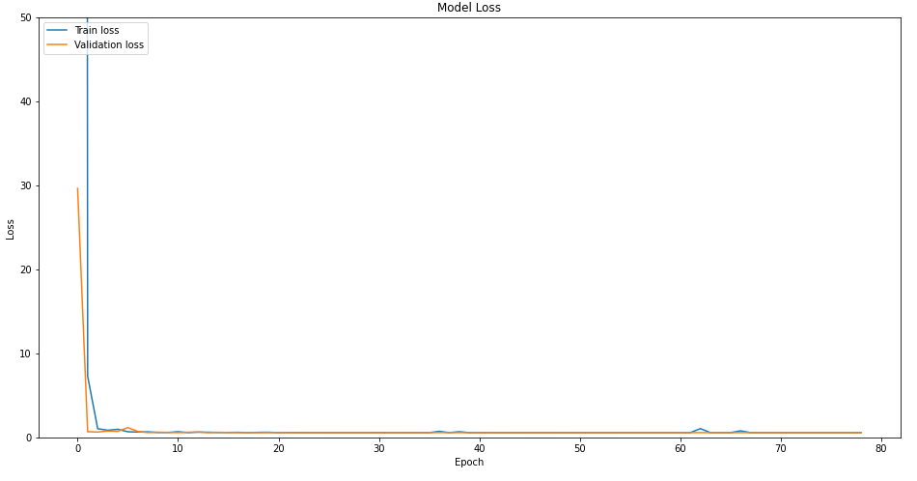
Model Evaluation: Loss
Train and validation loss are roughly the same.
Drops significantly near the start but flattens out relatively quickly.

Slide 6
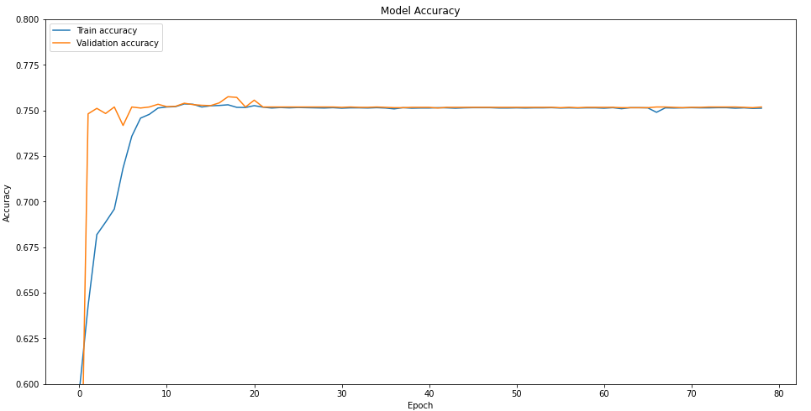
Model Evaluation: Accuracy
Model accuracy are almost the same after 25 epochs
Shows not much underfitting and overfitting
Final accuracy of 74.75% with a loss rate of 0.56

