Slide 1
Conventional statistics
Conditional probability (Bayes rule)
null
model
model
data
data
obs
process
Data is fixed
Centred on P[data | null model]
Data & observation process are uncertain
Centred on P[model, obs process | data]

Slide 2
Conventional statistics
Conditional probability (Bayes rule)
null
model
data
obs
process
model
data
Data is fixed
Centred on P[data | null model]
Data & observation process are uncertain
Centred on P[model, obs process | data]

Slide 3
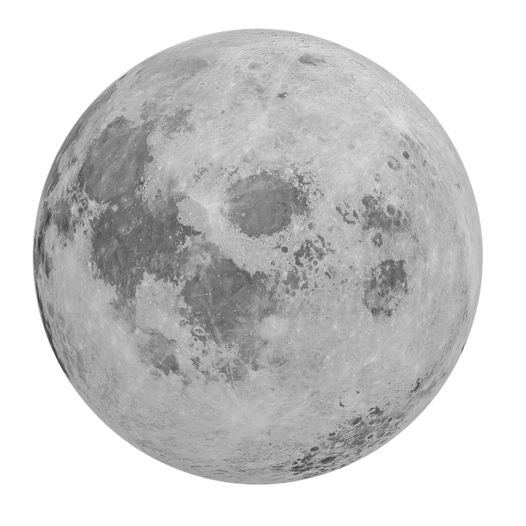
Data-centric view
Model-centric view
null
model
data
obs
process
model
data
Centred on P[data | null model]
Data is fixed
Centred on P[model | data] (Bayes’ rule)
Data & observation process are uncertain

Slide 4
