Slide 1
为了更好的工艺控制做了如下工作：
碘溶液转移增加质量流量计和视镜；
合成仪体系温度下限的增补验证；
合成仪软件优化包括报表，画面等；
基于客户需求进行的主要改善：
排废和体系转移人员判定，音叉与PLC软件改造和验证；
蠕动泵管与DIC/DIPEA长时间接触材质兼容性问题，更换为计量泵的方式；
工艺管线，脱保护配液罐及辅助设备钝化和检查，清洗和检测；

Slide 2
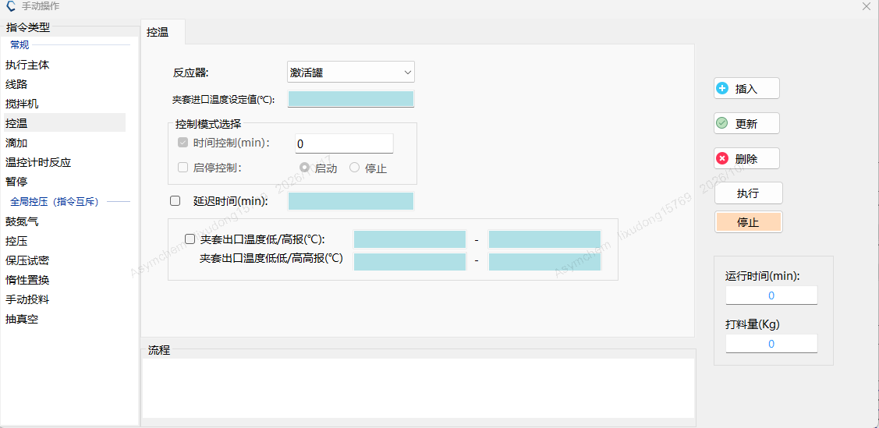
SPPS option review
2. Add high-high and low-low jacket-temperature alarms for synthesizer SY16 to the PLC.
Option assessment
Option 1 has audible and visual HH/LL alarms, plus H/L warnings. Floor response is immediate, so an excursion outside the process range is seen at once.
High/low alarms only, set as warnings. Personnel respond on the floor. An excursion is confirmed by checking the OR against the electronic data.
The MOR already records the minimum and maximum temperature for each operation, so a missed excursion is unlikely.
软件升级需要3d时间，我们评估目前软件和MOR设定温度极值的方式可满足生产需求。
Software update
Qualification options and charging schedule
Option | 20 | 21 | 22 | 23 | 24 | 25 | 26
Option 1 | Software upgrade | Verification |  | Iodine trial |  | CMa | Charge

Slide 3
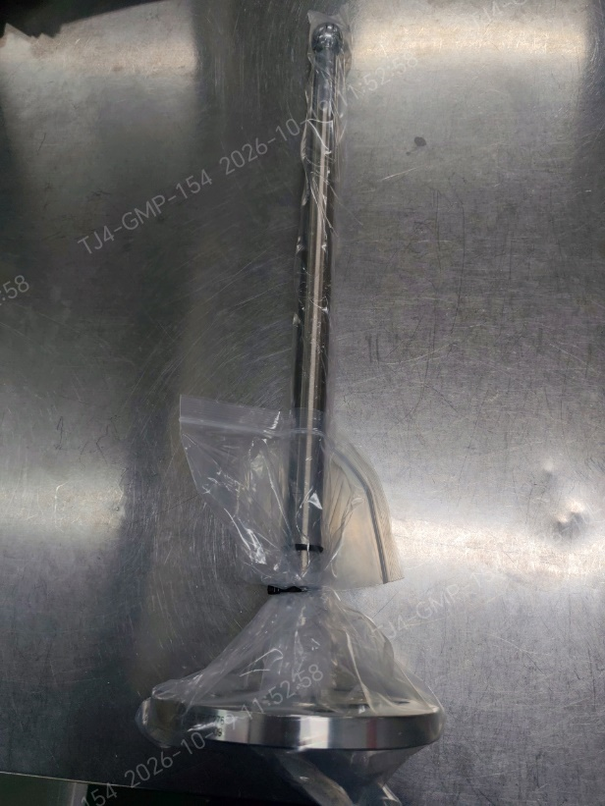
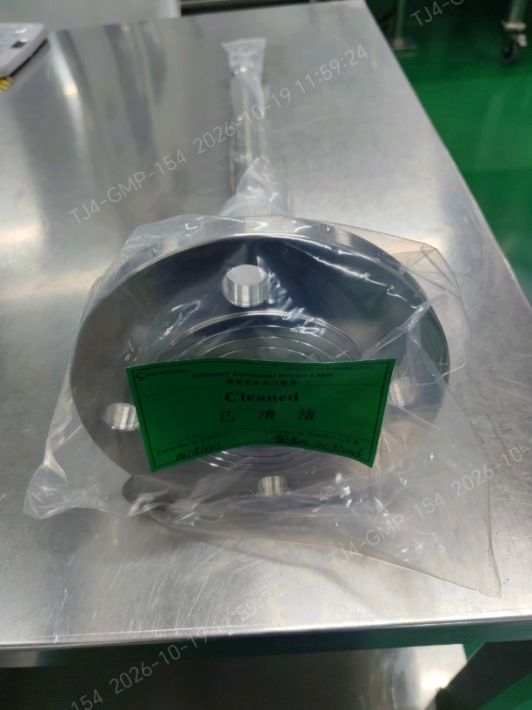
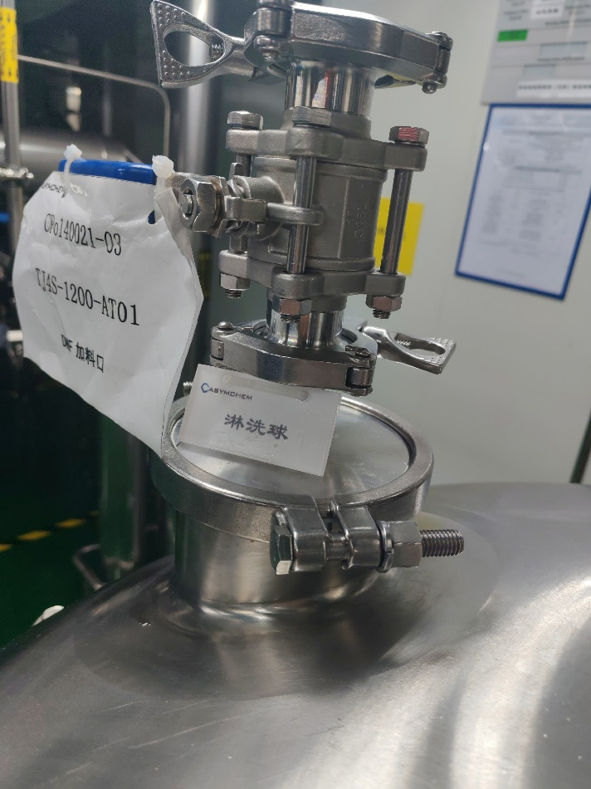
Spray-ball installation
1. Spray-ball installation, coverage test, riboflavin cleaning, and particulate check for AT09/AT01.
ASYM:
1. A stainless steel spray ball was used for the spray coverage test on mixing vessel AT09. Iodine is not compatible with prolonged stainless-steel contact, so this spray ball will be used only as a temporary accessory and will not remain in the vessel.
2. A PTFE spray ball has been purchased for mixing vessel AT09, following Lilly's recommendation and material-compatibility assessment. Given the project timeline, we recommend a trial run and completion of the supplemental spray-coverage verification and cleaning confirmation before this vessel is used for the project.
Proposed completion date: 10/20/2026
3. Mixing vessel AT01 is equipped with a spray ball and has completed spray coverage testing. The missing on-site identification tag has been corrected.
淋洗球是否必须要固定，淋洗球固定的方式需要增加2d的验证和清洗的时间，我们推荐目前的淋洗方式。
Qualification options and charging schedule
Option | 20 | 21 | 22 | 23 | 24 | 25 | 26
Option 1 | Coverage test | Iodine trial |  | CMa | Charge
Option 2 | Iodine trial |  | CMa | Charge
TJ4S-1213-AT09Dedicated spray ball
TJ4S-1200-AT01

Slide 4
3. Qualification of iodine-solution nitrogen transfer time before the solvent run.
ASYM: Nitrogen transfer of the iodine solution to the synthesizer will be performed during the solvent run.
Proposed completion date: 10/22/2026

Slide 5
4. Post-oxidation DMF cooling-time qualification in the activation tank, during the solvent run.
ASYM: The post-oxidation DMF cooling-time test in the activation tank will be performed during the solvent run.
Proposed completion date: 10/22/2026

Slide 6
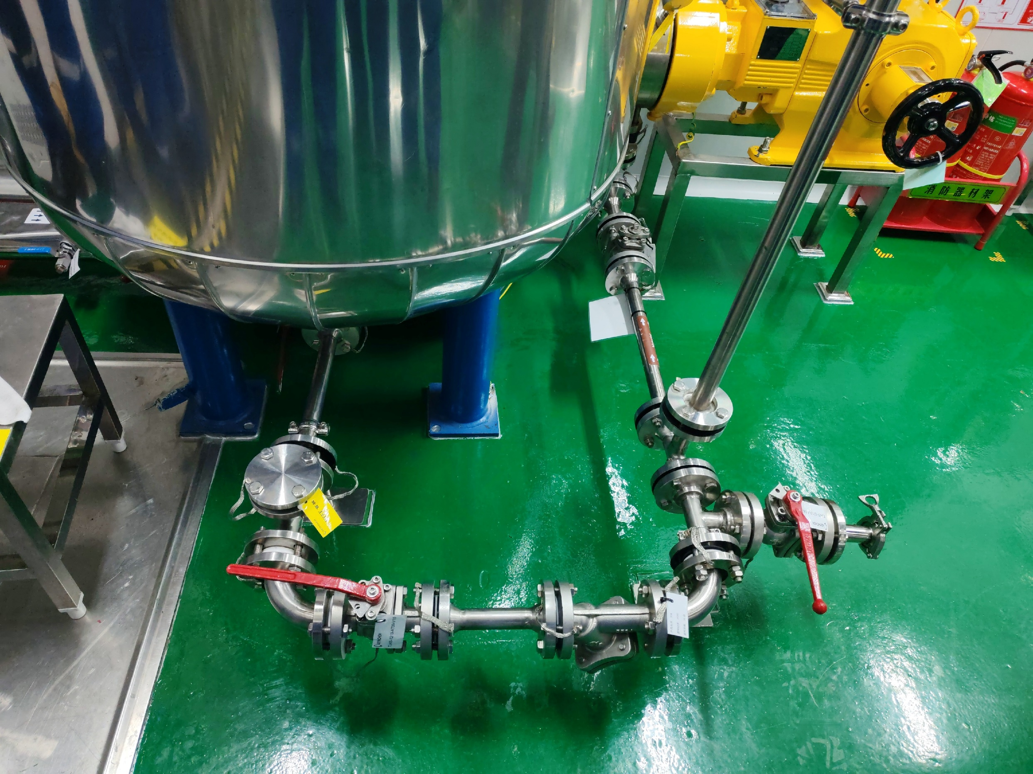
Piping correction
5. Dead-leg removal from unused branches of the iodine-solution transfer line.
ASYM: Completed. The redundant valve was removed, and a tagged PTFE blind flange was installed.

Slide 7
6. Pre-production rinse/swab acceptance for the equipment train, or an equivalent criterion in the CCS.
ASYM:
1. Post-passivation cleaning of the equipment train is complete, and TOC testing is complete.
2. The solvent trial used elemental iodine. After cleaning, iodine residue will be checked with test strips.

Slide 8
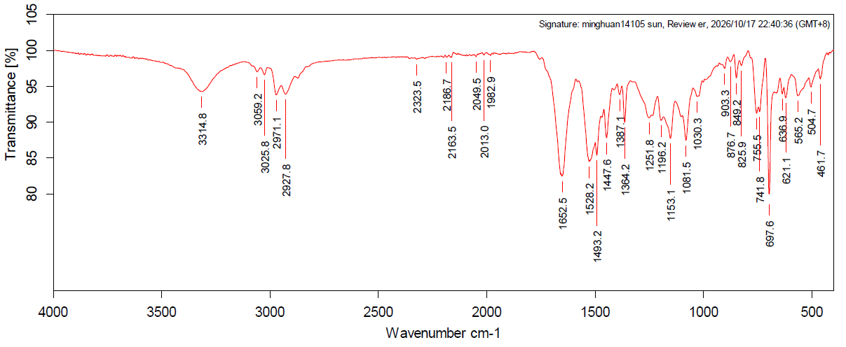
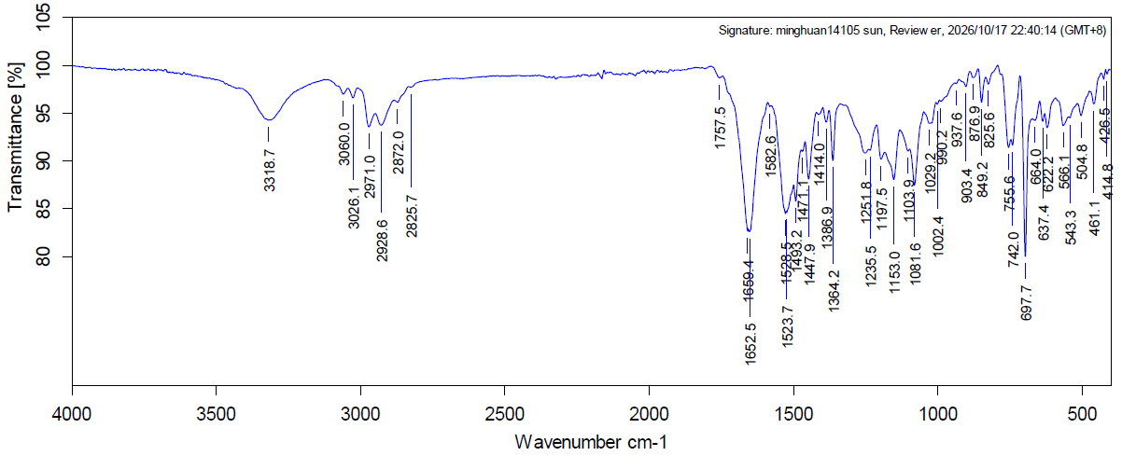
7. Investigation of the contaminated sampling tool in the L3 synthesizer SY16 glovebox and the yellow solid in the L2 synthesizer SY15 glovebox. Contaminant identification is strongly recommended. At a minimum, show that contamination is limited to the glovebox and rule out contamination inside the synthesizer.
ASYM:
1. SY15 last ran 140020 Step 1 solid-phase synthesis. The yellow solid in the glovebox matches the 140020 peptide resin by IR. No residue was found inside the synthesizer.
Reference
Yellow solid, SY15 glovebox

Slide 9
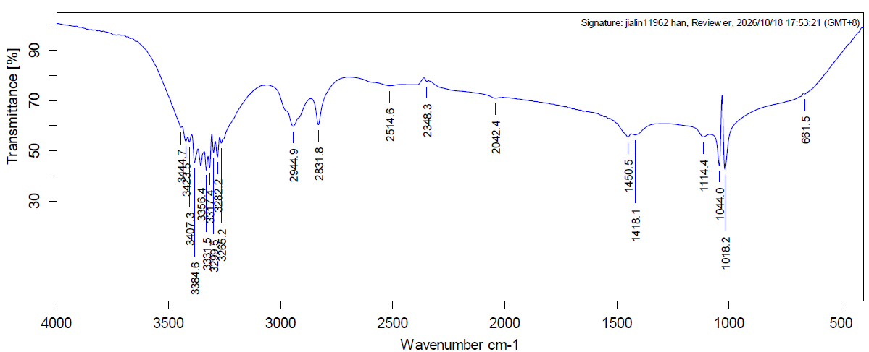
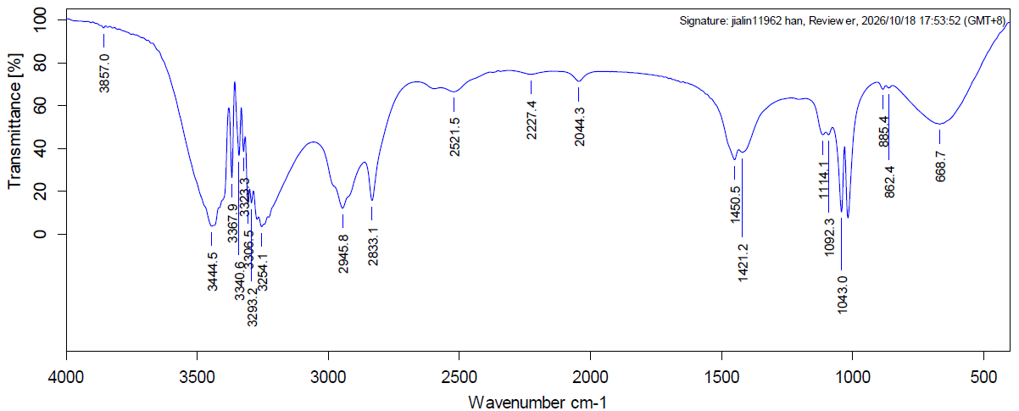
7. Investigation of the contaminated sampling tool in the L3 synthesizer SY16 glovebox and the yellow solid in the L2 synthesizer SY15 glovebox. Contaminant identification is strongly recommended. At a minimum, show that contamination is limited to the glovebox and rule out contamination inside the synthesizer.
ASYM:
2. IR of the contaminant on the SY16 LDPE sampler bag matches ethylene glycol. DMF was the other low-volatility reference. No residue was found inside the synthesizer.
LDPE contaminant, SY16 glovebox
Ethylene glycol

