Slide 1


Project 9788 Weld Inspection Summary
www.asymchem.com Stock Code: 002821.SZ / 6821.HK
Conﬁdential | 保密文件

Slide 2
Overall Execution Plan
Step | Equipment No. | Material / Size | Line | Current Status | Planned Completion
Step 1 | TJ4S-1213-AT08 | Glass-lined agitated tank, 500 L | Toluene line | In progress | Oct 10
 | TJ4S-1213-R23 | Glass-lined reactor, 2000 L | DMF line | In progress | Oct 10
 | TJ4S-1213-Sy12 | Hastelloy solid-phase peptide synthesizer, 2000 L | Deprotection solution line | In progress | Oct 10
 |  |  | Toluene line | In progress | Oct 10
 |  |  | 1213-AT08 line | PTFE-lined, not applicable | N/A
 |  |  | MTBE line | In progress | Oct 10
 |  |  | DMF line | In progress | Oct 10
 |  |  | IPAC line | In progress | Oct 10
 |  |  | 1213-R23 reactor line | In progress | Oct 10
 |  |  | Activation tank to synthesizer transfer line | Completed | N/A
 |  |  | Non-dedicated solvent pump line | Completed | Completed
 |  |  | Head | In progress | Oct 7
 | TJ4S-1213-Sy12-R01 | 316L activation tank, 1000 L | MTBE line | In progress | Oct 10
 |  |  | DMF line | In progress | Oct 10
 |  |  | IPAC line | In progress | Oct 10
 |  |  | Recirculation cleaning line | Completed | N/A
 |  |  | Head | In progress | Oct 8
Step 2 | TJ4S-1213-R10 | Glass-lined reactor, 2000 L | N/A | Glass-lined / PTFE-lined piping | N/A
 | TJ4S-1213-R09 | Glass-lined reactor, 2000 L | TJ4S-1213-R10 transfer line | PTFE-lined, not applicable | N/A
 | TJ4S-1200-F04 | Hastelloy pressure filter, DN900 | TJ4S-1213-R09 transfer line | PTFE-lined, not applicable | N/A
 |  |  | Head | In progress | Oct 8
 | TJ4S-1213-AT06 | Stainless steel agitated tank, 3000 L | MTBE line | In progress | Oct 10
 |  |  | Self-recirculation line | In progress | Oct 12
 |  |  | Head | In progress | Oct 9
 | TJ4S-1213-R15 | Hastelloy reactor, 8000 L | TJ4S-1213-AT06 transfer line | In progress | Oct 10
 |  |  | TJ4S-1200-F04 transfer line | PTFE-lined, not applicable | N/A
 |  |  | Head | In progress | Oct 9
 | TJ4S-1212-FD06 | Hastelloy agitated filter dryer (AFD), DN1600 | TJ4S-1213-R15 transfer line | N/A | N/A
 |  |  | Head | In progress | Oct 9

Slide 3
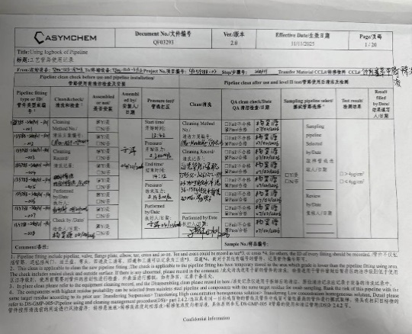
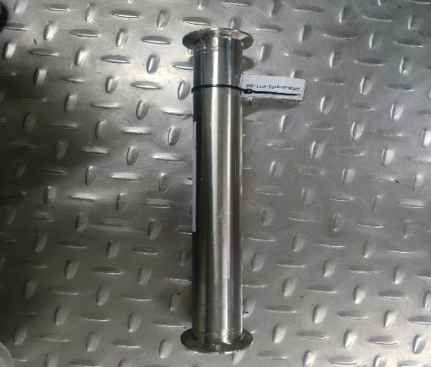
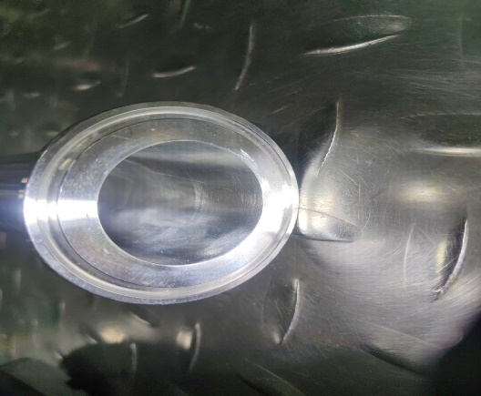
Weld Inspection Photo Summary
Weld Inspection Photos of Equipment and Facilities: Details and Rationale
No. | Piping / Fitting Category | Weld Type | Inspection Approach | Assessment | External Surface Photo | Borescope Photo | Acceptance Record
1 | Standard piping (spools assembled per process requirements) | Manual weld | Not inspected | Standard piping is cleaned, accepted and released by QA before installation. Because it is inspected and released before every installation, it is not included in this inspection. | N/A | N/A
2 | Fixed inter-equipment transfer piping (installed together with the equipment) | Manual weld | All dismantled for weld inspection | N/A |  |  | N/A

Slide 4
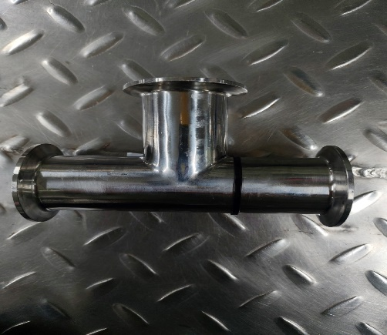
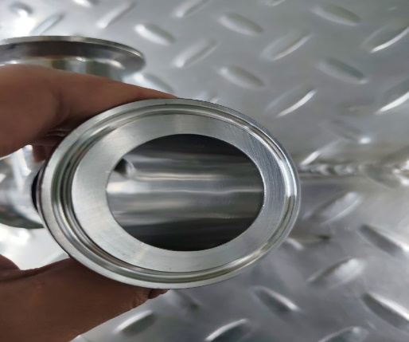
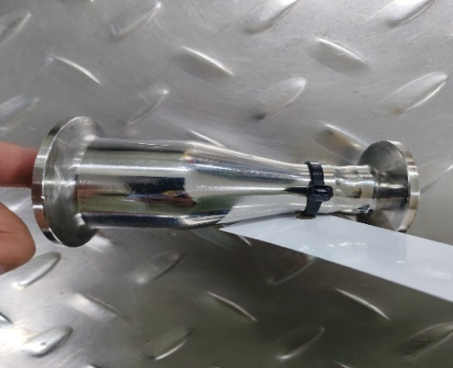
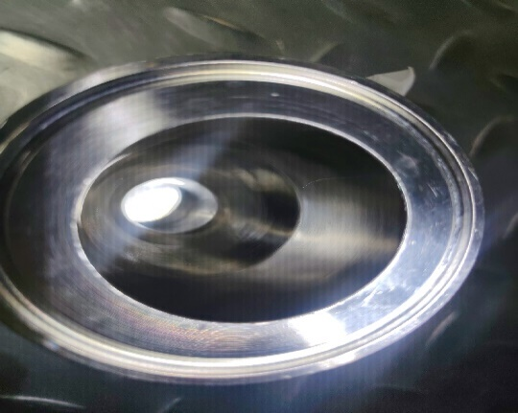
Weld Inspection Photo Summary
No. | Piping / Fitting Category | Weld Type | Inspection Approach | Assessment | External Surface Photo | Borescope Photo | Acceptance Record
3 | Standard fittings (incl. in-house fabricated) | Automatic weld | 20% sampling inspection | Standard fittings are automatically welded and polished. |  |  | N/A
4 |  | Manual weld | 20% sampling inspection | In-house fabricated fittings are polished; the overall weld finishing standard is high, so the likelihood of nonconformance is low. |  |  | N/A

Slide 5
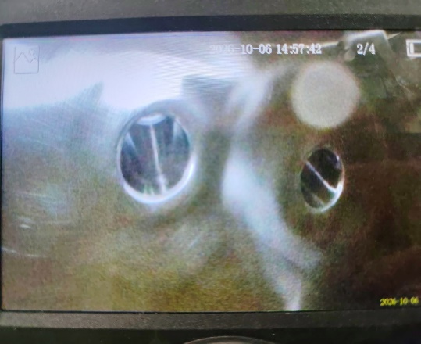
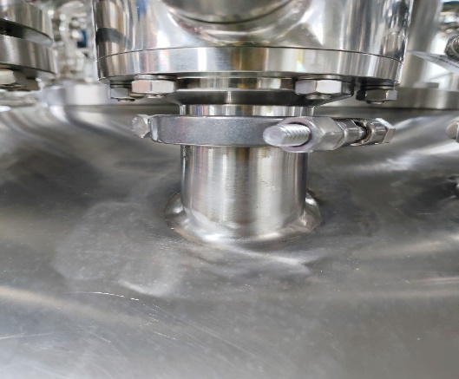
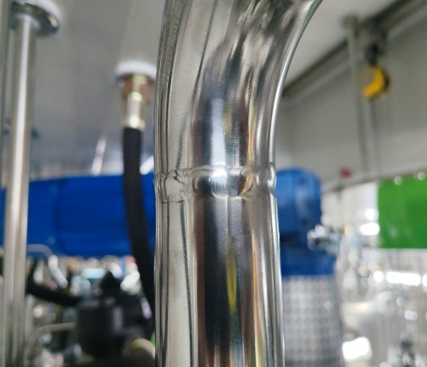
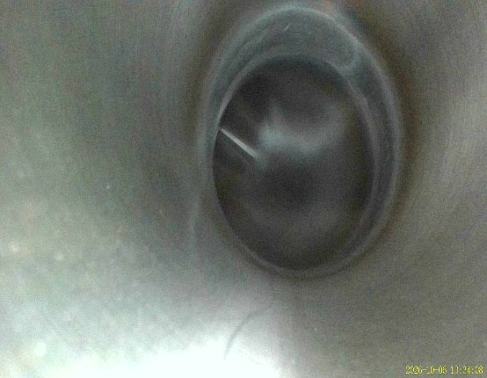
Weld Inspection Photo Summary
No. | Piping / Fitting Category | Weld Type | Inspection Approach | Assessment | External Surface Photo | Borescope Photo | Acceptance Record
5 | Equipment nozzles (Head) | Manual weld | Inspected from the head up to the first valve | N/A |  |  | N/A
6 | Solvent piping | Manual weld | Borescope inspection from the head toward the main line, up to the maximum reach of the borescope | N/A |  |  | N/A
7 | Category 3 and 4 piping | Automatic and manual welds | No additional inspection | Welds were inspected before the piping was installed (automatic welds 20%, manual welds 100%); the corresponding photos are archived. | N/A | N/A | N/A

Slide 6

THANK YOU!
Asymchem Labs.
www.asymchem.com Stock Code: 002821.SZ / 6821.HK
Conﬁdential | 保密文件

