Slide 1


139788 BLA Retrofit Plan
www.asymchem.com Stock Code: 002821.SZ / 6821.HK
Conﬁdential | 保密文件

Slide 2
Three Retrofit Options: Completion Dates, Pros and Cons
Option | Scope of Retrofit | Completion Date | Pros and Cons after Retrofit
Option 1 (Piping retrofit with 2D drainability; shortest option) | Hastelloy reactor R05: replace with a new BPE-standard unit. Solution-preparation tanks: replace 7 tanks with 316L tanks. Preparative operation: replace 8 receiving drums with 8 small side-sampling receivers; retrofit the nozzles of 5 tanks in this area to BPE. UF area: replace the 1000 L feed tank with a BPE-compliant 1500 L agitated tank; piping not designed to establish a CIP system. Precipitation area: replace the 80 L and 600 L agitated tanks with BPE-compliant 100 L and 600 L agitated tanks; retrofit the nozzles of the DN1200 AFD (agitated filter dryer); other main equipment unchanged. All associated piping, instruments, valves, metering pumps, diaphragm pumps, etc. to be changed to centrifugal pumps, quaternary diaphragm pumps, instruments, valves, pH meters and flowmeters that meet BPE; tank connections and the water system do not meet 2D/3D drainability; for mobile-phase lines, 2D is not mandatory and 3D is considered; 316L material considered. | 12/17/2026 | Pros: only preparative solution-prep, preparative fraction and precipitation-area equipment replaced (old for new) and some tank nozzles retrofitted to BPE; piping components changed to centrifugal pumps, quaternary diaphragm pumps, instruments, valves, pH meters and flowmeters that meet BPE with 2D/3D drainability; short retrofit time and fewer equipment validation items. Cons: materials of some AFD, reactor and tank equipment are not replaced to meet BPE; most connecting piping is not retrofitted for CIP; the resulting audit risk needs to be assessed.
Option 2 (Piping retrofit with CIP cleaning valves reserved) | Hastelloy reactor R05: replace with a new BPE-standard unit. Solution-preparation tanks: replace 7 tanks with 316L tanks. Preparative operation: replace 8 receiving drums with 8 small side-sampling receivers; retrofit the nozzles of 5 tanks in this area to BPE. UF area: replace the 1000 L feed tank with a BPE-compliant 1500 L agitated tank; piping arranged to establish a CIP system. Precipitation area: replace the 80 L and 600 L agitated tanks with BPE-compliant 100 L and 600 L agitated tanks; retrofit the nozzles of the DN1200 AFD; other main equipment unchanged. All associated piping, instruments, valves, metering pumps, diaphragm pumps, etc. to be changed to centrifugal pumps, quaternary diaphragm pumps, instruments, valves, pH meters, flowmeters that meet BPE with 2D/3D drainability; designed for CIP, with valve connections reserved for CIP cleaning lines; 316L material considered. | 01/20/2027 | Pros: preparative solution-prep, preparative fraction and precipitation-area equipment replaced (old for new) and some tank nozzles retrofitted to BPE; piping components changed to centrifugal pumps, quaternary diaphragm pumps, instruments, valves, pH meters and flowmeters that meet BPE with 2D/3D drainability; valve connections reserved for CIP cleaning lines make it easy to add a CIP system later; short retrofit time and fewer equipment validation items. Cons: materials of some AFD, reactor and tank equipment are not replaced to meet BPE; most connecting piping is not retrofitted for CIP; the resulting audit risk needs to be assessed. In addition, the reserved CIP valves have a long procurement lead time.
Option 3 (Piping retrofit with a new CIP system) | Hastelloy reactor R05: replace with a new BPE-standard unit. Solution-preparation tanks: replace 7 tanks with 316L tanks; retrofit the piping to establish a CIP system. Preparative operation: replace 8 receiving drums with 8 small side-sampling receivers; retrofit the nozzles of 5 tanks in this area to BPE; piping arranged to establish a CIP system. UF area: replace the 1000 L feed tank with a BPE-compliant 1500 L agitated tank; retrofit the piping to establish a CIP system. Precipitation area: replace the 80 L and 600 L agitated tanks with BPE-compliant 100 L and 600 L agitated tanks; retrofit the nozzles of the DN1200 AFD; other main equipment unchanged; retrofit the piping to establish a CIP system. All associated piping, instruments, valves, metering pumps, diaphragm pumps, etc. to be changed to centrifugal pumps, quaternary diaphragm pumps, instruments, valves, pH meters and flowmeters that meet BPE with 2D/3D drainability; CIP piping and valve cleaning system established; 316L material considered. | 04/25/2027 | Pros: preparative solution-prep, preparative fraction and precipitation-area equipment replaced (old for new) and some tank nozzles retrofitted to BPE; piping components changed to centrifugal pumps, quaternary diaphragm pumps, instruments, valves, pH meters and flowmeters that meet BPE with 2D/3D drainability; CIP piping and valve cleaning system established, ensuring compliance to the greatest extent. Cons: materials of some AFD, reactor and tank equipment are not replaced to meet BPE; long supply lead time for the CIP piping retrofit, many construction items and more subsequent validation, i.e. a long procurement, construction and validation cycle.

Slide 3
Equipment and Tank Retrofit / Replacement Plan
Process | No. | Equipment Tag | Size | Material | Status | Vendor | Equipment Use | Arrival Date | Drawings Sent to CIP Designer for Clarification | Remarks
Prep system tanks Hanbon | 1 | TJ4S-1213-R05 | 3000L | Hastelloy | Replace | Chengxin | Dissolution / solution prep | 11/07/2026 arrival | Yes | Two options: Option 1: on-site retrofit – not enough time; Tentatively Option 2: follow the pilot-plant area – replace with a new Chengxin reactor – supplier's new drawing (AT04)
 | 2 | TJ4S-1211-HPPC03-AT01 | 600L | 316L | Replace | Tofflon | Concentrated salt tank | 10/20/2026 arrival | Yes | Replace tank – supplier info required
 | 3 | TJ4S-1211-HPPC03-AT02 | 600L | 316L | Replace | Yingde | Salt solution prep tank | 10/18/2026 arrival | Yes | Replace tank – supplier info required
 | 4 | TJ4S-1211-HPPC03-T01 | 1000L | 316L | Replace | Yingde | PW storage tank | 10/18/2026 arrival | Yes | Replace tank – supplier info required
 | 5 | TJ4S-1211-HPPC03-T02 | 1500L | 316L | Replace | Yingde | Acetonitrile tank | 10/18/2026 arrival | Yes | Replace tank – supplier info required
 | 6 | TJ4S-1211-HPPC03-T03 | 1000L | 316L | Replace | Yingde | Mobile phase A tank | 10/18/2026 arrival | Yes | Replace tank – supplier info required
 | 7 | TJ4S-1211-HPPC03-T04 | 1000L | 316L | Replace | Yingde | Mobile phase B tank | 10/18/2026 arrival | Yes | Replace tank – supplier info required
 | 8 | TJ4S-1211-HPPC03-WT01 | 2000L | 304 | N/A | Chengxin | Waste liquid tank | N/A | N/A | N/A
 | 9 | TJ4S-1211-HPPC03-WT02 | 500L | 304 | N/A | Chengxin | Waste liquid tank | N/A | N/A | N/A
 | 10 | TJ4S-1211-HPPC03-T05 | 1500L | 316L | Replace | Yingde | IPA tank | 10/18/2026 arrival | Yes | Confirm whether IPA can use tank T06 (option cancelled) – Liu Linchong – confirmed: tank to be replaced with the Yingde 1500 L spare tank – 2026.09.27
Grade D area Hanbon | 11 | TJ4S-1211-HPPC03-AT03 | 8000L | 316L | Retrofit nozzles | Chengxin | Fraction tank | 11/05/2026 retrofitted | Yes | Retrofit nozzles – supplier info required
 | 12 | TJ4S-1211-HPPC03-AT04 | 3000L | 316L | Retrofit nozzles | Chengxin | Load tank | 11/05/2026 retrofitted | Yes | Retrofit nozzles – supplier info required
 | 13 | TJ4S-1211-HPPC03-AT05 | 3000L | 316L | Retrofit nozzles | Chengxin | Fraction tank (buffer) | 11/05/2026 retrofitted | Yes | Retrofit nozzles – supplier info required
 | 14 | TJ4S-1211-HPPC03-AT06 | 1000L | 316L | Retrofit nozzles | Chengxin | Fraction receiver (in-spec) | 11/05/2026 retrofitted | Yes | Retrofit nozzles – supplier info required
 | 15 | TJ4S-1211-HPPC03-T06 | 1000L | 316L | Retrofit nozzles | Chengxin | Chase tank | 11/05/2026 retrofitted | Yes | Retrofit nozzles – supplier info required
 | 16 | TJ4S-1211-MTK03 | 600L | 316L | N/A | Hanbon | Slurry tank | N/A | N/A | N/A
UF system Tofflon | 17 | TJ4S-1211-TFF02-T01 | 1500L | 316L | Replace | Yingde | UF receiving tank | 10/18/2026 arrival | Yes | Replace tank – supplier info required
Salt conversion & crystallization reactors, AFD Yaguang | 18 | TJ4S-1211-AT02 | 100L | 316L | Replace | Yingde | NaOH+MeOH storage solution | 10/18/2026 arrival | Yes | Replace tank – supplier info required
 | 19 | TJ4S-1211-AT01 | 600L | 316L | Replace | Yingde | Salt conversion reactor | 10/18/2026 arrival | Yes | Replace tank – supplier info required
 | 20 | TJ4S-1211-R01 | 2000L | Hastelloy | No retrofit | Chengxin | Crystallization reactor | N/A | Yes | No nozzle retrofit – supplier info required
 | 21 | TJ4S-1211-FD01 | DN1200 | Hastelloy | Retrofit nozzles | Yaguang | AFD drying | 11/10/2026 retrofitted | Yes | Retrofit nozzles – supplier info required

Slide 4
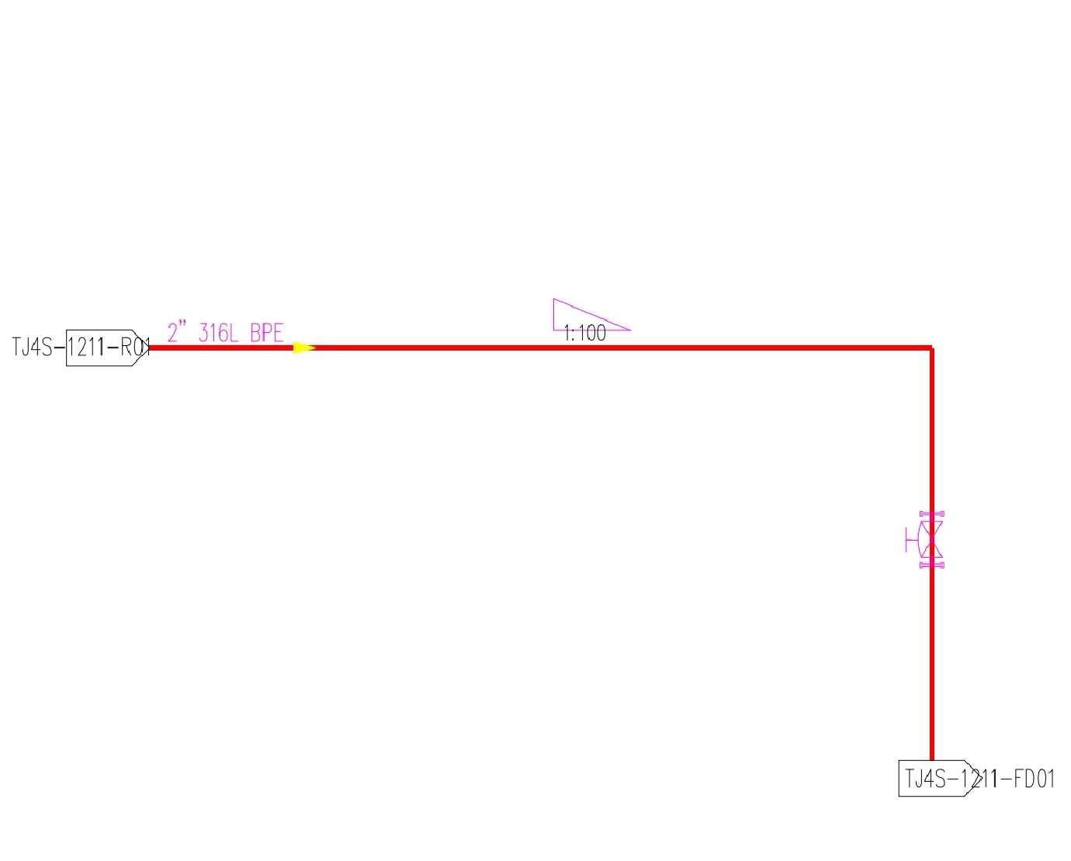
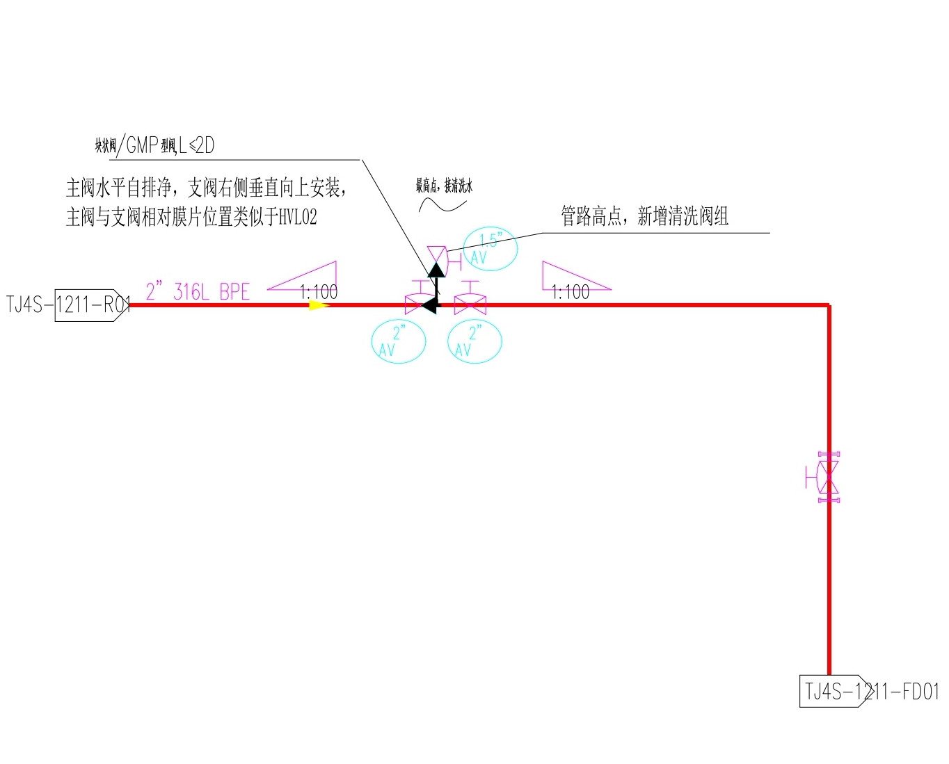
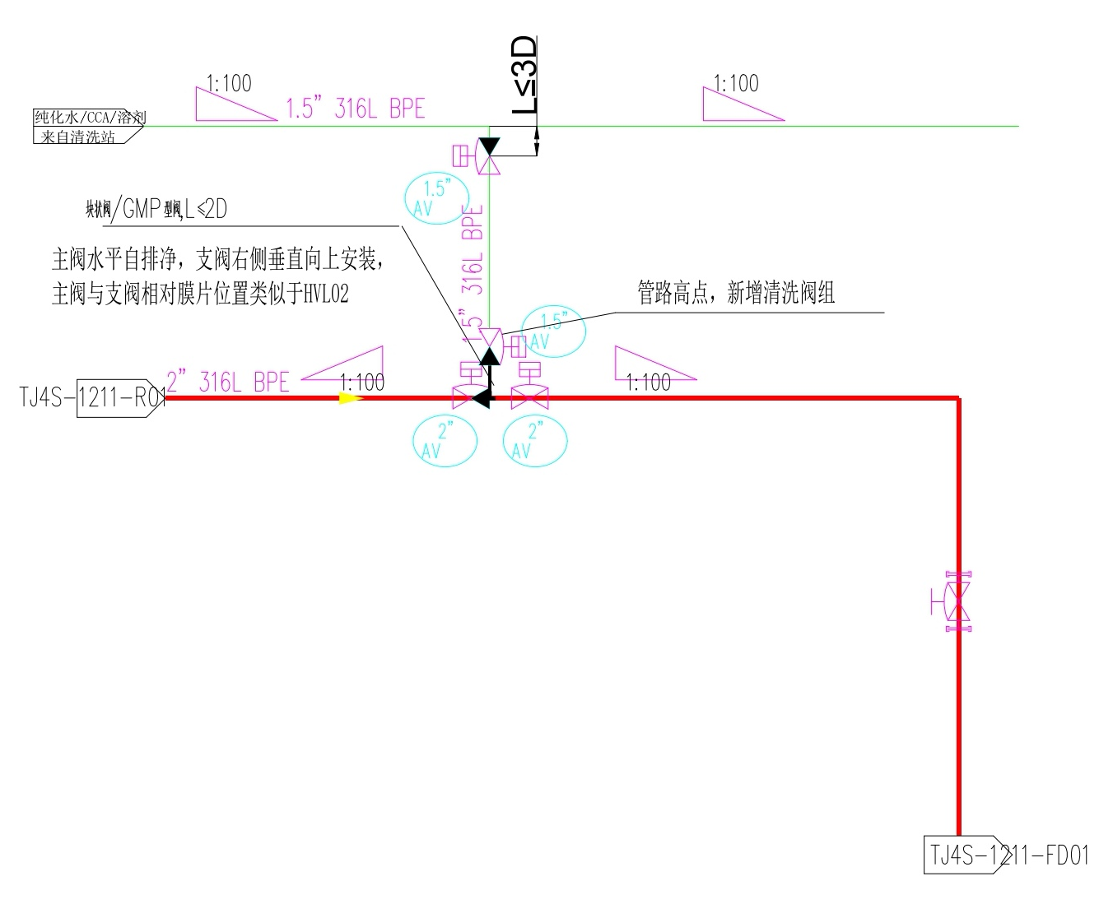
Piping Retrofit Options (Schematic)
Option 1
Option 2
Option 3
PW / CCA / solvent
from wash station
Block valve / GMP-type valve, L ≤ 2D
Block valve / GMP-type valve, L ≤ 2D
Main valve horizontal, self-draining;
branch valve mounted vertically upward
on the right; main/branch valve diaphragm
orientation similar to HVL02
Highest point:
connect cleaning water
Piping high point:
new cleaning valve set added
Main valve horizontal, self-draining;
branch valve mounted vertically upward
on the right; main/branch valve diaphragm
orientation similar to HVL02
Piping high point:
new cleaning valve set added

Slide 5

THANK YOU!
www.asymchem.com Stock Code: 002821.SZ / 6821.HK
Conﬁdential | 保密文件
Asymchem Labs.

