Slide 1
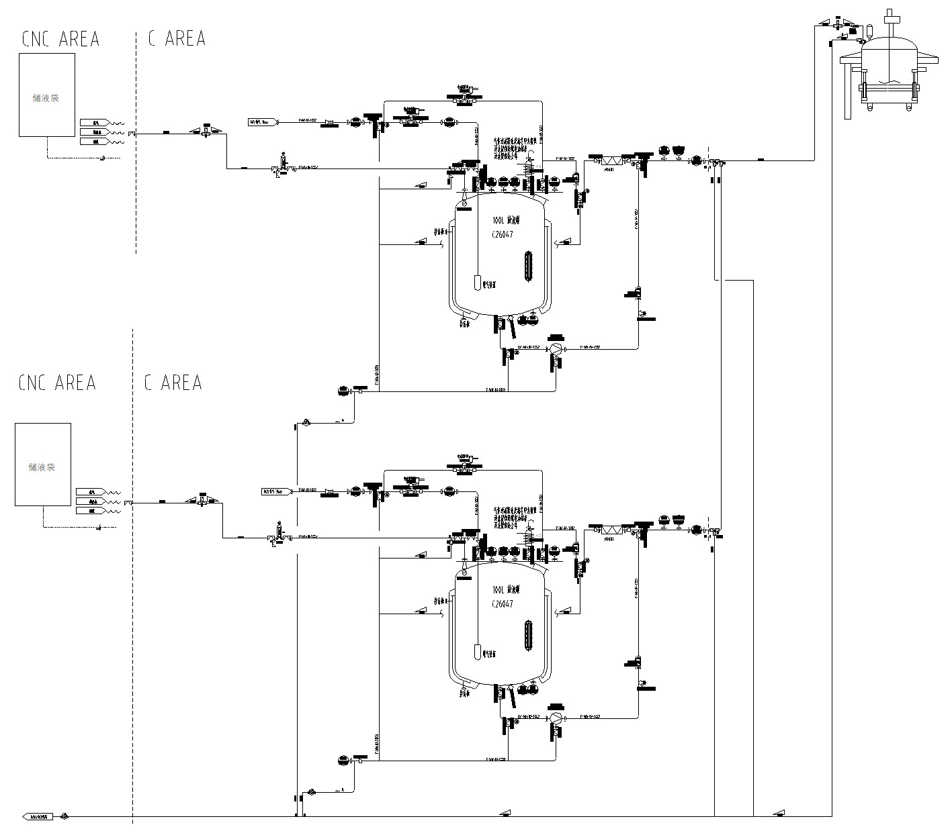
Humidified Nitrogen – Operating Strategy
湿氮气-使用策略
Overall strategy for the humidified nitrogen system: 湿氮气装置整体策略：
I. First Use 一、首次使用时：
1. Alkaline cleaning: Recirculate alkaline solution and then purified water through the unit; finally, purge the unit with nitrogen and drain at the low points.
1. 碱液清洗：依次使用碱液、纯化水进行循环冲洗，最后使用氮气对设备进行吹扫低点排净。
2. WFI rinse: Using a sterile bag and an aseptic connector, recirculate and spray-rinse the unit with WFI, then drain at the low points.
2. 注射水淋洗：使用无菌软袋，通过无菌链接器，使用注射水对装置进行循环喷淋淋洗后，低点排净。
3. WFI charge: Charge WFI again through a sterile bag for use.
3. 注射水进料：再次通过无菌袋加入注射水进行使用。
II. Periodic WFI Replacement 二、注射水周期性更换
1. Drain at the low points.
1. 低点排净。
2. Add fresh WFI, recirculate to rinse, then drain at the low points.
2. 补充新注射水循环淋洗，低点排净。
3. Recharge WFI for use.
3. 再次补入注射水进行使用。
III. Alternate Use of Two Humidifiers 三、两套氮气加湿装置互补
Within the WFI replacement interval, the two units are periodically cleaned by recirculation per Section II and used alternately.
在注射水周期范围内按照方式二，周期性循环清洗交替使用。

Slide 2
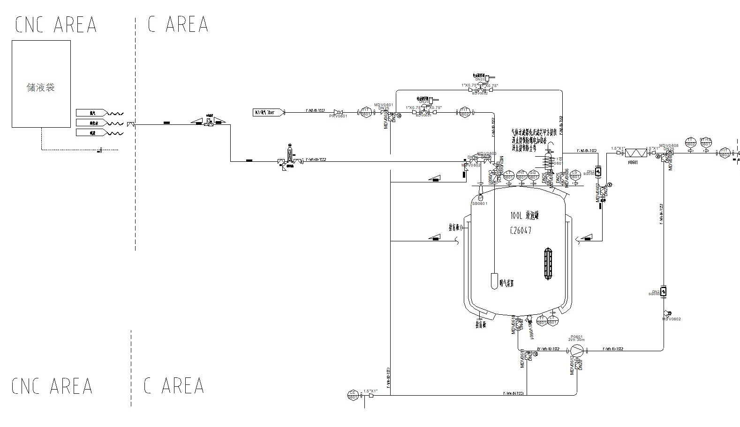
Low-Point Drain and High-Point Purge Locations 设备低点排净和高位吹扫点位
1. Material line into the clean area: fitted with a cleaning/purge port, allowing cleaning and purging in both directions.
1. 进洁净区物料管路：设置有清洗吹扫口，能够往两个方向进行清洗吹扫。
2. Filter strategy: filters are cleaned off-line.
2. 过滤器策略：过滤器采用离线清洗的方式。
3. WFI pre-flush drain line.
3. 注射水预冲洗排净管路。
4. Equipment low-point drain line.
4. 设备低点排净管路。

Slide 3
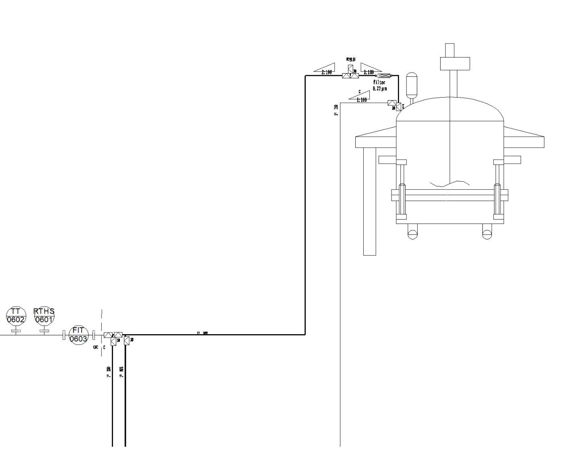
Low-Point Drain and High-Point Purge Locations 设备低点排净和高位吹扫点位
1. Humidified N₂ line to the AFD: fitted with a cleaning/purge port, allowing cleaning and purging in both directions.
1. 进三合一的湿氮气管路：设置有清洗吹扫口，能够往两个方向进行清洗吹扫。
2. Low-point drain of the humidified N₂ line to the AFD.
2. 进三合一的湿氮气管路低点排净。
For Lilly's confirmation: 需客户确认：
Should the valves at the drain and purge points be installed to a 2D or a 3D dead-leg requirement?
排净和吹扫点位阀门安装要求2D还是3D？
1. 2D — longer valve procurement lead time;
1. 2D——阀门采购周期较长；
2. 3D — shorter valve procurement lead time; domestic equipment suppliers have confirmed that a 3D design can be cleaned effectively.
2. 3D——阀门采购周期短，国内设备厂家反馈3D能够清洗干净。

