Slide 1
为了更好的工艺控制做了如下工作：
碘溶液转移增加质量流量计和视镜，；
合成仪体系温度下限的增补验证；
合成仪软件优化包括报表，画面等；
基于客户需求进行的主要优化：
排废和体系转移人员判定，音叉与PLC软件改造和验证；
蠕动泵管与DIC/DIPEA长时间接触材质兼容性问题，更换为计量泵的方式；
工艺管线，脱保护配液罐及辅助不锈钢设备钝化和检查，清洗和检测；

Slide 2
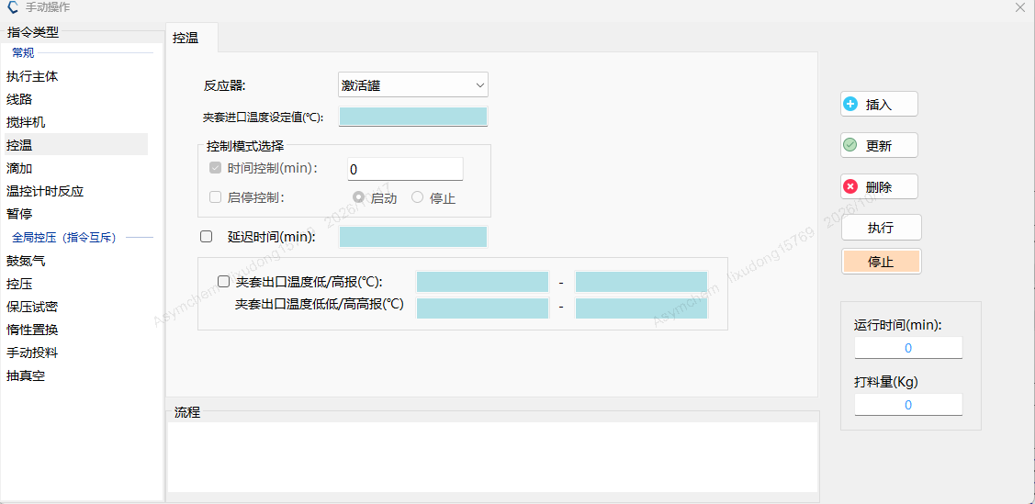
SPPS option review
2. Add high-high and low-low jacket-temperature alarms for synthesizer SY16 to the PLC.
Option assessment
Option 1 has audible and visual HH/LL alarms, plus H/L warnings. Floor response is immediate, so an excursion outside the process range is seen at once.
High/low alarms only, set as warnings. Personnel respond on the floor. An excursion is confirmed by checking the OR against the electronic data.
The MOR already records the minimum and maximum temperature for each operation, so a missed excursion is unlikely.
软件升级需要3d时间，我们评估目前软件和MOR设定温度极值的方式可满足生产需求。
Software update
Qualification options and charging schedule
Option | 20 | 21 | 22 | 23 | 24 | 25 | 26
Option 1 | Software upgrade | Verification |  | Iodine trial |  | CMa | Charge

Slide 3
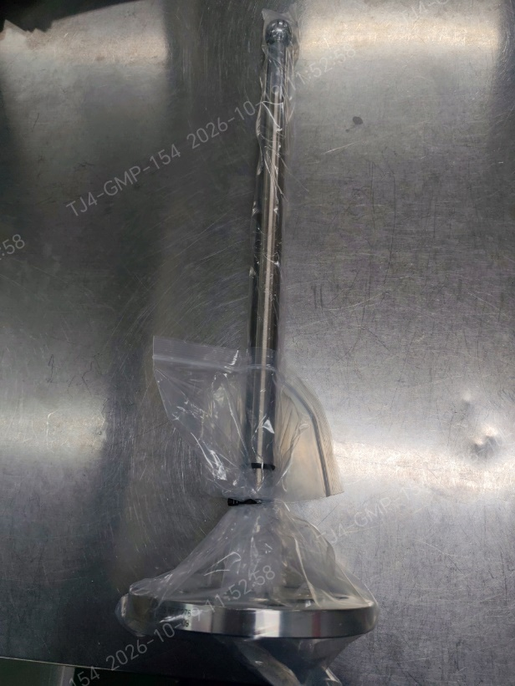
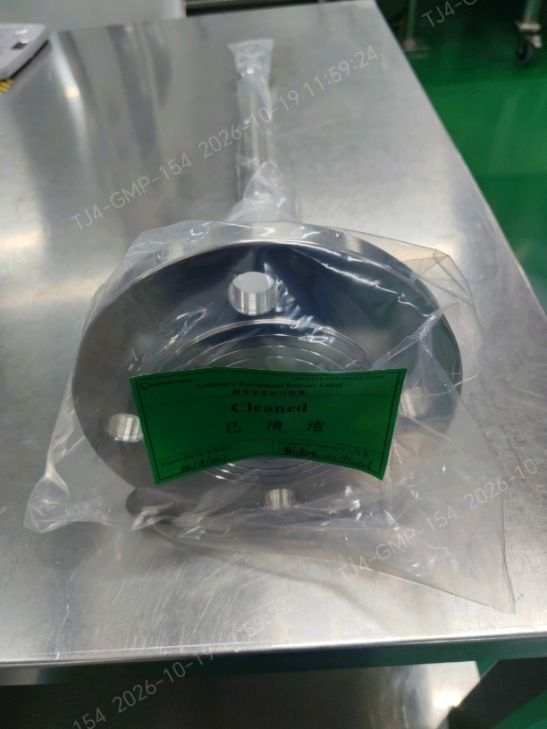
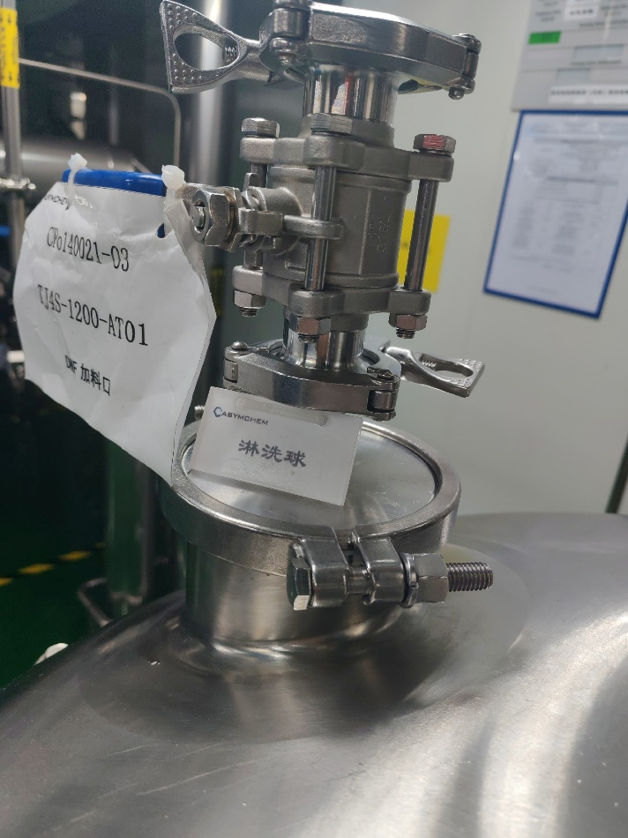
Spray-ball installation
1. Spray-ball installation, coverage test, riboflavin cleaning, and particulate check for AT09/AT01.
ASYM:
1. A stainless steel spray ball was used for the spray coverage test on mixing vessel AT09. Iodine is not compatible with prolonged stainless-steel contact, so this spray ball will be used only as a temporary accessory and will not remain in the vessel.
2. A PTFE spray ball has been purchased for mixing vessel AT09, following Lilly's recommendation and material-compatibility assessment. Given the project timeline, we recommend a trial run and completion of the supplemental spray-coverage verification and cleaning confirmation before this vessel is used for the project.
Proposed completion date: 10/20/2026
3. Mixing vessel AT01 is equipped with a spray ball and has completed spray coverage testing. The missing on-site identification tag has been corrected.
淋洗球是否必须要固定，淋洗球固定的方式需要增加2d的验证和清洗的时间，我们推荐目前的淋洗方式。
Qualification options and charging schedule
Option | 20 | 21 | 22 | 23 | 24 | 25 | 26
Option 1 | Coverage test | Iodine trial |  | CMa | Charge
Option 2 | Iodine trial |  | CMa/Dispense | Charge
TJ4S-1213-AT09Dedicated spray ball
TJ4S-1200-AT01

Slide 4

Step# | 1 | Batch No./批次 | 2 | Batch star/ 批次开始 | 2026/10/22 16:00 | Batch Cycle ( d )/批次周期（天） |  | 12.7 d | Completed/已完成 | Ongoing/进行中
Material Dispensing/ 原料分装 (A portion of Oxyma is dispensed first, followed by PyBOP and amino acid. The remaining Oxyma is dispensed to enable rapid charging. Starting with Batch 2, the sequence will be adjusted as appropriate./先分装一部分 Oxyma，再分装 PyBOP 和氨基酸。剩余 Oxyma 进行分装，以实现快速投料。从第 2 批开始，将酌情调整操作顺序。) | No. | AAs | Begin/开始 | End/结束 | Unit Operation Time(h)/ 单元操作时间(h) | Dispensing | Begin/开始 | End/结束 | Unit Operation Time(h)/ 单元操作时间(h) | Dispensing | Begin/开始 | End/结束 | Unit Operation Time(h)/ 单元操作时间(h)
 | 1 | 2-Chlorotrityl Chloride Resin | 2026/10/22 16:00 | 2026/10/22 20:00 | 4
 | 2 | Fmoc-Gly-OH | 2026/10/24 4:00 | 2026/10/24 8:00 | 4
 | 3 | Fmoc-L- Thr(tBu)-OH | 2026/10/24 10:00 | 2026/10/24 14:00 | 4 | Oxyma | 2026/10/22 22:00 | 2026/10/23 0:00 | 2 | PyBOP | 2026/10/23 18:00 | 2026/10/23 22:00 | 4
 | 4 | Fmoc-L-Ala-OH·H₂O | 2026/10/25 0:00 | 2026/10/25 4:00 | 4 | Oxyma | 2026/10/23 2:00 | 2026/10/23 4:00 | 2
 | 5 | Fmoc-L- Cys(Trt)-OH | 2026/10/25 10:00 | 2026/10/25 14:00 | 4 | Oxyma | 2026/10/23 6:00 | 2026/10/23 8:00 | 2
 | 6 | Fmoc-L- Thr(tBu)-OH | 2026/10/24 14:00 | 2026/10/24 18:00 | 4 | Oxyma | 2026/10/23 10:00 | 2026/10/23 12:00 | 2
 | 7 | Fmoc-L-Ala-OH·H₂O | 2026/10/25 4:00 | 2026/10/25 8:00 | 4 | Oxyma | 2026/10/23 14:00 | 2026/10/23 16:00 | 2
 | 8 | Fmoc-L- Thr(tBu)-OH | 2026/10/24 18:00 | 2026/10/24 22:00 | 4 | Oxyma | 2026/10/26 8:00 | 2026/10/26 10:00 | 2
 | 9 | Fmoc-L-Asn(Trt)-OH | 2026/10/25 20:00 | 2026/10/26 0:00 | 4 | Oxyma | 2026/10/26 12:00 | 2026/10/26 14:00 | 2
 | 10 | Fmoc-L- Cys(Trt)-OH | 2026/10/25 14:00 | 2026/10/25 18:00 | 4 | Oxyma | 2026/10/26 16:00 | 2026/10/26 18:00 | 2
 | 11 | Boc-L-Glu-OtBu | 2026/10/26 2:00 | 2026/10/26 6:00 | 4 | Oxyma | 2026/10/26 20:00 | 2026/10/26 22:00 | 2 | PyBOP | 2026/10/23 22:00 | 2026/10/24 2:00 | 4
 | 12 | Iodine | 2026/10/27 0:00 | 2026/10/27 4:00 | 4
1. Fmoc-Gly-OH Coupling Cycle /芴甲氧羰基-甘氨酸偶联循环 | Gly
 | Unit Operation/单元操作 |  | Pre-treatment/预处理 |  | Charge Resin/树脂投料 |  | swelling&wash/溶胀&洗涤 |  | Charge AA/氨基酸投料 |  | Activation/活化 |  | Coupling/偶联 |  | DMF wash/洗涤 |  | Capping/封端 |  | DMF wash/洗涤
 | Time/时间 |  | Begin/开始 | End/结束 | Begin/开始 | End/结束 | Begin/开始 | End/结束 | Begin/开始 | End/结束 | Begin/开始 | End/结束 | Begin/开始 | End/结束 | Begin/开始 | End/结束 | Begin/开始 | End/结束 | Begin/开始 | End/结束
 | Synthesizer/合成仪 |  | 2026/10/24 8:00 | 2026/10/24 14:00 | 2026/10/24 14:00 | 2026/10/24 16:00 | 2026/10/24 16:00 | 2026/10/24 19:00 |  |  |  |  | 2026/10/24 19:30 | 2026/10/24 23:30 | 2026/10/24 23:30 | 2026/10/25 2:00 | 2026/10/25 2:00 | 2026/10/25 5:00 | 2026/10/25 5:00 | 2026/10/25 7:30
 | Activation Reactor/激活釜 |  |  |  |  |  |  |  | 2026/10/24 16:00 | 2026/10/24 18:00 | 2026/10/24 18:00 | 2026/10/24 19:30
 | Unit Operation Time(h)/单元操作时间(h) |  | 6 |  | 2 |  | 3 |  | 2 |  | 1.5 |  | 4 |  | 2.5 |  | 3 |  | 2.5
2. Fmoc-L-Thr(tBu)-OH Coupling Cycle /芴甲氧羰基-叔丁基-L-苏氨酸偶联循环 | Thr
 | Unit Operation/单元操作 |  | De-Fmoc/脱Fmoc |  | IPAC wash/IPAC洗涤 |  | DMF wash/DMF洗涤 |  | Charge AA & oxyma/ 氨基酸和oxyma投料 |  | Activation/活化 |  | Coupling/偶联 |  | DMF wash/洗涤
 | Time/时间 |  | Begin/开始 | End/结束 | Begin/开始 | End/结束 | Begin/开始 | End/结束 | Begin/开始 | End/结束 | Begin/开始 | End/结束 | Begin/开始 | End/结束 | Begin/开始 | End/结束
 | Synthesizer/合成仪 |  | 2026/10/25 7:30 | 2026/10/25 11:00 | 2026/10/25 11:00 | 2026/10/25 14:30 | 2026/10/25 14:30 | 2026/10/25 16:30 |  |  |  |  | 2026/10/25 18:30 | 2026/10/25 22:30 | 2026/10/25 22:30 | 2026/10/26 1:00
 | Activation Reactor/激活釜 |  |  |  |  |  |  |  | 2026/10/25 11:00 | 2026/10/25 14:00 | 2026/10/25 16:30 | 2026/10/25 18:30
 | Unit Operation Time(h)/单元操作时间(h) |  | 3.5 |  | 3.5 |  | 2 |  | 3 |  | 2 |  | 4 |  | 2.5
3. Fmoc-L-Ala-OH·H₂O Coupling Cycle /芴甲氧羰基-L-丙氨酸一水合物偶联循环 | Ala
 | Unit Operation/单元操作 |  | De-Fmoc/脱Fmoc |  | IPAC wash/IPAC洗涤 |  | DMF wash/DMF洗涤 |  | Charge AA & oxyma/ 氨基酸和oxyma投料 |  | Activation/活化 |  | Coupling/偶联 |  | DMF wash/洗涤
 | Time/时间 |  | Begin/开始 | End/结束 | Begin/开始 | End/结束 | Begin/开始 | End/结束 | Begin/开始 | End/结束 | Begin/开始 | End/结束 | Begin/开始 | End/结束 | Begin/开始 | End/结束
 | Synthesizer/合成仪 |  | 2026/10/26 1:00 | 2026/10/26 4:30 | 2026/10/26 4:30 | 2026/10/26 8:00 | 2026/10/26 8:00 | 2026/10/26 10:00 |  |  |  |  | 2026/10/26 11:30 | 2026/10/26 15:30 | 2026/10/26 15:30 | 2026/10/26 18:00
 | Activation Reactor/激活釜 |  |  |  |  |  |  |  | 2026/10/26 4:30 | 2026/10/26 6:30 | 2026/10/26 10:00 | 2026/10/26 11:30
 | Unit Operation Time(h)/单元操作时间(h) |  | 3.5 |  | 3.5 |  | 2 |  | 2 |  | 1.5 |  | 4 |  | 2.5

Slide 5
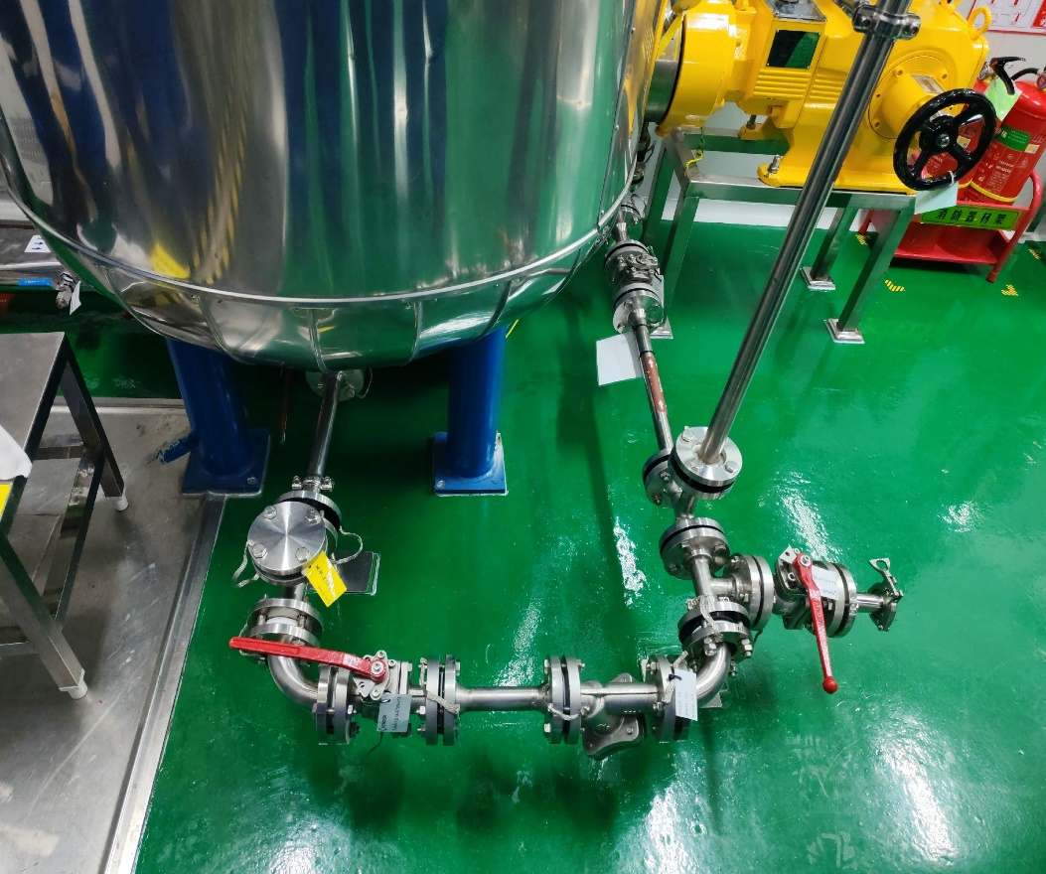
Piping correction
3. Qualification of iodine-solution nitrogen transfer time before the solvent run.
ASYM: Nitrogen transfer of the iodine solution to the synthesizer will be performed during the solvent run.
Proposed completion date: 10/22/2026
4. Post-oxidation DMF cooling-time qualification in the activation tank, during the solvent run.
ASYM: The post-oxidation DMF cooling-time test in the activation tank will be performed during the solvent run.
Proposed completion date: 10/22/2026
5. Dead-leg removal from unused branches of the iodine-solution transfer line.
ASYM: Completed. The redundant valve was removed, and a tagged PTFE blind flange was installed.

Slide 6
6. Pre-production rinse/swab acceptance for the equipment train, or an equivalent criterion in the CCS.
ASYM:
1. Post-passivation cleaning of the equipment train is complete, and TOC testing is complete.
2. The solvent trial used elemental iodine. After cleaning, iodine residue will be checked with test strips.

