Slide 1
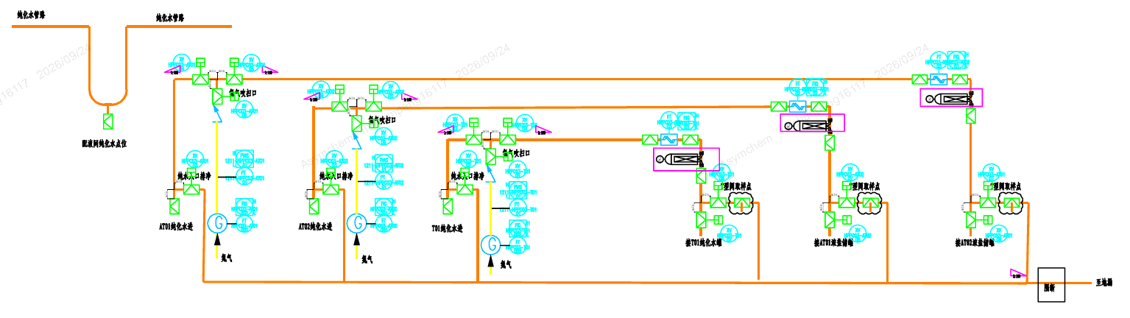
Drain and Water-Fill Flow
② Water-fill path
① Drain path
v

Slide 2
Sampling Flow
① Drain → ② Sample
v

Slide 3
Sampling Flow
Purge ① first → then purge ②

Slide 4
Purified Water Use Procedure
1. Purified Water Use
Connect the hose from the PW outlet to the fixed line → Open the water valve → Flush PW to waste → After flushing, supply water to the point of use
Open the nitrogen purge valve → Purge toward the equipment side → Then purge back toward the PW outlet → Close all valves when finished
2. Sampling
Connect the hose from the PW outlet to the fixed line → Open the water valve → Flush PW to waste → After flushing, take a manual sample
3. Filter Management Principle
Install the filter before each use; the filter's time in use shall not exceed 24 hours.

Slide 5
Action Item | Implementation Plan | Target Date
Justify the one-month service life for dedicated PW hoses | Practice: weekly cleaning; replacement every six months | 10/20/2026
Replace silicone water hoses with PTFE hoses or provide a documented technical justification | Replace with PTFE hoses: 1. Domestic brand: lead time ~3 weeks 2. Imported brand: lead time ~8 weeks | 1. 10/30/2026 2. 11/30/2026
Update procedure to ensure immediate water hose disconnection and controlled storage after use | Update the procedure documents. | 10/20/2026
Purified Water header throughout the facility does not meet industry guidance - sample point is not representative of POU, no means of pre-use flushing/blowing, etc. Additionally, POU filtration should be provided for any PW supplied to a growth promoting solution via hose connection (upstream of drain line). These filters should have time in use tracked and be replaced frequently (NMT 24 hours). Implement point-of-use flushing directly to waste and post-use draining and drying for purified-water lines using zero-static valves or minimum-distance tees without creating dead legs | Submit a change control and carry out the modification per the scheme shown on Slide 1 (valves designed to the 3D principle). Estimated durations: Procurement: ~6 weeks Installation: ~3 weeks Pickling and passivation: ~2 weeks Continuous sampling validation and incubation: ~3 weeks Line drying validation: ~2 weeks | 01/30/2027

Slide 6
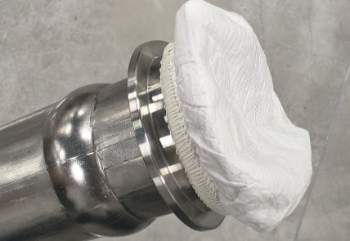
Action Item | Implementation Plan | Target Date
Implement the use of permeable film to cover the ends of process and water hoses while stored for drying | Permeable film has been procured (see photo at left). | 10/30/2026
Install point-of-use filters for purified water supplied by hose to growth-promoting solutions, track time in use, and replace filters no later than 24 hours | Immediate corrective action | 09/30/2026
Assess representative sampling from new point-of-use drains and determine whether formal revalidation or an informal verification study is required to confirm water-system quality | Assessment of sampling points is in progress. | 10/30/2026
Store hose ends at least 6 inches off the floor and provide a clear visual indicator confirming compliant storage position | 1. Short term: train on-site personnel 2. Long term: install custom stainless-steel hose racks to keep hose ends more than 6 inches off the floor | 1. 09/30/2026 2. 11/30/2026

