Slide 1
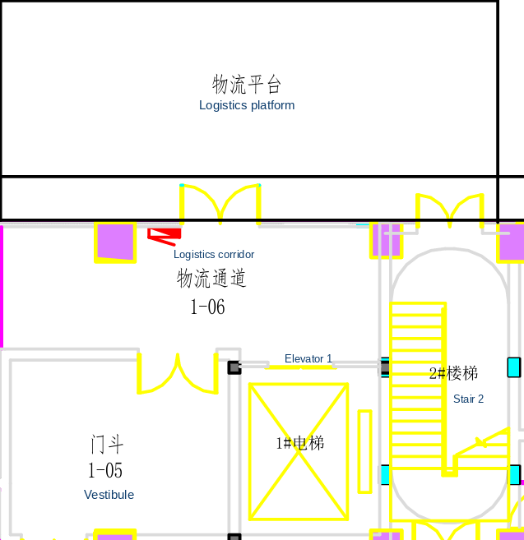
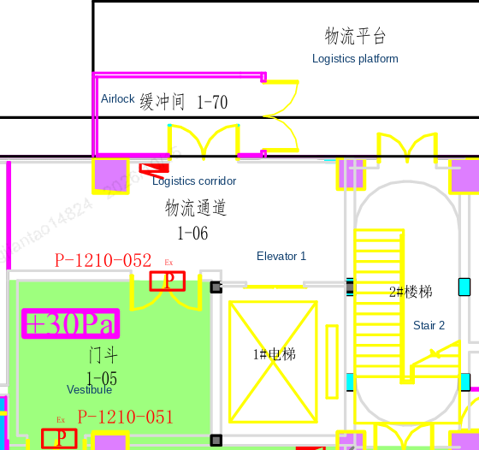
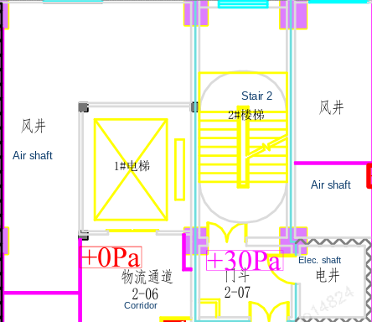
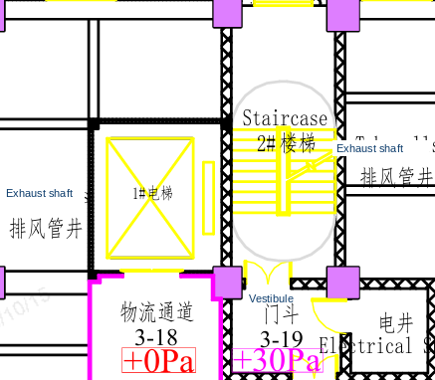
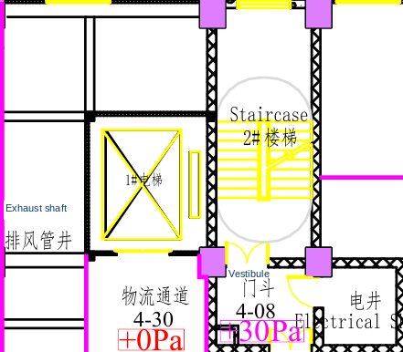
Peptide Building 2 — New Logistics Platform Airlock
Current state of the material-platform airlock
Action | Current status | Target date
Change-control document | Approved | N/A
Airlock structure | Construction complete | N/A
Access control | Installed and entered in the system | N/A
HVAC | Ductwork complete | N/A
Interlock | Commissioning | 10/16/2026
Differential pressure | Commissioning | 10/18/2026
Qualification | IQ in progress | 10/20/2026
Material transfer flow
Logistics platform before the change
After the change (vestibule upgraded to a CNC area)
Step | Control
Staffing | Two dedicated operators: one external, one internal, for receipt and transfer.
Platform check | The external operator checks the delivery record against the outer label (identity, quantity, and pack), then calls the internal operator and moves the material into the airlock.
Airlock check | Only one material for one project at a time. The internal operator completes the second barcode check in the airlock.
Clean and transfer | After the check, clean the material in the airlock and move it at once into the logistics corridor, then by the logistics elevator to the suite. Do not leave material staged.
Level 2 logistics corridor
Level 3 logistics corridor
Level 4 logistics corridor
Logistics corridors in the building are classified as general areas and are controlled to the CNC standard.

