Slide 1


Gap Identification – TFF
Green Chemistry is the Future
www.asymchem.com Stock Code: 002821.SZ

Slide 2

Category 3 Piping and Equipment Requirements
Category 3
Standard Item | Description / Guidance
Lines, Connections, Components | • Tri-clamp connections (solid gasket seal)
 | • ASME BPE tubing
 | • Ball valves: not permitted in systems at risk of residue, as material trapped behind the ball is a hazard; ball valves may be used for isolation in solvent systems
 | • MOC: stainless steel, high alloy
 | • Follow ASME BPE; if another sanitary standard is used, its acceptability must be assessed
Tanks | • Material: stainless steel or high alloy
 | • Internal surface finish: NMT 25 µin Ra, i.e. 0.63 µm
 | • Tri-clamp connections
 | • Minimize the projection length of nozzles on tank heads
Cleaning | • Applies to buffer systems: solvent media, not growth-promoting, no product build-up, no routine cleaning required
 | • Minimize dead legs; where a dead leg exists, it must have a path for cleaning, changeover and draining
 | ○ Assess dead legs against the BPE 2 L/D criterion; they must be flushable
 | ○ Very small dead legs are acceptable where the system is always liquid-full in normal operation
 | • Tanks and large non-piping components require a spray coverage test to support flushing / changeover; cleaning validation not required
Surface Finish | • Internal surface finish: NMT 25 µin Ra or 0.63 µm
 | • Internal weld inspection: smooth internal weld surface, no dead spots for product hold-up
Line Slope | • Line slope not mandatory, but the system must be designed to be drainable
 | • Provide low-point drains as needed to ensure effective flushing and changeover
Documentation | • Full set of ASME weld documentation
 | • Elastomers in contact with product or process materials (solvents, buffers, etc.) require compliance documents: FDA 21 CFR or USP Class VI material certificates

Slide 3
Category 4 Piping and Equipment Requirements
Category 4
Standard Item | Description / Guidance
Lines, Connections, Components | • Tri-clamp connections (solid gasket seal)
 | • ASME BPE tubing
 | • Diaphragm valves or other clean-in-place valves; ball valves prohibited
 | • Minimum dead-leg fittings (zero-static valves, integrated aseptic GMP valves, instrument tees, etc.)
 | • MOC: stainless steel, alloy
 | • Follow ASME BPE; where another sanitary standard is used, its acceptability must be assessed
Tanks | • Material: stainless steel or alloy
 | • Internal surface finish: NMT 25 µin Ra / 0.63 µm
 | • Tri-clamp, NovAseptic or equivalent aseptic connections
 | • Minimize nozzle length on tank heads
Cleaning | • Product-contact tanks and piping require cleaning validation
 | ○ Higher cleaning frequency and more rigorous cleaning inspection
 | ○ Per guidance, establish clean / dirty hold times and perform bioburden sampling; the system must be fully drainable and flushable, leaving no substrate for microbial growth
 | • Tanks and large non-piping components requiring cleaning validation must pass a spray coverage test (e.g. AFD dust filter, discharge chute, product glovebox) so that cleaning validation is reproducible
Surface Finish | • Internal surface finish: NMT 25 µin Ra or 0.63 µm
 | • Internal weld inspection: smooth internal surface, no dead spots for product hold-up
Line Slope | • Line slope mandatory to ensure the piping system is fully drainable
Documentation | • Enhanced weld documentation
 | • Line slope drawings
 | • Weld maps
 | • Elastomer material certificates (FDA 21 CFR compliant)

Slide 4
P&ID before Retrofit – Tank Section
1. Replace the tank with a BPE-compliant tank;
2. Replace the DP level transmitter with a radar level transmitter;
3. Feed each material through a separate inlet;
4. Remove the pressure gauge root valve;
5. Add in-line CIP cleaning to the tank;
6. Change the dip-tube thermometer to bottom-outlet measurement;
7. Modify the tank bottom outlet valve.

Slide 5
P&ID after Retrofit – Tank Section
1. Replace the tank with a BPE-compliant tank;
2. Replace the DP level transmitter with a radar level transmitter;
3. Feed each material through a separate inlet;
4. Remove the pressure gauge root valve;
5. Add in-line CIP cleaning to the tank;
6. Change the dip-tube thermometer to bottom-outlet measurement;
7. Modify the tank bottom outlet valve.

Slide 6

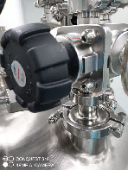
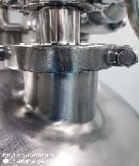
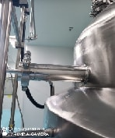

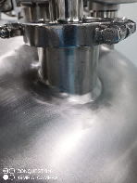

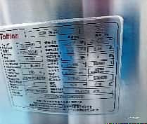
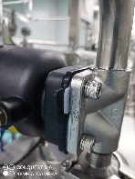

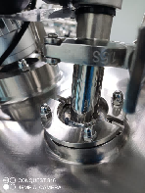


Category 4 Tank Requirements
Item | Material | Valves | Connection | Cleaning | Lighting | Tee Dead Legs | Instruments | Remarks
C4 Standard | 316L stainless steel or alloy | Diaphragm valve or other clean-in-place valve | Tri-clamp connections (solid gasket seal) | Removable for cleaning, drainable, compliant | NA | 3D compliant, minimum dead-leg design | Installed to meet 3D, easy to clean, no dead legs | N/A
Tank | 316L | Compliant | Compliant, all clamp connections | Compliant | Non-compliant, no sight-glass light | Compliant | Non-compliant, does not meet 3D | Non-compliance: Replace the entire tank with a BPE-compliant tank; Separate inlet for each material; Add in-line CIP to the tank to meet cleaning needs.
TFF TFF Skid | 316L | Diaphragm valves | Compliant, all clamp connections | Compliant | Compliant | Compliant | Compliant | N/A

Slide 7



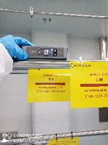




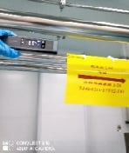




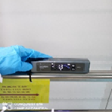
Category 3 Piping Requirements
Item | Material | Valves | Connection | Piping Standard | Cleaning |  | Slope | Low-Point Drain | Remarks
C3 Standard | Stainless steel, alloy | Diaphragm valves or other clean-in-place valves; ball valves prohibited | Tri-clamp connections (solid gasket seal) | BPE tubing | Piping can be CIP-cleaned; 3D design to minimize residual dead legs |  | Slope > 1%, fully drainable | Low-point drains provided
Solvent Drum → TJ4S-1211-TFF02 ACN / Water Line | 316L Stainless Steel/DN25 | Compliant | Compliant, clamp joints | Non-compliant; replace with BPE tubing | Non-compliant | Retrofit Plan | Compliant | Has low-point drain
 |  |  |  |  |  | Use 3D-compliant piping to minimize residual dead legs
CNC-Solvent → TJ4S-1211-TFF02-T01 Methanol Line | 316L Stainless Steel/DN25 | Compliant | Compliant, clamp joints | Non-compliant; replace with BPE tubing | Non-compliant | Retrofit Plan | Compliant | Has low-point drain
 |  |  |  |  |  | Use 3D-compliant piping to minimize residual dead legs
TJ4S-1211-R02 → TJ4S-1211-TFF02 NaOH Line | 316L Stainless Steel/DN25 | Compliant | Compliant, clamp joints | Non-compliant; replace with BPE tubing | Non-compliant | Retrofit Plan | Compliant | Has low-point drain, compliant
 |  |  |  |  |  | Replace filter to meet drainage requirement

Slide 8
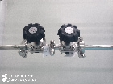
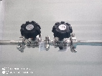
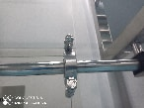
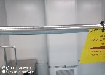

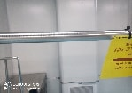
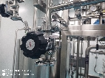
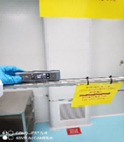

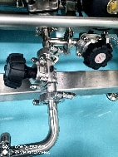
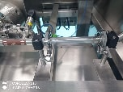
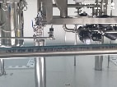
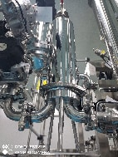
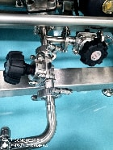
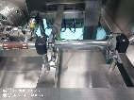
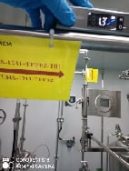
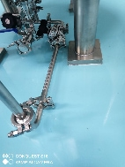
Category 4 Piping Requirements
Item | Material | Valves | Connection | Piping Standard | Cleaning |  | Slope | Flowmeter | Low-Point Drain |  | Remarks
C4 Standard | Stainless steel or alloy, BPE | Diaphragm valves or other clean-in-place valves; ball valves prohibited | Tri-clamp connections (solid gasket seal) | BPE | Piping can be CIP-cleaned; 3D design to minimize residual dead legs |  | Slope > 1%, fully drainable | No non-drainable flowmeters | Low-point drains provided |  | 1. Piping material is BPE, compliant; See attachment for details
TJ4S-1211-HPPC03-AT03 → TJ4S-1211-TFF02-T01 Prep Fraction Feed to Tank | Compliant, BPE | Compliant, diaphragm valves | Compliant, clamp joints | Compliant | Non-compliant | Retrofit Plan | Compliant | Compliant, flowmeter installed vertically | Compliant | Retrofit Plan
 |  |  |  |  |  | Retrofitted piping meets 3D; cleaned in place by CIP |  |  |  | N/A
TJ4S-1211-TFF02-T01 → TJ4S-1211-TFF02 Methanol and Prep Fraction Feed to TFF | Compliant, BPE | Compliant, diaphragm valves | Compliant, clamp joints | Compliant | Non-compliant | Retrofit Plan | Compliant | Retrofit Plan | Non-compliant: no low-point drain on piping or filter | Retrofit Plan
 |  |  |  |  |  | Retrofitted piping meets 3D; cleaned in place by CIP |  | N/A |  | Add a low-point drain; Add an inlet drain to the filter

