Slide 1
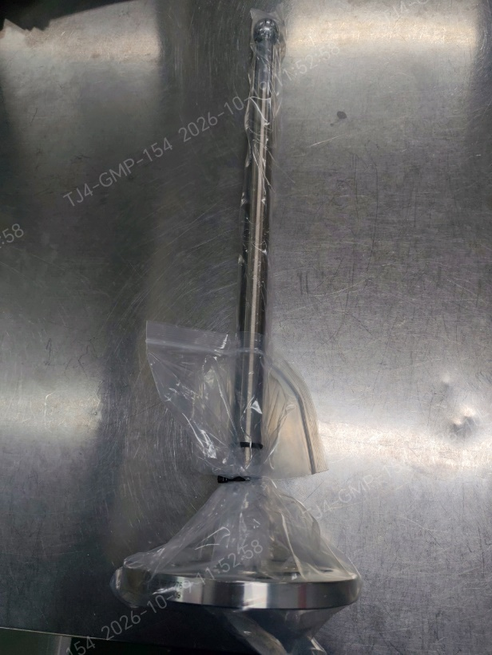
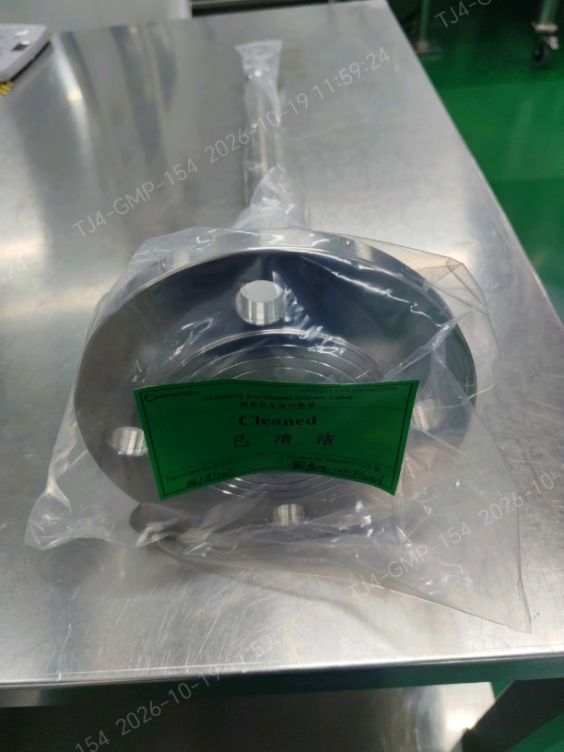
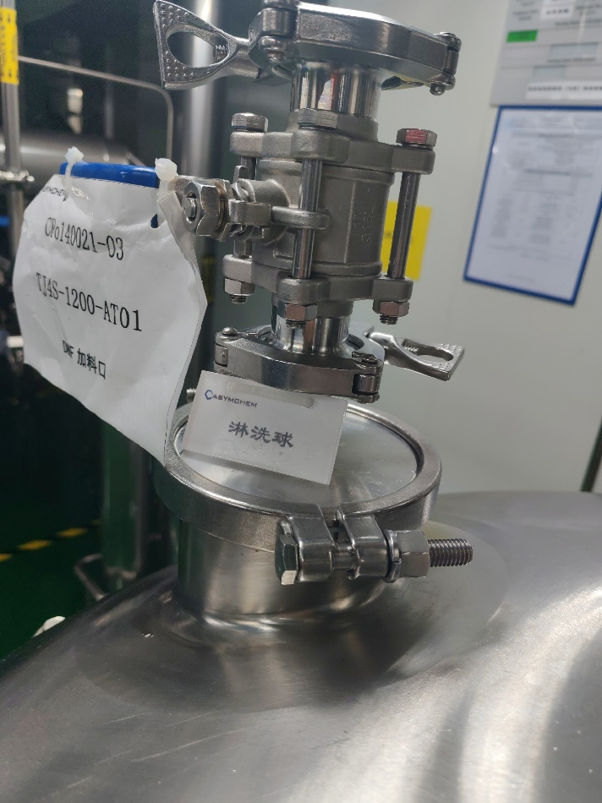
Spray-ball installation
1. Spray-ball installation, coverage test, riboflavin cleaning, and particulate check for AT09/AT01.
ASYM:
1. A stainless steel spray ball was used for the spray coverage test on mixing vessel AT09. Iodine is not compatible with prolonged stainless-steel contact, so this spray ball will be used only as a temporary accessory and will not remain in the vessel.
2. A PTFE spray ball has been purchased for mixing vessel AT09, following Lilly's recommendation and material-compatibility assessment. Given the project timeline, we recommend a trial run and completion of the supplemental spray-coverage verification and cleaning confirmation before this vessel is used for the project.
Proposed completion date: 10/22/2026
3. Mixing vessel AT01 is equipped with a spray ball and has completed spray coverage testing. The missing on-site identification tag has been corrected.
TJ4S-1213-AT09Dedicated spray ball
TJ4S-1200-AT01

Slide 2
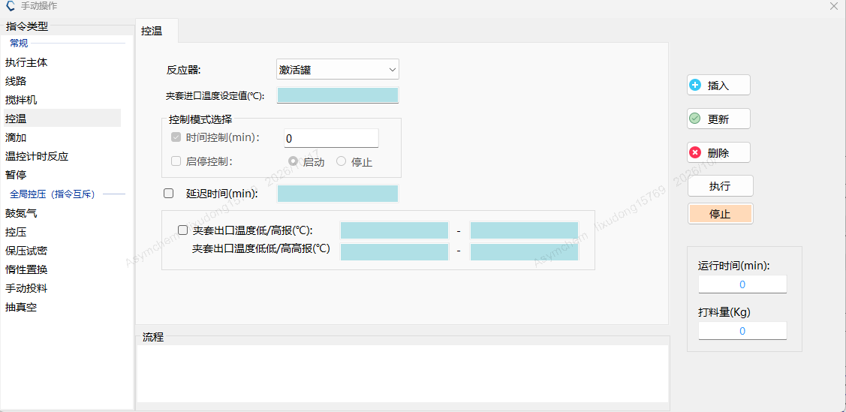
SPPS option review
2. Add high-high and low-low jacket-temperature alarms for synthesizer SY16 to the PLC.
Option assessment
1. Option 1 has audible and visual HH/LL alarms, plus H/L warnings. Floor response is immediate, so an excursion outside the process range is seen at once.
Software update
2. Options 2 and 3
a. High/low alarms only, set as warnings. Personnel respond on the floor. An excursion is confirmed by checking the OR against the electronic data.
b. The MOR already records the minimum and maximum temperature for each operation, so a missed excursion is unlikely.
3. Options 2 and 3 differ only in when the mixing-vessel coverage test is done. The vessel is used for about 7 days after charging; the test and cleaning take about 2 days and do not stop the synthesizer. Option 3 has less impact.
Qualification options and charging schedule
Option | 20 | 21 | 22 | 23 | 24 | 25 | 26
Option 1 | Software upgrade | Verification |  | Iodine trial |  | CMa | Charge
Option 2 | Coverage test | Iodine trial |  | CMa | Charge
Option 3 | Iodine trial |  | CMa | Charge | Coverage test | Vessel cleaning
Based on the charging date, we recommend Option 3.

Slide 3
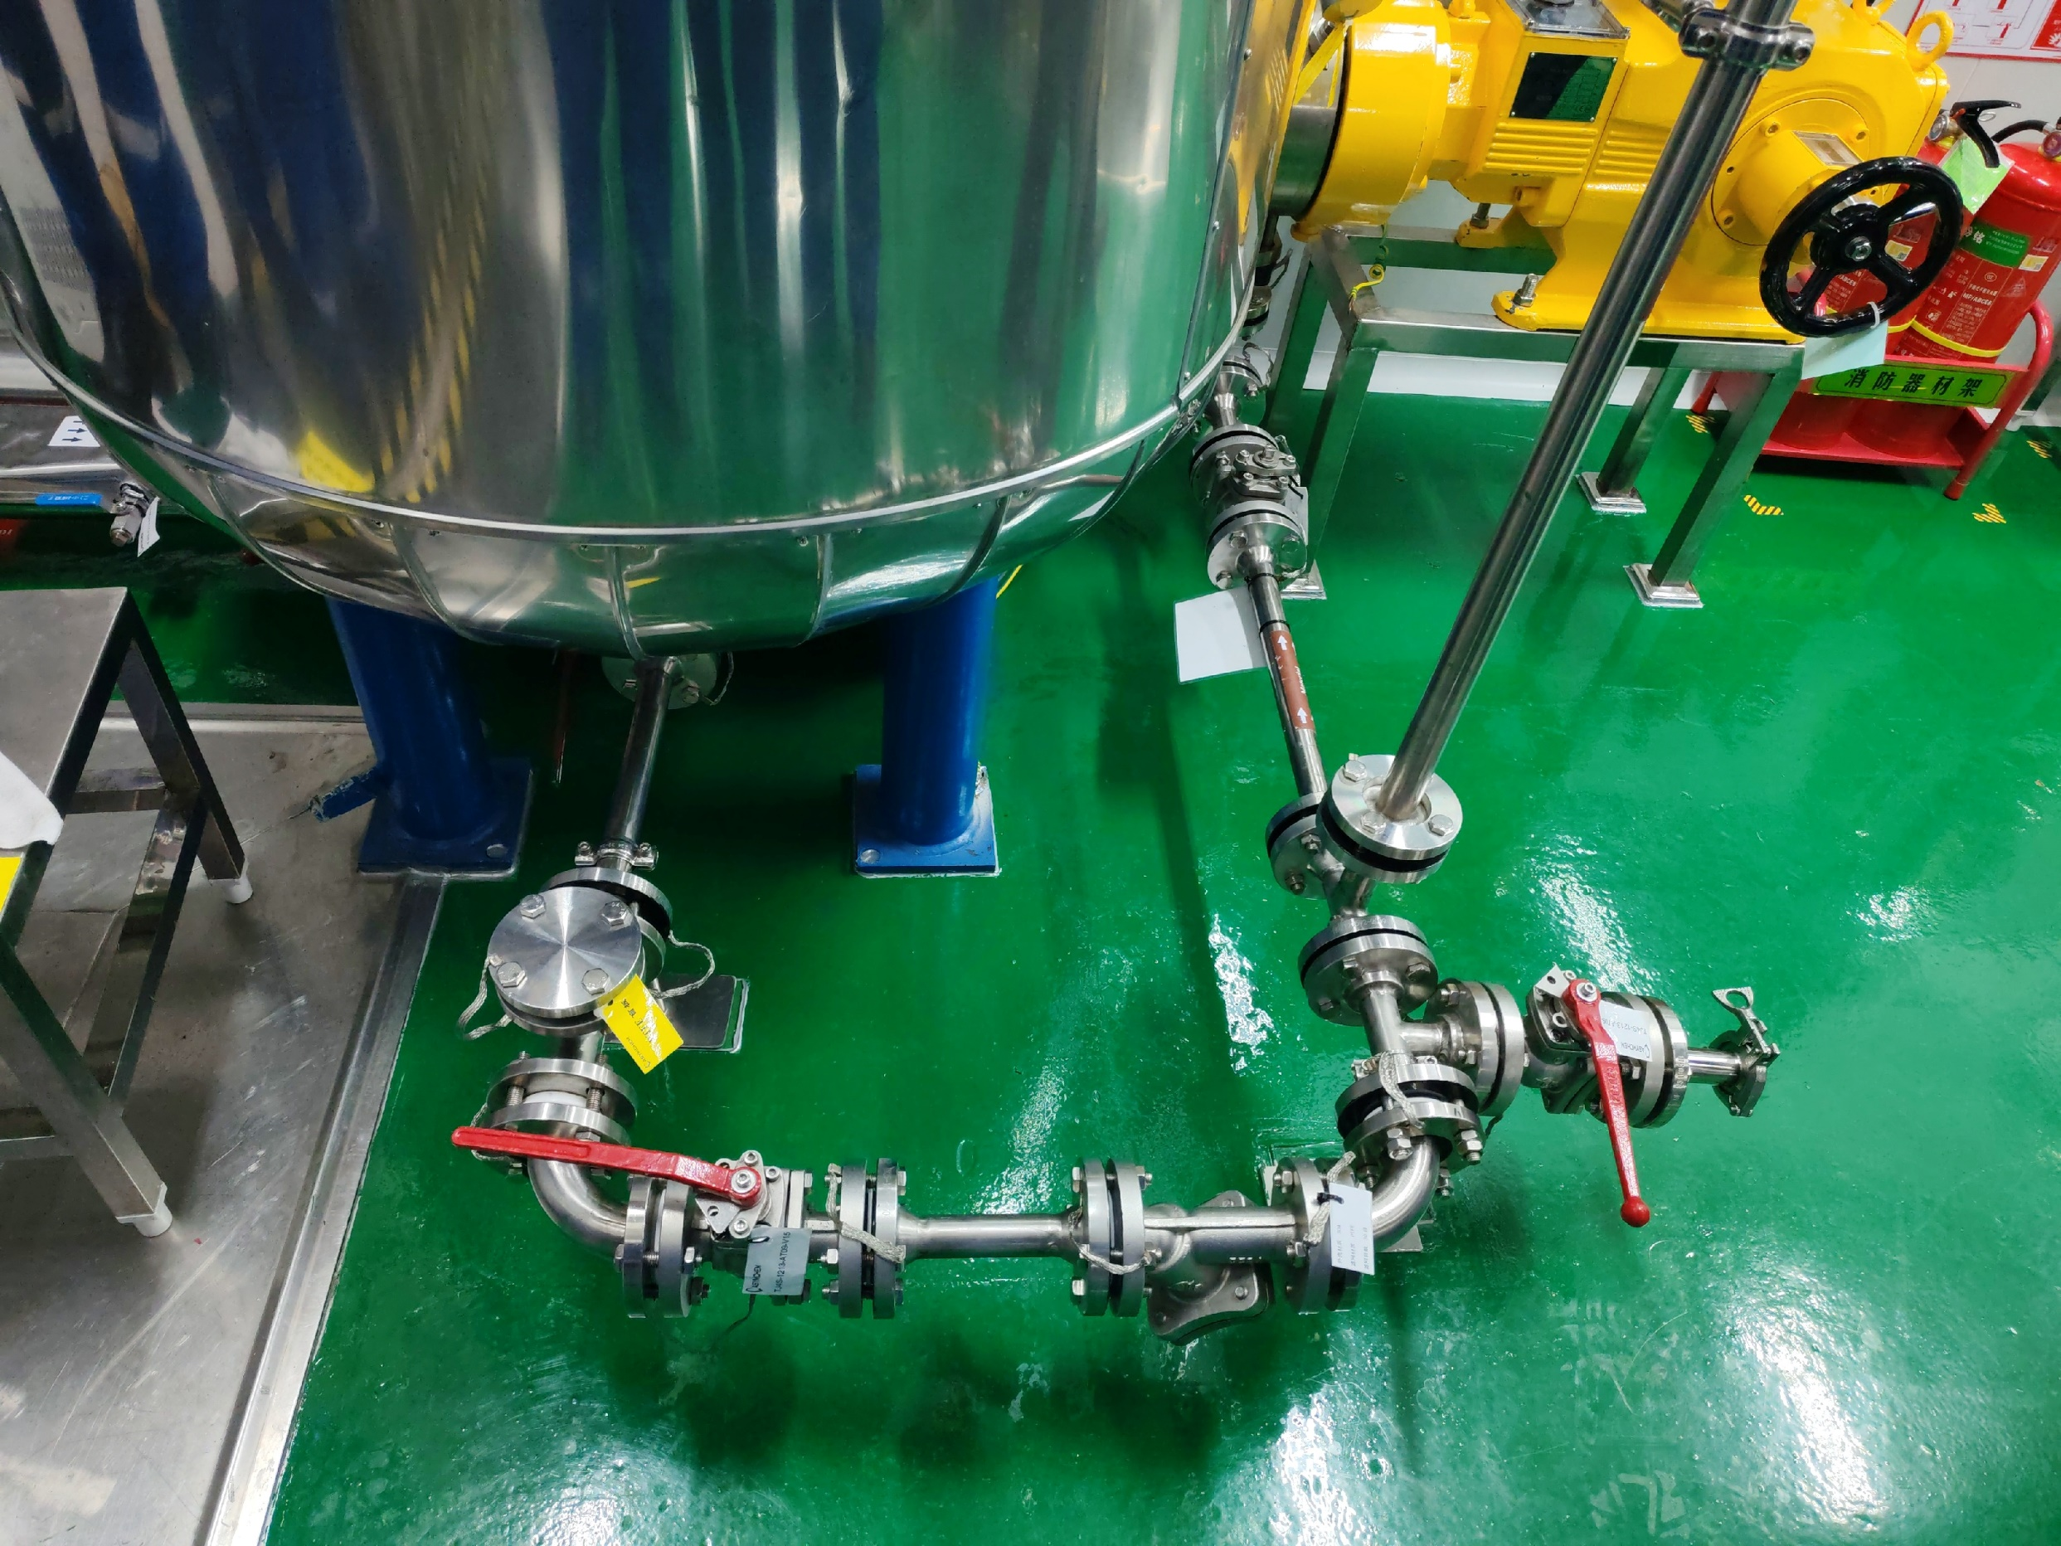
Piping correction
3. Dead-leg removal from unused branches of the iodine-solution transfer line.
ASYM: Completed. The redundant valve was removed, and a tagged PTFE blind flange was installed.

Slide 4
4. Qualification of iodine-solution nitrogen transfer time before the solvent run.
ASYM: Nitrogen transfer of the iodine solution to the synthesizer will be performed during the solvent run.
Proposed completion date: 10/22/2026

Slide 5
5. Post-oxidation DMF cooling-time qualification in the activation tank, during the solvent run.
ASYM: The post-oxidation DMF cooling-time test in the activation tank will be performed during the solvent run.
Proposed completion date: 10/22/2026

Slide 6
6. Pre-production rinse/swab acceptance for the equipment train, or an equivalent criterion in the CCS.
ASYM:
1. Post-passivation cleaning of the equipment train is complete, and TOC testing is complete.
2. The solvent trial used elemental iodine. After cleaning, iodine residue will be checked with test strips.

Slide 7
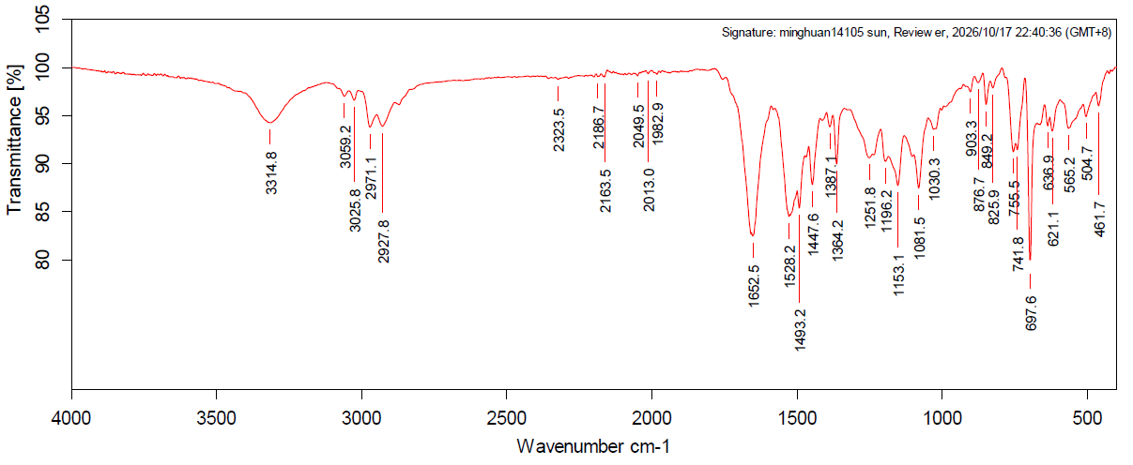
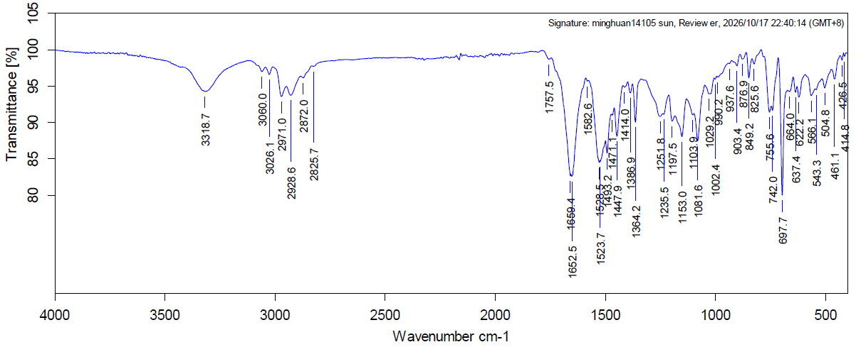
7. Investigation of the contaminated sampling tool in the L3 synthesizer SY16 glovebox and the yellow solid in the L2 synthesizer SY15 glovebox. Contaminant identification is strongly recommended. At a minimum, show that contamination is limited to the glovebox and rule out contamination inside the synthesizer.
ASYM:
1. SY15 last ran 140020 Step 1 solid-phase synthesis. The yellow solid in the glovebox matches the 140020 peptide resin by IR. No residue was found inside the synthesizer.
Reference
Yellow solid, SY15 glovebox

Slide 8
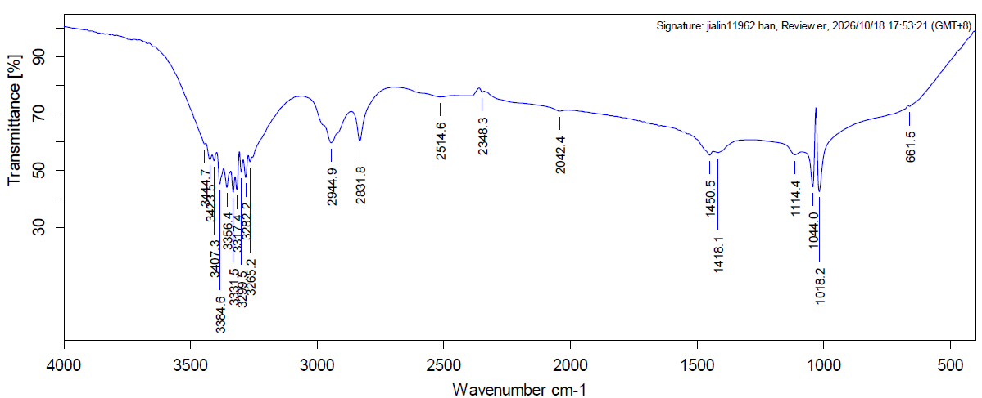
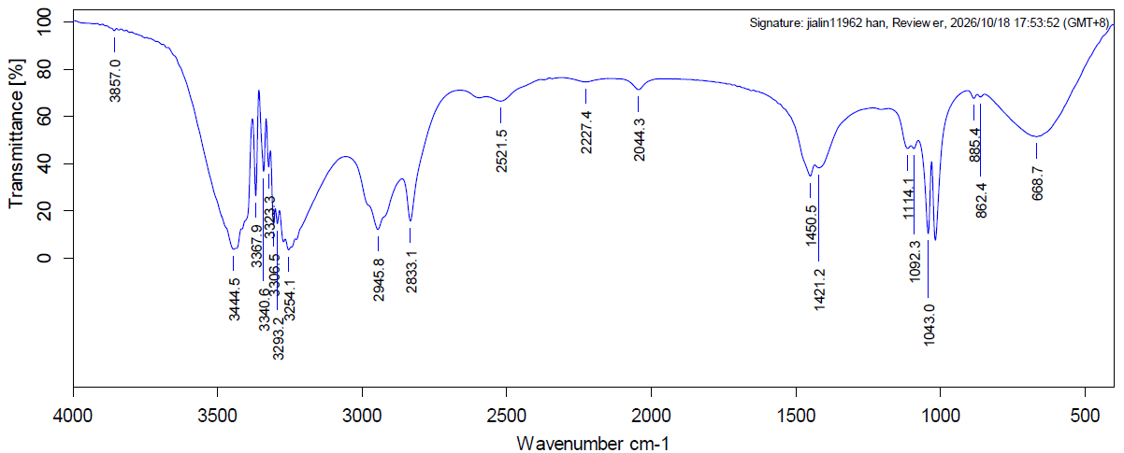
7. Investigation of the contaminated sampling tool in the L3 synthesizer SY16 glovebox and the yellow solid in the L2 synthesizer SY15 glovebox. Contaminant identification is strongly recommended. At a minimum, show that contamination is limited to the glovebox and rule out contamination inside the synthesizer.
ASYM:
2. IR of the contaminant on the SY16 LDPE sampler bag matches ethylene glycol. DMF was the other low-volatility reference. No residue was found inside the synthesizer.
LDPE contaminant, SY16 glovebox
Ethylene glycol

