Slide 1


139788 Follow-on Instrument Installation
Green Chemistry is the Future
www.asymchem.com Stock Code: 002821.SZ

Slide 2
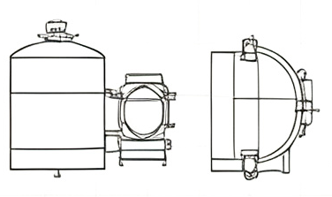
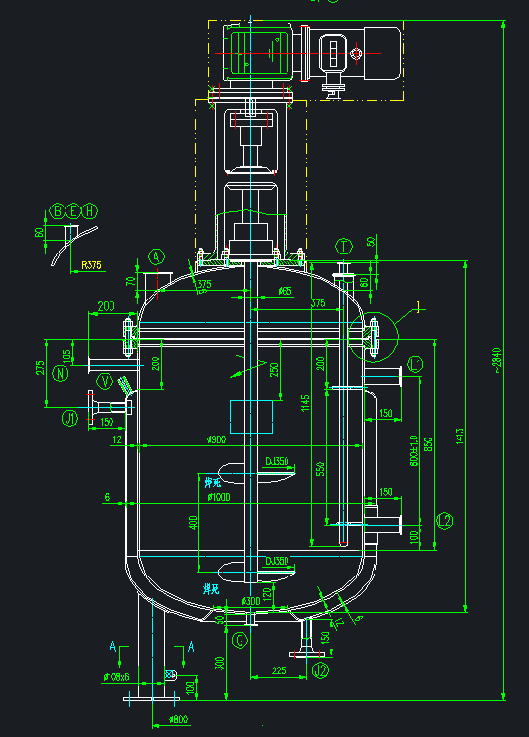
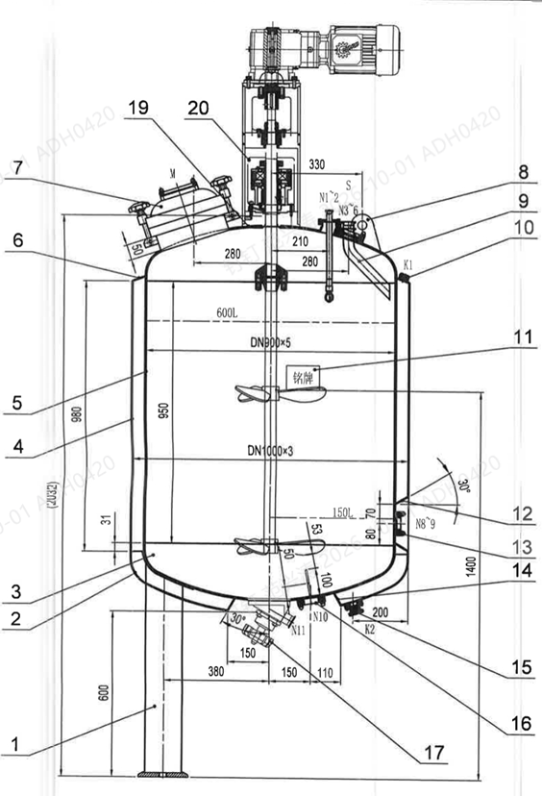
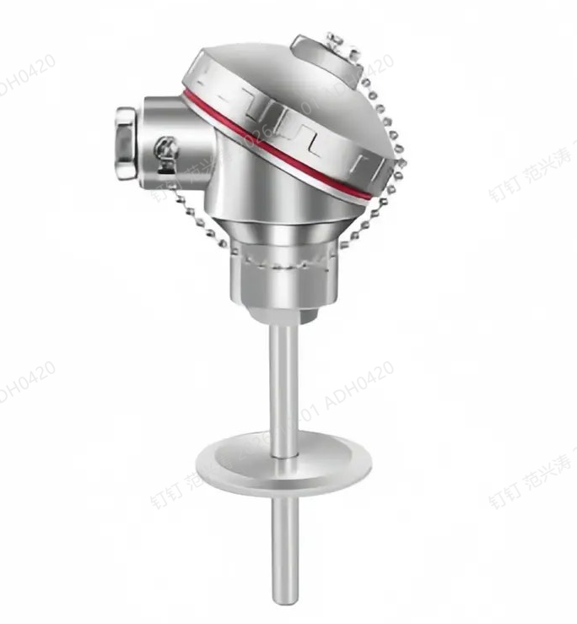
Temperature probe installation
Current vessels:
Top thermowell with thermal oil and a temperature sensor.
Replacement vessels:
A 50 mm probe inserted into an NA nozzle on the lower shell.

Slide 3
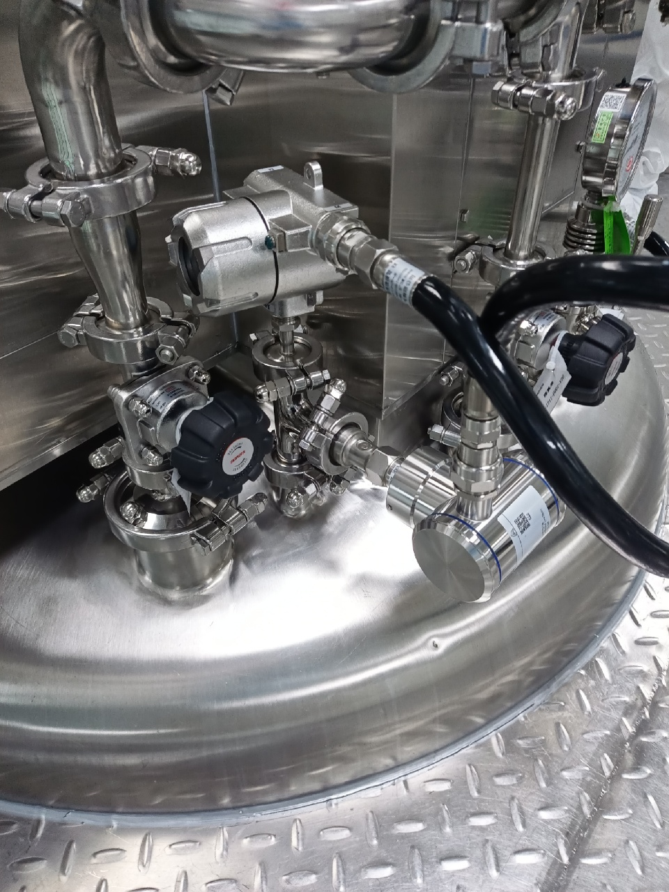
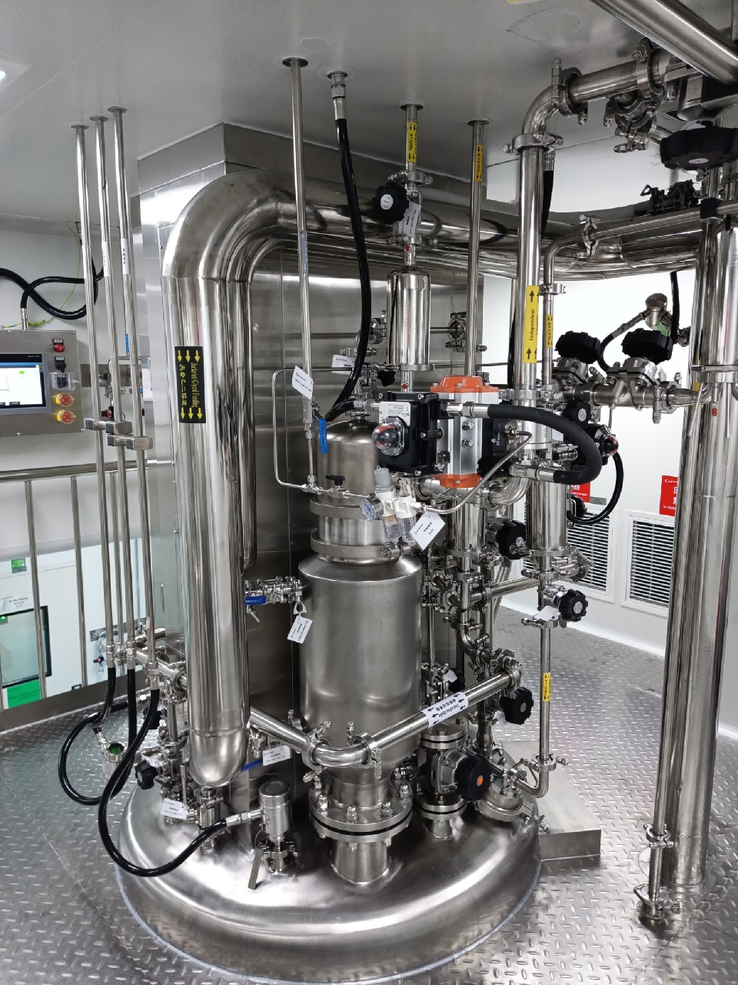
Pressure transmitter installation
Current:
Shared nozzle with other connections, such as the vent, through a tee.
Planned:
A dedicated nozzle.

Slide 4
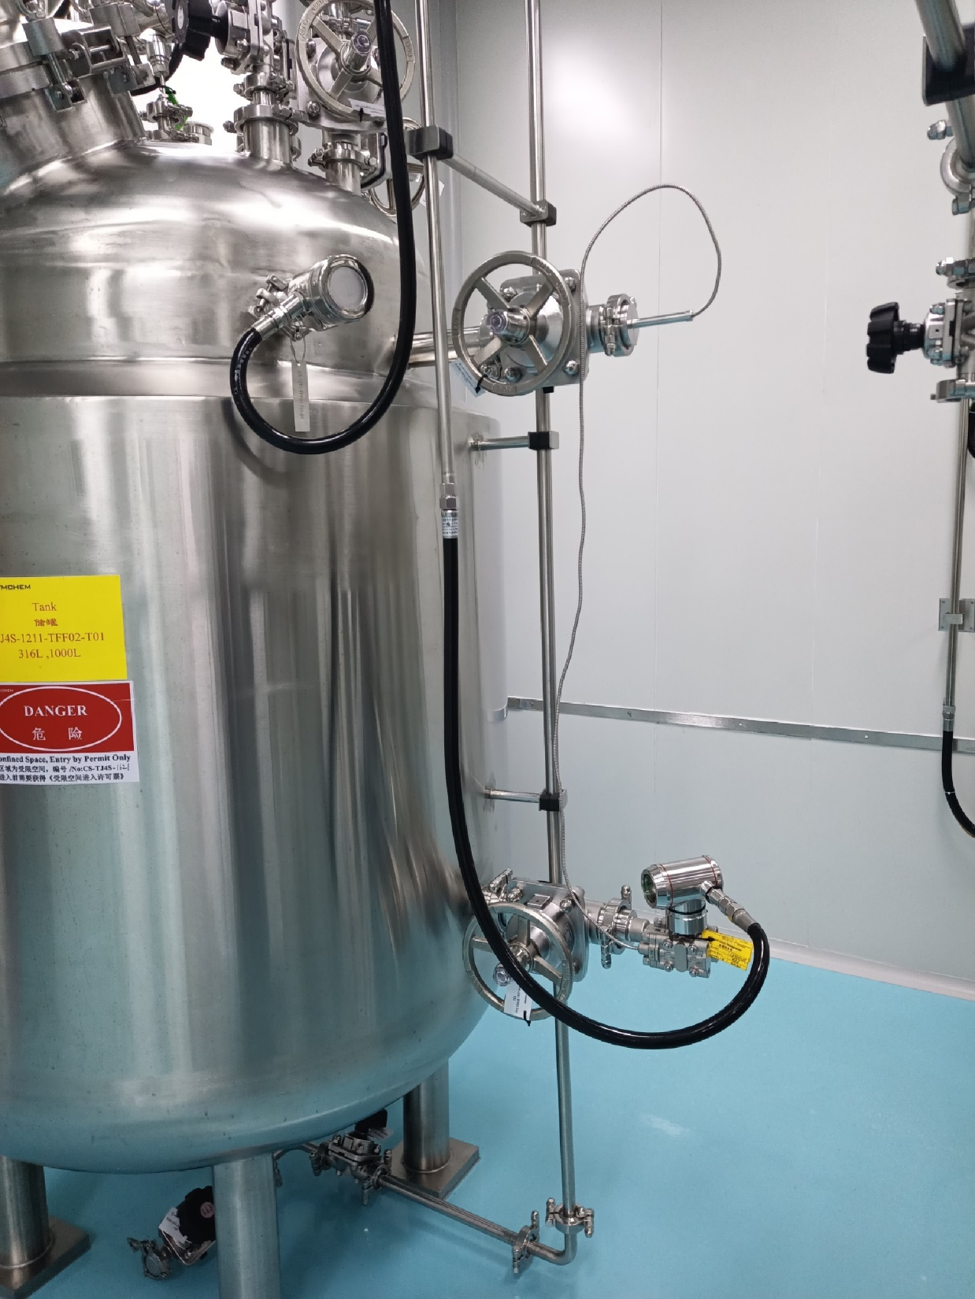
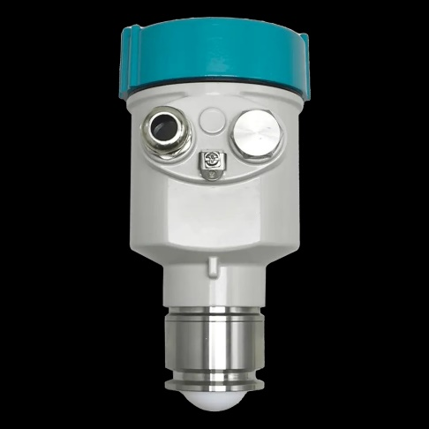
Level transmitter installation
Current vessels:
Upper and lower quick-open nozzles on the side, with a DP level transmitter.
Replacement vessels:
Radar level transmitter on the top NA nozzle.

Slide 5
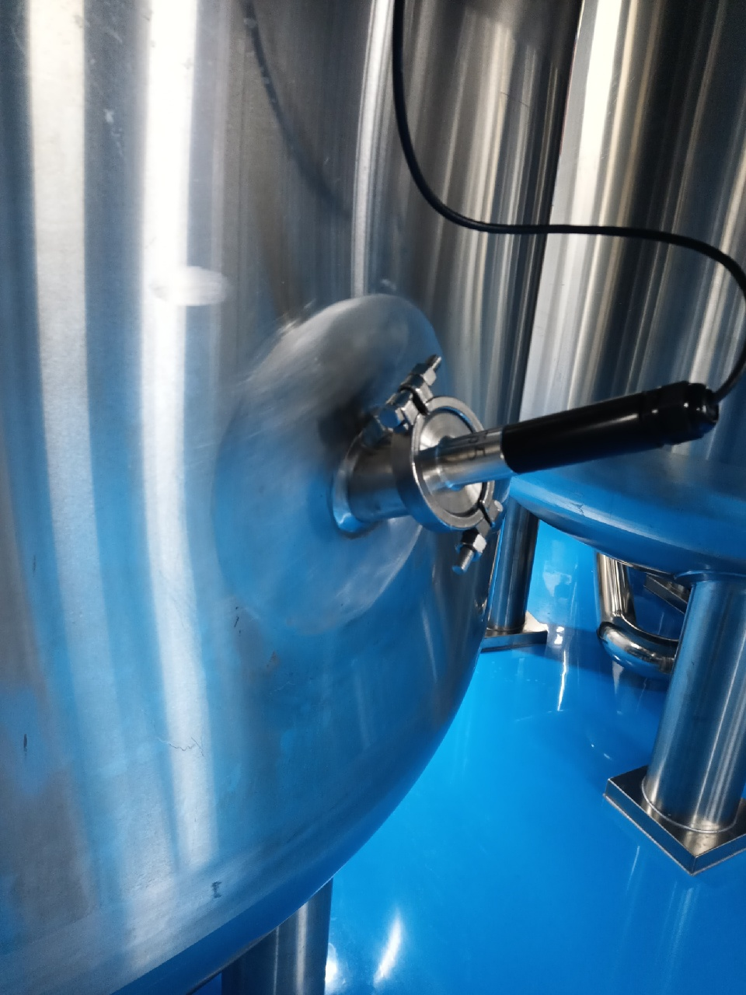
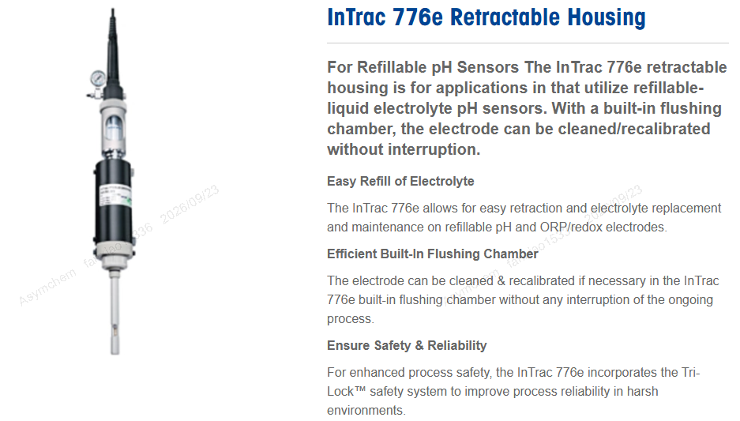
pH probe installation
Current vessels:
Non-retractable pH probe on a quick-open nozzle, low on the side wall.
Planned:
Retractable pH probe on an NA nozzle, low on the side wall.

Slide 6
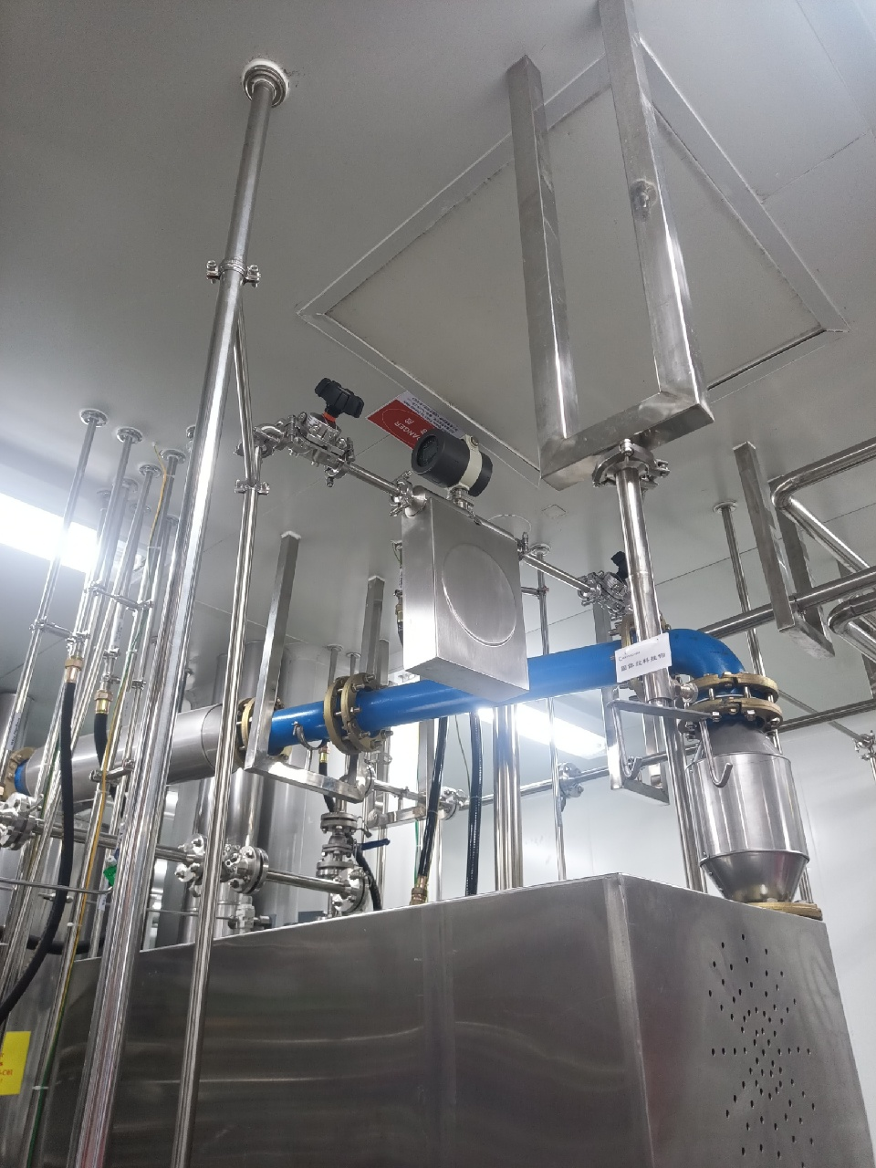
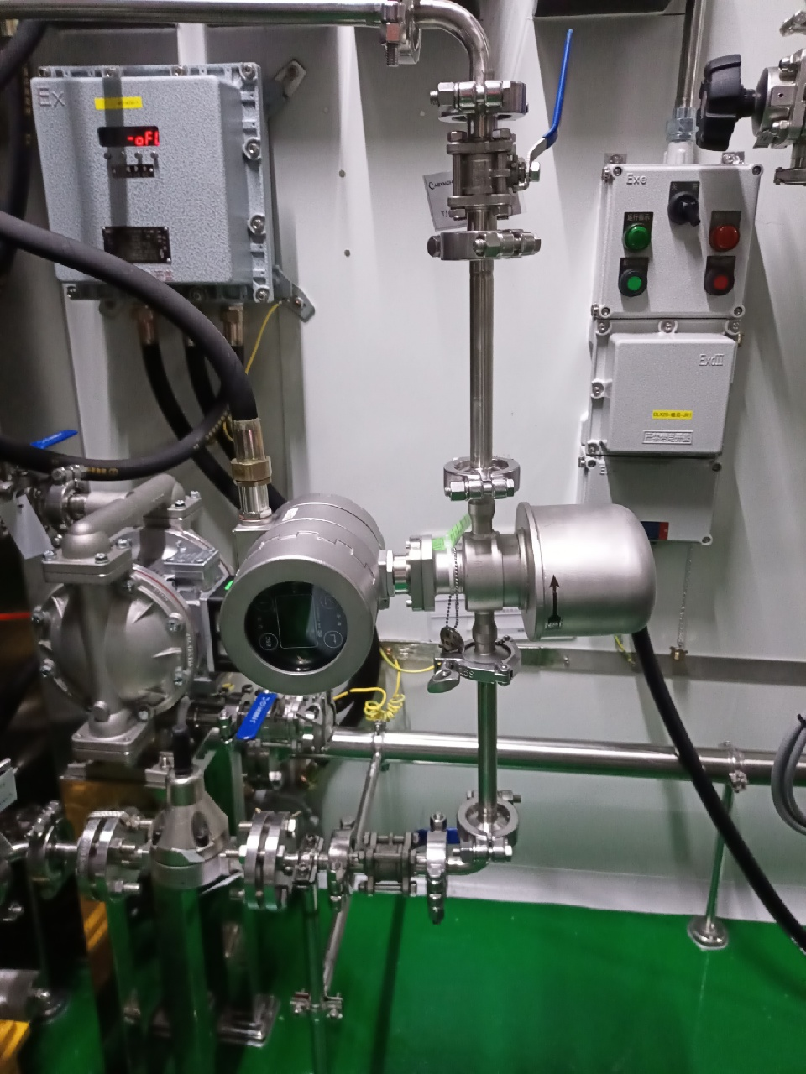
Mass flow meter installation
Current:
Horizontal installation. The meter cannot drain completely.
Revised:
Side installation. The meter drains by gravity.

