Slide 1
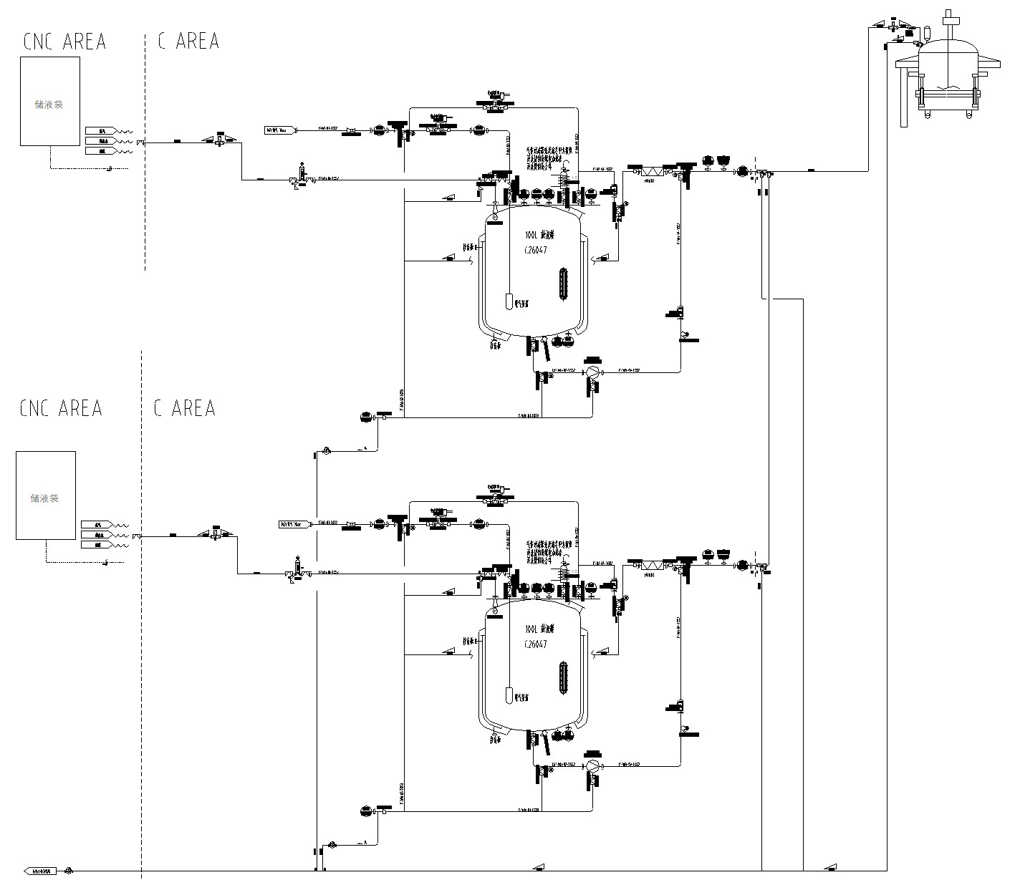
Humidified Nitrogen – Operating Strategy
Overall strategy for the humidified nitrogen system:
I. First Use
1. Alkaline cleaning: Recirculate alkaline solution and then purified water through the unit; finally, purge the unit with nitrogen and drain at the low points.
2. WFI rinse: Using a sterile bag and an aseptic connector, recirculate and spray-rinse the unit with WFI, then drain at the low points.
3. WFI charge: Charge WFI again through a sterile bag for use.
II. Periodic WFI Replacement
1. Drain at the low points.
2. Add fresh WFI, recirculate to rinse, then drain at the low points.
3. Recharge WFI for use.
III. Alternate Use of Two Humidifiers
Within the WFI replacement interval, the two units are periodically cleaned by recirculation per Section II and used alternately.

Slide 2
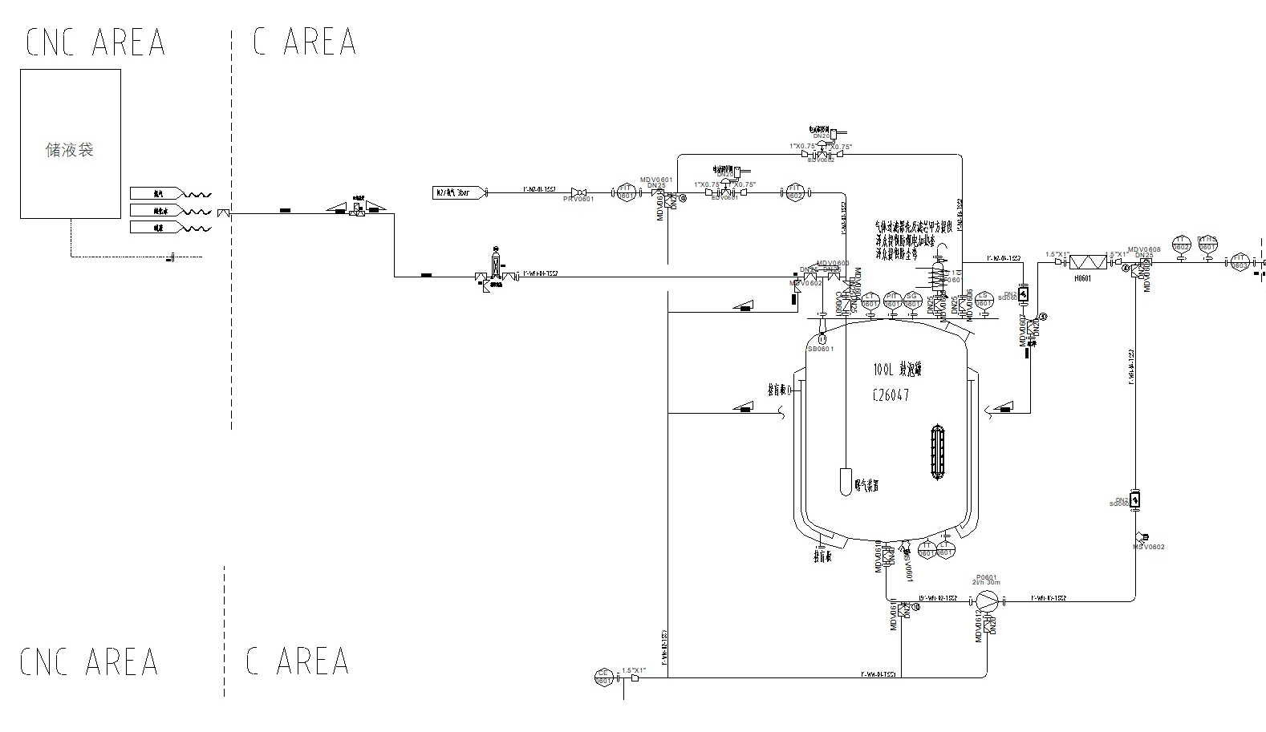
Low-Point Drain and High-Point Purge Locations
1. Material line into the clean area: fitted with a cleaning/purge port, allowing cleaning and purging in both directions.
2. Filter strategy: filters are cleaned off-line.
3. WFI pre-flush drain line.
4. Equipment low-point drain line.

Slide 3
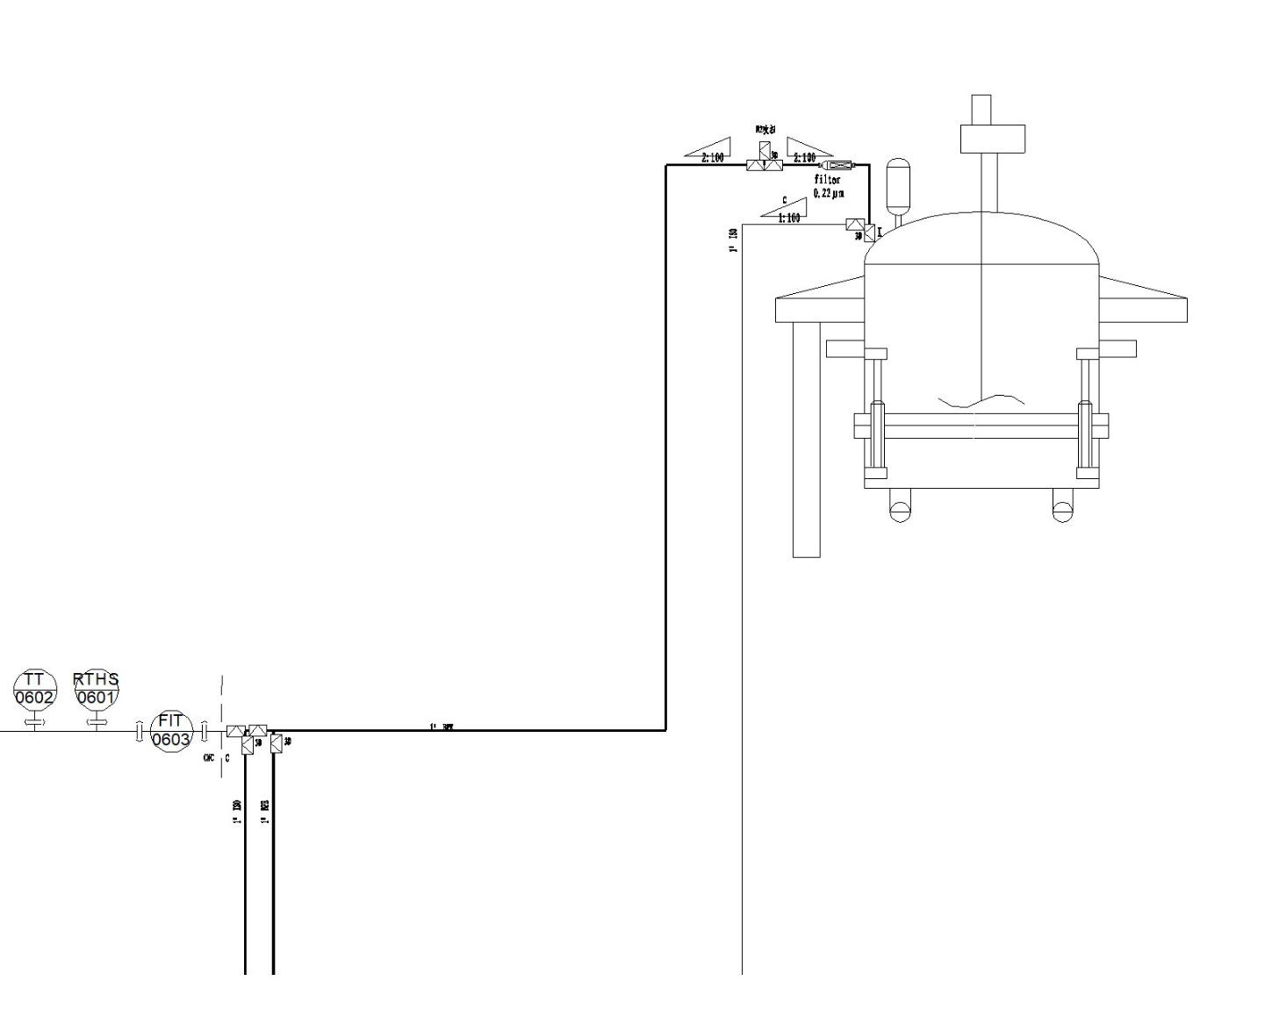
Low-Point Drain and High-Point Purge Locations
1. Humidified N₂ line to the AFD: fitted with a cleaning/purge port, allowing cleaning and purging in both directions.
2. Low-point drain of the humidified N₂ line to the AFD.
For Lilly's confirmation:
Should the valves at the drain and purge points be installed to a 2D or a 3D dead-leg requirement?
1. 2D — longer valve procurement lead time;
2. 3D — shorter valve procurement lead time; domestic equipment suppliers have confirmed that a 3D design can be cleaned effectively.

