Slide 1
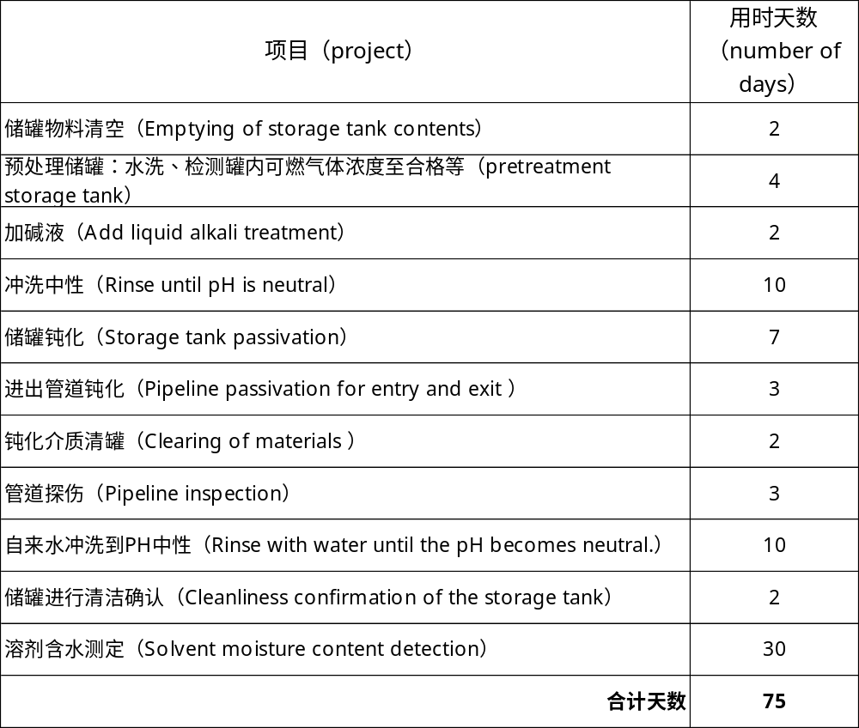

钝化方案及影响
钝化流程及耗时
备注：
1、单批储罐处理周期是75天。
The processing cycle for a single batch of storage tanks is 75 days.
2、因厂区硝酸用量不足，需重新申购，所以分批进行储罐钝化工作。
Due to insufficient nitric acid usage in the factory area, a new purchase is required, so the tank passivation work will be carried out in batches.
3、碱洗是处理管道残留油污
Rinsing with alkaline solution is used to remove residual oil stains from the pipes.
4、储罐钝化方式是人员入罐喷洒钝化液至检测合格。
The tank passivation method is to have personnel enter the tank and spray the passivation solution until it is qualified upon inspection.
5、管路钝化方式是钝化液侵泡至检测合格。
The pipeline passivation method is to immerse it in the passivation solution until it passes the inspection.
单批钝化预计耗时：75d

