Slide 1
Survey data analysis Week 9: “Designing weights”
© Peter Lugtig

Slide 2
Literature today
Exercise last week
How to design weights
Bias-variance trade-off
Adjustment error
Paradata
Short lecture
How to design and select covariates for weights?
Class discussion
Exercise on calibration, raking

Slide 3
Exercise nonresponse weights
Discussion
Is weighting succesful?
What happens to bias?
MAR or MNAR?
What happens to standard errors

Slide 4
Weighting methods
1. Propensity score weighting
Often using frame information from sample
Last week
2. post-stratification
3. linear weighting (GREG)
4. Raking
2-4 often based on population statistics

Slide 5
Nonresponse bias
Deterministic
It is a function of the nonresponse rate M/N and the difference between the respondents’ r and the nonrespondents’ m population values.
Probabilistic
It is a function of the correlation σ of the survey outcome y with the response propensity ρ and the mean response propensity measured in the target population (Bethlehem 2002).
Note that nonresponse bias is always estimate-specific!

Slide 6
Propensity weighting
Deterministic
It is a function of the nonresponse rate M/N and the difference between the respondents’ r and the nonrespondents’ m population values.
Probabilistic
It is a function of the correlation σ of the survey outcome y with the response propensity ρ and the mean response propensity measured in the target population (Bethlehem 2002).

Slide 7
Propensity-score weights
For propensity-score weights (logistic regression) models estimate the response propensity (predicted probability) of each sample unit given a set of covariates.
Response rate for all linear combinations of for example:
response[0;1] ~ gender+age+region+typehouse
Weight is the scaled inverse of the predicted response propensity of each sample unit.
Design weight = sample inclusion probability
Propensity weight = participation probability

Slide 8
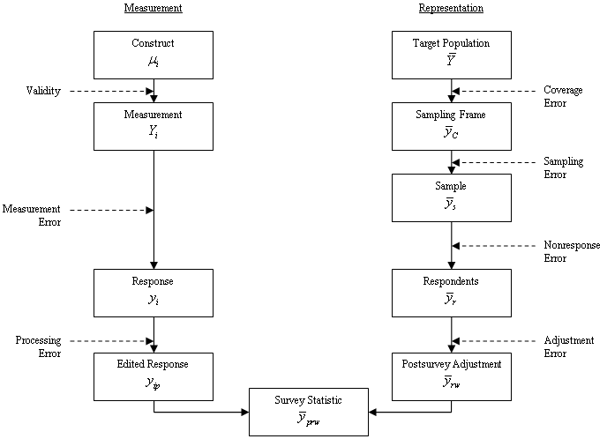
Post-stratification
Deterministic approach
Uses population statistics
Correct multiple error sources in one go
Nonresponse
Coverage

Slide 9
Post-stratification: fictitious example
Survey distribution
Population distribution
Age | Gender
 | Male | Female
16-25 | 6.1% | 5.9%
26-35 | 12.8% | 10.7%
36-45 | 19.5% | 16.9%
46-55 | 10.0% | 9.5%
56-65 | 3.9% | 4.7%
Age | Gender
 | Male | Female
16-25 | 10.0% | 10.0%
26-35 | 10.0% | 10.0%
36-45 | 10.0% | 10.0%
46-55 | 10.0% | 10.0%
56-65 | 10.0% | 10.0%
Male respondents aged 16-25 receive a weight of w = 0.1/0.061 = 1.639

Slide 10
Post-stratification: fictitious example
Survey distribution
Population distribution
Age | Gender
 | Male | Female
16-25 | 6.1% | 5.9%
26-35 | 12.8% | 10.7%
36-45 | 19.5% | 16.9%
46-55 | 10.0% | 9.5%
56-65 | 3.9% | 4.7%
Age | Gender
 | Male | Female
16-25 | 10.0% | 10.0%
26-35 | 10.0% | 10.0%
36-45 | 10.0% | 10.0%
46-55 | 10.0% | 10.0%
56-65 | 10.0% | 10.0%
Female respondents aged 36-45 receive a weight of w = 0.1/0.169 = 0.592

Slide 11
Post-stratification: fictitious example
Survey distribution
Population distribution
Age | Gender
 | Male | Female
16-25 | 6.1% | 5.9%
26-35 | 12.8% | 10.7%
36-45 | 19.5% | 16.9%
46-55 | 10.0% | 9.5%
56-65 | 3.9% | 4.7%
Age | Gender
 | Male | Female
16-25 | 10.0% | 10.0%
26-35 | 10.0% | 10.0%
36-45 | 10.0% | 10.0%
46-55 | 10.0% | 10.0%
56-65 | 10.0% | 10.0%
In R (using survey library):
PostStratify(design= svy.unweighted, strata = agegender, population=agegender.dist

Slide 12
When does weighting work?
Target variables vary little within strata
Response probabilities vary little within strata
Target variable and response probabilities are not correlated within strata (=MAR)
Example Unit Nonresponse:
Income varies little within gender and age (male/female)
Given gender and age, there is little variation in response rates
Given gender and age, there is no correlation between probability of response and income

Slide 13
When does weighting work?
Target variables vary little within strata
Response probabilities vary little within strata
Target variable and response probabilities are not correlated within strata (=MAR)
Example Unit Nonresponse:
Income varies little within gender and age (male/female)
Given gender and age, there is little variation in response rates
Given gender and age, there is no correlation between probability of response and income
Unlikely

Slide 14
How to weight better…
Use more variables in weighting
Gender, age, …
To improve relation X-> R and X->Y
Problems:
1. There may be empty strata
Combine empty strata
Use fewer variables
2. The population distribution across all variables may not be available

Slide 15
Raking aka multiplicative weighting
Raked weights adjust the individual distributions of key survey variables to known joint population distributions.
Raking is an iterative process.

Slide 16
Raking: fictitious example
Survey distribution
Population distribution
Gender
Male | 52.3%
Female | 47.7%
Gender
Male | 50.0%
Female | 50.0%
Age
16-25 | 12.0%
26-35 | 23.5%
36-45 | 36.4%
46-55 | 19.5%
56-65 | 8.6%
Age
16-25 | 20.0%
26-35 | 20.0%
36-45 | 20.0%
46-55 | 20.0%
56-65 | 20.0%

Slide 17
Raking: fictitious example
Survey distribution
Population distribution
Gender
Male | 52.3%
Female | 47.7%
Gender
Male | 50.0%
Female | 50.0%
Age
16-25 | 12.0%
26-35 | 23.5%
36-45 | 36.4%
46-55 | 19.5%
56-65 | 8.6%
Age
16-25 | 20.0%
26-35 | 20.0%
36-45 | 20.0%
46-55 | 20.0%
56-65 | 20.0%
The survey distributions are iteratively adjusted to the age and gender population distributions until an equilibrium is reached.

Slide 18
Raking: fictitious example
Survey distribution
Population distribution
Gender
Male | 52.3%
Female | 47.7%
Gender
Male | 50.0%
Female | 50.0%
Age
16-25 | 12.0%
26-35 | 23.5%
36-45 | 36.4%
46-55 | 19.5%
56-65 | 8.6%
Age
16-25 | 20.0%
26-35 | 20.0%
36-45 | 20.0%
46-55 | 20.0%
56-65 | 20.0%
Raking in R with survey library:
rake(design = svy.unweighted,
sample.margins = list(~sex, ~age), population.margins = list(sex.dist, age.dist))

Slide 19
Alternative: Linear weighting
Aka Generalized Regression Estimator (GREG) or calibration
Fixes problem of empty population cells
Fixes problem of population distribution
Sample Population
 | Male | Female | Total
Young | 23 | 15 | 38
Middle | 16 | 17 | 33
Old | 13 | 16 | 39
Total | 52 | 48 | 100
 | Male | Female | Total
Young | ? | ? | 43
Middle | ? | ? | 30
Old | ? | ? | 27
Total | 51 | 49 | 100%
With thanks to Jelke Bethlehem for this example

Slide 20


Linear weighting
Assume there are p continuous auxiliary variables
Similar to propensity score weighting (other link-function)
Required: vector of population means
Estimate: conditional RR (most likely) for combinations of categories of p
Best value for B (least squares):
Sample-based estimate (full response):
With thanks to Jelke Bethlehem for this example

Slide 21
Linear weighting
Gender | Age | X1 | X2 | X3 | X4 | X5 | X6
Male | Young | 1 | 1 | 0 | 1 | 0 | 0
Male | Middle | 1 | 1 | 0 | 0 | 1 | 0
Male | Old | 1 | 1 | 0 | 0 | 0 | 1
Female | Young | 1 | 0 | 1 | 1 | 0 | 0
Female | Middle | 1 | 0 | 1 | 0 | 1 | 0
Female | Old | 1 | 0 | 1 | 0 | 0 | 1
Sample prop |  | - | .52 | .48 | .38 | .33 | .39
Population prop. |  | 1.00 | .51 | .49 | .43 | .30 | .27
Weights |  | 1.00
Weight for X2 (as in raking):
Naive - .51/.52 = .98 (But correlated with x4-x6

Slide 22
Linear weighting
Gender | Age | X1 | X2 | X3 | X4 | X5 | X6
Male | Young | 1 | 1 | 0 | 1 | 0 | 0
Male | Middle | 1 | 1 | 0 | 0 | 1 | 0
Male | Old | 1 | 1 | 0 | 0 | 0 | 1
Female | Young | 1 | 0 | 1 | 1 | 0 | 0
Female | Middle | 1 | 0 | 1 | 0 | 1 | 0
Female | Old | 1 | 0 | 1 | 0 | 0 | 1
Sample prop |  | - | .52 | .48 | .38 | .33 | .39
Population prop. |  | 1.00 | .51 | .49 | .43 | .30 | .27
Weights |  | 1.00
Weight for X2 (as in raking):
Minimize total distance across variables
.503/ .52 = .967. Weight = -.033

Slide 23
Linear weighting
Linear weighting computations
Weight for young female = 1 +.033+.161=1.185
Gender | Age | X1 | X2 | X3 | X4 | X5 | X6
Male | Young | 1 | 1 | 0 | 1 | 0 | 0
Male | Middle | 1 | 1 | 0 | 0 | 1 | 0
Male | Old | 1 | 1 | 0 | 0 | 0 | 1
Female | Young | 1 | 0 | 1 | 1 | 0 | 0
Female | Middle | 1 | 0 | 1 | 0 | 1 | 0
Female | Old | 1 | 0 | 1 | 0 | 0 | 1
Sample prop |  | - | .52 | .48 | .38 | .33 | .39
Population prop. |  | 1.00 | .51 | .49 | .43 | .30 | .27
Weights |  | 1.00 | -.033 | .033 | .161 | -.095 | -.066

Slide 24
Linear weighting
Linear weighting computations
Gender | Age | X1 | X2 | X3 | X4 | X5 | X6
Male | Young | 1 | 1 | 0 | 1 | 0 | 0
Male | Middle | 1 | 1 | 0 | 0 | 1 | 0
Male | Old | 1 | 1 | 0 | 0 | 0 | 1
Female | Young | 1 | 0 | 1 | 1 | 0 | 0
Female | Middle | 1 | 0 | 1 | 0 | 1 | 0
Female | Old | 1 | 0 | 1 | 0 | 0 | 1
Sample prop |  | - | .52 | .48 | .38 | .33 | .39
Population prop. |  | 1.00 | .51 | .49 | .43 | .30 | .27
Weights |  | 1.00 | -.033 | .033 | .161 | -.095 | -.066
In R using survey library:
Calibrate(design=svy.unweighted, formula = ~age+gender , population=c(sex.dist,age.dist)

Slide 25
GREG or Raking?
GREG
Clear model
Variance of estimators can be computed
Can include continuous weighting variables (e.g. age)
Assumptions of regression model (normality, linearity)
Weights may become negative (causing computational problems)
Raking
No model, no assumptions
No variance estimation
Only categorical variables

Slide 26
Total Survey Error (TSE) Framework
(Groves et al. 2009, p.48)

Slide 27
Total Survey Error (TSE) Framework
(Groves et al. 2009, p.48)
Notes:
Die Fehler erst nach und nach einblenden!!!!

Slide 28
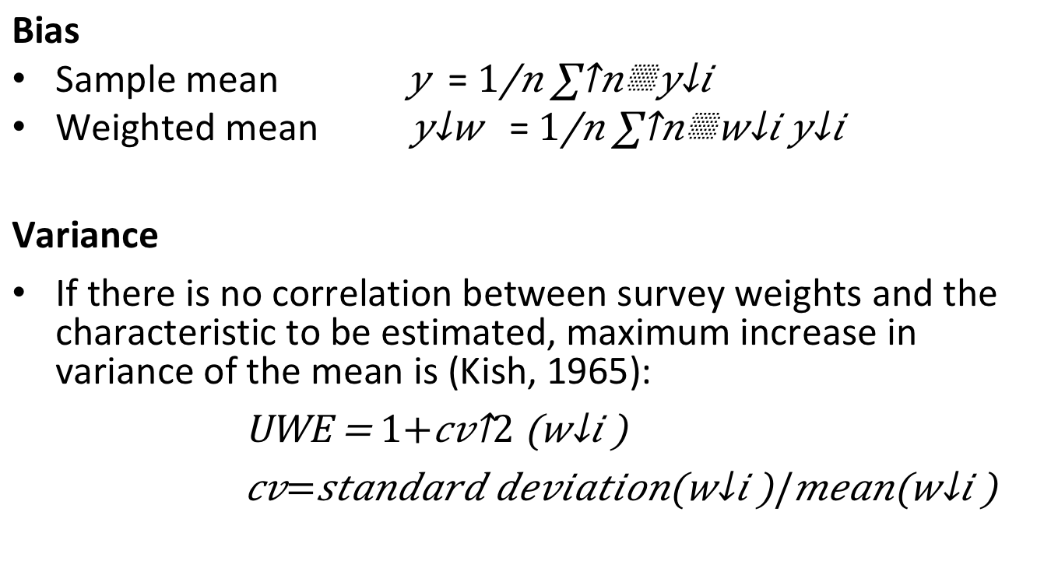
Bias-variance trade-off
Bias
Sample mean $\overline{ y}$ = $\frac{1}{n}\sum^{n}{y_{i}}$
Weighted mean $\overline{ y_{w}}$ = $\frac{1}{n}\sum^{n}{w_{i}y_{i}}$
Variance
If there is no correlation between survey weights and the characteristic to be estimated, maximum increase in variance of the mean is (Kish, 1965):
UWE = $1+{cv}^{2}\left(w_{i}\right)$
$cv=standard deviation\left(w_{i}\right)/mean\left(w_{i}\right)$

Slide 29
Succesful NR weighting
When (NR) weighting is succesful
Little and Vartivarian (2005)
 | X -> Y weak | X -> Y strong
X-> R weak | Nothing happens | Still bias Variance deflation
X -> R strong | Still bias Variance inflation | Bias reduction Variance reduction
X
Z
R
Y
MAR

Slide 30
Bias-variance trade-off(2)
To avoid the inflation of variance
Outlier trimming
Trimming weights >3 to 3
Propensity score weighting
Use 5 bands of propensity scores

Slide 31
Designing weights
Sample level information
Location, gender, age, ….
?
Population level information
LOTS of potential variables
Gender, age, education, ethnicity, region, income
Membership of union, newspaper readership, politically active, visited the Efteling, etc,

Slide 32
Designing weights
Sample level information
Location, gender, age, ….
? ---- paradata
Population level information
LOTS of potential variables
Gender, age, education, ethnicity, region, income
Membership of union, newspaper readership, politically active, visited the Efteling, etc,

Slide 33
Paradata
By-product of doing research
Surveys
F2f: Interviewer observations
Or Recordings
CATI: Call record data
WEB: Browser data, Response timings, section timings, evaluation questions, etc.

Slide 34
Paradata – so what?
Interviewer observations
Useful in nonresponse corrections
Strong link X -> Y
X
Z
X
Z
X
Z
R
Y
R
Y
R
Y
MCAR
MAR
MNAR

Slide 35
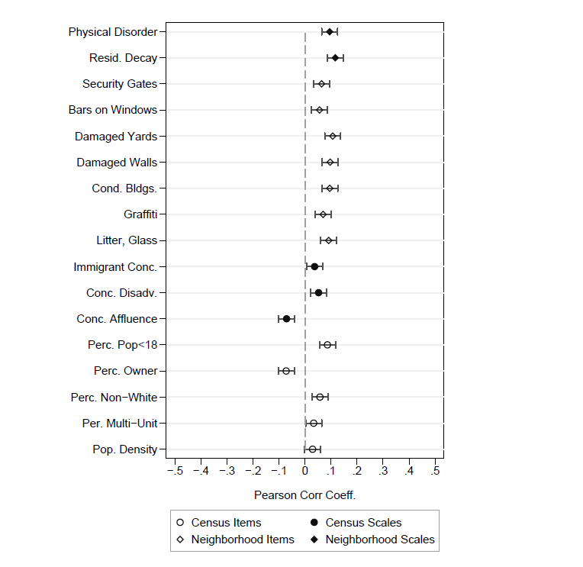
Interviewer observations example Casas-Cordero (2010)
Relations X -> R.
Bivariate (logistic) relations rather weak,
… but strong link with Y?
Figure taken from Casas-Cordero (2010)

Slide 36
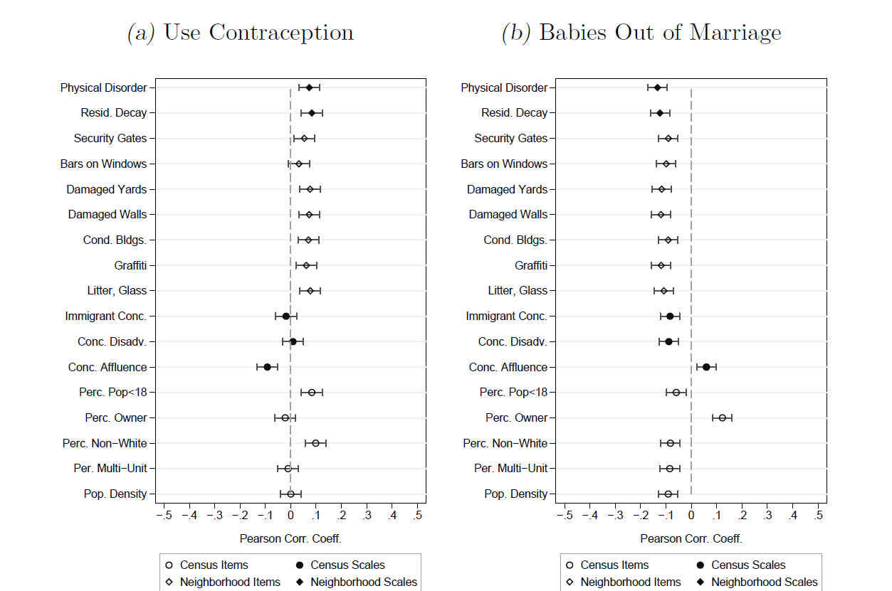
Interviewer observations (2)
Relation X-> Y. Figure taken from Casas-Cordero (2010)

Slide 37
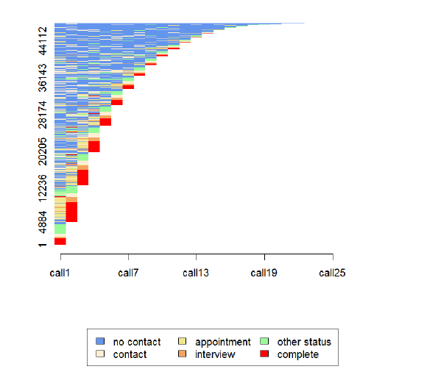
Call record data?
Sequence analysis
Taken from Durrant, Mavlovskaya & Smith, 2014, Sequence analysis as a tool for analysing call record data. NCRM working papers

Slide 38
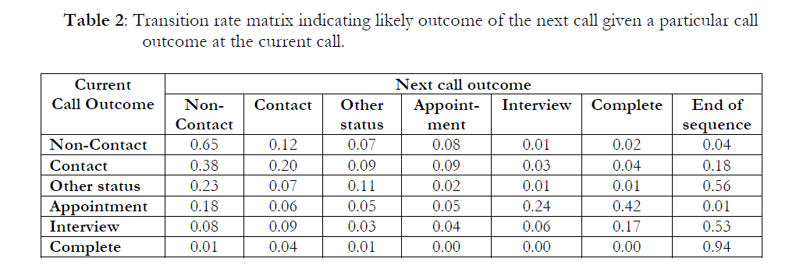
Call record data
Taken from Durrant, Mavlovskaya & Smith, 2014, Sequence analysis as a tool for analysing call record data. NCRM working papers

Slide 39

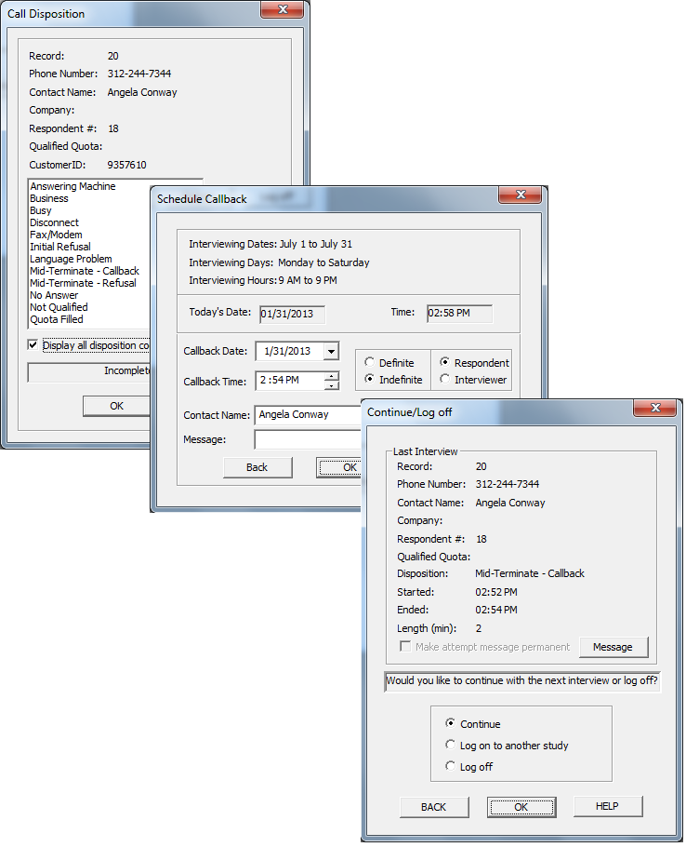
Fieldwork monitoring Telephone
Telephone
Highly centralized
Automatic call schedules ->
If not automated
Vary the time and day of calling
Try to predict best calling times
E.g. if someone works, probably try in evening
Keep to your appointments
Record interviewers if possible
For analysis and quality control purposes

Slide 40
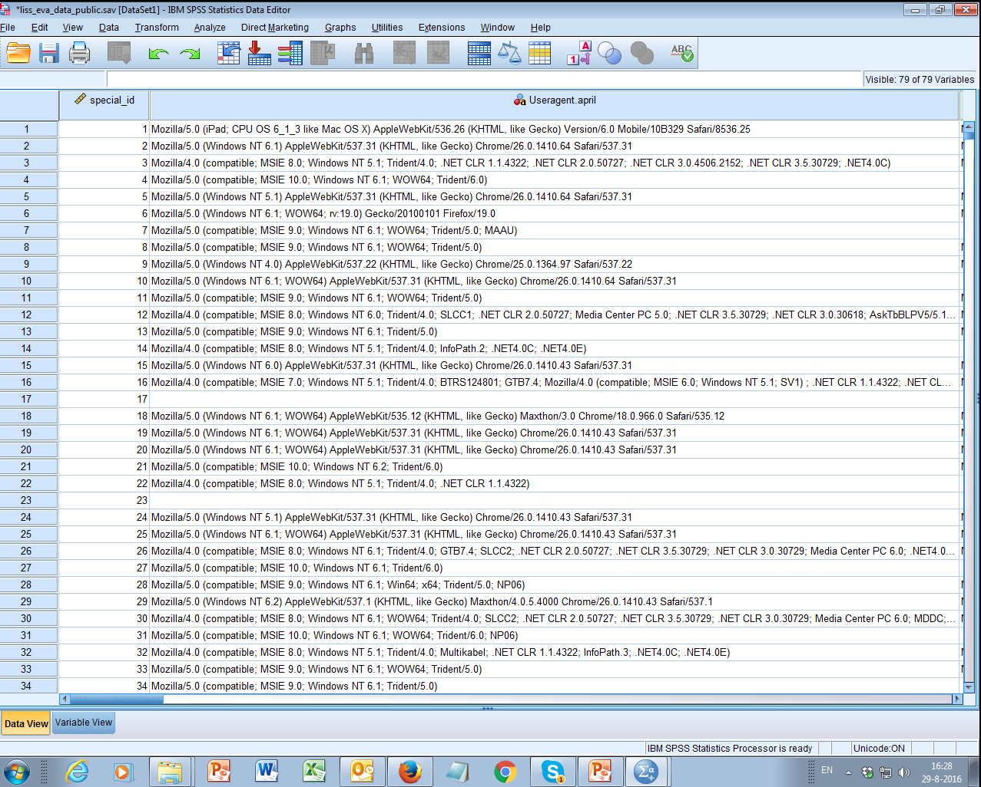
Paradata – web
User Agent strings:

Slide 41
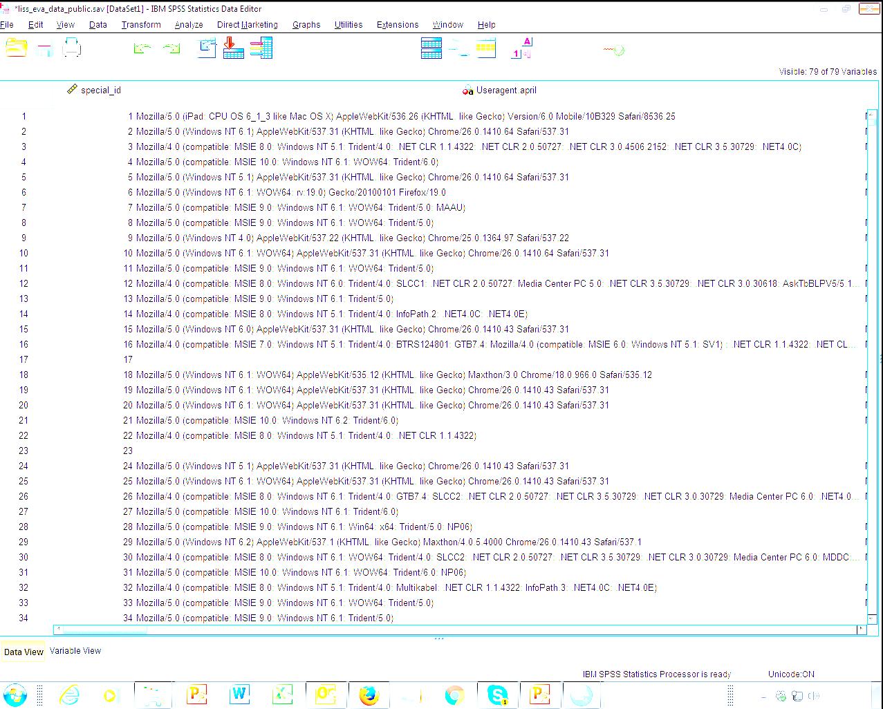
Device type: ipad
Operating system: OS X 6.1.3
Browser: Safari
Version: 6.0

Slide 42
User agent strings Example by Lugtig and Toepoel (2015)
% Device used in month (t) |  | % Device used in May
 |  | PC | Tablet | Phone | No participation |  | N | % of wave respondents
April | PC | 77.4 | 1.1 | 0.4 | 21.1 |  | 4966 | 90.2
 | Tablet | 19.3 | 24.4 | 0.2 | 56.1 |  | 435 | 7.8
 | Phone | 33.9 | 4.6 | 30.3 | 31.2 |  | 109 | 2.0
 | No participation | 37.6 | 2.1 | 0.8 | 59.4 |  | 715 | -

Slide 43
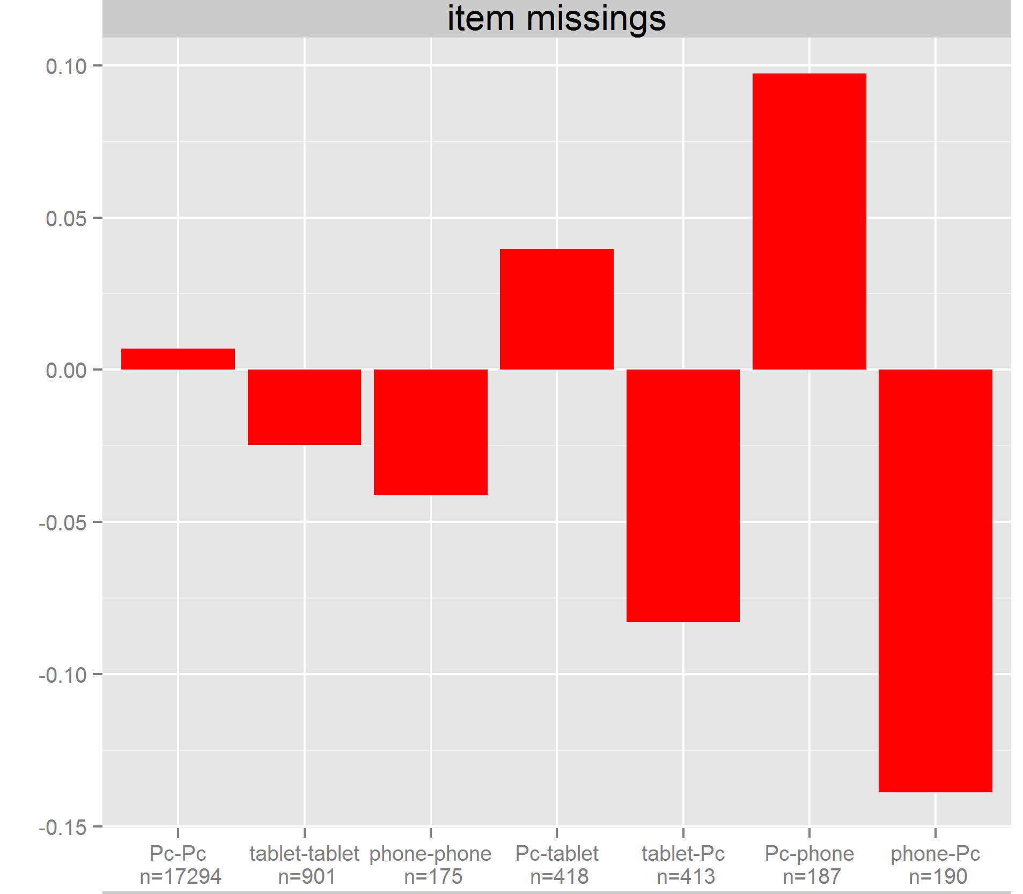
User agent strings Example by Lugtig and Toepoel (2)

Slide 44
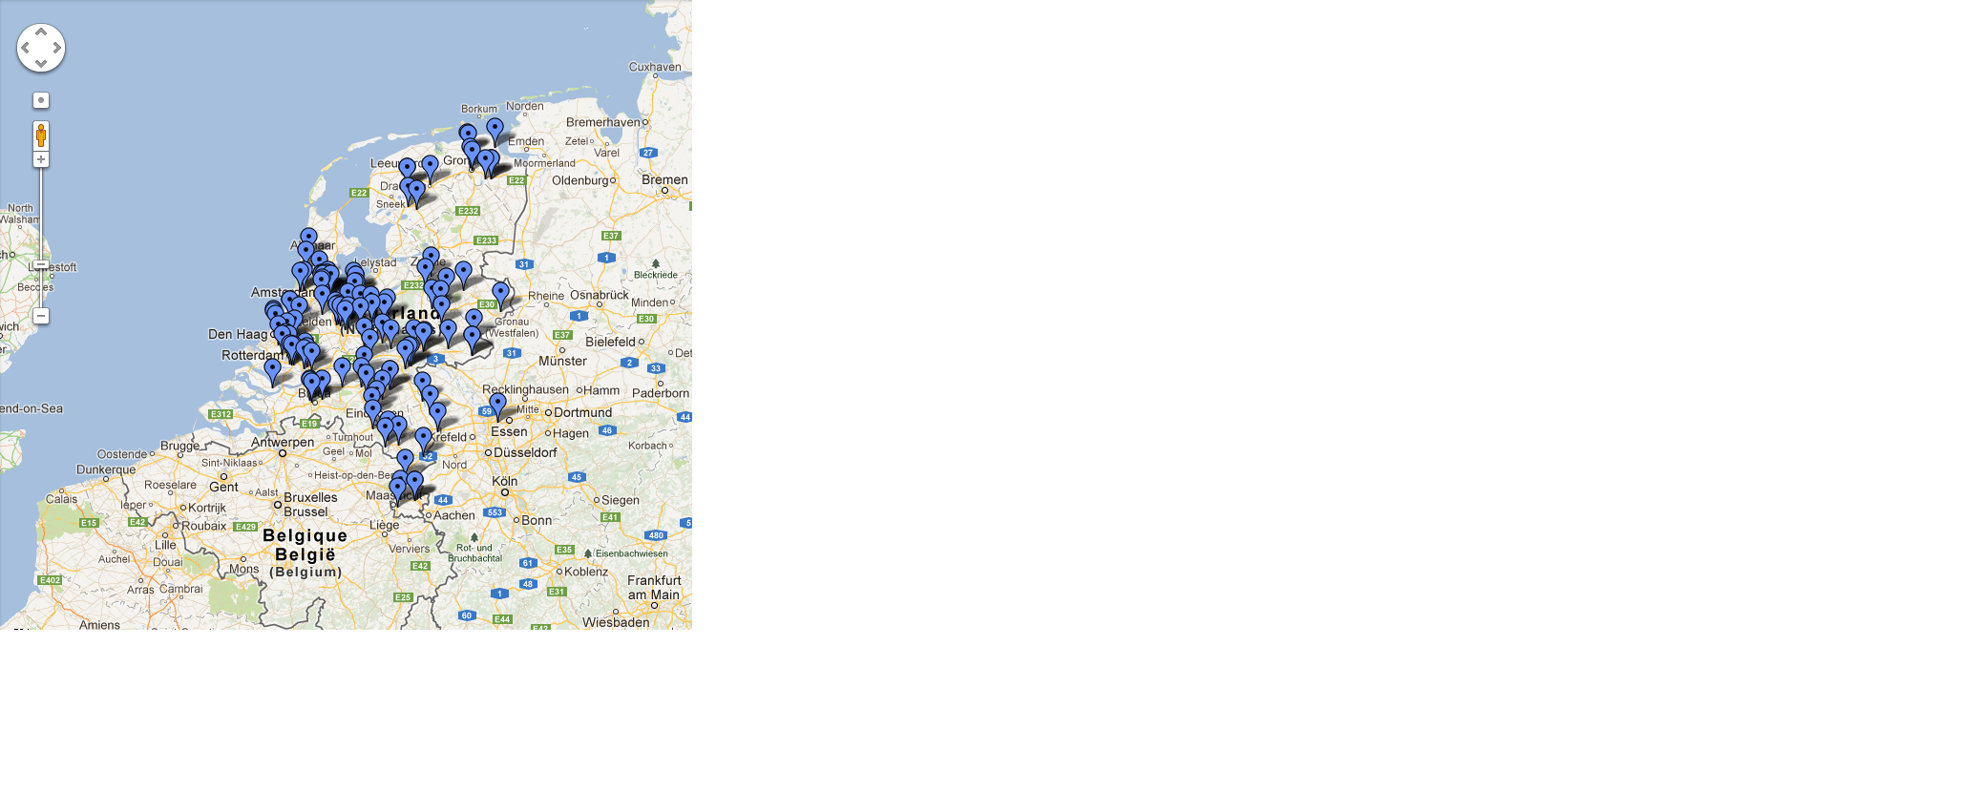
Paradata +++
Taken from Toepoel and Lugtig (2014)
more in week “designed big data”

Slide 45
How to use paradata
Scheduling what to do next -> reduce costs
Call scheduling, interviewer visits
Planning next wave of data collection
Longitudinal, or repeated surveys
For corrections!
Use interviewer observations to weight (or impute)
Use type of nonresponse and make separate models.
Noncontact <- age + #hh members + work
Refusal <- level of education + gender

Slide 46
Designing weights in R
Design your study such that
You get a rich frame (paradata)
You ask about known population statistics that predict Y
2. Find variables (x) that predict both R and Y
propensity score weighting
Poststratify
calibrate (linear weighting)
Rake

Slide 47
Combining weights
Designing weights can have several stages. For example:
The design weight is derived from the sampling frame (and the household selection during fieldwork).
Propensity-score weights are calculated using information from the sampling frame and the response indicator.
The data are post-stratified to known population distributions.
Weights can be combined : W1 * W2 * W3 = Wt
Often only the total Weight included in public datasets
No detailed information on sampling design or nonresponse correlates
Or svydesign for sampling plan, use weights for nonresponse and coverage

Slide 48
Class exercise
Website of Statistics Netherlands: statline
https://opendata.cbs.nl/statline/#/CBS/en/
Find auxiliary variables for your scenario
Should predict your Y
… and nonresponse
15 minutes in groups of 4

Slide 49
How to use variables in R…
‘survey’ library
Imagine: auxiliary data for sex, age
PostStratify(design= svy.unweighted, strata = agegender, population=agegender.dist
rake(design = svy.unweighted, sample.margins = list(~sex, ~age), population.margins = list(sex.dist, age.dist))
Calibrate(design=svy.unweighted, formula = ~age+gender , population=c(sex.dist,age.dist)

Slide 50
Next week
Finish exercise on creating weights
Next week:
Designed big data

Slide 51
Now: work on exercise
Exercise on creating your own weights
Poststratification
Propensity weighting
Raking
All with the survey package

