Slide 1
Survey data analysis Week 8: “Nonresponse and nonresponse weights”
© Peter Lugtig

Slide 2
Today
Lecture on NR
Exercise working with weights

Slide 3
Literature today
The increasing problem of nonresponse
Details of weighting methods
Kalton and Flores-cervantes (2003)
Brick (2013)

Slide 4
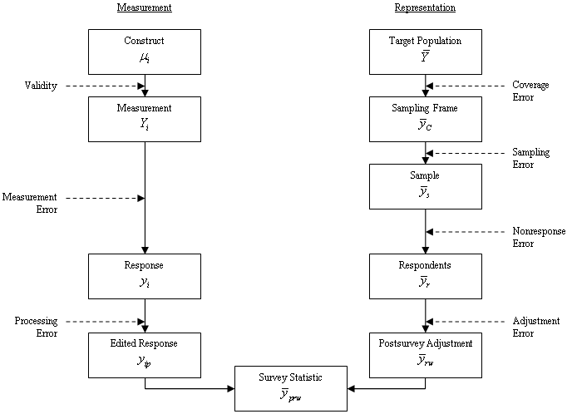
Total Survey Error (TSE) Framework
(Groves et al. 2009, p.48)

Slide 5
Nonresponse in LFS over time
Based on Luiten, De leeeuw & Hox (2018) nternational Nonresponse Trends across Countries and Years: An analysis of 36 years of Labour Force Survey data. Survey Insights: Methods from the Field. Retrieved from https://surveyinsights.org/?p=10452.

Slide 6
European Social Survey Nonresponse
From: Beullens, K., Loosveldt G., Vandenplas C. & Stoop I. (2018).Response Rates in the European Social Survey: Increasing, Decreasing, or a Matter of Fieldwork Efforts? Survey Methods: Insights from the Field. Retrieved from
https://surveyinsights.org/?p=9673

Slide 7
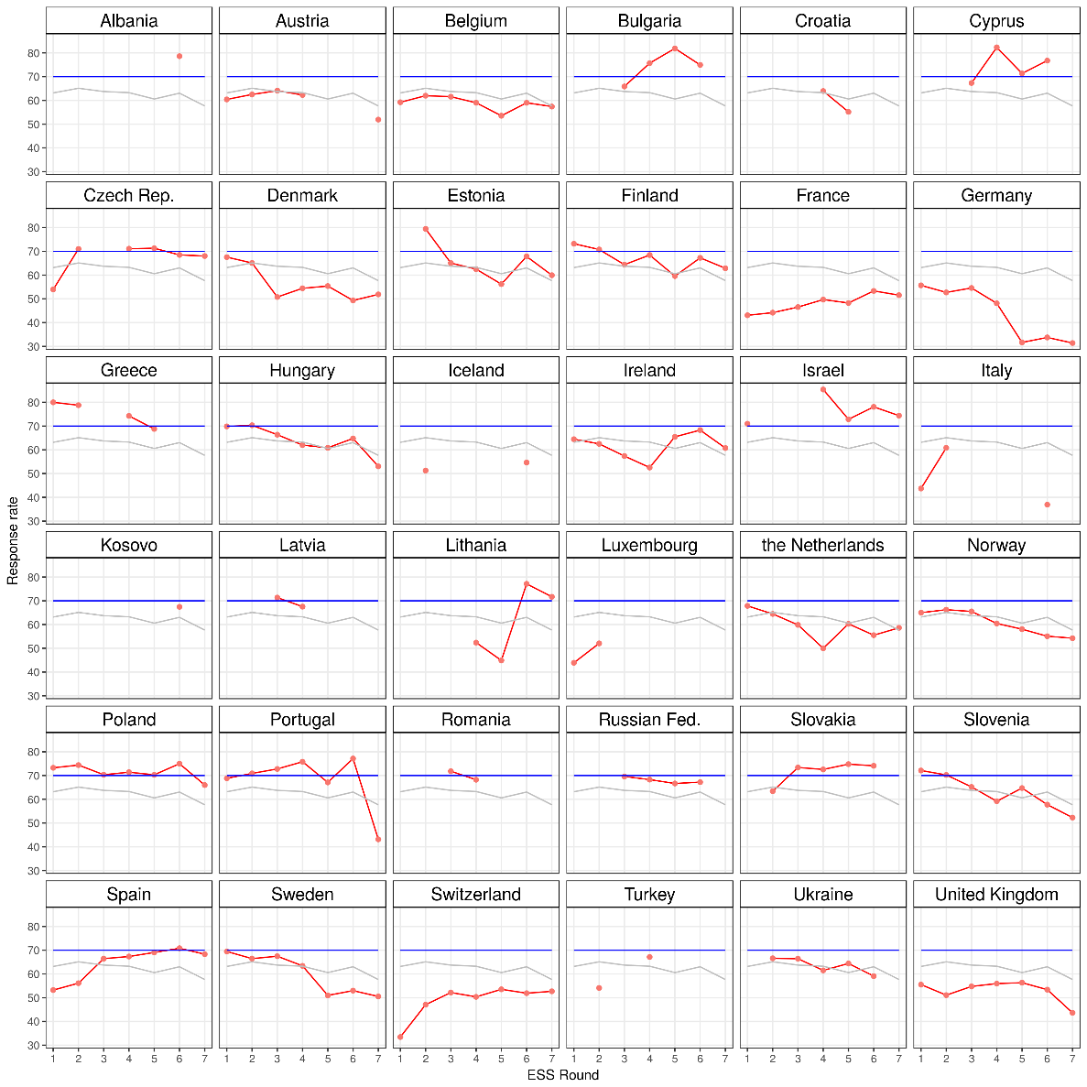
ESS: RR variation in response rate

Slide 8
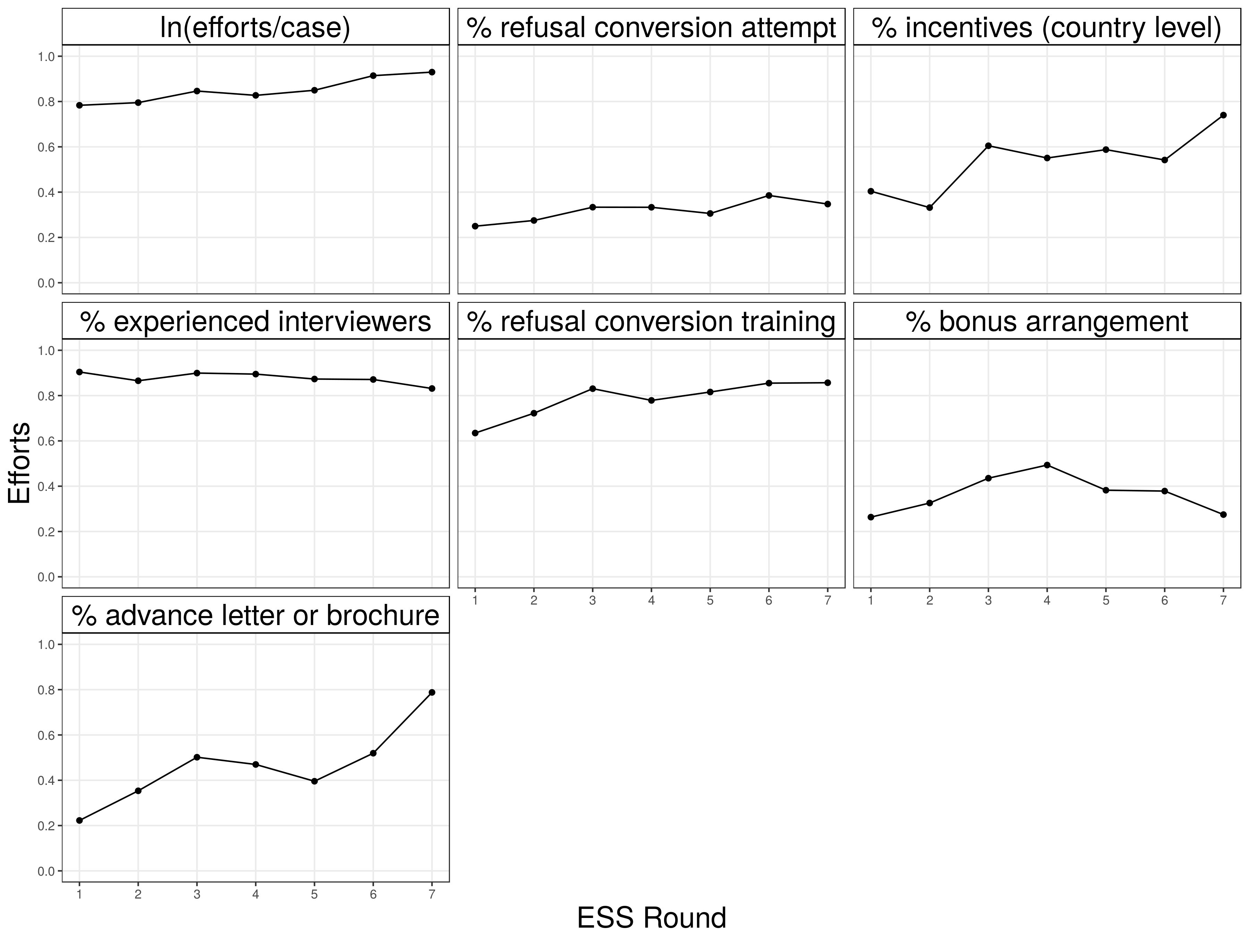
ESS – increase in fieldwork efforts

Slide 9
Four main types of nonresponse
In survey research we typically distinguish four types of nonresponse:
Unit nonresponse The sample unit (e.g. person, household, institution) was sampled, i.e. belonged to the gross sample, but did not participate in the survey.
Item nonresponse The sample unit was sampled and interviewed, but failed to provide answers to all of the survey items.
Attrition The sample unit was sampled and initially interviewed for a longitudinal surveys, but did not complete all waves of the survey.
Partial (household) nonresponse The sample unit was sampled and at least one member of the unit interviewed. However, at least one member of the unit did not participate.

Slide 10
Main causes of nonresponse
Unit nonresponse non-contact, refusal, unable
Item nonresponse refusal, don’t know, breakoff
Attrition non-location, non-contact, refusal, unable
Partial (household) nonresponse non-contact, refusal, unable

Slide 11
How to prevent nonresponse
Things you noticed in your adopted survey?

Slide 12
How to prevent nonresponse
A good questionnaire, invitation letter, etc.
keep it simple, keep it simple, test it
Incentives
Preferable unconditional, and cash
3. Multiple contact attempts
4. Multiple modes (e-mail, mail, phone, f2f)
5. Refusal conversion
- Interviewer training
6. Be responsive to questions/remarks/problems

Slide 13
Correction for nonresponse
Item nonresponse
Rich information on individual
Partial (household) nonresponse
Proxy-answers, information on household
Attrition
Information from earlier waves
Unit nonresponse
Weak individual information (only frame)
Imputation
weighting

Slide 14
What is nonresponse bias?
Nonresponse bias occurs when the sampled units (e.g. individual, household, business …) are not or only partially observed (e.g. interviewed)
AND observed units are systematically different from unobserved units.

Slide 15
MCAR, MAR, NMAR
Missing Completely At Random (MCAR): The responding units are a random subsample of the gross sample.
Missing At Random (MAR): The responding units are not a random subsample of the gross sample. However, the auxiliary information x renders the relationship between y and response r independent.
Not Missing At Random (NMAR): The responding units are not a random subsample of the gross sample. In addition, the auxiliary information x does not render the relationship between y and response r independent.

Slide 16
Missing data mechanisms
MCAR
X
Z
R
Y

Slide 17
Missing data mechanisms
MCAR
MAR - before
Z
R
Y

Slide 18
Missing data mechanisms
MCAR
MAR - after
X
Z
R
Y

Slide 19
Missing data mechanisms
MCAR
MAR
MNAR
X
Z
R
Y

Slide 20
Example: income
Unit response rates in surveys:
~5-50%
Nonresponse: 50-95%!
Item-nonresponse for income question:
~25%
What do we have: MCAR, MAR, or MNAR?
Discuss!

Slide 21
Item nonresponse (weeks 11,12)
Use covariates (x) at level of respondent
Strongly related to both response (R) and Y
MCAR, MAR, MNAR models
X
Z
Example item missings in income:
Education, wealth, age, gender, value of house (X)
To predict income (Y) and
Take away relation R-Y
R
Y

Slide 22
Unit nonresponse
Few covariates (x) at level of respondent
Often only address, or e-mail
Weakly related to both response (R) and Y
X
Z
Example Unit Nonresponse:
Only use address (house price)
Can predict income (Y), but
Cannot explain relation R-Y
Not successful in NR correction
R
Y

Slide 23
Why weight?
Sampling: selection probabilities may differ
-> design weights
Coverage: sampling list may not cover target population
Nonresponse: not all people in sample will end up in data
-> adjustment weights for coverage/NR

Slide 24
Design weights (repeat from weeks 3-6)
SRS: equal probabilities
no design weights
Stratified, cluster, multistage
need design weights for unbiased estimatesSee slides for those weeks
Weights not needed if:
you specify correct svydesign (ids=~, strata=~, ….)
You use a HT-estimator (weight = ~inclusionprobabilities)

Slide 25
Different kinds of weights
Sampling: selection probabilities may differ
also known as (aka) design weights
Nonresponse weights
Nonresponse: not all people in sample will end up in data
+ Coverage: sampling list may not cover target population
Aka adjustment weights
Analysis weights = sampling weight * nonresponse weight

Slide 26
The idea behind NR weighting
X values at level of (sub)population
One weighting model for all substantive analysis
In imputation model often Y-specific.
X
Z
R
Y

Slide 27
Population level data?
1. Sampling frame (nonresponse)
Address.
Can be enriched (e.g. use google streetview)
Statistics Netherlands: admin data
2. Population level statistics (coverage + NR)
Gender (50/50), age, income, region, nationality
Next week…

Slide 28
How weighting works
This week: X variables on sampling frame
Predict R_{0,1} with X
Get predicted probabilities
Weight by inverse of probabilities
X
Z
R
Y

Slide 29
Propensity-score weights
For propensity-score weights (logistic regression) models estimate the response propensity (predicted probability) of each sample unit given a set of covariates.
Response rate for all linear combinations of for example:
response[0;1] ~ gender+age+region+typehouse
Save predicted probabilities
Weight is the scaled inverse of the predicted response propensity of each sample unit.

Slide 30
Brick (2013)
Review of weighting approaches
Propensity score models
Sampling frame data is limited
Population information is limited
Other weighting models
Can we use more information?
Next week:
Section 7: paradata?
Population data

Slide 31
Next weeks
Next week: designing weights
After that
Designed big data
Two weeks on missing data
Non-probability inference
Data integration
Assignment 2 (weighting and imputation)

Slide 32
Now: Exercise
European Social Survey
Hungary and Slovakia only
Explore and understand different weights in dataset
How does weighting matter?
Point estimates
Variances
Finish at home, before next lecture

