Slide 1
Survey data analysis Week 13: “Inference for non-probability samples”
© Peter Lugtig

Slide 2
Today
Group assignment
Lecture
Inference ‘competition’

Slide 3
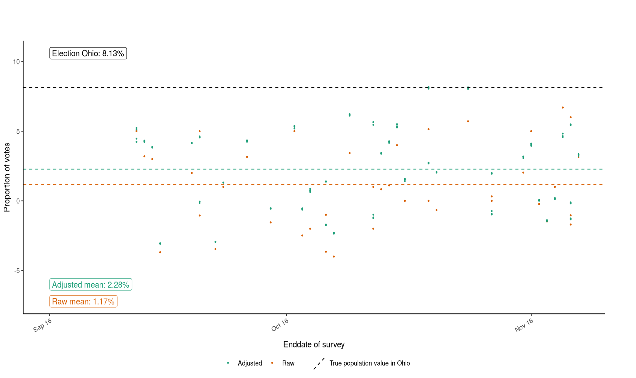
Back to week 1
See: https://utrecht-university.shinyapps.io/SDA_shinyelectionbias/

Slide 4
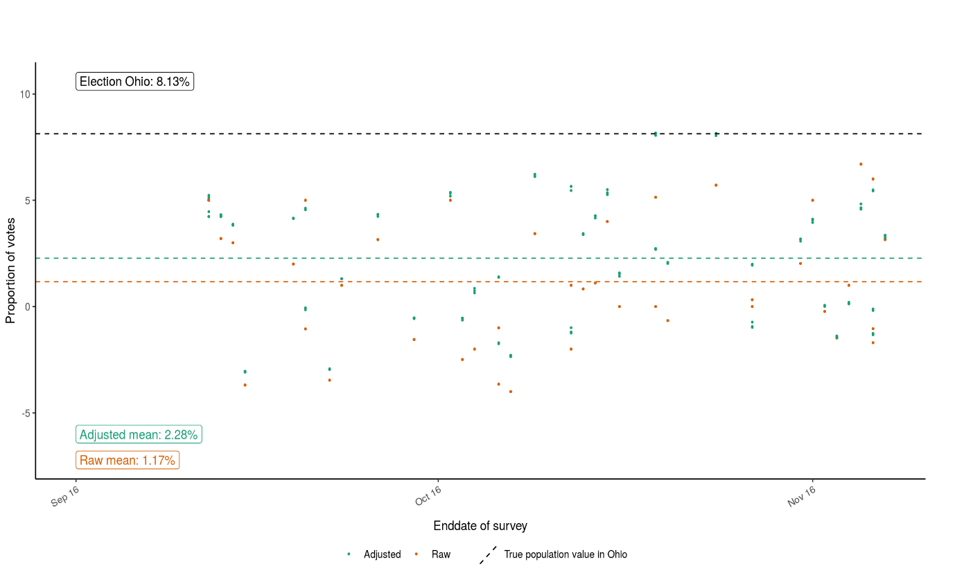
Back to week 1
Adjustments only help a bit on average
For individual polls they sometimes make matters worse!

Slide 5
Back to week 1
Adjustments only help a bit on average
For individual polls they sometimes make matters worse!
Grade of pollster/ sample size/ population dont make the difference

Slide 6
We have an inference problem
Adjustments only help a bit on average
For individual polls they sometimes make matters worse!
Grade of pollster/ sample size/ population dont make the difference
Problems with weighting
A lot of polls are not probability based

Slide 7
Three articles today
Mercer et al (2018)
Meng (2018)
Valliant (2020)
(chapter of Lohr)
What are the differences between their views?

Slide 8
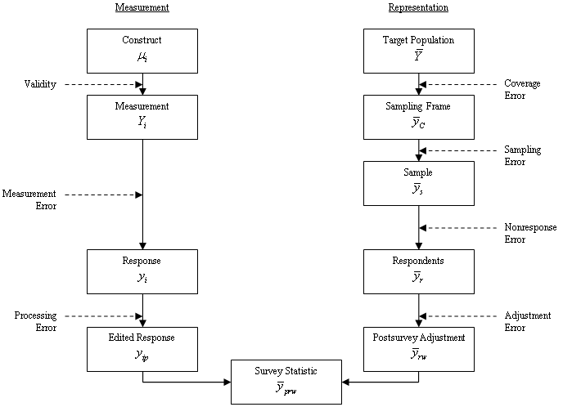
Selection bias vs. TSE
(Groves et al. 2009, p.48)

Slide 9
Mercer et al (2018)
Three conditions for inference
Which? Discuss in pairs….

Slide 10
Mercer et al (2018)
Three conditions for inference (p. 252)
Exchangeability
Do we have all relevant X covariates that (could) explain selection bias?
Positivity
Do we have all subgroups?
Composition
Can we match sample to the population?
Calibration or other weighting techniques

Slide 11
Mercer et al (2018)
Three conditions for inference (p252)
Exchangeability
Do we have all relevant X covariates that (could) explain selection bias?
Positivity
Do we have all subgroups?
Composition
Can we match sample to the population?
Calibration or other weighting techniques
X
Z
Can you apply these terms to the missing data diagrams? (2 min)
R
Y

Slide 12
Mercer et al (2018)
Three conditions for inference (p252)
Exchangeability
Do we have all relevant X covariates that (could) explain selection bias?
Positivity
Do we have all subgroups?
Composition
Can we match sample to the population?
Calibration or other weighting techniques
X
Z
Can you apply these terms to the missing data diagrams? (2 min)
R
Y

Slide 13
Inference: perspectives from other fields
Natural sciences
Laws of nature: gravity works everywhere
Representation error not an issue
2 paradigms for inference in Social sciences:
We want to test causal mechanisms
Internal validity
More psychological/medical viewpoint
We need descriptives about our population and models about the world
External validity
More sociological/epidemiological viewpoint

Slide 14
Mercer et al (2018) on paradigm 1
Causality: experiments
Strong ignorability (random assignment)
Causal effect (y) not dependent on X
Exchangeability and
Positivity
Transportability: composition of sample
Not considered an issue in inference
WEIRD samples

Slide 15
Mercer et al (2018) on paradigm 2
Design-based surveys
Random samples leads to ignorability
Exchangeability and
Positivity
And to transportability
Only sampling error
Nonresponse and coverage error
Weighting fixes exchangeabilty
Positivity assumed (subgroups are all there)

Slide 16
Mercer et al (2018)
Non-prob surveys and what to do?
Exchangeability (we need the right X vars)
Positivity (we need to have all subgroups)
Composition
More a technical issue

Slide 17
Meng 2018 – linking data quality,quantity
ρ(R,G): correlation between selection bias (R) and variable of interest
𝛔(G): variation in population of variable of interest
E.g. If everyone votes for Clinton, no problem
Data quantity:
f= sampling fraction from population.
P. 690 (eq 2.3)

Slide 18
Meng (2018) implications
Problem difficulty is a given
Data quantity: we never have full population
Data quality: this matters. In Big data bias, is often larger than in small data, because data quality is a bigger problem

Slide 19
Meng 2018 – linking data quality,quantity
R mechanism (response)
Design based
Sampling probabilities are known
Nonresponse propensities are modeled.
Non-probability: selection probabilities are unknown
G: estimate of interest (e.g. a mean)
Y in missing data literature
If correlation [R,G] = 0, no problem with any data
If R does not vary over elements, no problem

Slide 20
Meng 2018 – valid inferences
When can we draw inferences for Big Data (non-probability samples)?
Data quality: ρ(R,G): 0
design based philosophy
Quality and quantity are independent (?)
Data quantity: f very large (close to 1)
Big data philosophy
Quality and quantity negatively correlated?
𝛔(G): very small

Slide 21
Valliant

Slide 22
Now to practice
What matters in study design?
Exchangeability (Mercer), or ρ(R,G): 0 (Meng)
Mercer: we need the right X variables that correct for biases between R <-> Y
Meng: we need to ensure the relation between R <-> is 0, and can do that by design (preferred) or having the right covariates.
Positivity is a design feature

Slide 23
Solutions - composition
1.Global correction methods
Quasi-randomisation (aka Pseudo design based estimation) (Elliott & Valliant 2017)
2. Estimate-specific methods
Superpopulation modeling (e.g. Elliott & Valliant, 2020)
Calibration (Little, 2004)
non-prob -> probability
Mass imputation (Yang and Kim, 2020)
3. Sensitivity analyses
Meng: for ρ(R,G)
Pattern mixture models for NMAR (e.g West 2020)

Slide 24
1. Quasi-randomisation example
non-probability survey
gender | age | education | health | Fav ice
0 | 34 | 1 | 5 | vanilla
1 | 54 | 2 | 5 | lemon
1 | 12 | 3 | 4 | Choc
1 | 56 | 3 | 5 | vanilla
0 | 87 | 4 | 2 | strawb
1 | 45 | 5 | 3 | zabaione
1 | 67 | 6 | 4 | lemon
1 | 23 | 6 | 5 | straccia
0 | 16 | 2 | 5 | vanilla
1 | 24 | 4 | 4 | straccia
1 | 56 | 2 | 4 | straccia
1 | 78 | 3 | 2 | vanilla
Taste | percentage
Vanilla | 33%
Lemon | 16%
Straccia | 25%
Zabaione | 8%
Strawberry | 8%
Chocolate | 8%

Slide 25
1. Quasi-randomisation
Large non-probability based
Other Probability based survey
gender | age | education | health | Fav ice
0 | 34 | 1 | 5 | vanilla
1 | 54 | 2 | 5 | lemon
1 | 12 | 3 | 4 | Choc
1 | 56 | 3 | 5 | vanilla
0 | 87 | 4 | 2 | strawb
1 | 45 | 5 | 3 | zabaione
1 | 67 | 6 | 4 | lemon
1 | 23 | 6 | 5 | Banana
0 | 16 | 2 | 5 | vanilla
1 | 24 | 4 | 4 | pear
1 | 56 | 2 | 4 | straccia
1 | 78 | 3 | 2 | vanilla
gender | age | education | health | P(Response)
0 | 34 | 1 | 5 | ,24
1 | 54 | 2 | 5 | ,44
1 | 12 | 3 | 4 | .23
1 | 56 | 3 | 5 | .56
0 | 87 | 4 | 2 | ,36
1 | 45 | 5 | 3 | .56
1 | 67 | 6 | 4 | .44
1 | 23 | 6 | 5 | .33
0 | 16 | 2 | 5 | ,32
1 | 24 | 4 | 4 | .43
1 | 56 | 2 | 4 | .42
1 | 78 | 3 | 2 | .43
Match on covariates

Slide 26
1. Quasi-randomisation
non-probability based
gender | age | education | health | P(Response) | Fav ice
0 | 34 | 1 | 5 | ,24 | vanilla
1 | 54 | 2 | 5 | ,44 | lemon
1 | 12 | 3 | 4 | .23 | Choc
1 | 56 | 3 | 5 | .56 | vanilla
0 | 87 | 4 | 2 | ,36 | strawb
1 | 45 | 5 | 3 | .56 | zabaione
1 | 67 | 6 | 4 | .44 | lemon
1 | 23 | 6 | 5 | .33 | straccia
0 | 16 | 2 | 5 | ,32 | vanilla
1 | 24 | 4 | 4 | .43 | straccia
1 | 56 | 2 | 4 | .42 | straccia
1 | 78 | 3 | 2 | .43 | vanilla
Taste | Raw percentage | Weight (1/p)
Vanilla | 33% | 1/.39
Lemon | 16% | 1/.44
Straccia | 25% | 1/.39
Zabaione | 8% | 1/.56
Strawberry | 8% | 1/.36
Chocolate | 8% | 1/.23

Slide 27
1. Quasi-randomisation
non-probability based
gender | age | education | health | P(Response) | Fav ice
0 | 34 | 1 | 5 | ,24 | vanilla
1 | 54 | 2 | 5 | ,44 | lemon
1 | 12 | 3 | 4 | .23 | Choc
1 | 56 | 3 | 5 | .56 | vanilla
0 | 87 | 4 | 2 | ,36 | strawb
1 | 45 | 5 | 3 | .56 | zabaione
1 | 67 | 6 | 4 | .44 | lemon
1 | 23 | 6 | 5 | .33 | straccia
0 | 16 | 2 | 5 | ,32 | vanilla
1 | 24 | 4 | 4 | .43 | straccia
1 | 56 | 2 | 4 | .42 | straccia
1 | 78 | 3 | 2 | .43 | vanilla
Taste | Raw percentage | Weight (1/p) | Weighted %
Vanilla | 33% | 1/.39 | 33%
Lemon | 16% | 1/.44 | 14%
Straccia | 25% | 1/.39 | 24%
Zabaione | 8% | 1/.56 | 6%
Strawberry | 8% | 1/.36 | 9%
Chocolate | 8% | 1/.23 | 14%
Average |  | .40

Slide 28
2. Estimate specific methods
2.1 Calibration (Little, 2004)
2.2 Superpopulation modeling (e.g. Elliott & Valliant, 2020)
2.3 Mass imputation (Yang and Kim, 2020)

Slide 29
2.1 traditional calibration
Ask potential X variables in non-prob survey
Weight to population characteristics
Every cell of cross-table: calibration
Margins of cross-table: raking
Problem:
Lack of X variables
Small se., but still bias
Use same NR methods as earlier in course

Slide 30
2.1 Calibration for non-prob
Conduct a large nonprobability sample
Small s.e., large bias(?)
Conduct a small probability based sample
Large s.e., small bias
Weight non-probabity based -> prob based
Small bias (?), small s.e.
Lots of X vars, because you have control
Use same NR methods as earlier in course
Expensive, time consuming

Slide 31
2.1 Little (2004) Calibrated bayes
Model based (regression) vs. design based
Solution:
Use a model that includes design-based features
E.g. A fixed-effects regression model to deal with clustering
Bayesian modeling for variance estimation
Priors (often uninformative)
Posteriors for variance estimation
Remember convergence, traceplots,, and how imputations are generated in Mice?

Slide 32
2.2 Superpopulation modeling
Non-probability based surveys don’t use sample frames
We can rake or calibrate to population statistics:
gender, age, region, ethnicity, income, etc…
Idea is to collect more population statistics X
Netflix subscriptions, voting Behavior, customer of a company, member of organization, ….

Slide 33
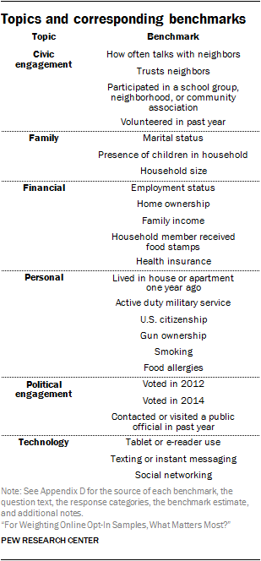
2.2 Superpopulation modeling
Approach by Mercer (2018)
Netflix subscription? Voting Behavior, customer of a company, member of organization
i.e. More elaborate weighting
Source:https://www.pewresearch.org/methods/2018/01/26/reducing-bias-on-benchmarks/

Slide 34
2.3 Mass imputation
We know the population distribution:
Gender, age, education, income, region, etc.
In some cases we have frame data
Why not impute the whole population?

Slide 35
Mass imputation
gender | age | education | health | Fav ice
0 | 34 | 1 | 5 | vanilla
1 | 54 | 2 | 5 | lemon
1 | 12 | 3 | 4 | Choc
1 | 56 | 3 | 5 | vanilla
0 | 87 | 4 | 2 | strawb
1 | 45 | 5 | 3 | zabaione
1 | 67 | 6 | 4 | lemon
1 | 23 | 6 | 5 | straccia
0 | 16 | 2 | 5 | vanilla
1 | 24 | 4 | 4 | straccia
1 | 56 | 2 | 4 | straccia
1 | 78 | 3 | 2 | ???
1 | 56 | 4 | 5 | ???
…. | … | … | .. | ???
You have X million rows, only X thousand of thesehave Y
We know the population distribution:
Gender, age, education, income, region, etc.
In some cases we have frame data
Why not impute the whole population?

Slide 36
Double-robust estimators
Combine
Example:
1 quasi-randomization
Estimate response propensities
2. Calibration (superpopulation)

Slide 37
Valliant (2020) simulation
Tried out different estimation methods
Different methods
Variance estimation
Jackknife???
Result:
no method works perfectly
Double robust methods generally best

Slide 38
3. Sensitivity analyses
Cf Meng (2018)
Pattern Mixture modeling
Enter an additional parameter in the model (e.g a selection bias parameter)
This parameter can take different forms
Covary with Y and all other parameters
Simulate
Similar to Heckman selection models.
See Andridge, R. R., & Little, R. J. (2011). Proxy pattern-mixture analysis for survey nonresponse. Journal of Official Statistics, 27(2), 153.
See West, B. T., & Andridge, R. R. (2023). Evaluating Pre-Election Polling Estimates Using a New Measure of Non-Ignorable Selection Bias. Public Opinion Quarterly, nfad018.

Slide 39
Exercise (class + THE)
Competition!
Three non-probability samples
Sample size 30.000
June/July 2016
You get 15.000 cases
And a superpopulation dataset (Mercer, Lau & Kennedy, 2018)
Goal: adjust your sample:
Choose your variables
Calibrate, rake, impute?
Prize: eternal fame and a survey related present

Slide 40
Next week
Lecture on “data integration”
Keep working on your group assignments
In two weeks -> final meeting
Prepare an online document that should be readable in 6 minutes
Video, wiki, website….
Send around by December 8, 17:00
Review 1 presentation of other group and prepare 3 questions.

Slide 41
More reading?
Andridge, R. R., & Little, R. J. (2011). Proxy pattern-mixture analysis for survey nonresponse. Journal of Official Statistics, 27(2), 153.
Chen, S., Yang, S., & Kim, J. K. (2020). Nonparametric Mass Imputation for Data Integration. Journal of Survey Statistics and Methodology.
Elliott, M. R., & Valliant, R. (2017). Inference for nonprobability samples. Statistical Science, 32(2), 249-264.
Kim, J. K., Park, S., Chen, Y., & Wu, C. (2018). Combining non-probability and probability survey samples through mass imputation. arXiv preprint arXiv:1812.10694.
Rafei, A., Flannagan, C. A., & Elliott, M. R. (2020). Big Data for Finite Population Inference: Applying Quasi-Random Approaches to Naturalistic Driving Data Using Bayesian Additive Regression Trees. Journal of Survey Statistics and Methodology, 8(1), 148-180.
Valliant, R. (2020). Comparing alternatives for estimation from nonprobability samples. Journal of Survey Statistics and Methodology, 8(2), 231-263.
West, B. T., & Andridge, R. R. (2023). Evaluating Pre-Election Polling Estimates Using a New Measure of Non-Ignorable Selection Bias. Public Opinion Quarterly, nfad018.

