Slide 1
Survey Data Analysis week 6 “R practical – Combinations of stratification and clustering”
© Peter Lugtig

Slide 2
Today
Discuss take home exercise
Your adopted survey
Questions: what do you encounter?
Short lecture
Survey design:
{population, question, frames} -> modes
How to stratify?
How to cluster?
Set of class exercises

Slide 3
Which mode do I want to use?
What is my population?
What modes are acceptable?
What is my question?
Measurement error
What kind of sampling frame info?
- address, tel, e-mail

Slide 4
Which mode do I want to use?
What kind of sampling frame info?
- address, tel, e-mail
If mail, telephone, Web survey
Stratification to increase precision, subgroups
Frame information

Slide 5
Which mode do I want to use?
What kind of sampling frame info?
- address, tel, e-mail
If face-to-face survey
Clustersample (PSU) to save cost
SRS
PPS
Stratified

Slide 6
Which mode do I want to use?
What kind of sampling frame info?
- address, tel, e-mail
If face-to-face survey
Clustersample (PSU) to save cost
SRS
PPS
Stratified
Within every cluster (SSU)
Stratify
SRS

Slide 7
Which mode do I want to use?
What kind of sampling frame info?
- address, tel, e-mail
If face-to-face survey
If mail, telephone, Web survey
Clustersample (PSU) to save cost
SRS
PPS
Stratified
Stratification to increase precision, subgroups
Frame information
Within every cluster (SSU)
Stratify
SRS

Slide 8
Class exercises
Other statistics
Hurvitz-Thompson estimator
Design weights
Inclusion robabilities
Stratified cluster samples

Slide 9
Extra slides
Not discussed in class, but in case you want to know the end of the story of the “student” sample…

Slide 10
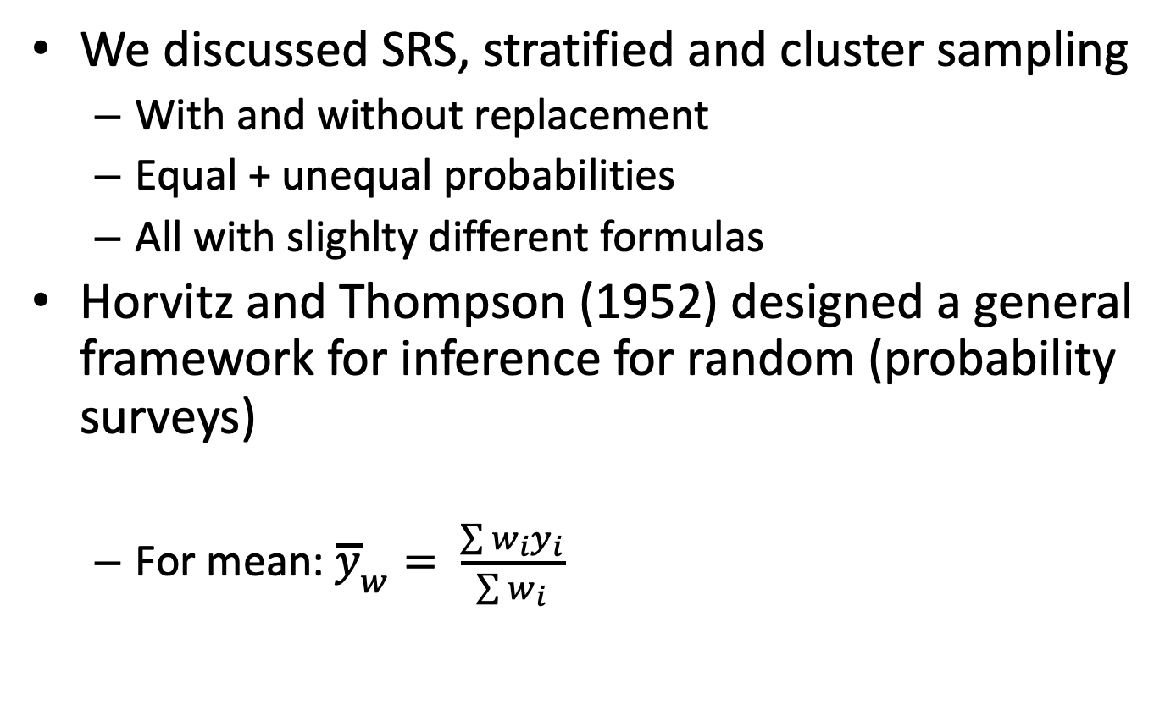
Horvitz-Thompson estimation
We discussed SRS, stratified and cluster sampling
With and without replacement
Equal + unequal probabilities
All with slighlty different formulas
Horvitz and Thompson (1952) designed a general framework for inference for random (probability surveys)
For mean: ${\overline{y}}_{w}= \frac{\sum{w_{i}y_{i}}}{\sum{w_{i}}}$

Slide 11
HT-estimation – a unifying framework…
HT-estimation works for all design-based sampling methods
SRS equal probabilities: 𝛑_{i} = equal
Stratified: 𝛑_{i} depends on strata selection
One-stage cluster: 𝛑_{i} depends on cluster selection
Two-stage (and more complex): cluster and within-cluster
All you need is 𝛑_{i} , for every individual on your sampling frame

Slide 12
Our recurring example
We would like to do a survey among all students at Utrecht University
Population = 20.000
RQ: Interested in differences in grades and student happiness between programmes
approx. 49 BA programmes and 150 MA programmes
Limited budget (cannot do census) for about n=1000
This week:
What if we combine clustering and stratification?

Slide 13
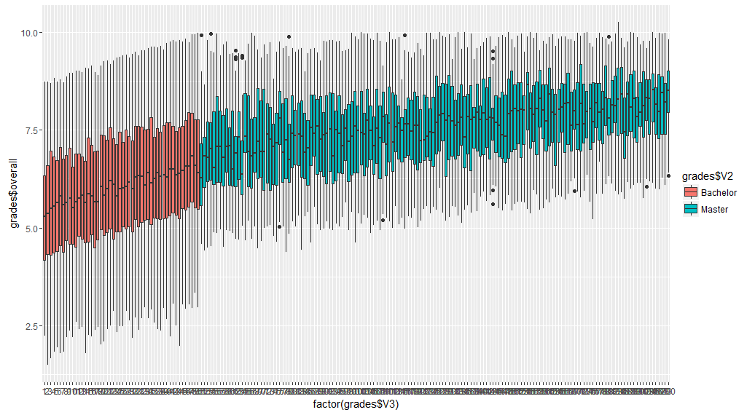
Example – 150 programmes (Ba/MA) simulated data
Student grades (y)
200 programmes (x)
50 BA, n=280 each
150 MA, n=40 each
R-code is available on Blackboard
Population mean: 6.52

Slide 14
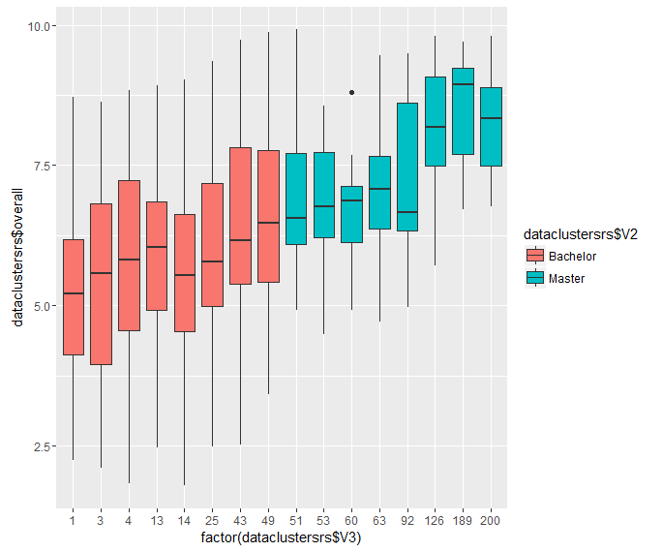
Stratified cluster sample
Stratify on programme (2)
8 clusters in each (can also vary)
Random sample per cluster PPS:
sample with p=.4
16 clusters
For BA:
Total n=1000 out of population 20000

Slide 15
Variance estimation
- How do we calculate variances.
Alternative: Horvitz-Thompson estimator
Stage 1: stratify
Stage 1: cluster
Stage 2: Select individuals
- Weights:
- Stage 2: per cluster:
Wt|s,master = 15 out of 40 -> 2.5
Wt|s,Bachelor = 112 out of 280 -> 2.5

Slide 16
Variance estimation using weights
- Weights:
Stage 2: per cluster:
Wt|s,master = 15 out of 40 -> 2.5
Wt|s,Bachelor = 112 out of 280 -> 2.5
Stage 1: clusters out of strata
Wt|s,master = 8 out of 150 -> 18.75
Wt|s,Bachelor = 8 out of 50 -> 6,25

Slide 17
Variance estimation – constructing weights
- Weights:
Stage 2: per cluster:
Wt|s,master = 15 out of 40 -> 2.5
Wt|s,Bachelor = 112 out of 280 -> 2.5
Stage 1: clusters out of population
Wt|s,master = 8 out of 150 -> 18.75
Wt|s,Bachelor = 8 out of 50 -> 6,25
Total weight
Wt|s,master = 2.5 * 18.75 -> 46.875
Wt|s,Bachelor = 2.5 * 6.25 -> 18.75
Rescaled weight
Wt|s,master = 46.875/mean(Wt) = 2,42
Wt|s,Bachelor = 18.75/mean(Wt)= 0,81

Slide 18
Variance estimation in R – identical results
clus2a <- svydesign(ids=~cluster+id, strata=~programme,
# weights=~weights, fpc = ~fpc1+fpc2, data=dataclustersrs)
Clus2b <- svydesign(ids=~cluster+id, #strata=~dataclustersrs$V2,
weights=~weights,# fpc = ~fpc1+ffpc2,data=dataclustersrs)
Mean: 6.04
s.e. = .15275
Deff= 8.86

Slide 19
Weights
The study doesn’t stop at sampling
nonresponse weights (see week 44,45)
Variance in weights indication of difference with perfect SRS design without nonresponse
In SRS -> Wi=1, Var(weights)=0.
In our design -> Var(weights)=.27
Likely in our design with NR: Var(weights) >.27
Variance inflation
Can trim weights if they are large (rescaled weights >3 or 5)
Bias becomes larger
Variance lower -> precision higher
Goal is to Minimize Mean Square Error (bias² + variance)

Slide 20
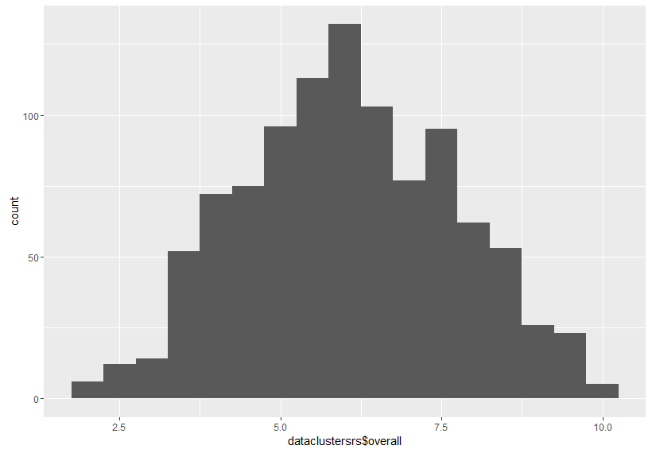
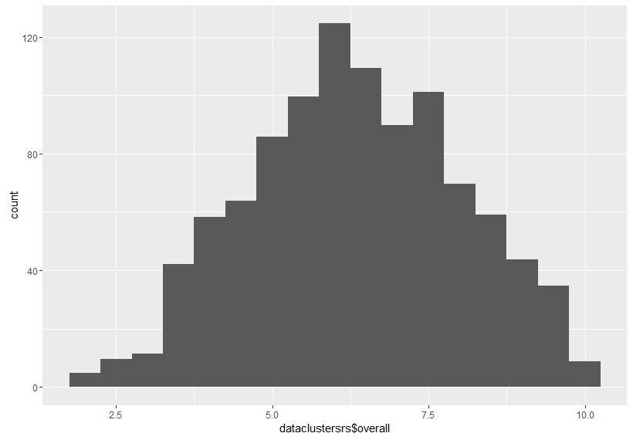
Weighted graphs (using ggplot2)
Without weights
With weights
Heavier mass in upper tail (high weights for MA students)

Slide 21
Next weeks:
Next week:
In two weeks: class-free week
In two weeks:
Last week about sampling: model assisted estimation
Design based ------------------------ model-based
Ratio and regression estimation
Stuart 71-90
Finish class exercises today
Take home exercise:
Specify your survey design in R
Assignment 1 online
Deadline: 21 October 17:00

