Slide 1
What these lectures WONT do!
We are not trying to build high-end web-pages and web-sites
We are not going to be covering complex interactions including client-server interactions
We are trying to understand the processes around displaying spatial data on a map on a web-page.

Slide 2
Understanding Web Page Structure
<HEAD>
<BODY>

Slide 3
Understanding Web Page Structure
<HEAD>
This is normally where we link to code
and other structures
which add functionality to our web-page
<BODY>
This is “the web” page which
your users will see

Slide 4
Understanding Web Page Structure
<HEAD>
We don't normally do much work in
the <HEAD> of the page
<BODY>
The BODY can be split into separate
“containers” which hold
different components of the page

Slide 5
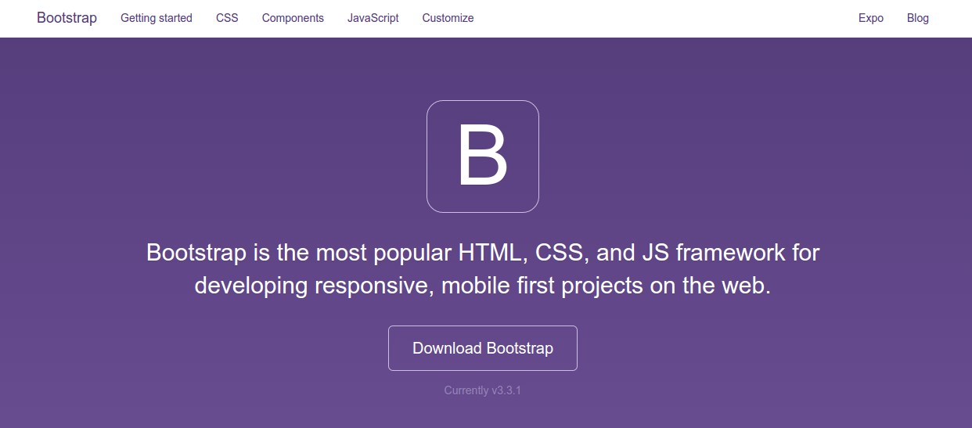
We will use Twitter Bootstrap to help us develop our web-pages

Slide 6
I've download BOOTSTRAP for you already to use today
Inside the folder(s) you have downloaded you will notice a folder called “bootstrap”.
Inside this folder – there are 3 sub folders (CSS, Fonts, JS)
We will need the files inside these folders to build our web-pages today.
In fact we will need additional files to include our mapping functionality also.

Slide 7
What's with the CSS, Fonts and JS folders?
We don't really need to go into much details about what these files are today
But
CSS: This is Cascading Style Sheet and it controls the “look and feel” of your web-page
Fonts: well ... these helps with Bootstrap fonts
JS: For Javascript – this is required to make some functionality provided by Boostrap work

Slide 8
Encapsulation!
The idea behind using a framework such as BOOTSTRAP is that – YOU DON'T WORRY ABOUT CSS, FONTS and JAVASCRIPT
The murky details of these are hidden or encapsulated away!
We will have to work with Javascript later – but that is when we want to add our own functionality which is additional to what Bootstrap gives us

Slide 9
We will need to link to the Bootstrap CSS and JS on every page
This will be done in the <HEAD> section of the webpage
Without this link we will not have a nice responsive web-page.

Slide 10
Bootstrap is “Mobile First”
What does this mean?
Bootstrap has been developed by the people at Twitter to be “responsive across all devices”
This means that if you use Bootstrap (and use it correctly) – then your webpage(s) should look great from small smartphone screens right up to huge screen displays!

Slide 11

After each example – check out the webpage you create on your PC and your smartphone/tablet

Slide 12
JQuery

Slide 13
What is Jquery?
Jquery is one of the most useful Javascript libraries on the Internet today
You'll see it inside the Jquery folder in the todays download
Like Bootstrap – there is no need to look at it.
But Bootstrap needs Jquery AND our mapping application will also need it.
Suffice to say – Jquery is very important

Slide 14
Let's start building some pages

Slide 15
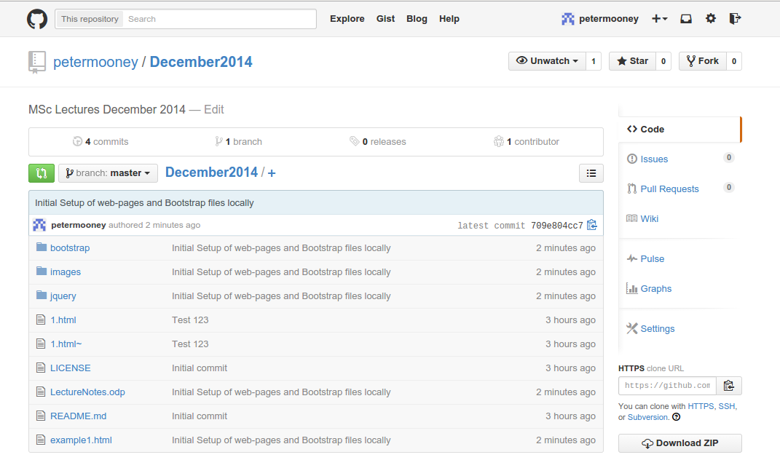
GITHUB Page for today's lectures
https://github.com/petermooney/December2014

Slide 16
You can download as ZIP
https://github.com/petermooney/December2014
Download as ZIP – just unzip to any location on your computer. Do not change or move any of the folders within the extracted zip file

Slide 17
You can always just do git clone
https://github.com/petermooney/December2014
Open a command/terminal prompt
git clone https://github.com/petermooney/December2014.git

Slide 18
All web-pages will have the same code structure today
<html>
<head>
<title> Your page title </title>
Your links to CSS and JS go here
</head>
<body>
Your webpage goes here
</body>
</html>

Slide 19
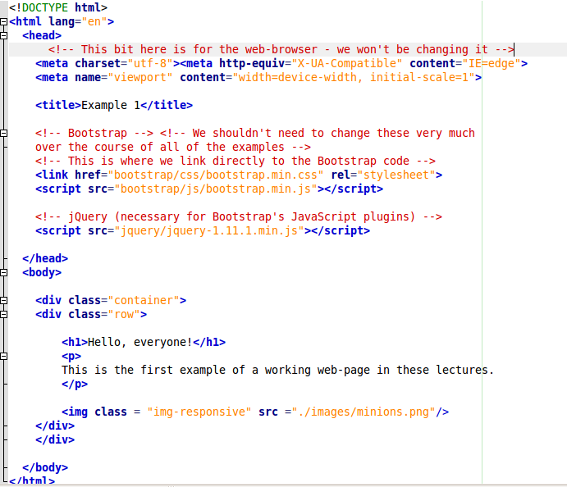
Example1.html

Slide 20
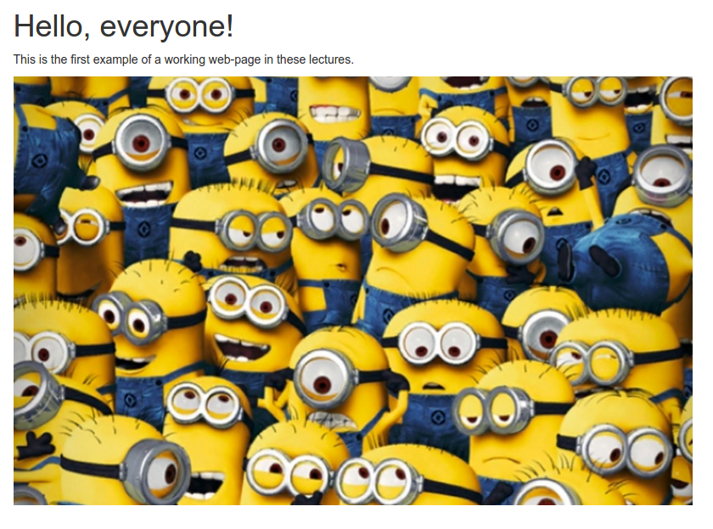
https://webcourse.cs.nuim.ie/~YOURNAME/YOURFOLDER/example1.html

Slide 21
Trying some HTML tags
Let's try to use some basic HTML tags to 'MARKUP' our text
<h1>This is a big heading</h1>
<h2>Second biggest heading</h2>
<h3>, <h4> and <h5>
<p> starts a pargaraph which ends with </p>
<strong> marks bold text</strong>
<em> marks bold text </em>

Slide 22
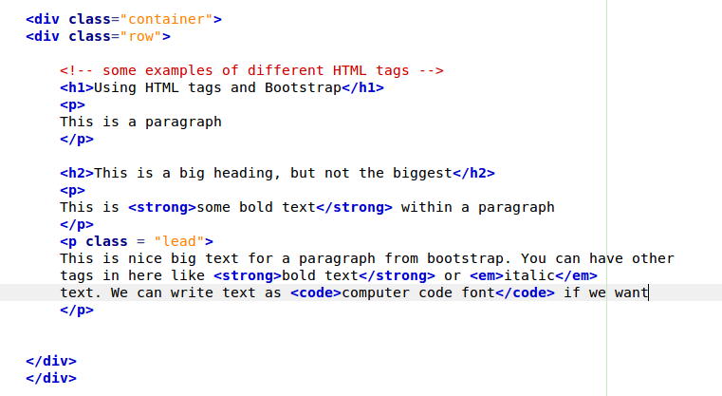
Open up Example2.html and upload to your webcourse folder

Slide 23
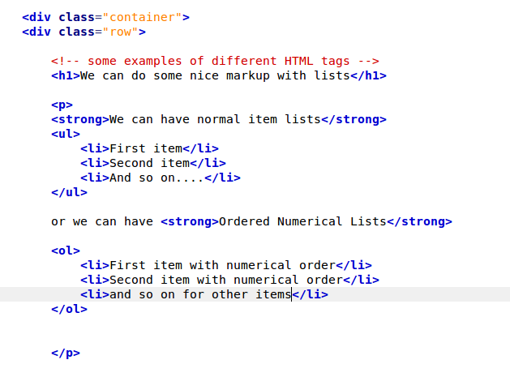
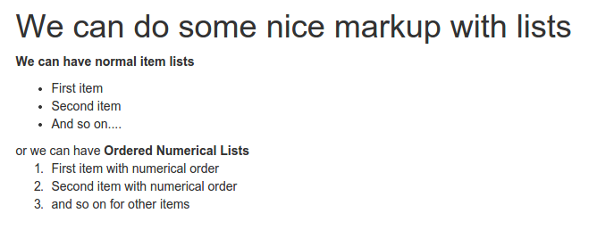
Open up Example3.html and upload to your webcourse folder

Slide 24
Task 1
Create a file called Task1.html – you should copy Example1, example2 or example3 and change their filename – as we need all of the content in the page <head> and <body> structure to be the same.
Create a simple webpage – showing heading tags, paragraphs, lists to outline the your module list, your favourite web apps, anything..
Upload and display on your webcourse folder

