Slide 1
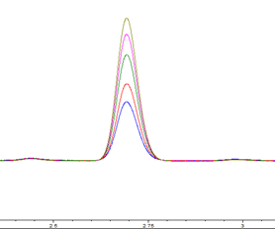
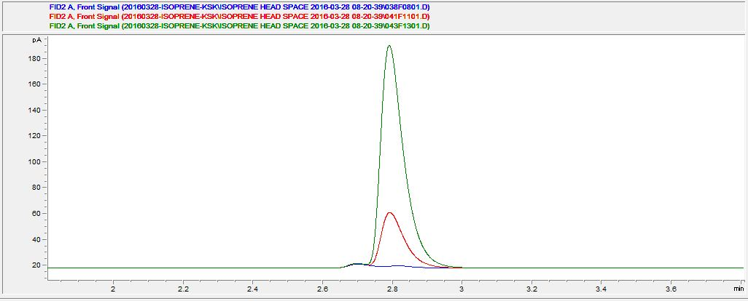
250 mg/L
200 mg/L
150 mg/L
100 mg/L
75 mg/L
Isoprene
2.8min
Isoprene
MPIsp3 product
Empty vector
Fig. S2. GC-MS analysis of isoprene from the head space in culture for MPIspS3 and MVA pathway harboring E. coli. Isoprene, MPIspS3 product, and empty vector represent commercial isoprene as standard, product from MPIspS3 and MVA pathway harboring E. coli, and product from pET28a(+) and MVA pathway harboring E. coli, respectively.

