Slide 1
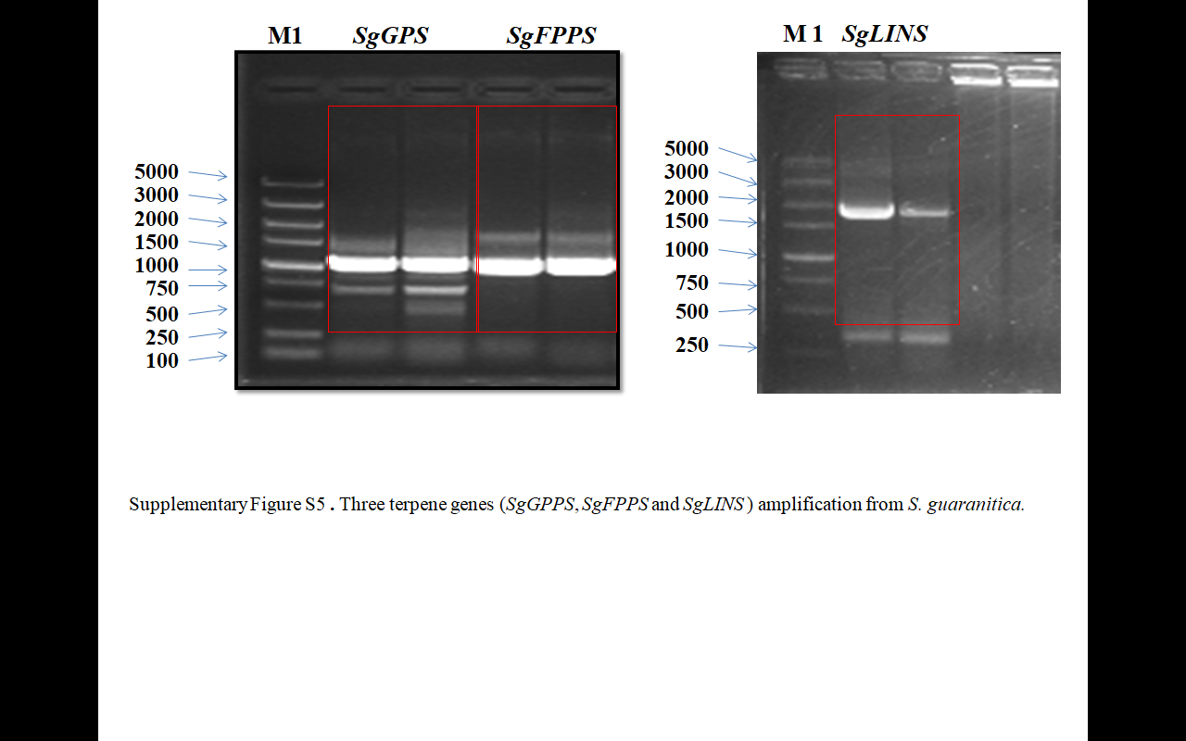
Supplementary Figure S1. Three terpene genes (SgGPPS, SgFPPS and SgLINS) amplification from S. guaranitica.

Slide 2
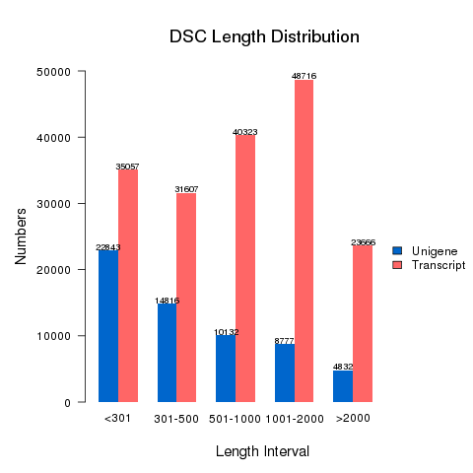
DSG Length Distribution
Supplementary Figure S2. Length distributions of transcripts and unigenes in S. guaranitica transcriptome.

Slide 3
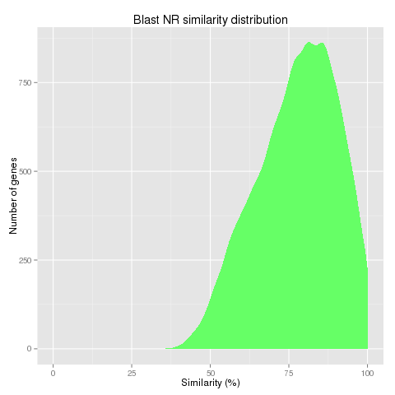
Supplementary Figure S3. Blast NR similarity distribution in S. guaranitica trascriptome.

Slide 4
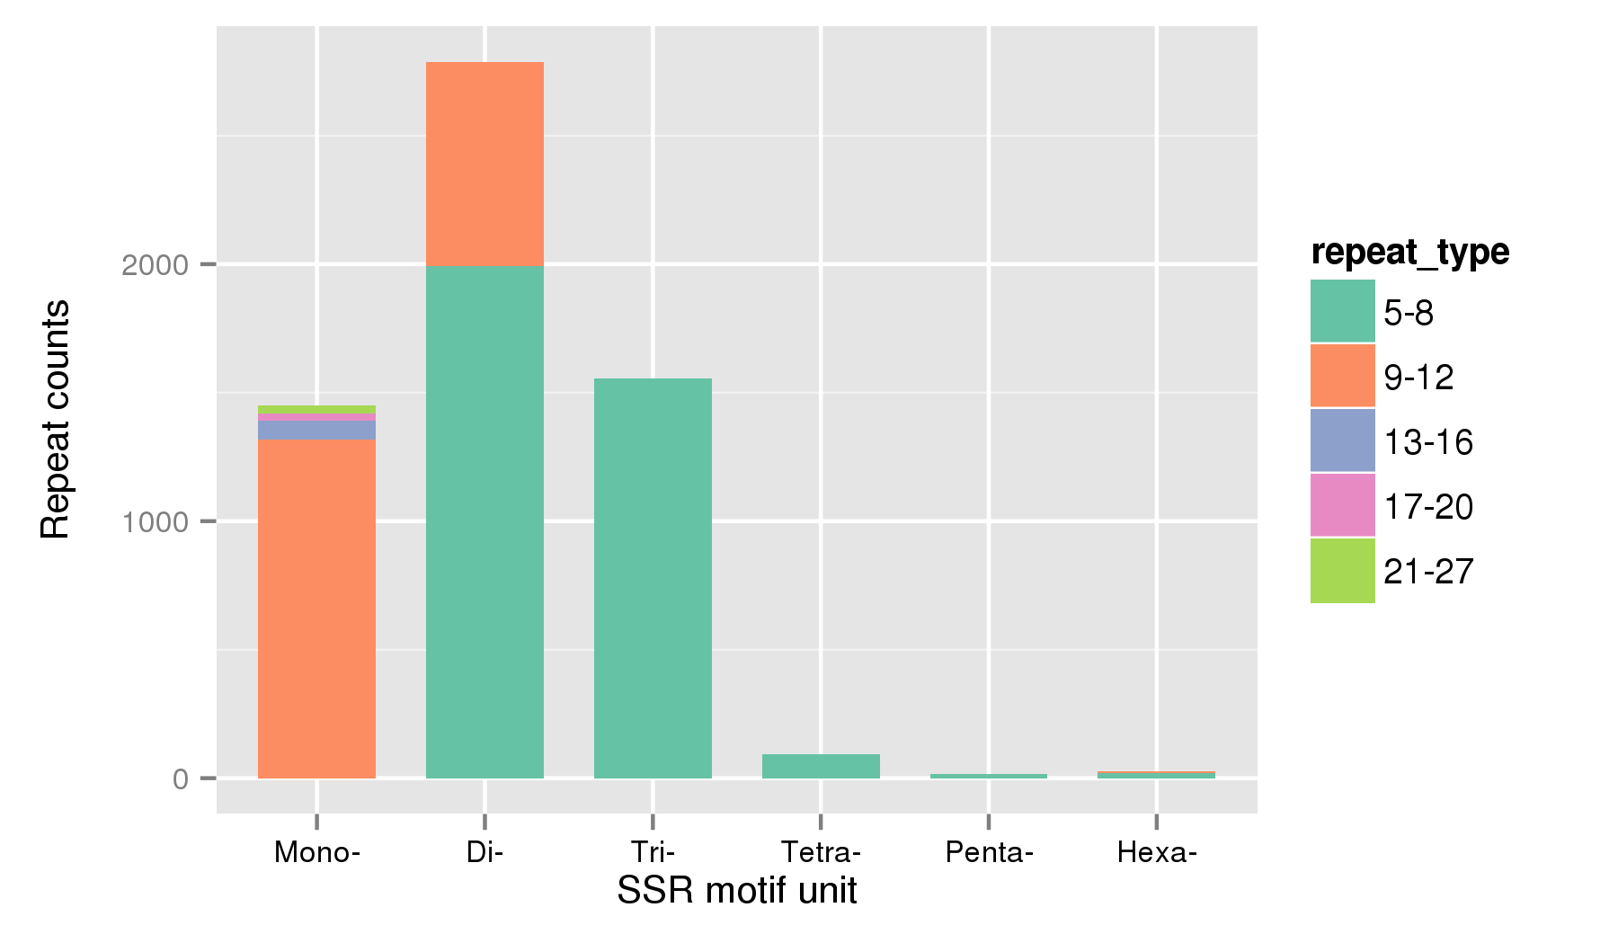
DSG Distribution of SSR Motifs
Supplementary Figure S4. Distribution of SSRs based on the motif units in S. guaranitica transcriptome.

Slide 5
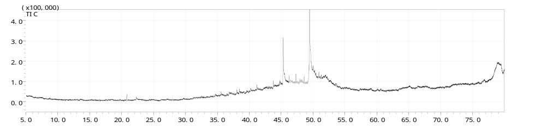
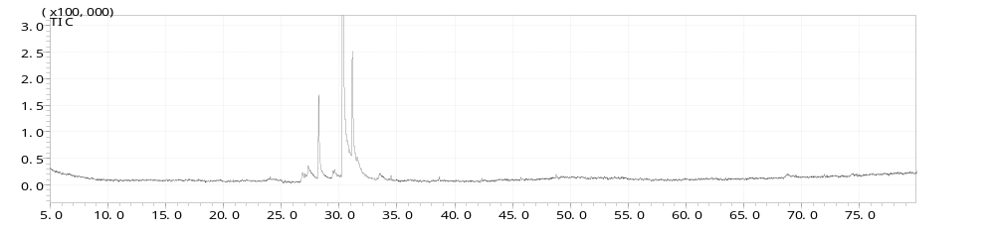
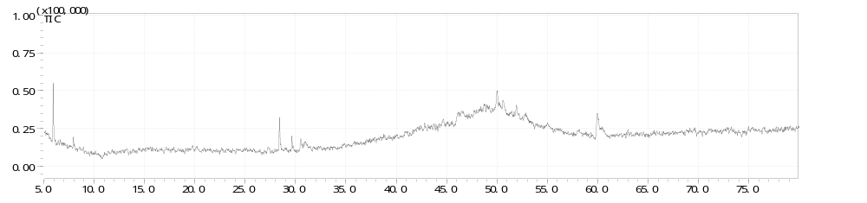
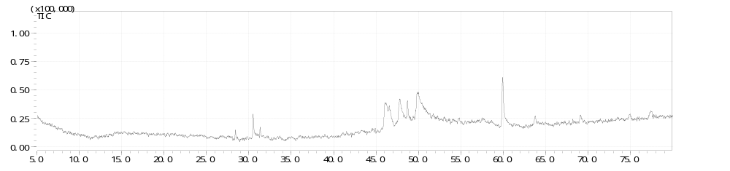
Figure 7.
W.T
Palmitic acid, trimethylsilyl est
trans-Elaidic acid
Palmitic acid
Tetrapentacontane
Oleic Acid
Menthol
Phytan
SgFPPS
Germacrene D
β-Caryophyllene
β-Elemene
Cadina-1,4-diene
Germacrene D-4-ol
SgGPPS
β-Caryophyllene
Eicosane, 9-cyclohexyl-
Diisooctyl phthalate
alpha.-Pinene
(Z)-α-Bisabolene
beta.-Pinene
Germacrene D
SgLINS
Palmitic acid, trimethylsilyl ester
dl-Methyltryptamine
Phytol
Linoleic acid
Diisooctyl phthalate
Germacrene D
β-caryophyllene
Supplementary Figure S5. Typical GC-MS Peak of three terpenoid genes from S. guaranitica expression in transgenic
A. thaliana leaves compares with wild type, W.T(wild type of A. thaliana), SgFPPS, SgGPPS, and SoLINS.

Slide 6
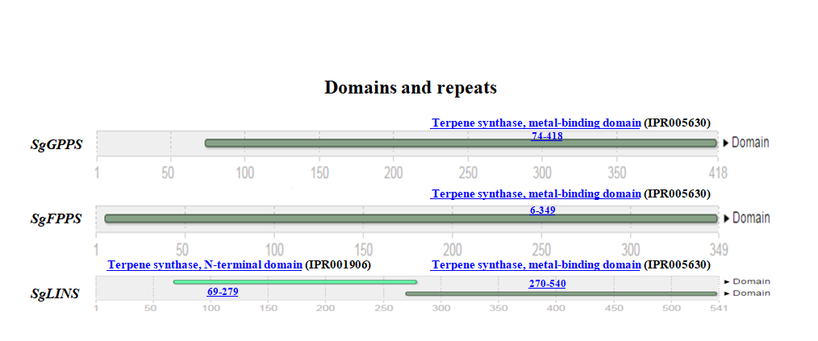
Supplementary Figure S6. Terpene synthase genes conserved motifs prediction from and S. guaranitica.

