Slide 1
Additional file 1: Figure. S1. Alignment of three wintersweet plants SQSs protein sequences. The black blocks are the locations of the different sites and the conserved domains was marked by the red underline.
Additional file 1: Figure. S2. The TMHMM and SignalP prediction result about the three wintersweet SQSs
and the SQS1 of Arabidopsis thaliana.
Additional file 1: Table S1. The compounds of dichloromethane extraction of C. Zhejiangensis foliage.
Additional file 1: Table S2. The volatiles compounds of C. Zhejiangensis foliage by SPME.
Additional file 1: Table S3. The accession number of SQSs sequences.

Slide 2
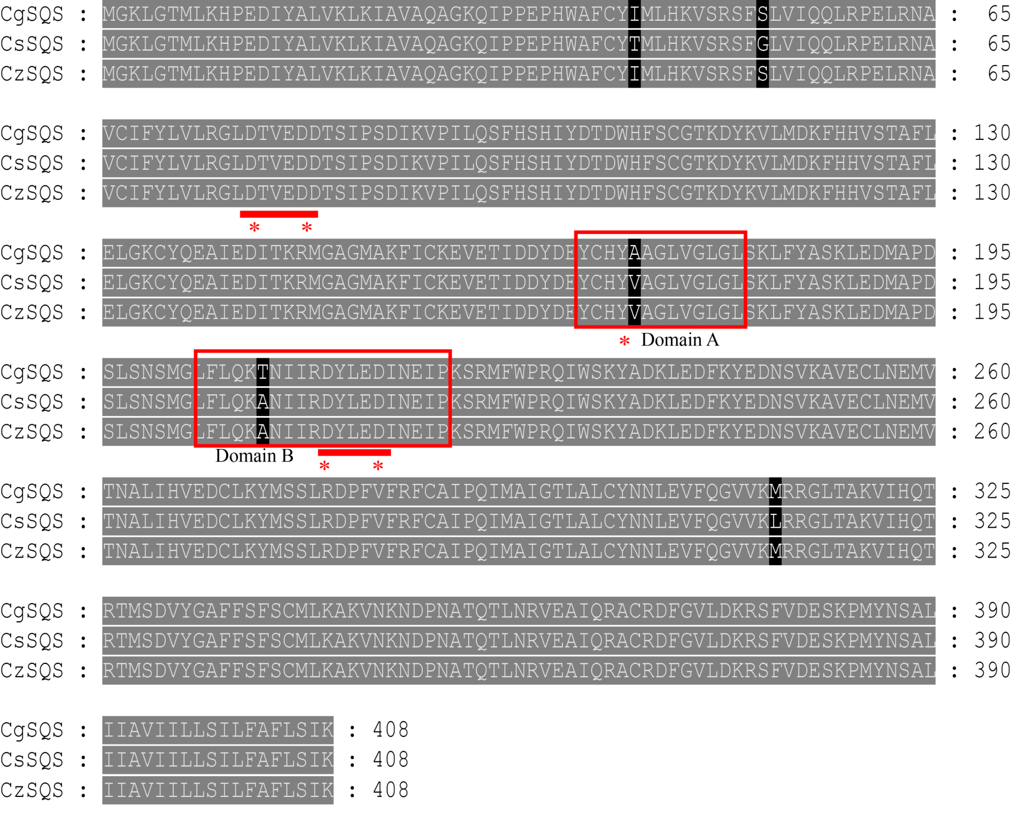
Additional file 1: Figure. S1.

Slide 3
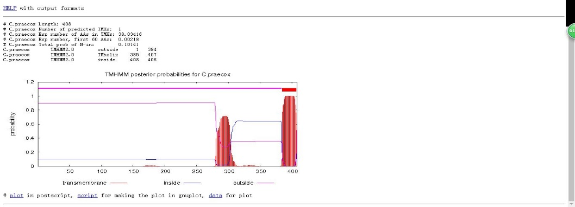
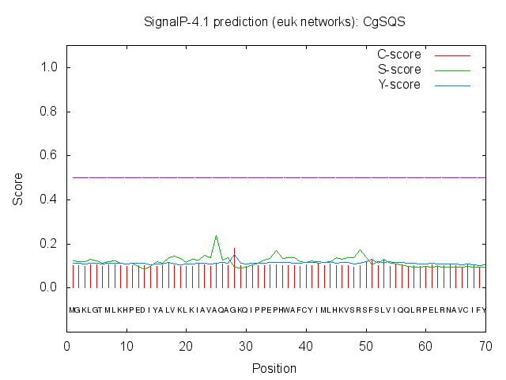
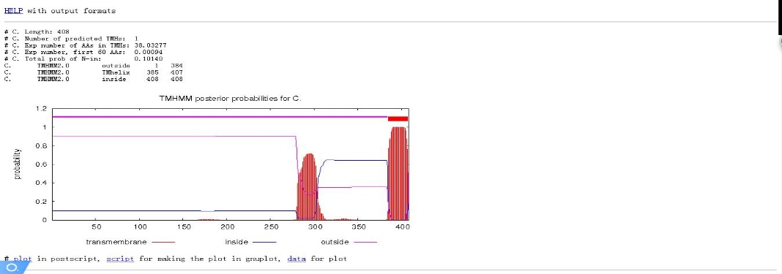

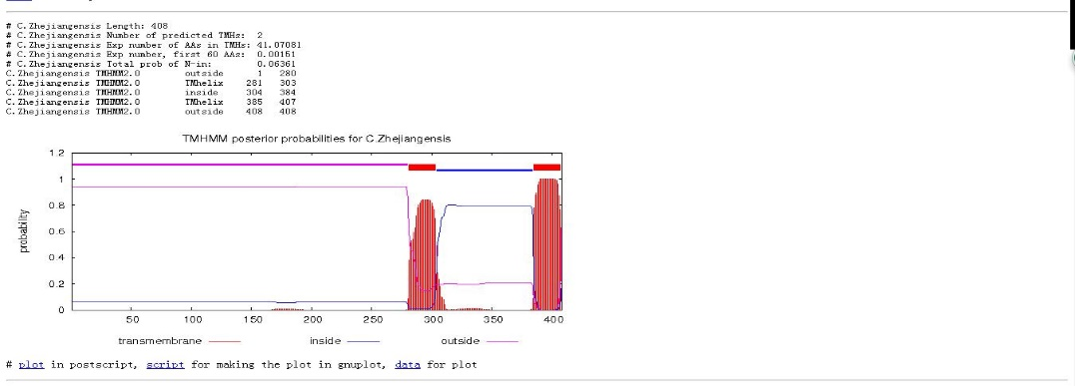

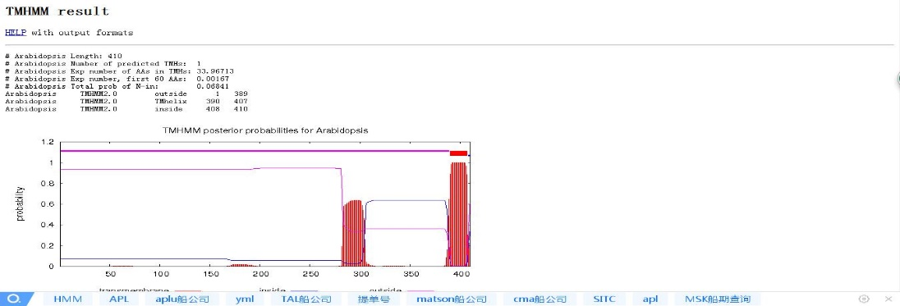
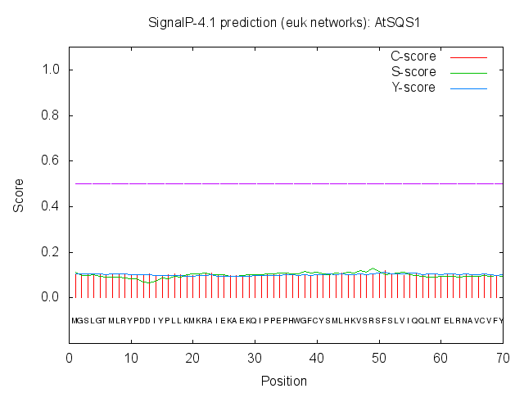
Additional file 1: Figure. S2.
TMHMM posterior probabilities for CgSQS
Signalp-4.1 prediction (euk networks): CgSQS
probability
TMHMM posterior probabilities for CsSQS
Signalp-4.1 prediction (euk networks): CsSQS
probability
TMHMM posterior probabilities for CzSQS
Signalp-4.1 prediction (euk networks): CzSQS
probability
TMHMM posterior probabilities for AtSQS1
Signalp-4.1 prediction (euk networks): AtSQS1
probability
transmembrane
inside
outside

Slide 4
Additional file 1: Table S1.
Name | 1st Dimension Time (minutes) | 2nd Dimension Time (s) | Area %
2-Hexenal, (E)- | 6.33333 | 2.68 | 6.218085246
3-Hexen-1-ol, (E)- | 6.41667 | 2.42 | 4.592494457
Styrene | 7.41667 | 2.36 | 0.028435667
Benzene, 1,1'-(1,2-cyclobutanediyl)bis-, cis- | 7.5 | 2.31 | 0.001974569
(-)-β-Pinene* | 8.16667 | 1.68 | 0.024887529
Bicyclo[3.1.0]hex-2-ene, 4-methyl-1-(1-methylethyl)- | 8.33333 | 1.65 | 2.053106909
Oxime-, methoxy-phenyl-_ | 8.41667 | 1.59 | 0.006428849
(+)-2-Carene | 8.5 | 1.78 | 0.653984371
trans-α-Ocimene | 8.58333 | 1.61 | 0.006041364
(1R)-2,6,6-Trimethylbicyclo[3.1.1]hept-2-ene | 8.58333 | 1.97 | 0.004967879
Bicyclo[3.1.0]hex-2-ene, 2-methyl-5-(1-methylethyl)- | 8.75 | 1.6 | 0.056369597
Camphene | 8.91667 | 1.73 | 2.113194808
Cyclopentene, 3-isopropenyl-5, 5-dimethyl | 9.5 | 1.75 | 2.77644965
2,3-Dehydro-1,8-cineole | 9.83333 | 1.89 | 1.128991478
ç-Terpinene | 10.1667 | 1.67 | 0.413933237
Eucalyptol | 10.4167 | 1.89 | 7.535331265
Dihydrocarvyl acetate | 10.5833 | 2.2 | 0.620662599
á-Myrcene | 10.9167 | 1.38 | 0.007781984
Benzaldehyde, 3-methyl- | 11 | 2.44 | 0.024188403
Limonene oxide, trans- | 11.0833 | 1.89 | 0.745400705
Linalool* | 11.0833 | 4.31 | 0.007445742
Isopulegol | 11.4167 | 1.86 | 6.109782926
(+)-2-Bornanone | 11.5 | 2.15 | 0.981257082
exo-2,7,7-trimethylbicyclo[2.2.1]heptan-2-ol | 11.9167 | 1.97 | 0.376070549
Terpineol | 12.6667 | 1.96 | 20.85627068
5-Undecen-3-yne, (E)- | 12.8333 | 1.62 | 0.349495004
Citronellal* | 12.8333 | 1.98 | 0.002824022
Pinocarvone | 12.8333 | 2.14 | 0.440102335
2-Oxabicyclo[2.2.2]octan-6-one, 1,3,3-trimethyl- | 13.1667 | 2.23 | 3.049572659
Citronellol | 13.25 | 1.8 | 3.898205804
1,5,5-Trimethyl-6-methylene-cyclohexene | 13.3333 | 2.19 | 0.044189828
Bicyclo[3.3.0]octan-3-one, 7-ethylidene- | 13.3333 | 2.34 | 0.052965368
(S)-(-)-Citronellic acid, methyl ester | 13.4167 | 1.74 | 2.400492867
Indole | 13.9167 | 2.86 | 0.005507928
Pinocarvone | 14.0833 | 1.55 | 0.008265246
à-Cubebene | 14.25 | 1.6 | 0.588877155
Falcarinol | 14.3333 | 1.67 | 0.101577485
Copaene | 15.0833 | 1.67 | 0.534871363
(-)-á-Bourbonene | 15.0833 | 1.69 | 0.015006417
1H-Cycloprop[e]azulene, 1a,2,3,4,4a,5,6,7b-octahydro-1,1,4,7-tetramethyl-, [1aR-(1a?4?4a?7b?]- | 15.3333 | 1.71 | 0.409373845
à-Guaiene | 15.9167 | 1.69 | 0.763464218
Caryophyllene* | 15.9167 | 1.78 | 0.381541041
Humulene | 16 | 1.8 | 0.423883387
γ-ylangene | 16.25 | 1.58 | 0.399625946
Germacrene D | 16.3333 | 1.83 | 3.915947467
isoledene | 16.5 | 1.71 | 0.409373845
cis-á-Farnesene | 16.75 | 1.93 | 0.052722279
cis-Muurola-4(15),5-diene | 16.75 | 1.99 | 4.796494408
1-Isopropyl-4,7-dimethyl-1,2,3,5,6,8a-hexahydronaphthalene | 17.0833 | 1.76 | 0.026808911
trans-Sesquisabinene hydrate | 17.6667 | 1.66 | 0.005142418
ç-Elemene | 17.6667 | 1.92 | 0.277781581
à-Calacorene | 17.6667 | 2.02 | 0.11356181
Butyric acid, 3-methyl-3-[2-isopropylphenyl]- | 17.6667 | 2.08 | 0.025431078
à-Muurolene | 17.75 | 2 | 1.21445114
Sativene | 17.75 | 4.58 | 0.005451628
(-)-Spathulenol | 17.8333 | 2.05 | 0.049357916
Alloaromadendrene oxide-(1) | 18.0833 | 1.96 | 0.777055853
7-epi-cis-sesquisabinene hydrate | 18.1667 | 1.84 | 0.043758101
Ledol | 18.3333 | 1.97 | 0.800908792
à-Corocalene | 18.4167 | 2.12 | 0.059827306
(1R,7S,E)-7-Isopropyl-4,10-dimethylenecyclodec-5-enol | 18.6667 | 2.06 | 0.147652718
Z,Z,Z-1,4,6,9-Nonadecatetraene | 18.8333 | 1.82 | 0.006313235
Isolongifolen-5-one | 18.8333 | 2.11 | 0.083119194
à-Cadinol | 18.9167 | 2.03 | 0.236408677
trans-Farnesol | 18.9167 | 1.89 | 0.380416021
1H-Cycloprop[e]azulene, 1a,2,3,4,4a,5,6,7b-octahydro-1,1,4,7-tetramethyl-, [1aR-(1aà,4à,4aá,7bà)]- | 18.9167 | 2.31 | 0.007891374
2,4-Dimethylstyrene | 19.0833 | 1.91 | 0.025926009
Caryophyllene oxide | 19.3333 | 2.24 | 0.070107086
Ledene oxide-(II) | 19.3333 | 2.26 | 0.008728575
Farnesene epoxide, E- | 19.4167 | 2.28 | 1.287955648
1, 4-Methanoazulen-9-one, decahydro-1, 5, 5, 8α-tetramethyl | 19.4167 | 2.32 | 0.019773893
1, 5, 9-Undecatriene, 2, 6, 10-trimethyl-, (Z)- | 19.5 | 1.77 | 0.00342144
1-(3-Methyl-cyclopent-2-enyl)-cyclohexene | 19.5 | 2.11 | 0.011536067
Murolan-3,9(11)-diene-10-peroxy | 19.5 | 2.46 | 0.020310635
1H-Indole, 2-methyl- | 19.6667 | 1.83 | 0.000929196
Isospathulenol | 19.6667 | 2.27 | 0.003631955
Cycloheptane, 4-methylene-1-methyl-2-(2-methyl-1-propen-1-yl)-1-viny | 19.75 | 2.31 | 0.006013652
á-Sitosterol | 20 | 0.89 | 0.090786245
Cryptomeridiol | 20.4167 | 2.05 | 0.684419208
à-D-Glucopyranoside, methyl | 20.8333 | 1.76 | 0.001451246
á-Eudesmol, TMS derivative | 20.8333 | 1.81 | 0.003679212
Naringenin | 20.8333 | 1.95 | 0.000637148
tau.-Muurolol | 20.8333 | 2.01 | 1.109377052
stigmasterol | 21.4167 | 0.28 | 0.167025027
trans-Ferulic acid | 22.3333 | 2.8 | 0.006159311
Salicylic acid, 2TMS derivative | 22.6667 | 0.87 | 4.05196202
Cyclohexane, 1-methylene-4-(1-methylethenyl)- | 23.0833 | 1.68 | 0.881787671
á-Myrcene | 23.0833 | 1.38 | 0.007781984
Limonene* | 23.4167 | 1.69 | 0.329697774
Indole | 24.25 | 2.86 | 0.005507928
Alloaromadendrene | 27 | 1.67 | 2.60440725
à-Cadinol | 27.3333 | 2.03 | 0.236408677
(-)-Spathulenol | 28.1667 | 1.9 | 0.082168227
Scopoletin | 29.3333 | 3.38 | 0.016177137
endo-Borneol | 29.6667 | 1.91 | 1.605636038
Eudesma-4(15),7-dien-1á -ol | 29.6667 | 2.02 | 0.347841994
Calycanthidine | 29.6667 | 3.73 | 0.002118284
Chimonanthine | 29.75 | 4.18 | 0.359596842
Tryptamine | 29.8333 | 2.09 | 0.003900813
Squalene* | 34 | 2.01 | 0.106840865
Coumarin, 6-benzyloxy-3,4-dihydro-4,4-dimethyl-7-nitro- | 34 | 1.89 | 0.001871402
(-)-Aristolene | 34.8333 | 1.8 | 1.181772098
á Carotene | 34.8333 | 4.55 | 0.003399173

Slide 5
Additional file 1: Table S2.
Retention Time(minutes) | Compounds Name | Area%
5.139 | 4-Pentenal, 2-methyl- | 0.243497039
6.28 | 2-Hexenal, (E)- | 0.222731905
6.73 | 3-Hexen-1-ol, (E)- | 7.375981778
7.611 | Styrene | 4.647168044
8.732 | Bicyclo[3.1.0]hex-2-ene, 4-methyl-1-(1-methylethyl)- | 0.484559864
8.981 | (1R)-2,6,6-Trimethylbicyclo[3.1.1]hept-2-ene | 5.181855175
9.332 | 1-(2-Methylphenyl)ethanol | 0.464912599
9.932 | Benzaldehyde | 0.282675946
10.122 | Oxime-, methoxy-phenyl-_ | 0.518160653
10.252 | Sabinen | 2.913077743
10.319 | (-)-β-Pinene* | 2.845130751
10.501 | α-Methylstyrene | 0.379485597
10.868 | β-Myrcene | 5.543837617
12.108 | Eucalyptol | 4.921213335
12.81 | β-Ocimene | 2.686035933
13.055 | γ-Terpinene* | 0.515862249
13.328 | trans-4-Thujanol | 1.493889159
13.912 | Terpinolen | 0.376797295
14.311 | Linalool* | 0.81882779
15.42 | Limonene oxide, trans- | 0.09482344
15.523 | 1,5,5-Trimethyl-6-methylene-cyclohexene | 0.036166243
15.586 | (+)-2-Bornanone | 0.310334139
15.669 | Isopulegol | 0.073621167
15.981 | (R)-(+)-Citronellal* | 4.123740472
16.166 | Pinocarvone | 0.065602799
16.502 | 5-Undecen-3-yne, (E)- | 0.057030177
16.616 | (-)-Terpinen-4-ol | 0.481387895
17.161 | α-Terpineol* | 6.964326703
17.473 | Bicyclo[3.3.0]octan-3-one, 7-ethylidene- | 0.028258021
17.603 | 6-Methyl-cyclodec-5-enol | 0.01942984
17.698 | 2-Oxabicyclo[2.2.2]octan-6-one, 1,3,3-trimethyl- | 0.022994753
17.963 | exo-2-Hydroxycineole | 0.063674795
18.14 | Citronellol | 1.375943785
18.902 | Z,Z,Z-1,4,6,9-Nonadecatetraene | 0.023537944
19.021 | (S)-(-)-Citronellic acid, methyl ester | 2.31408791
19.368 | 1-(3-Methyl-cyclopent-2-enyl)-cyclohexene | 0.969921625
20.151 | Indole | 0.301316135
20.869 | 7-epi-cis-sesquisabinene hydrate* | 0.215753716
21.074 | Cyclohexane, 1-ethenyl-1-methyl-2-(1-methylethenyl)-4-(1-methylethylidene)- | 0.499479137
21.406 | α-Cubebene | 0.968079464
21.544 | Ledene oxide-(II) | 0.02554011
21.717 | Falcarinol | 0.041095113
21.986 | Ylangene | 0.216722254
22.152 | α-Copaene | 3.219310695
22.349 | (-)-β-Bourbonene | 0.587871628
22.479 | cis-β-Copaene | 0.47124374
22.535 | (-)-β-Elemene | 0.747353363
22.993 | α-Gurjunene | 0.867104972
23.316 | Caryophyllene* | 4.475139142
23.64 | 1H-Cyclopropa[a]naphthalene, 1a,2,3,5,6,7,7a,7b-octahydro-1,1,7,7a-tetramethyl-, [1aR-(1aα,7α,7aα,7bα)]- | 0.193195156
23.723 | α-Guaiene | 1.201148986
23.853 | Eremophilene | 0.06115169
23.928 | Cadina-3,5-diene | 0.340939852
24.138 | 1,4,7,-Cycloundecatriene, 1,5,9,9-tetramethyl-, Z,Z,Z- | 2.31001402
24.288 | Alloaromadendrene | 0.519100356
24.347 | cis-Muurola-4(15),5-diene | 0.57729567
24.655 | (-)-β-Cadinene | 0.312242438
24.9 | Germacrene D | 8.1130007
24.975 | β-Eudesmene | 0.019434767
25.022 | Longifolene-(V4) | 0.227532239
25.148 | γ-Muurolene | 1.351769449
25.212 | β-Cyclogermacrane | 1.844926848
25.267 | α-Muurolene | 1.526909821
25.413 | δ-Guaiene | 1.157606703
25.619 | γ-Cadinene | 2.511689441
25.942 | Cadina-1(10),4-diene | 2.675024909
26.144 | Naphthalene, 1,2,3,4,4a,7-hexahydro-1,6-dimethyl-4-(1-methylethyl)- | 0.390545189
26.349 | α-Calacorene | 0.412348174
26.499 | Benzene, 1,1'-(1-methyl-1,2-ethanediyl)bis- | 0.270415061
26.665 | Germacra-1(10),4,7(11)-triene | 0.061656326
26.783 | β-Calacorene | 0.121198727
27.071 | Germacrene D-4-ol | 0.198148393
27.581 | Murolan-3,9(11)-diene-10-peroxy | 0.011577052
27.729 | Ledol | 0.05387877
27.861 | Arachidonic acid methyl ester | 0.019970152
28.043 | Benzene, 1,1'-(1-butene-1,4-diyl)bis-, (Z)- | 0.266888514
28.13 | α-Corocalene | 0.044950678
28.256 | Murolan-3,9(11)-diene-10-peroxy | 0.066936028
28.485 | Benzene, 1,1'-(3-methylbutylidene)bis- | 0.021312497
28.56 | 10-epi-α-Cadinol | 0.033198408
29.697 | Benzene, 1,1'-[1-(2-propenyl)-1,2-ethanediyl]bis- | 0.099789072
30.234 | Naphthalene, 1,2,3,4-tetrahydro-2-phenyl- | 0.917246749
31.513 | Epicubebol | 0.206838237

Slide 6
Additional file 1: Table S3.
Abbreviation | Accession Number | Organism
CoSQS | AMK48128.1 | Magnolia officinalis
DkSQS | ACN69082.1 | Diospyros kaki
SgSQS | ANM71227.1 | Siraitia grosvenorii
McSQS | OVA20399.1 | Macleaya cordata
CoSQS | AGB05603.1 | Camellia oleifera
VvSQS | CAN81937.1 | Vitis vinifera
ElSQS | AFZ93644.1 | Euphorbia lathyris
PgSQS | ACV88718.1 | Panax ginseng
GuSQS | ACS66749.1 | Glycyrrhiza uralensis
MdSQS | AGS78117.1 | Malus domestica
PtSQS | XP_002313765.1 | Betula platyphylla
BpSQS | AKR76253.1 | Betula platyphylla
CaSQS | AAV58897.1 | Centella asiatica
EgSQS | XP_010066209.1 | Eucalyptus grandis
BgSQS | ADD54645.1 | Bruguiera gymnorhiza
NsSQS | AMA66327.1 | Nigella sativa
PteSQS | ABG66304.1 | Polygala tenuifolia
AtSQS | NP_195190.1 | Arabidopsis thaliana
GpSQS | ANO43006.1 | Gynostemma pentaphyllum
CfSQS | GAV62379.1 | Cephalotus follicularis
SiSQS | APG29294.1 | Saussurea involucrata
NaSQS | OIS98890.1 | Nicotiana attenuata
AtrSQS | XP_006841632.1 | Amborella trichopoda
TwSQS | AMR60779.1 | Tripterygium wilfordii
PtSQS | XP_002313765.1 | Populus trichocarpa
BbSQS | sp|Q9SDW9|BSS_BOTBR | Botryococcus braunii
CalSQS | sp|P78589|FDFT_CANAX | Candida albicans
DcDDS | sp|B3Y522|DCD_DRYCA | Dryopteris crassirhizoma
SmSQS | AIL25719.1 | Selaginella moellendorffii
MoSQS | AMK48128.1 | Magnolia officinalis
CgSQS | MH277637 | Chimonanthus grammalus M.C. Liu
CsSQS | MH277638 | Chimonanthus salicifolius S. Y. Hu
CzSQS | MH277639 | Chimonanthus Zhejiangensis M.C.Liu

