Slide 1
ContentMine can
Automatically convert your PDFs into semantic (computable) form
Identify the different parts of the article (equations and tables)
Gather them into a computable metabolic network

Slide 2
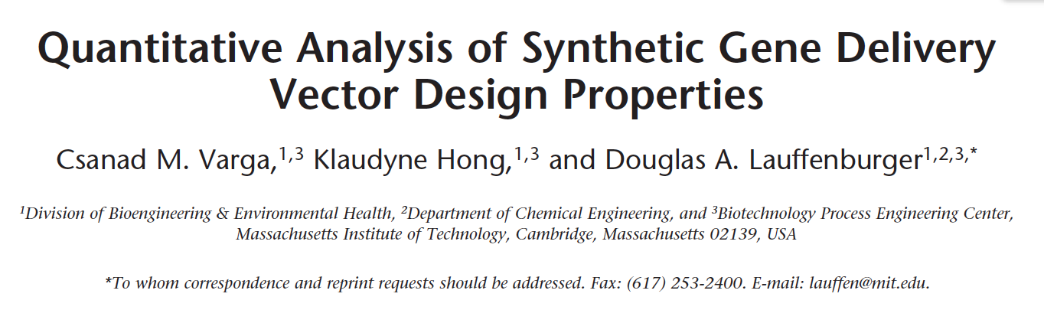
Extraction of equations (of metabolic networks) from PDFs
Extract metabolic networks from articles in human-readable and machine computable form.
Check for errors in paper
Enhance experience for human reviewers
Add multidisciplinary knowledge
Example:

Slide 3
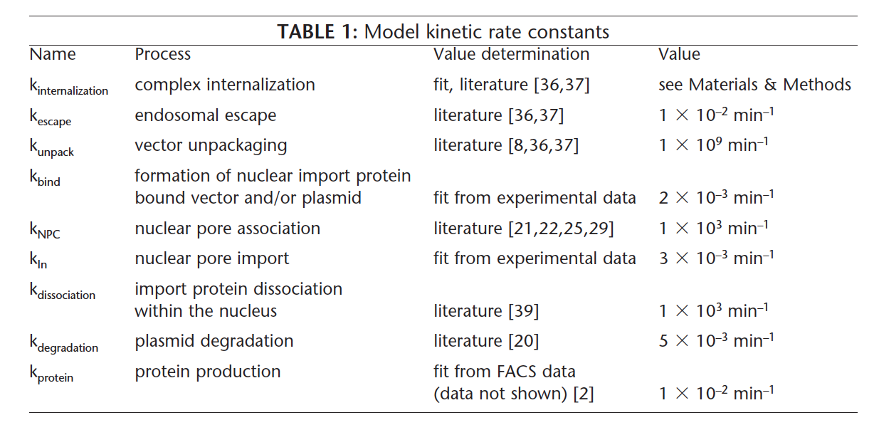
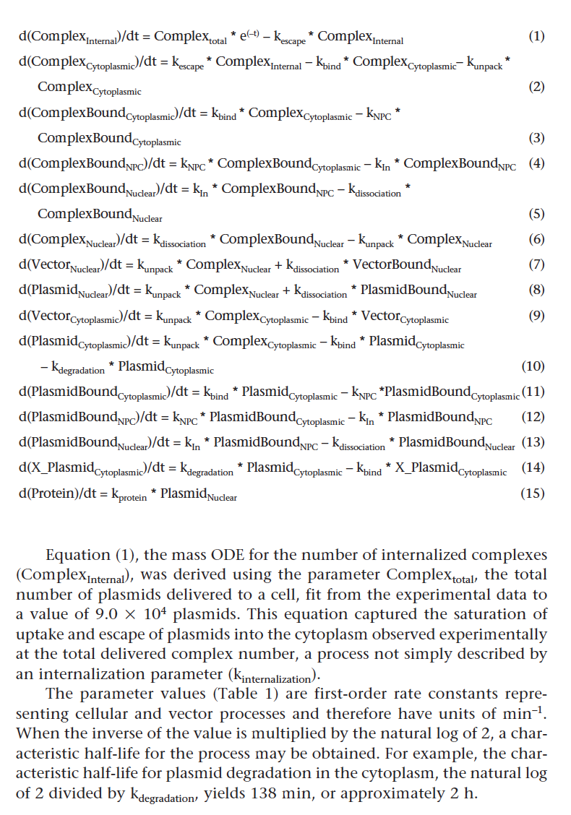
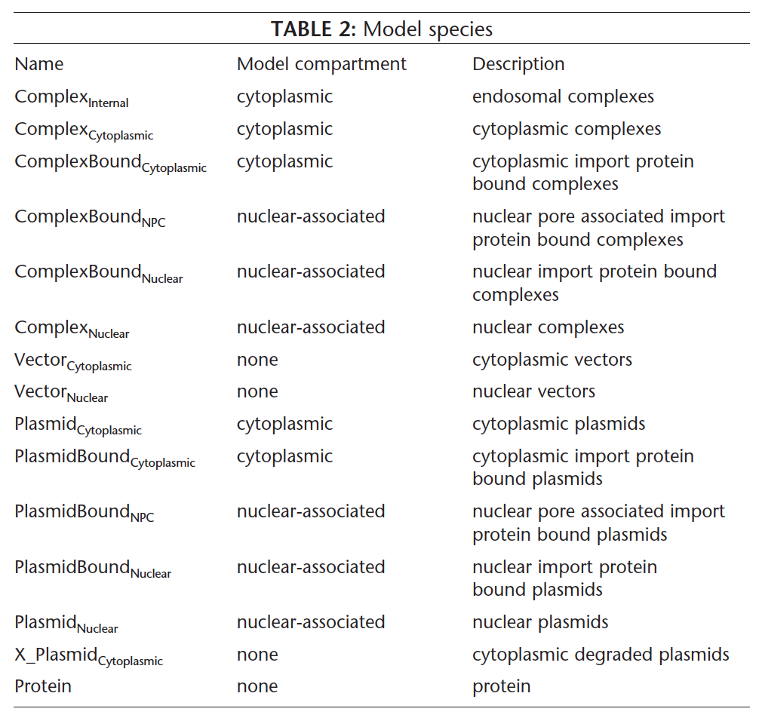
Metabolic network from Varga2001 in
PDF table form

Slide 4
Rate constants
Differential
Equations
Components
of the model
Metabolic network from Varga2001 in
PDF table form

Slide 5
M
M
HW
M
M
HW
HW
machines
Humans + Wikipedia

Slide 6
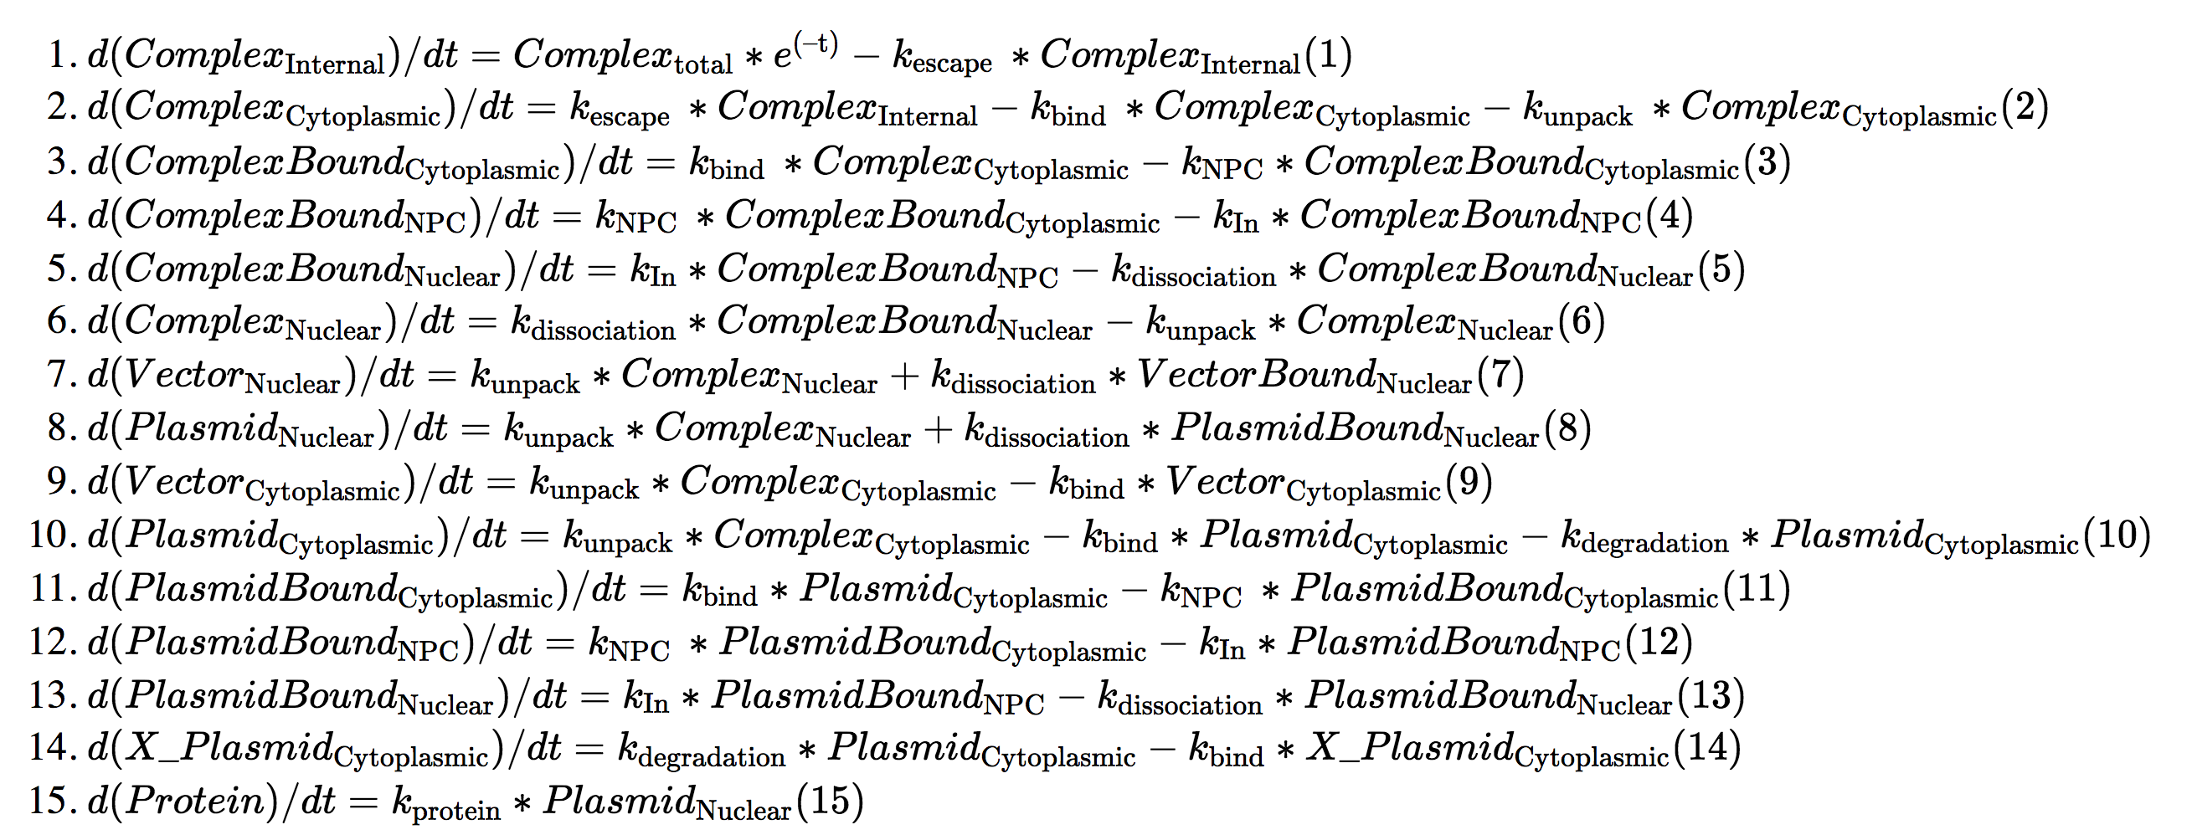
Matching sources and sinks in flow, 3-> 4

Slide 7
Machine-human assistance
Machine-assisted human review
Machines do the time-consuming, boring and error-prone parts
Machines link to additional knowledge
Machines compute properties
Machines spot errors in articles
Human-assisted machine extraction
Humans decide in each paper what to extract
Humans decide whether quality is sufficient

