Slide 1
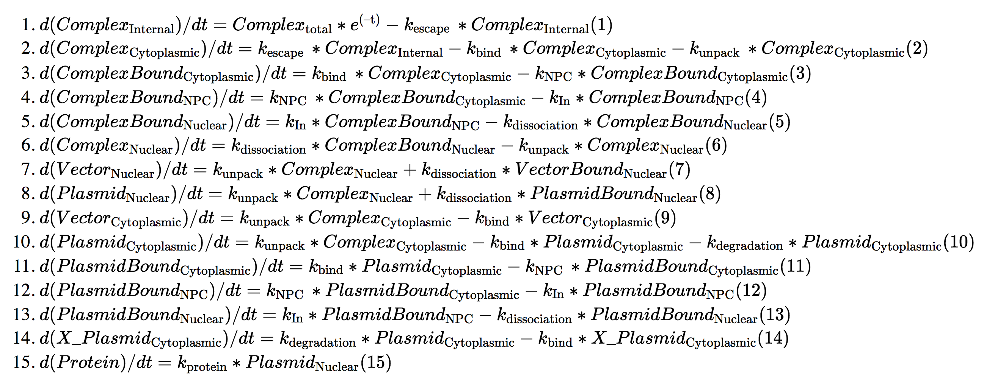
Matching sources and sinks in flow, 3-> 4

