Slide 1
Quaker Scientists
Graham Waterhouse and Peter Murray-Rust
Xxx
No knowledge of science is required Wikipedia links provided
Copyright: Both Graham and Peter have liberal approaches to copyright (CC BY)

Slide 2
About these slides
* copyright. Wherever possible we have used CC BY (SA) material
Copyright: Both Graham and Peter have liberal approaches to copyright (CC BY)

Slide 3
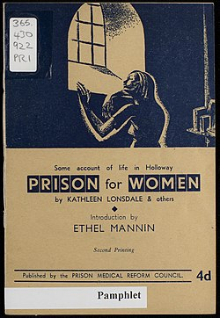
Pamphlet written by Kathleen Lonsdale on Prison Reform in 1943
After beginning her research career, in 1927 Yardley married Thomas Jackson Lonsdale. They had three children – Jane, Nancy, and Stephen. Stephen became a medical doctor and worked for several years in Nyasaland (now Malawi).^{[citation needed]}
Lonsdale was a vegetarian and teetotaller.^{[1]}
Pacifism
Though she had been brought up in the Baptist denomination as a child, Kathleen Lonsdale became a Quaker in 1935, simultaneously with her husband. Already committed pacifists, both were attracted to Quakerism for this reason.^{[36]} She was a Sponsor of the Peace Pledge Union.^{[37]}
She served a month in Holloway prison during the Second World War because she refused to register for civil defence duties or to pay a fine for refusing to register. During this time she experienced a range of issues which would eventually result in Lonsdale becoming a prison reform activist^{[38]} and she joined the Howard League for Penal Reform.^{[39]}
What I was not prepared for was the general insanity of an administrative system in which lip service is paid to the
Pamphlet written by Kathleen Lonsdale on Prison Reform in 1943
After beginning her research career, in 1927 Yardley married Thomas Jackson Lonsdale. They had three children – Jane, Nancy, and Stephen. Stephen became a medical doctor and worked for several years in Nyasaland (now Malawi).^{[citation needed]}
Lonsdale was a vegetarian and teetotaller.^{[1]}
Pacifism
Though she had been brought up in the Baptist denomination as a child, Kathleen Lonsdale became a Quaker in 1935, simultaneously with her husband. Already committed pacifists, both were attracted to Quakerism for this reason.^{[36]} She was a Sponsor of the Peace Pledge Union.^{[37]}
She served a month in Holloway prison during the Second World War because she refused to register for civil defence duties or to pay a fine for refusing to register. During this time she experienced a range of issues which would eventually result in Lonsdale becoming a prison reform activist^{[38]} and she joined the Howard League for Penal Reform.^{[39]}
What I was not prepared for was the general insanity of an administrative system in which lip service is paid to the

Slide 4


Slide 10
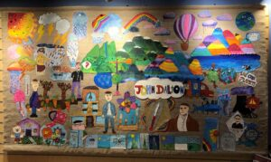
https://www.quaker-tapestry.co.uk/2021/03/19/john-dalton-scientist-quaker-and-pioneer/

Slide 11
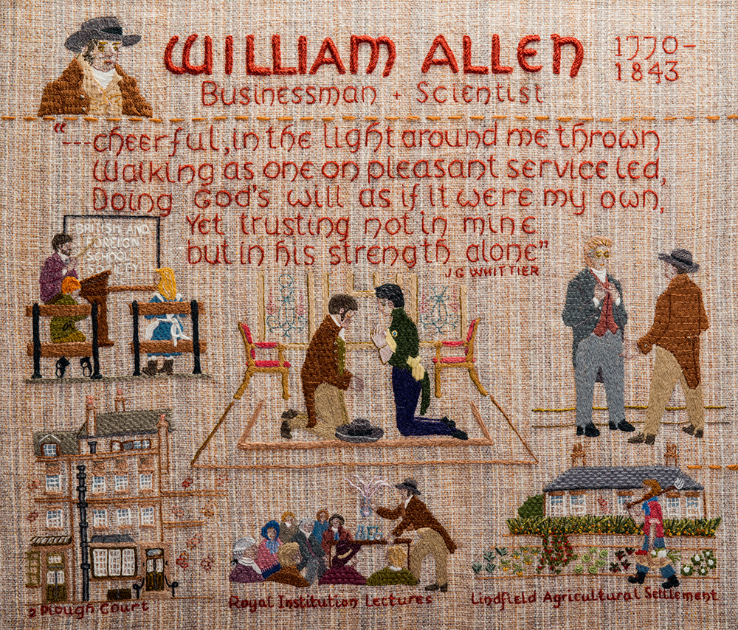

Slide 12
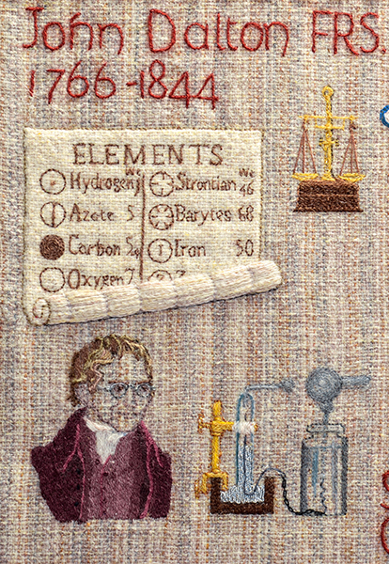

Slide 13
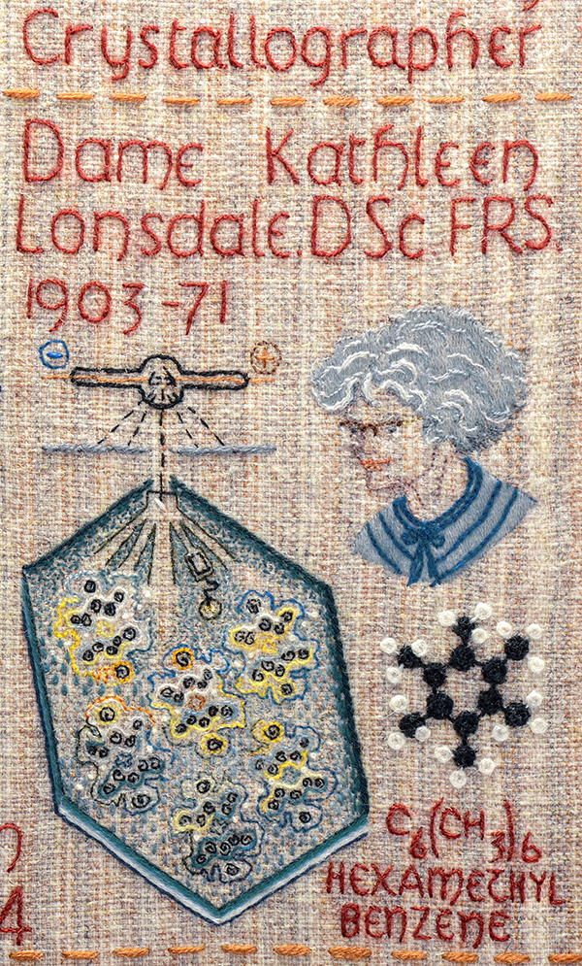

Slide 14
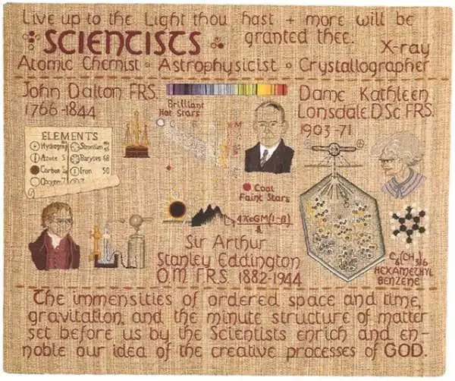

Slide 15
* Quaker principles
* How does PMR reconcile science and Quakerism
What was the scientific background at the time?
What were quaker networks, schools and industry
STEP
Effect of dissension

Slide 16
The finding of one generation will not serve for the next. It tarnishes
rapidly except it be reserved with an ever-renewed spirit of seeking.
Arthur Eddington

Slide 17
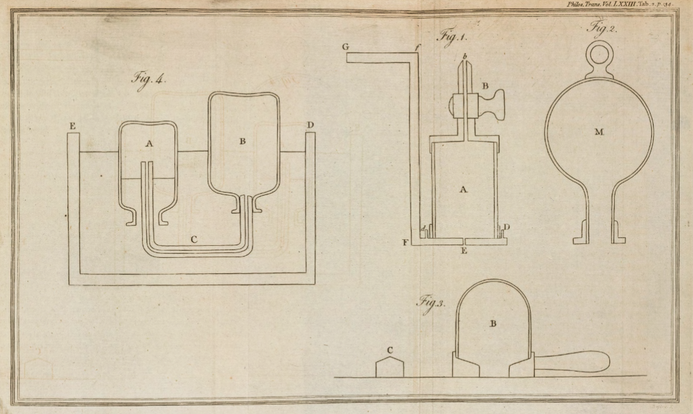
Scanned images copyright © 2017,
Royal Societyhttps://doi.org/10.1098/rstl.1783.0008open_in_new

Slide 18
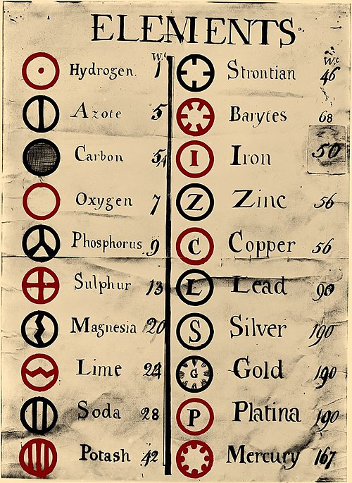
https://upload.wikimedia.org/wikipedia/commons/0/0f/Dalton%27s_Element_List.jpg

Slide 19
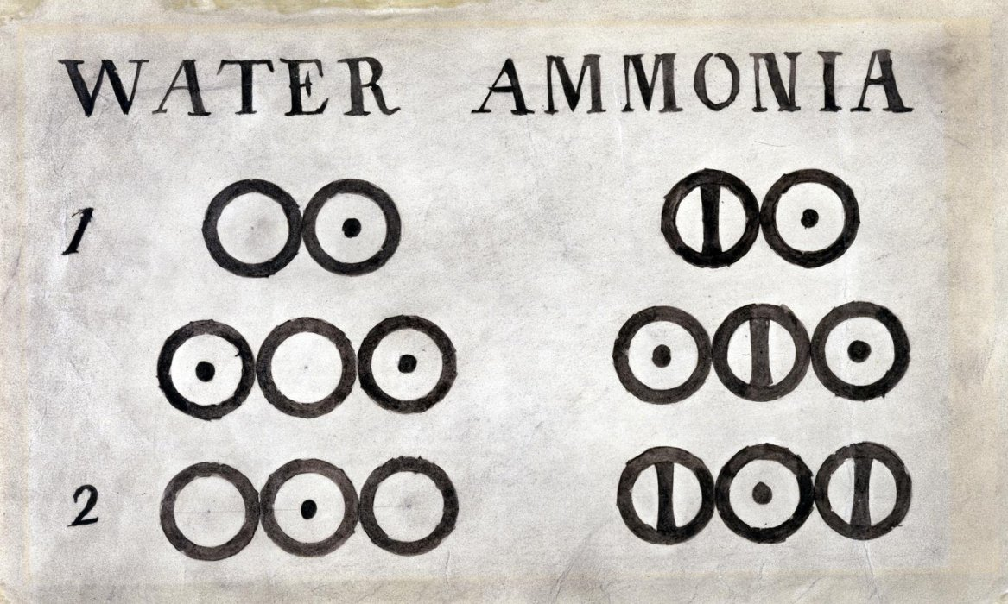

Slide 20
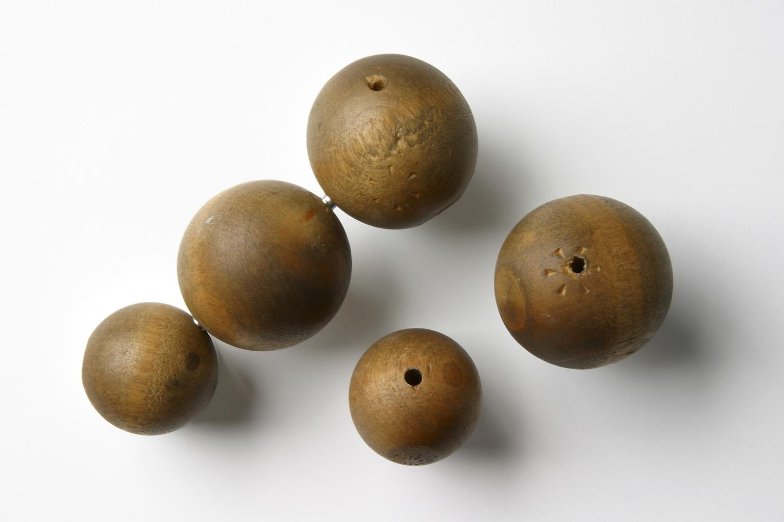
Five wooden balls, made by Peter Ewart of Manchester c.1810, and used by John Dalton for demonstrating his atomic theory c. 1810–42
Science Museum Group Collection

Slide 21
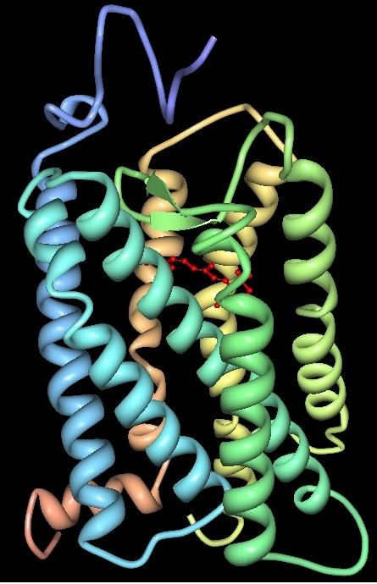
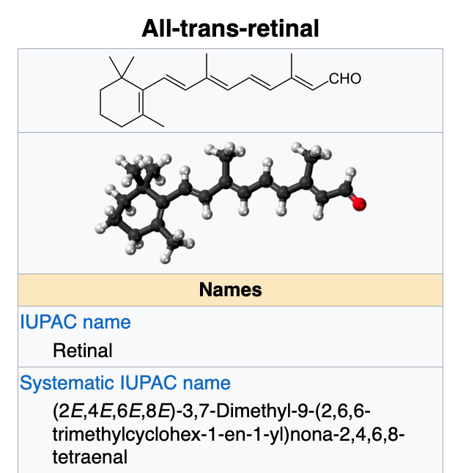
Atoms responsible
for John Dalton’s
colour blindness
https://en.wikipedia.org/wiki/Vertebrate_visual_opsin
Three-dimensional structure of bovine rhodopsin. The seven transmembrane domains are shown in varying colors. The retinal chromophore is shown in red. Wikipedia

Slide 22
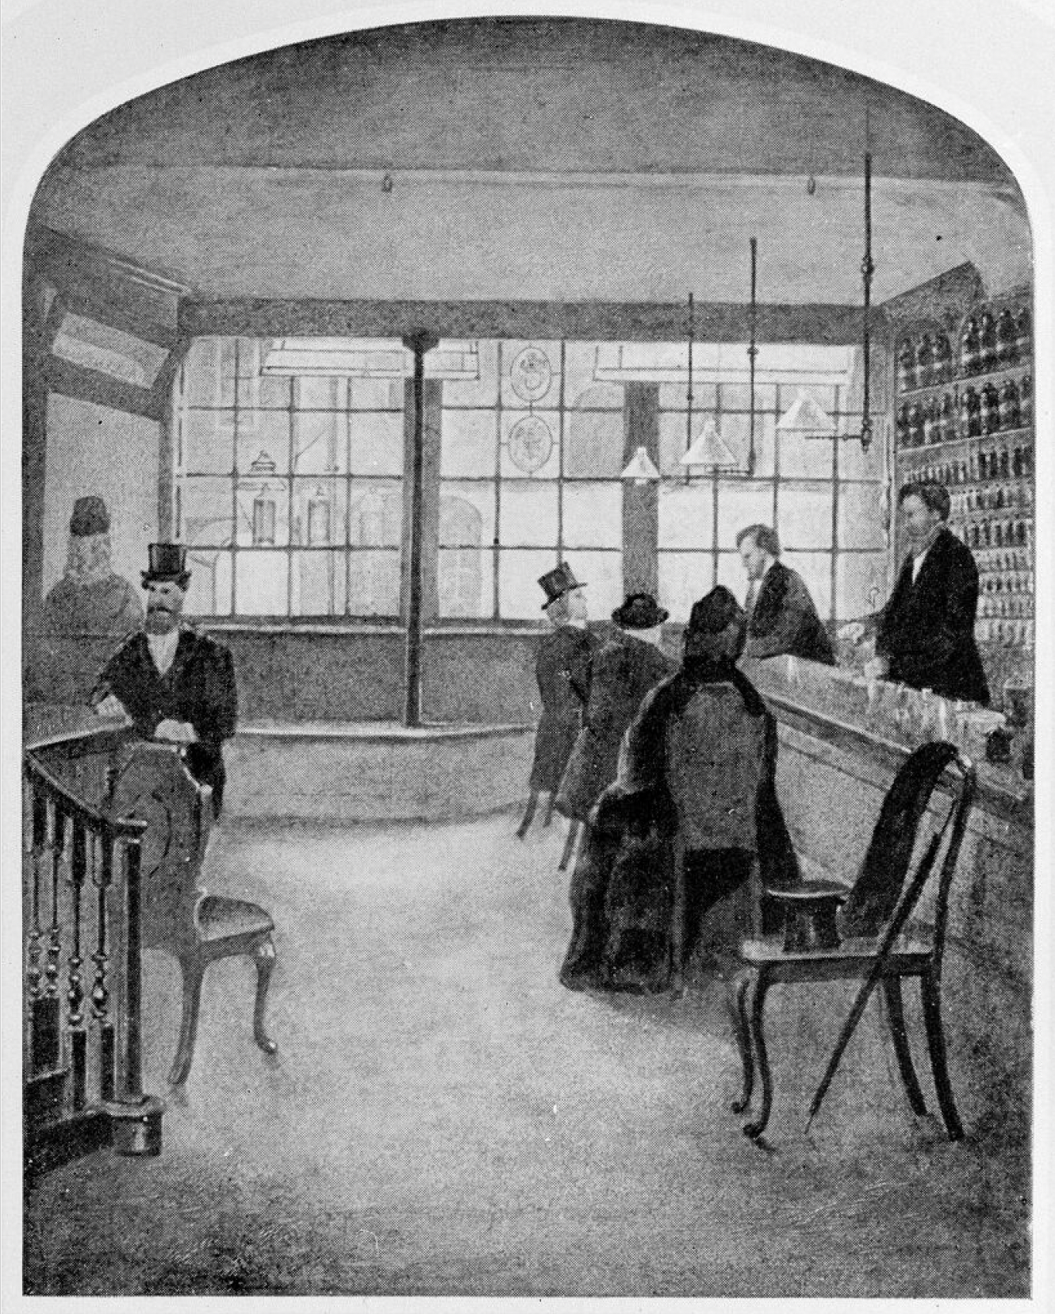
Wellcome Trust Corporate Archive
…Direct activities WT/D
Library and Museum WT/D/1
Images from the photographic library WT/D/1/20M0007729:
Interior of the old pharmacy at Plough Court WT/D/1/20/1/66/62

Slide 23
Plough Court Pharmacy Medicines (1715-1927)
Background:
Founded: 1715 in London by Silvanus Bevan (Quaker)
Location: Plough Court, Lombard Street, London
Significance: One of the most famous pharmacies of its era, later became Allen & Hanburys
Quaker connection: Founded and run by Quakers, reflecting their values of integrity and service
Categories of Medicines Sold:
1. Herbal Remedies
Digitalis (Foxglove): For heart conditions
Willow Bark: Pain relief and fever reduction (precursor to aspirin)
Chamomile: Digestive issues and anxiety
Peppermint: Digestive problems and nausea
Valerian: Anxiety and sleep disorders
Rose Water: Skin care and mild astringent
Peppermint Water: Digestive aid
2. Tinctures and Elixirs
Laudanum: Opium tincture for pain relief and coughs
Daffy's Elixir: Popular digestive tonic
Godfrey's Cordial: Infant soothing preparation
Various bitters: For digestive health
Alcohol-based solutions: For preservation and easy administration
3. Chemical Compounds
Mercury compounds: For syphilis treatment
Calomel (mercurous chloride): Purgative
Quinine powder: Malaria treatment
Antimony: Emetic and purgative
Arsenic preparations: Small doses for various treatments
Lead acetate: In ointments and salves
4. Topical Applications
Mercurial ointments: For skin conditions
Sulfur preparations: For skin problems
Zinc oxide ointments: For wounds and burns
Herbal salves: For wounds and inflammations
Poultices: For drawing out infections
Balms: For wound healing
5. Patent Medicines
Proprietary formulations: Often with secret ingredients
Tonic preparations: For general health
Cough syrups: With honey and herbal extracts
Digestive aids: Various proprietary blends
6. Apothecary Supplies
Empty bottles and containers
Scales and measuring equipment
Mortars and pestles
Distillation equipment
Ingredients for home remedies
7. Specialized Preparations
Compounded prescriptions: Custom-made for individual patients
Pills and powders: Solid medication forms
Lozenges: For respiratory and digestive issues
Distilled waters: Floral and herbal waters
Quaker Influence on the Pharmacy:
1. Quality and Integrity:Honest preparation and labeling
No adulteration of medicines
Fair pricing
2. Service to Community:Serving all people regardless of social status
Providing medicines to the poor
Educational role in health matters
3. Scientific Approach:Careful measurement and preparation
Record-keeping and documentation
Innovation in pharmaceutical techniques
Historical Context:
Medical Understanding of the Era:Based on humoral theory and herbal medicine
Limited understanding of disease causes
Many treatments now considered dangerous or ineffective
Focus on symptom relief rather than cure
References:"Plough Court: The Story of a Notable Pharmacy, 1715-1927" by Ernest C. Cripps
Wellcome Collection archives
Historical pharmacy records
The Plough Court Pharmacy represents an important example of how Quaker values of integrity, service, and scientific inquiry influenced the development of pharmaceutical practice in 18th and 19th century England.

Slide 24
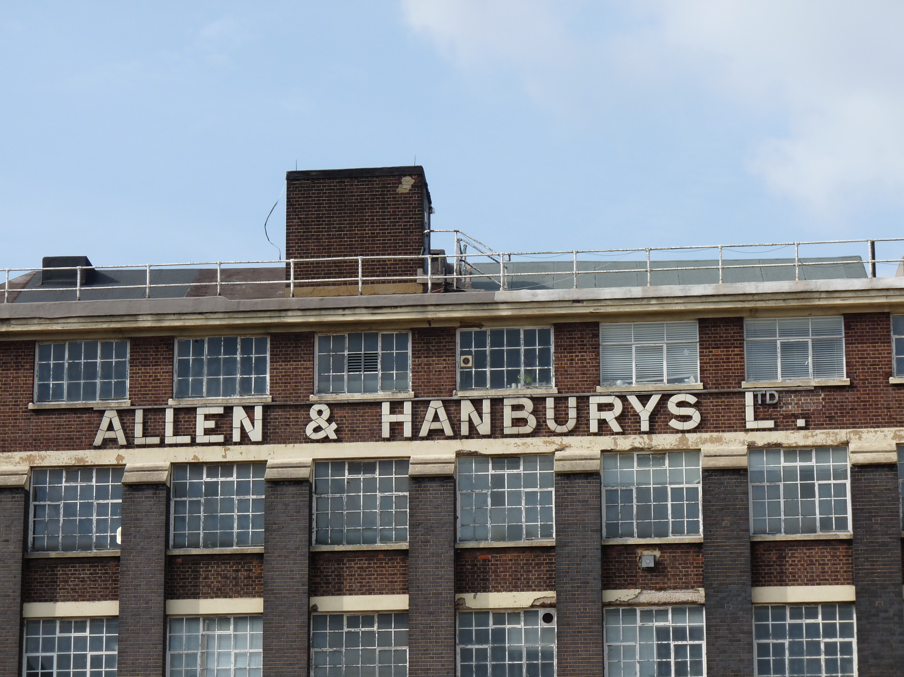

Slide 25
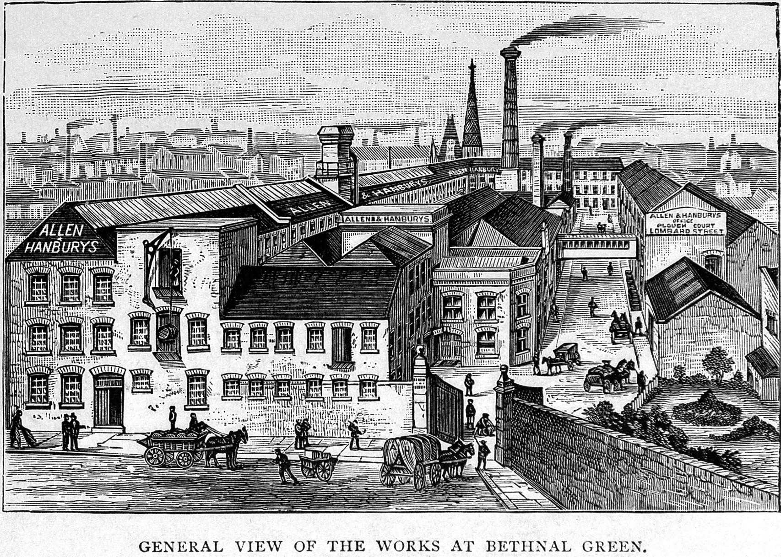
Creator: Wellcome Library, London
Copyright: Copyrighted work available under Creative Commons Attribution only licence
CC BY 4.0 http://creativecommons.org/licenses/by/4.0/

Slide 26
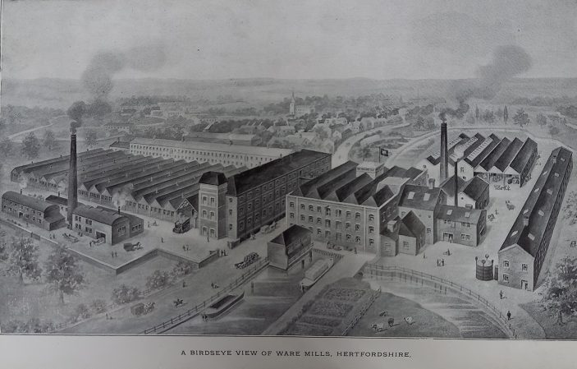
Allen & Hanbury's, Ware showing the factory and mills in 1920
Hertfordshire Archives & Local Studies (Ware.Industries pamphlet file)

