Slide 1
Quaker Scientists
Graham Waterhouse and Peter Murray-Rust
Xxx
No knowledge of science is required Wikipedia links provided
Copyright: Both Graham and Peter have liberal approaches to copyright (CC BY)

Slide 2
About these slides
* copyright. Wherever possible we have used CC BY (SA) material
Copyright: Both Graham and Peter have liberal approaches to copyright (CC BY)

Slide 3

Pamphlet written by Kathleen Lonsdale on Prison Reform in 1943
After beginning her research career, in 1927 Yardley married Thomas Jackson Lonsdale. They had three children – Jane, Nancy, and Stephen. Stephen became a medical doctor and worked for several years in Nyasaland (now Malawi).^{[citation needed]}
Lonsdale was a vegetarian and teetotaller.^{[1]}
Pacifism
Though she had been brought up in the Baptist denomination as a child, Kathleen Lonsdale became a Quaker in 1935, simultaneously with her husband. Already committed pacifists, both were attracted to Quakerism for this reason.^{[36]} She was a Sponsor of the Peace Pledge Union.^{[37]}
She served a month in Holloway prison during the Second World War because she refused to register for civil defence duties or to pay a fine for refusing to register. During this time she experienced a range of issues which would eventually result in Lonsdale becoming a prison reform activist^{[38]} and she joined the Howard League for Penal Reform.^{[39]}
What I was not prepared for was the general insanity of an administrative system in which lip service is paid to the
Pamphlet written by Kathleen Lonsdale on Prison Reform in 1943
After beginning her research career, in 1927 Yardley married Thomas Jackson Lonsdale. They had three children – Jane, Nancy, and Stephen. Stephen became a medical doctor and worked for several years in Nyasaland (now Malawi).^{[citation needed]}
Lonsdale was a vegetarian and teetotaller.^{[1]}
Pacifism
Though she had been brought up in the Baptist denomination as a child, Kathleen Lonsdale became a Quaker in 1935, simultaneously with her husband. Already committed pacifists, both were attracted to Quakerism for this reason.^{[36]} She was a Sponsor of the Peace Pledge Union.^{[37]}
She served a month in Holloway prison during the Second World War because she refused to register for civil defence duties or to pay a fine for refusing to register. During this time she experienced a range of issues which would eventually result in Lonsdale becoming a prison reform activist^{[38]} and she joined the Howard League for Penal Reform.^{[39]}
What I was not prepared for was the general insanity of an administrative system in which lip service is paid to the

Slide 4


Slide 10
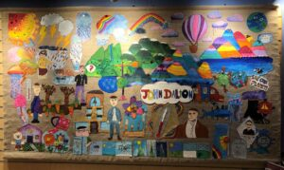
https://www.quaker-tapestry.co.uk/2021/03/19/john-dalton-scientist-quaker-and-pioneer/

Slide 11
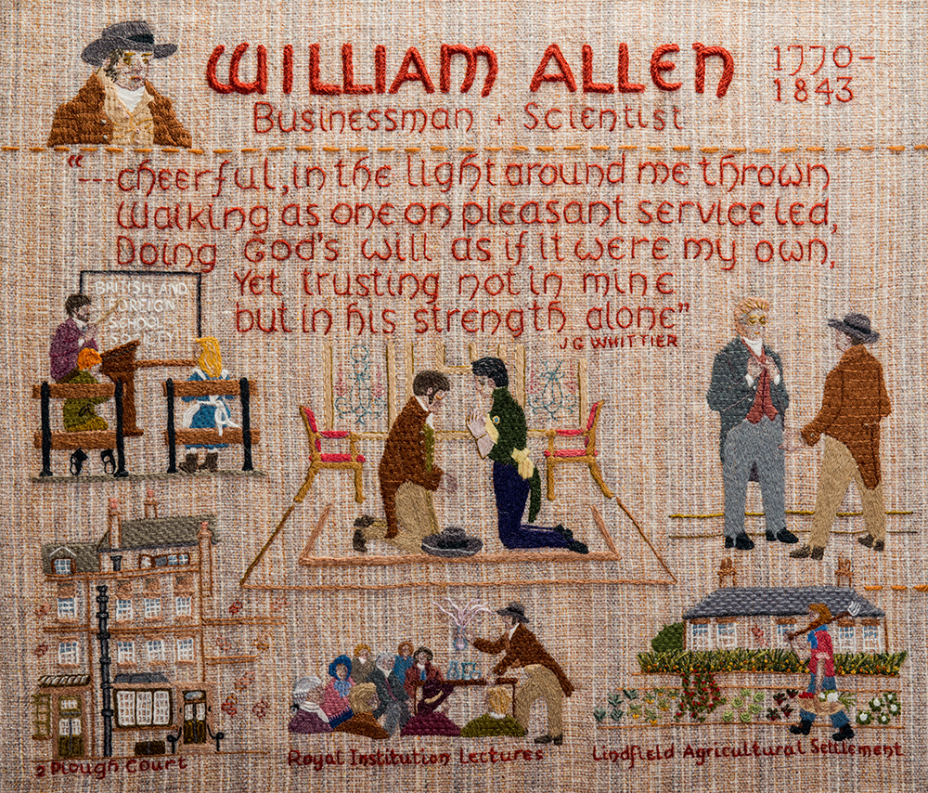

Slide 12
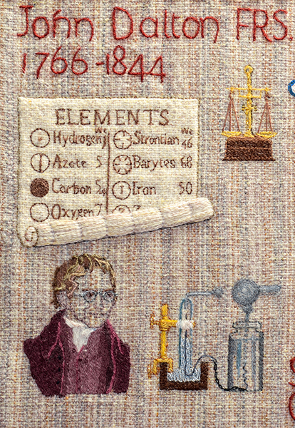

Slide 13
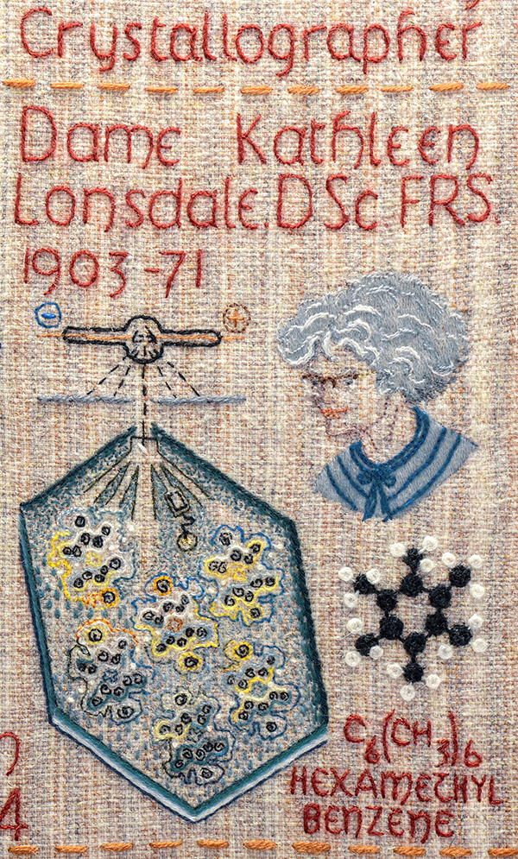

Slide 14
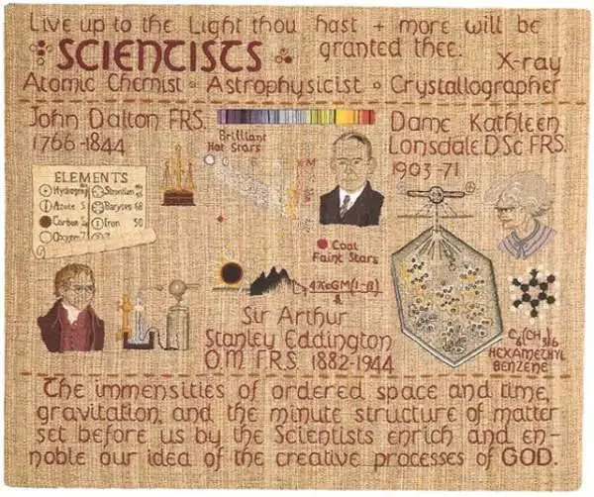

Slide 15
* Quaker principles
* How does PMR reconcile science and Quakerism
What was the scientific background at the time?
What were quaker networks, schools and industry
STEP
Effect of dissension

Slide 16
The finding of one generation will not serve for the next. It tarnishes
rapidly except it be reserved with an ever-renewed spirit of seeking.
Arthur Eddington

Slide 17
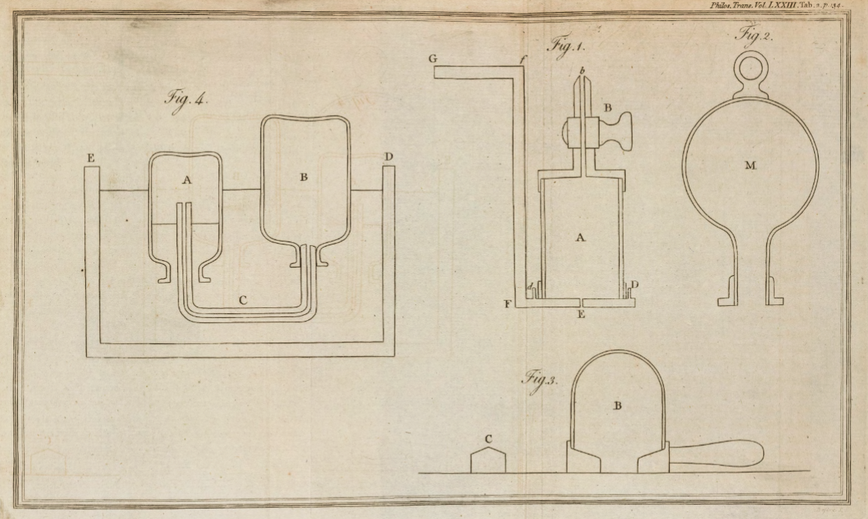
Scanned images copyright © 2017,
Royal Societyhttps://doi.org/10.1098/rstl.1783.0008open_in_new

Slide 18
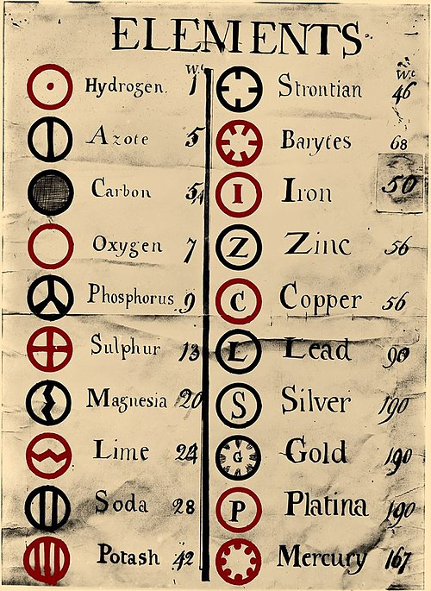
https://upload.wikimedia.org/wikipedia/commons/0/0f/Dalton%27s_Element_List.jpg

Slide 19
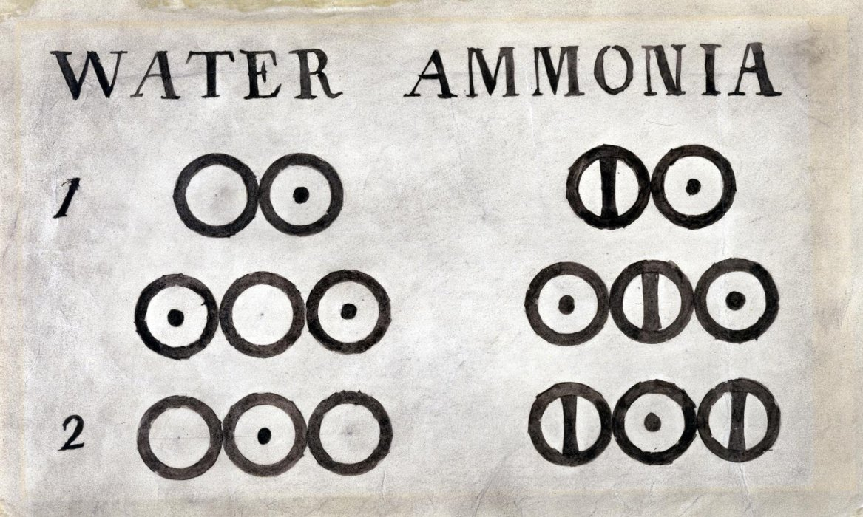

Slide 20
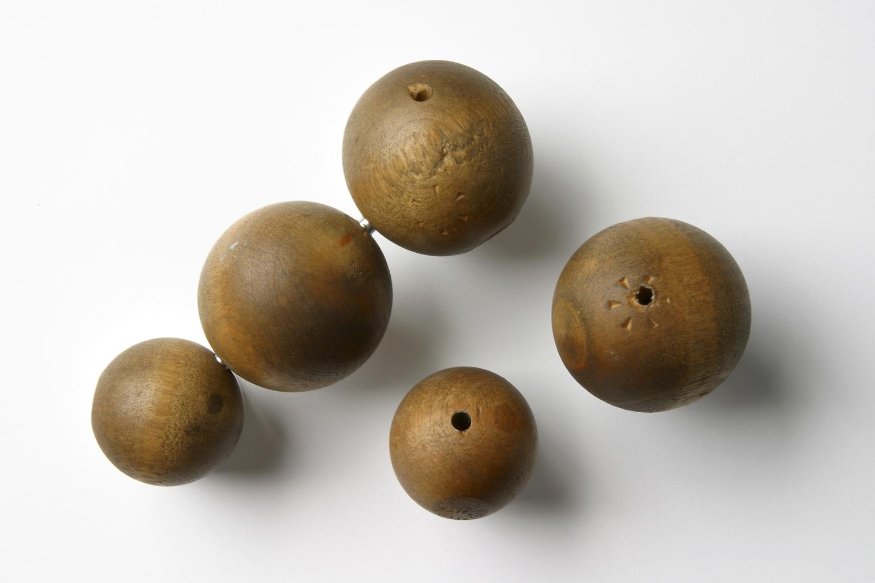
Five wooden balls, made by Peter Ewart of Manchester c.1810, and used by John Dalton for demonstrating his atomic theory c. 1810–42
Science Museum Group Collection

Slide 21
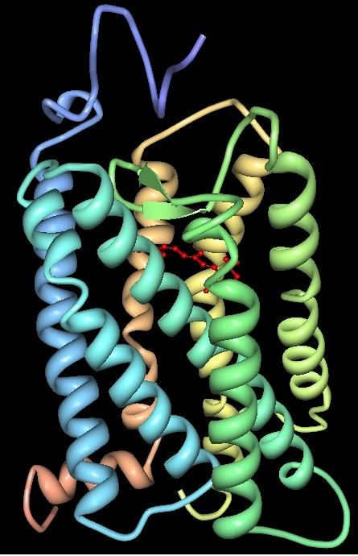
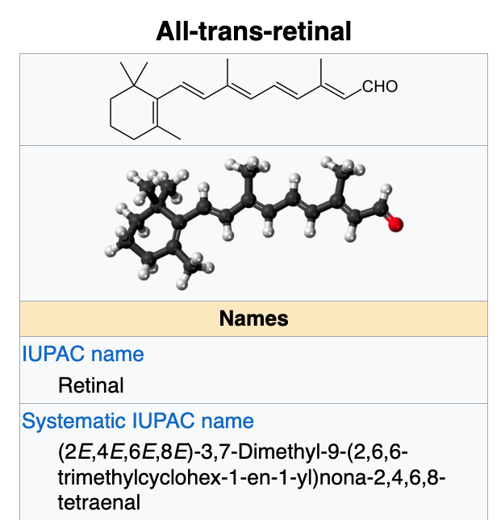
Atoms responsible
for John Dalton’s
colour blindness
https://en.wikipedia.org/wiki/Vertebrate_visual_opsin
Three-dimensional structure of bovine rhodopsin. The seven transmembrane domains are shown in varying colors. The retinal chromophore is shown in red. Wikipedia

Slide 22
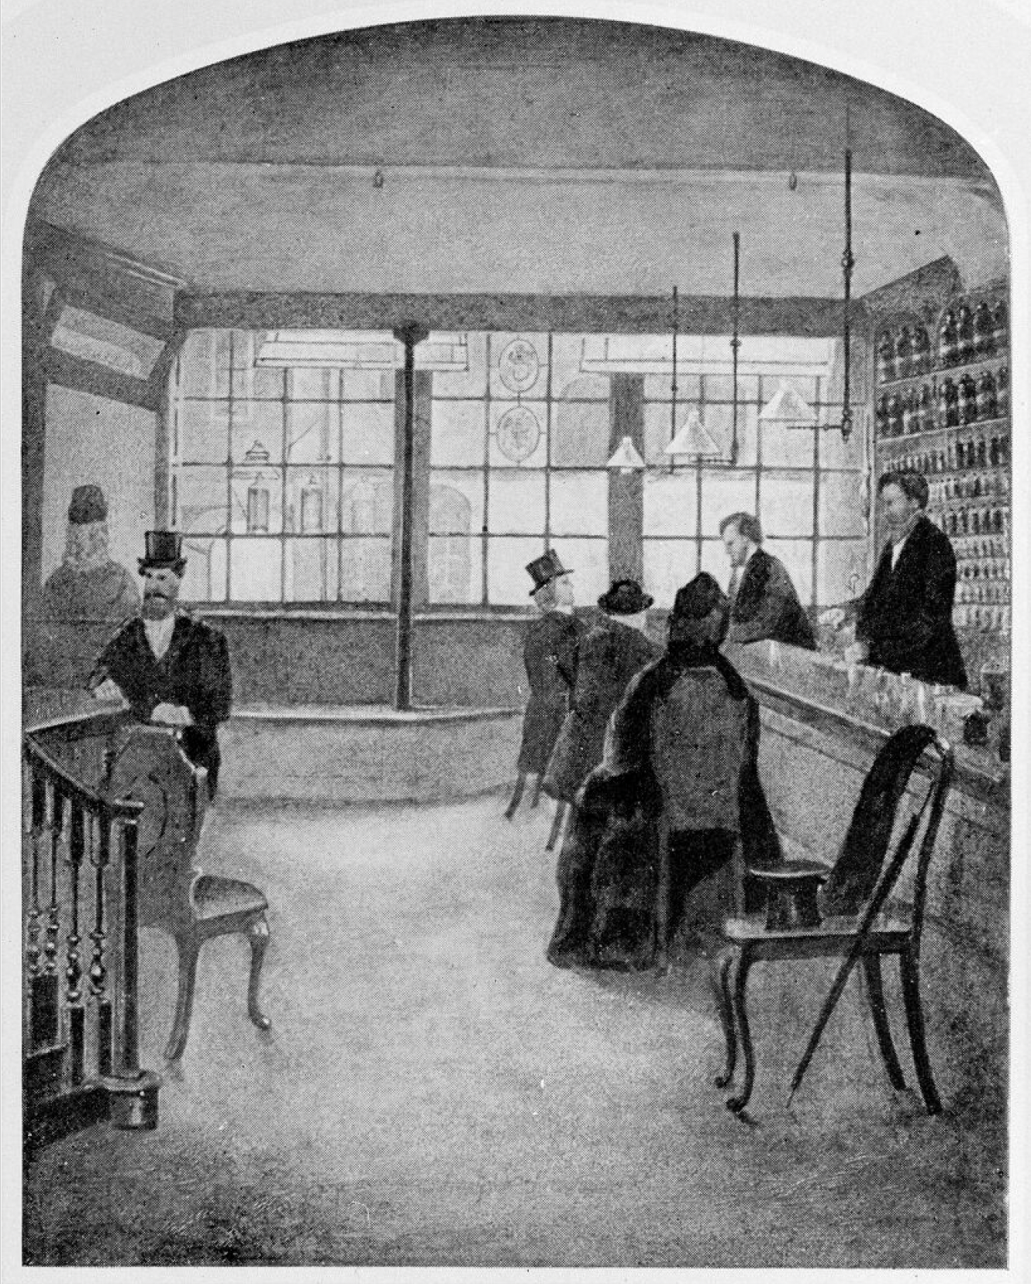
Wellcome Trust Corporate Archive
…Direct activities WT/D
Library and Museum WT/D/1
Images from the photographic library WT/D/1/20M0007729:
Interior of the old pharmacy at Plough Court WT/D/1/20/1/66/62

Slide 23

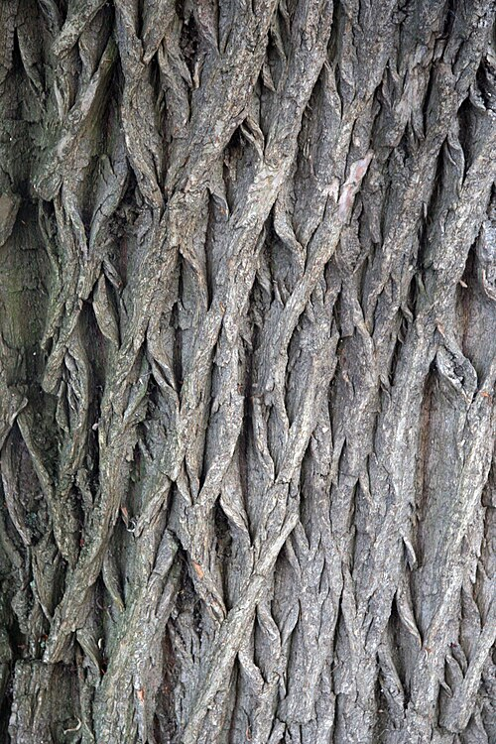

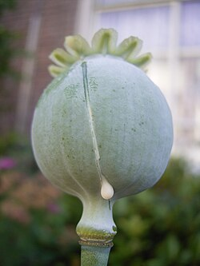
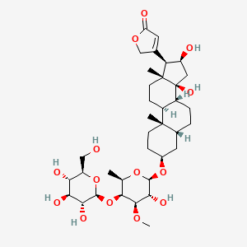
Plough Court Pharmacy Medicines (1715-1927) [from CursorAI]
NATURAL:
Digitalis (Foxglove): For heart conditions
Willow Bark: Pain relief and fever reduction (precursor to aspirin)
Quinine powder: Malaria treatment
Chamomile: Digestive issues and anxiety
Peppermint: Valerian: Rose Water:
Laudanum: Opium tincture for pain relief and coughs
Elixirs, Cordials, bitters
Chemical Compounds
Mercury compounds: For syphilis treatment
Calomel (mercurous chloride): Purgative
Antimony: Emetic and purgative
Arsenic preparations, Lead acetate
Sulfur preparations: For skin problems
Zinc oxide ointments: For wounds and burns
Bottles, Scales, equipment, Mortars and pestles, Distillation equipment
Pills and powders: Lozenges:

Slide 24
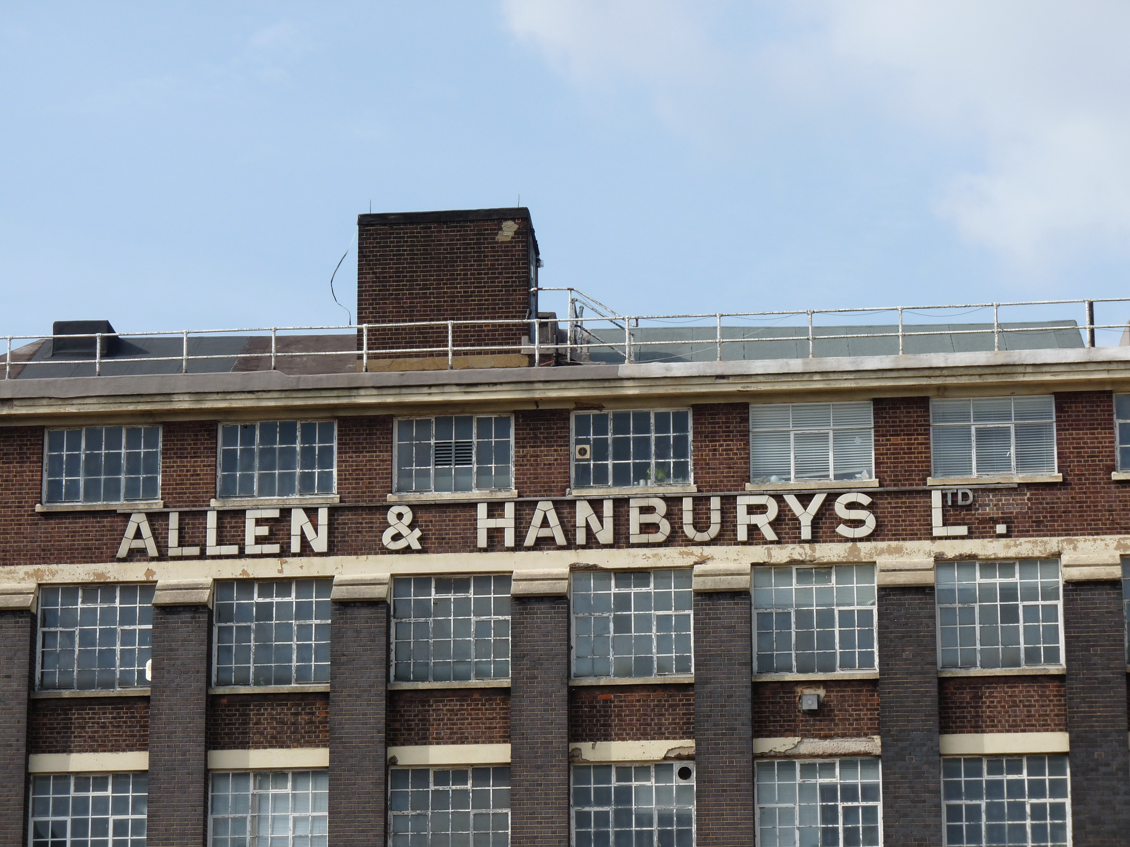

Slide 25
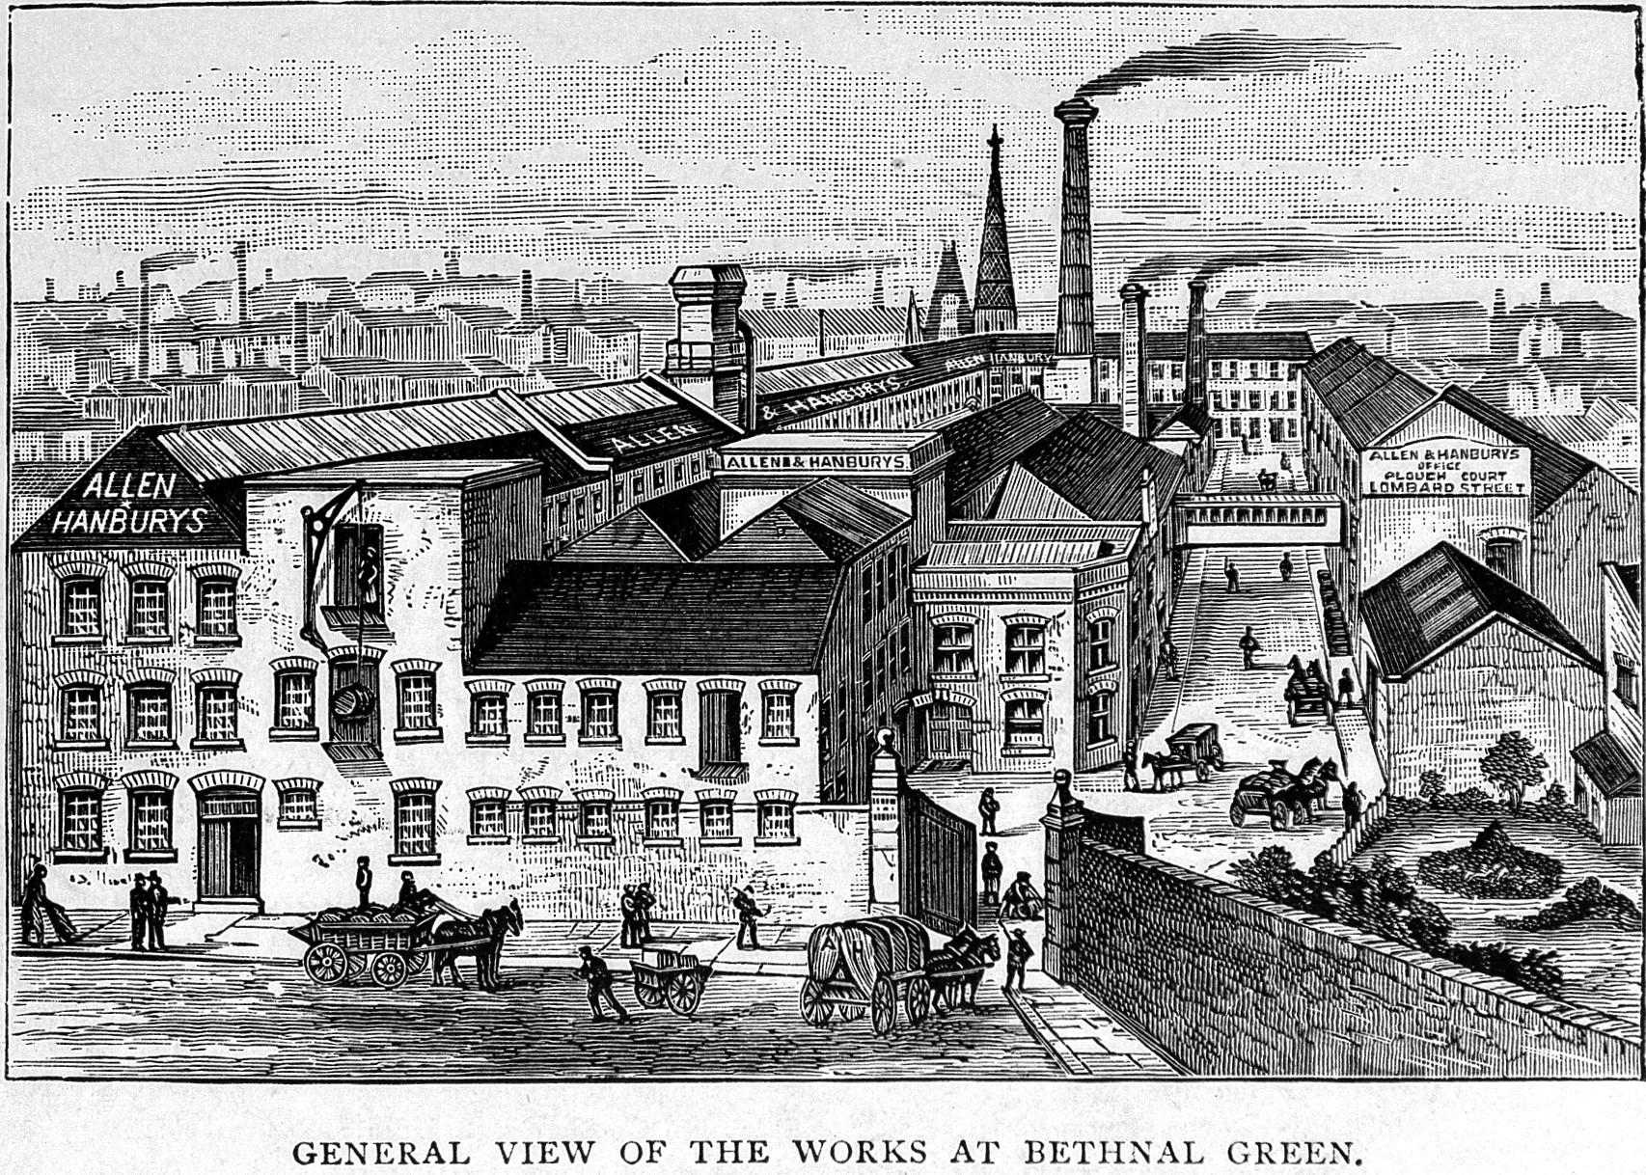
Creator: Wellcome Library, London
Copyright: Copyrighted work available under Creative Commons Attribution only licence
CC BY 4.0 http://creativecommons.org/licenses/by/4.0/

Slide 26
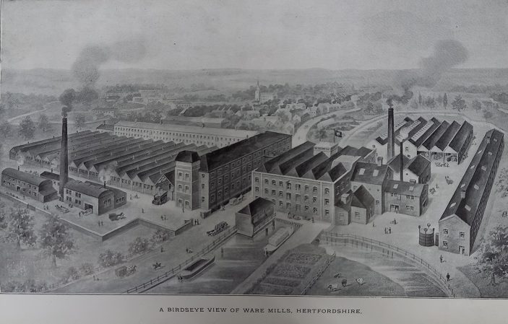
Allen & Hanbury's, Ware showing the factory and mills in 1920
Hertfordshire Archives & Local Studies (Ware.Industries pamphlet file)

