Slide 1
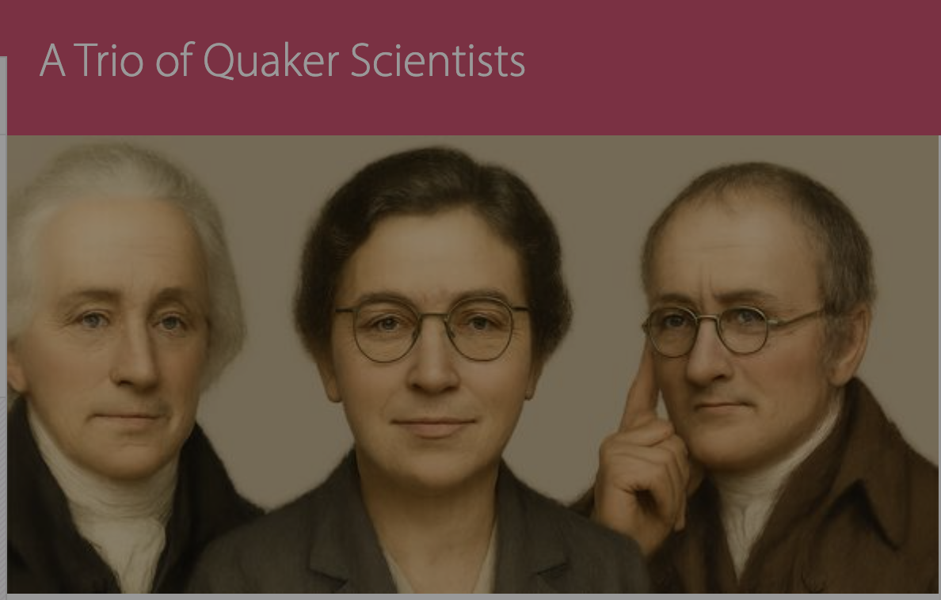
William Allen
Kathleen Lonsdale
John Dalton
Graham Waterhouse and Peter Murray-Rust
Jesus Lane Meeting House, 2025-09-18

Slide 3
The SPICES Principles
Simplicity:
Peace:
Integrity:
Community:
Equality:
Stewardship:
Themes:
Science + religion
Education, Quaker schools
Outreach
Dissension
The finding of one generation will not serve for the next. It tarnishes
rapidly except it be reserved with an ever-renewed spirit of seeking.
Arthur Eddington

Slide 4
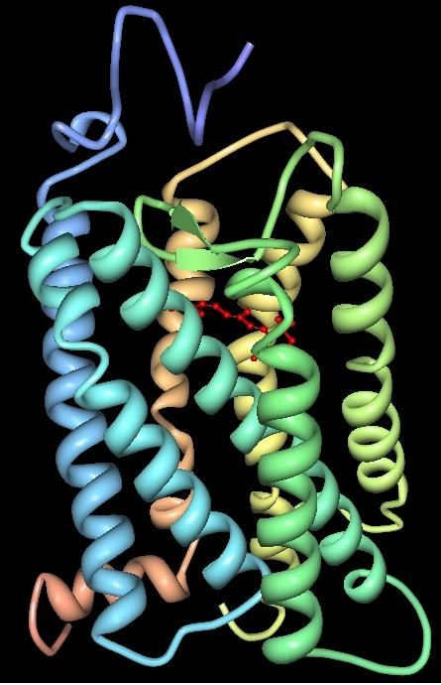
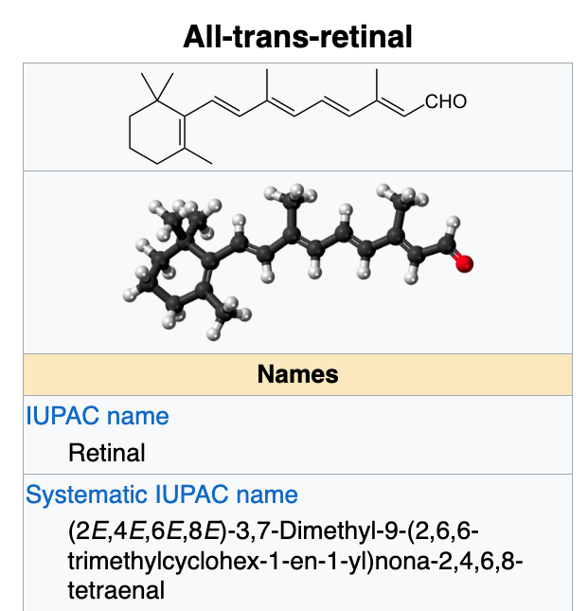
Atoms responsible
for John Dalton’s
colour blindness
https://en.wikipedia.org/wiki/Vertebrate_visual_opsin
Three-dimensional structure of bovine rhodopsin. The seven transmembrane domains are shown in varying colors. The retinal chromophore is shown in red. Wikipedia

Slide 5
Knowledge Graphs for the scientists
Cursor AI was used to generate knowledge graphs of relatives, mentors/mentees
William Allen

Slide 6
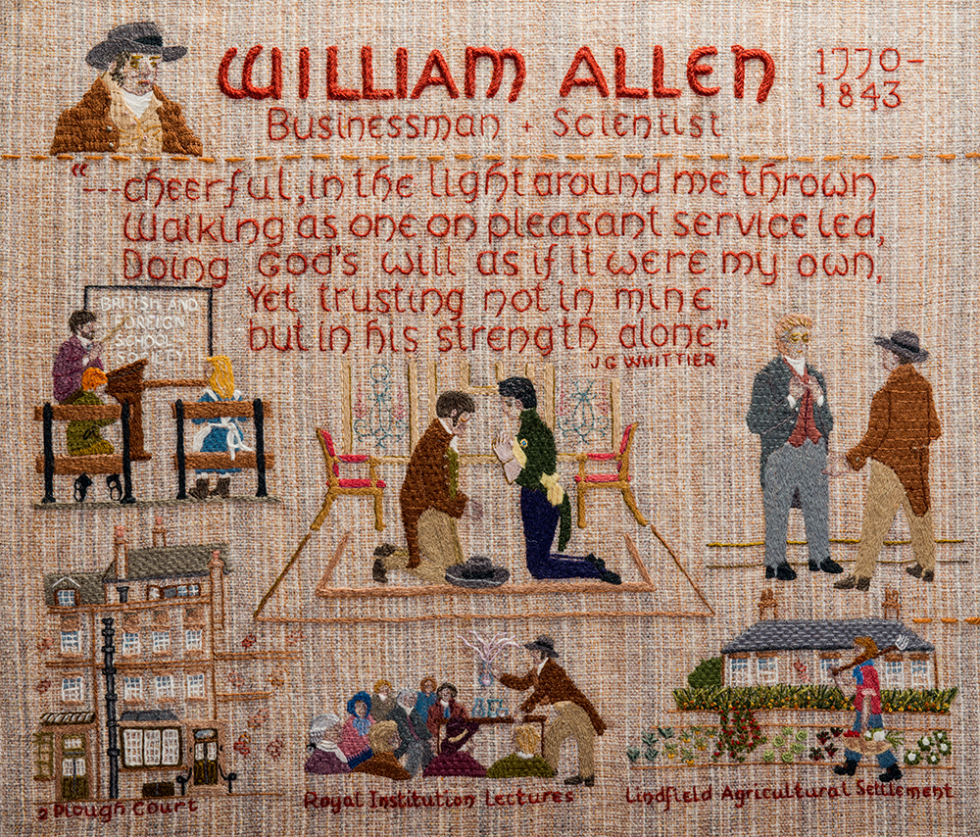

Slide 7
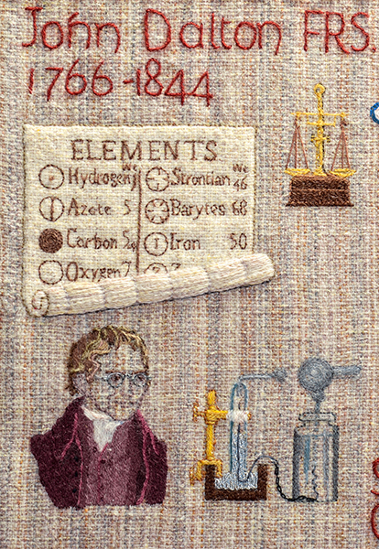

Slide 8
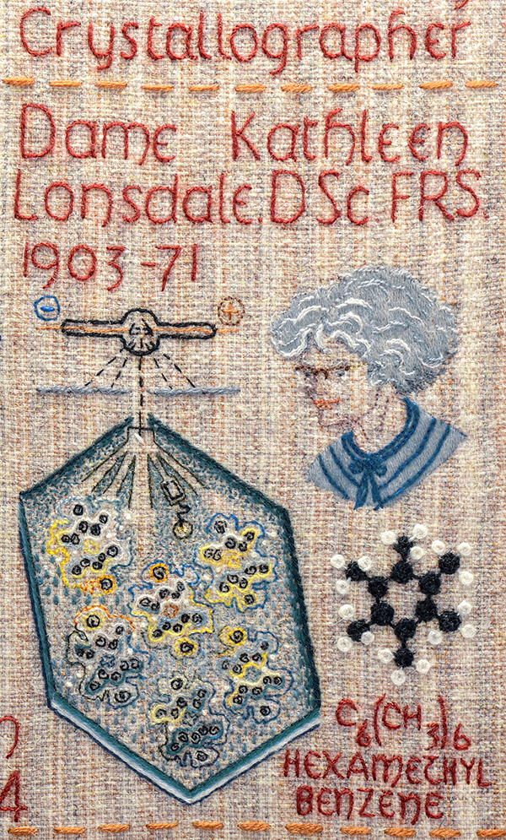

Slide 9
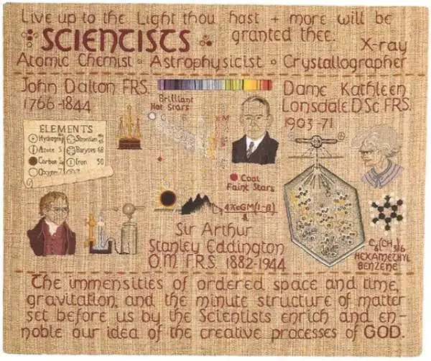

Slide 10
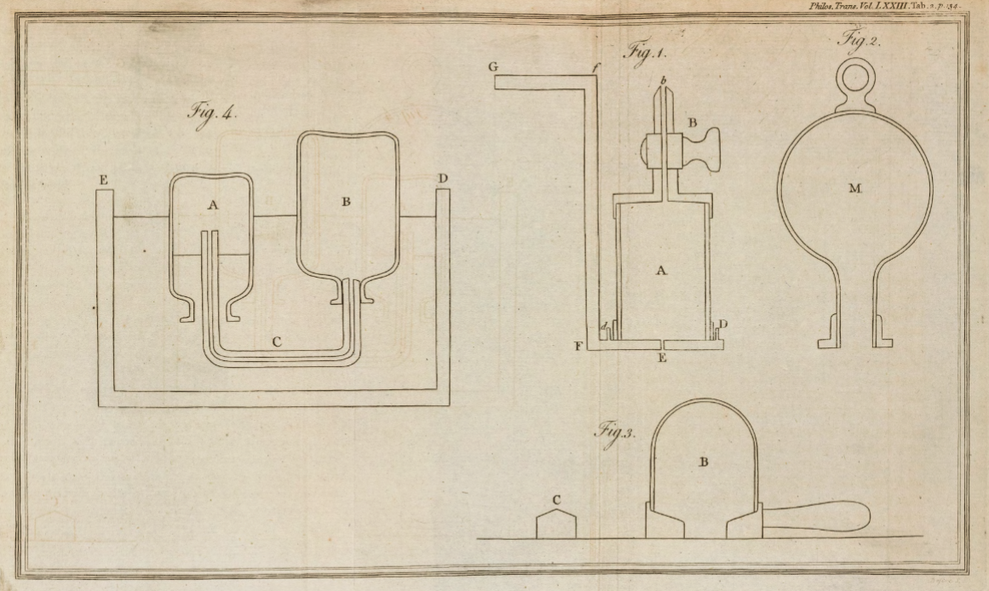
Scanned images copyright © 2017,
Royal Societyhttps://doi.org/10.1098/rstl.1783.0008open_in_new

Slide 11
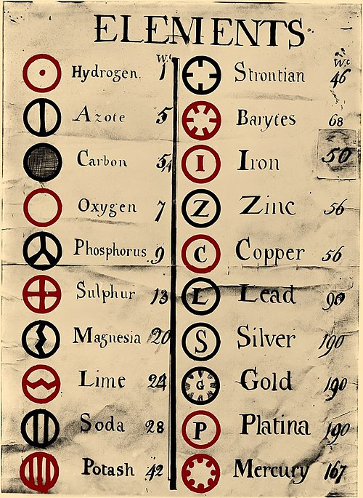
https://upload.wikimedia.org/wikipedia/commons/0/0f/Dalton%27s_Element_List.jpg

Slide 12
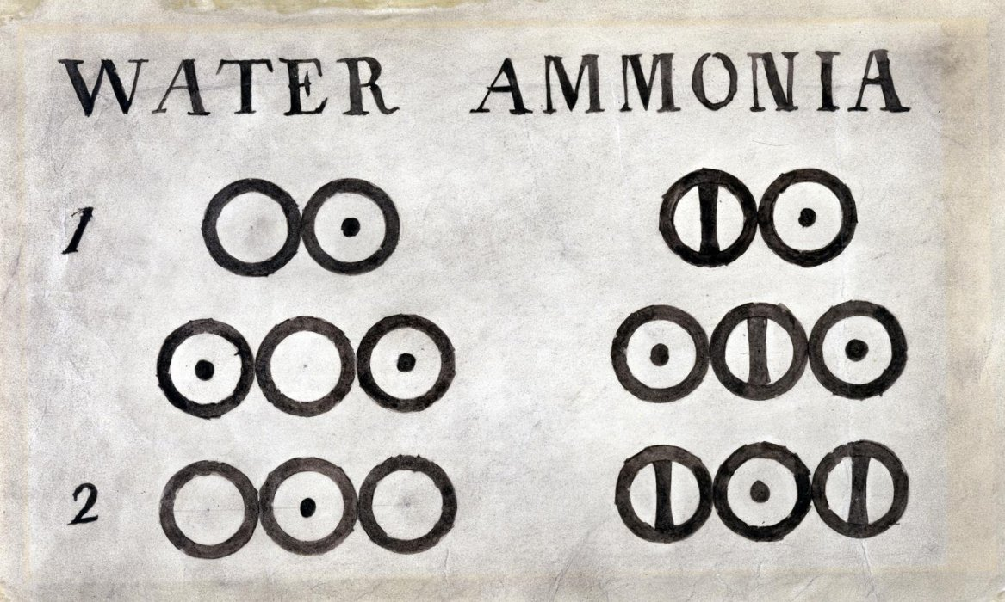

Slide 13
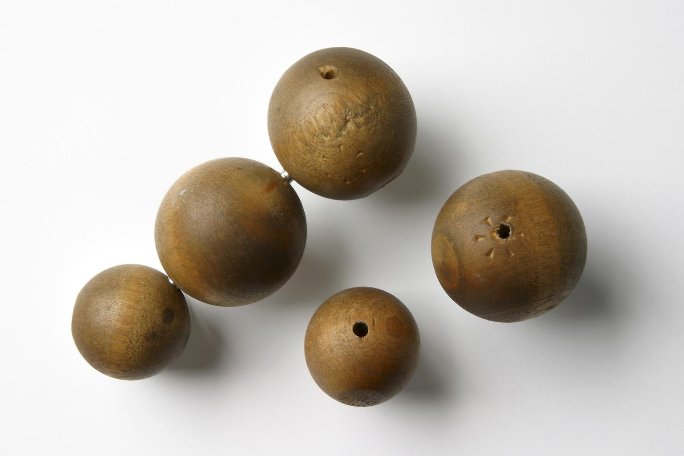
Five wooden balls, made by Peter Ewart of Manchester c.1810, and used by John Dalton for demonstrating his atomic theory c. 1810–42
Science Museum Group Collection

Slide 14
Atoms responsible
for John Dalton’s
colour blindness
https://en.wikipedia.org/wiki/Vertebrate_visual_opsin
Three-dimensional structure of bovine rhodopsin. The seven transmembrane domains are shown in varying colors. The retinal chromophore is shown in red. Wikipedia

Slide 15
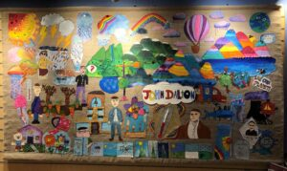
https://www.quaker-tapestry.co.uk/2021/03/19/john-dalton-scientist-quaker-and-pioneer/

Slide 16
William Allen

Slide 17
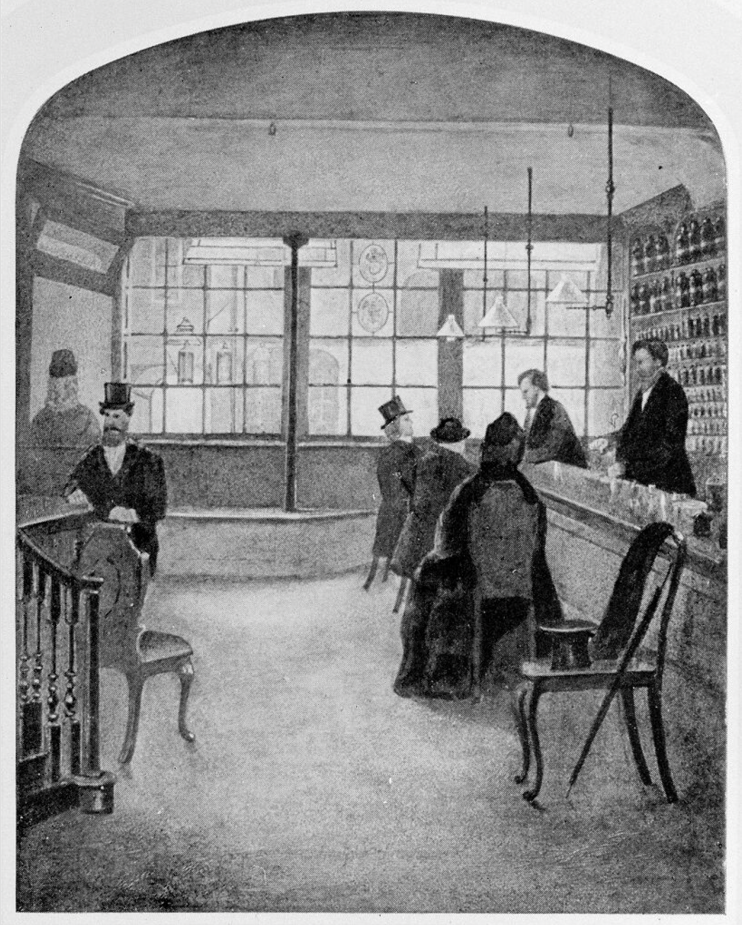
Wellcome Trust Corporate Archive
…Direct activities WT/D
Library and Museum WT/D/1
Images from the photographic library WT/D/1/20M0007729:
Interior of the old pharmacy at Plough Court WT/D/1/20/1/66/62

Slide 18
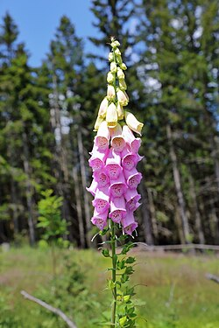

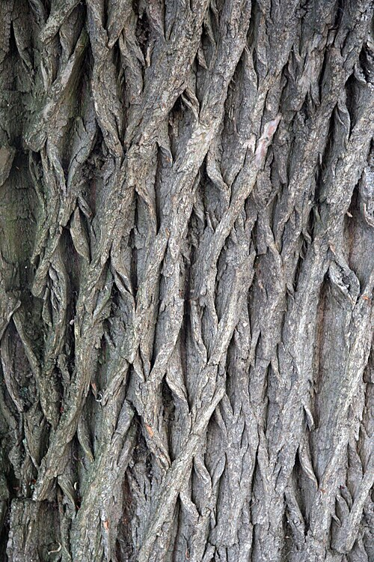
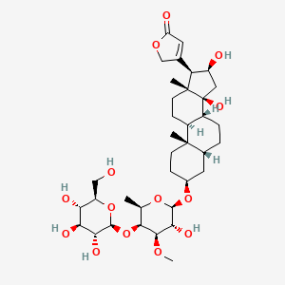
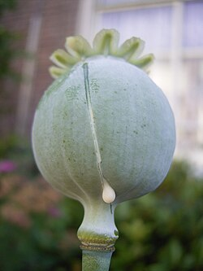
Plough Court Pharmacy Medicines (1715-1927) [from CursorAI]
NATURAL:
Digitalis (Foxglove): For heart conditions
Willow Bark: Pain relief and fever reduction (precursor to aspirin)
Quinine powder: Malaria treatment
Chamomile: Digestive issues and anxiety
Peppermint: Valerian: Rose Water:
Laudanum: Opium tincture for pain relief and coughs
Elixirs, Cordials, bitters
Chemical Compounds
Mercury compounds: For syphilis treatment
Calomel (mercurous chloride): Purgative
Antimony: Emetic and purgative
Arsenic preparations, Lead acetate
Sulfur preparations: For skin problems
Zinc oxide ointments: For wounds and burns
Bottles, Scales, equipment, Mortars and pestles, Distillation equipment
Pills and powders: Lozenges:

Slide 19
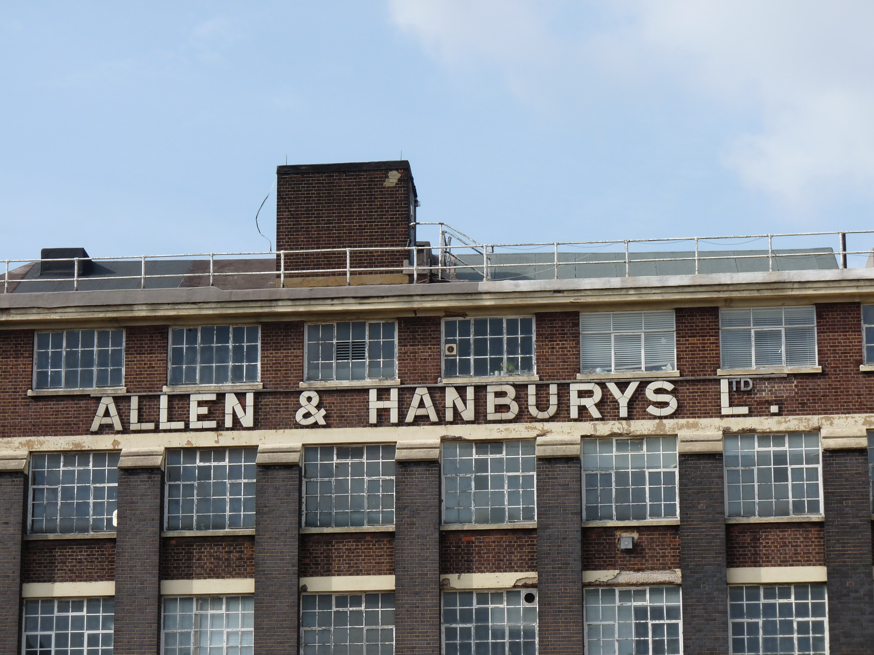

Slide 20
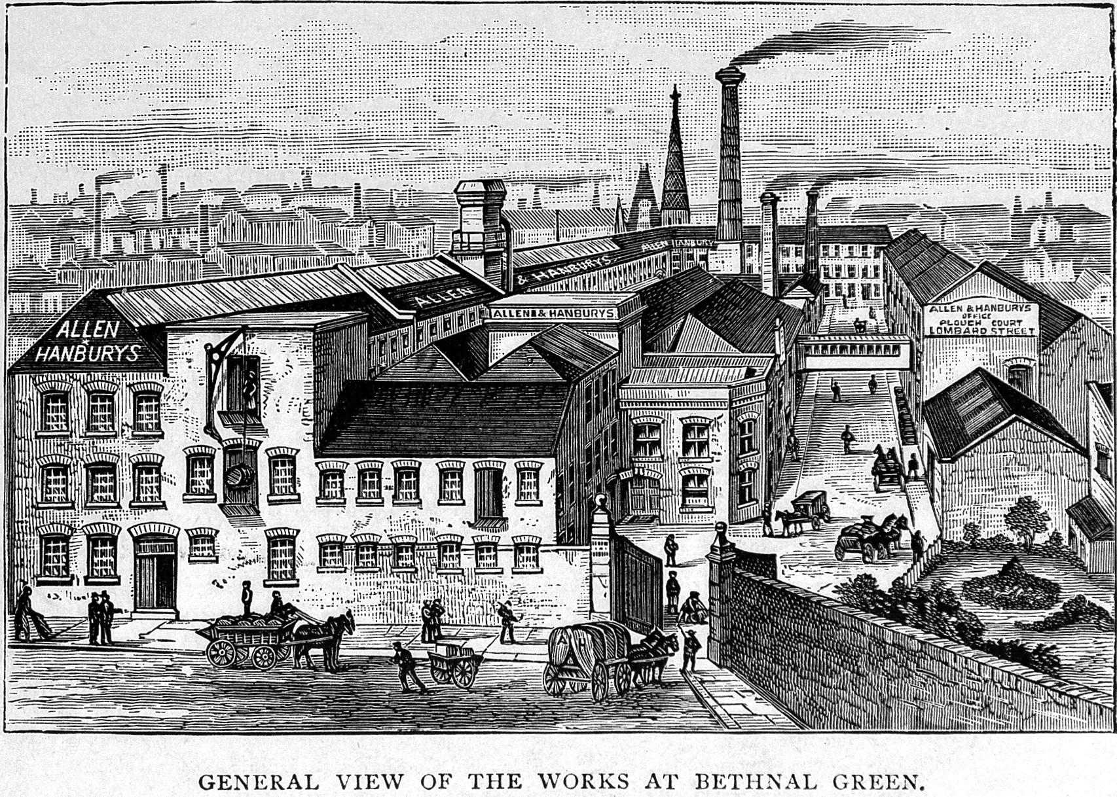
Creator: Wellcome Library, London
Copyright: Copyrighted work available under Creative Commons Attribution only licence
CC BY 4.0 http://creativecommons.org/licenses/by/4.0/

Slide 21
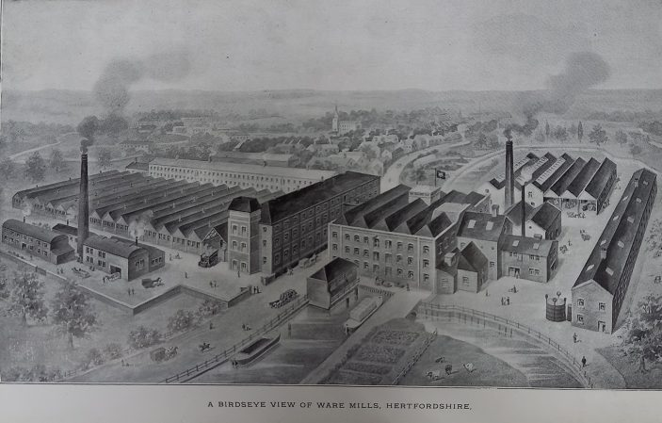
Allen & Hanbury's, Ware showing the factory and mills in 1920
Hertfordshire Archives & Local Studies (Ware.Industries pamphlet file)

Slide 22
Kathleen Lonsdale

Slide 23
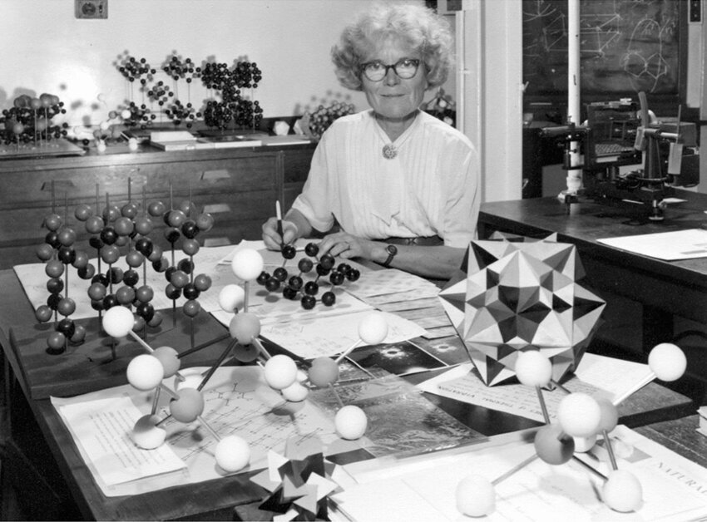
Kathleen Lonsdale in her crystallography research laboratory at UCL. Photographer and date unknown

Slide 24
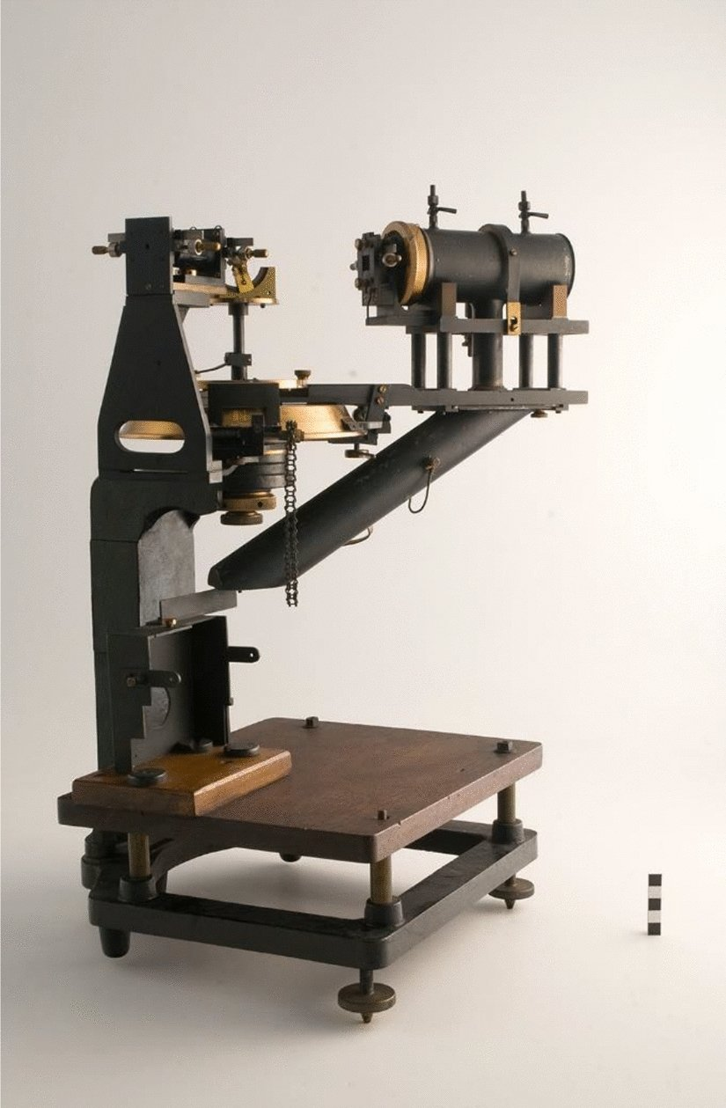

Slide 25
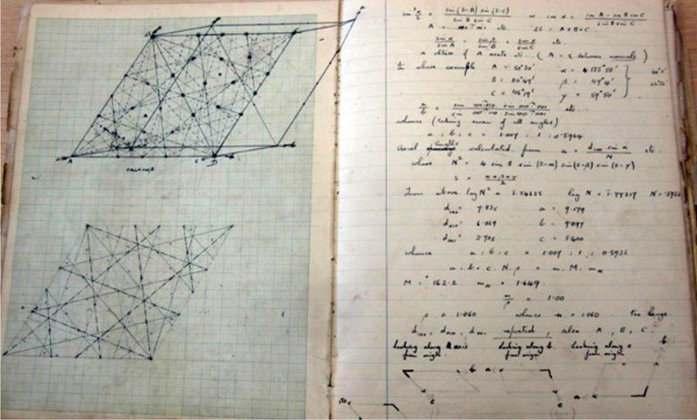

Slide 26
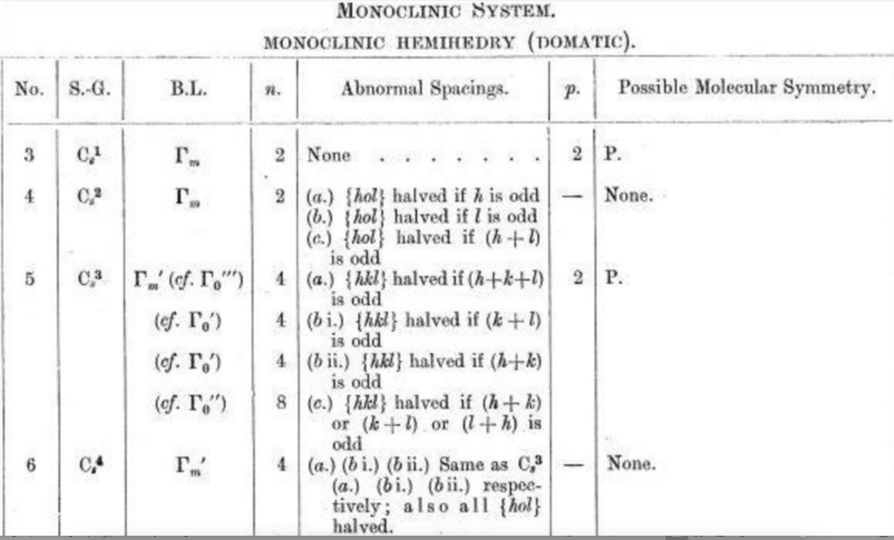
International Tables for Crystallography (230 spacegroups),
major contributions from Kathleen Lonsdale

Slide 27
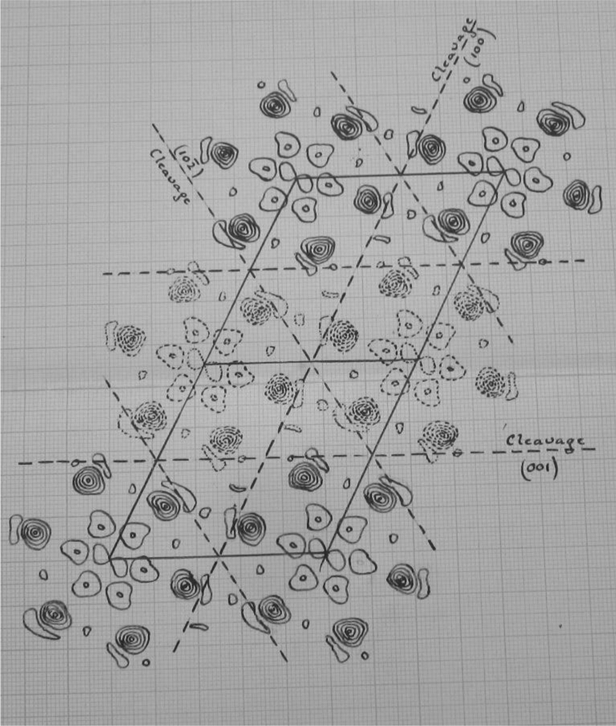
Drawing of the electron density projection on the (010) plane calculated for hexachlorobenzene. Extract from Lonsdale’s notebook labelled ‘1924’ Papers of Dame Kathleen Lonsdale UCL Special Collections. Courtesy: The Lonsdale family

Slide 28
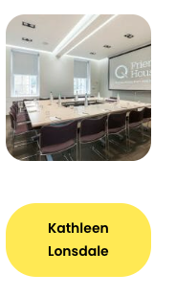
…another baby and I spent most of my time finishing off
(by hand, of course, using log tables) the Fourier analysis
of hexachlorobenzene. In view of the oft-repeated claims
of organic chemists that the crystallographers told them
nothing that they did not already known, it may be
interesting to reprint a more generous tribute from
C. K. Ingold (dated 2 November 193 1).
‘Ever so many thanks for the reprint of your wonderful
paper on Hexachlorobenzene. I havejust been studying
it in the Royal [Society journals] but am very glad to
have it in a handy form. The calculations must
have been dreadful but one paper like
this brings more certainty into organic
chemistry than generations of activity
by us professionals.’

Slide 29
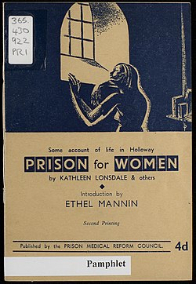
Of her experience in prison, she said,
“What I was not prepared for was the
general insanity of an administrative system
In which lip service is paid to the idea of
segregation and the ideal of reform, when
in practice the opportunities for
contamination and infection are innumerable,
and those responsible for re-education
practically nil”.
Kathleen joined the Howard League for
Penal Reform and frequently visited women
in prison as a form of support.

Slide 30
About these slides
Copyright. Wherever possible we have used CC BY (SA) material, especially
from Wikimedia. Other quoted material is offered as “personal use or non-commercial”.
We suggest you treat this set of slides as CC BY-NC.
(Both Graham and Peter have liberal approaches to copyright (CC BY)
Repository. These slides and associated material are at
https://github.com/petermr/quaker_scientists
Use of AI. CursorAI (2025-09) has been used to gather information, primarily
from Wikipedia. I have checked most of it for accuracy but there may be slight errors
Knowledge Graphs. These have been created by CursorAI and I am continually revising
The protocol. There may be errors
Copyright:

