Slide 1
Customer Churn Analysis
ABC Communications Ltd, AnalystLab Africa Data Analytics Internship, Week 1
Prepared by Peter Thuo Muiruri | Junior Data Analyst, AnalystLab Africa Consulting

Slide 2
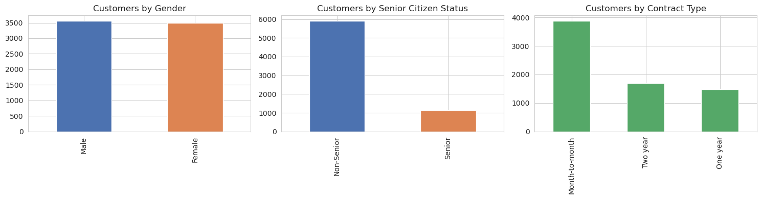
What does the customer base look like?
Interpretation
[ Paste 2-3 sentence summary of the gender, senior citizen, and contract mix charts. State the split, e.g. contract type skew. ]
Gender is close to a 50/50 split, so it is not a useful churn predictor on its own. Senior citizens make up a small minority of the base, roughly one in six customers. Contract type is heavily skewed toward month-to-month, which matters most since that is the segment with the least switching friction.

Slide 3
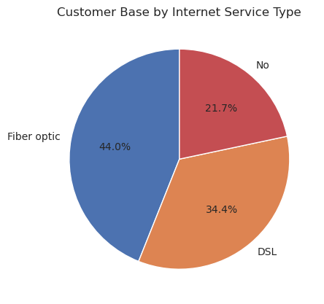
Fiber optic makes up the largest share of the customer base at 44%, ahead of DSL at 34%.
Worth flagging alongside the earlier finding that fiber optic customers also churn the most, so this segment is both the biggest and the riskiest.

Slide 4
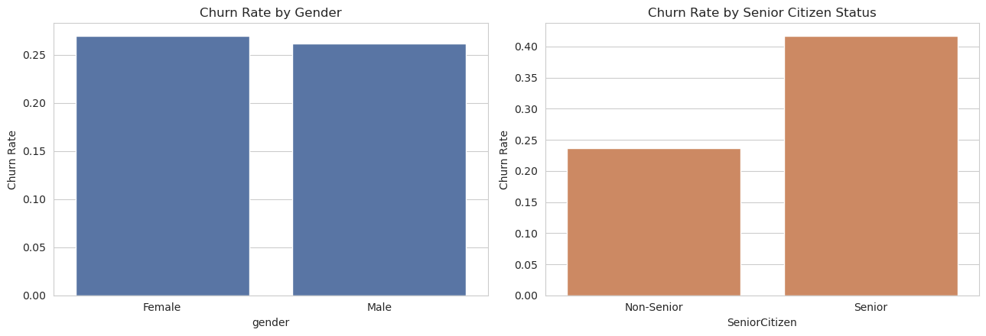
Which segments have the highest churn?
Interpretation
Gender shows almost no difference in churn rate, confirming it is not a useful segment for retention targeting. Senior citizens churn at a noticeably higher rate than non-seniors, roughly 1.75x, making age a real but partial risk signal worth combining with other variables rather than acting on alone.

Slide 5
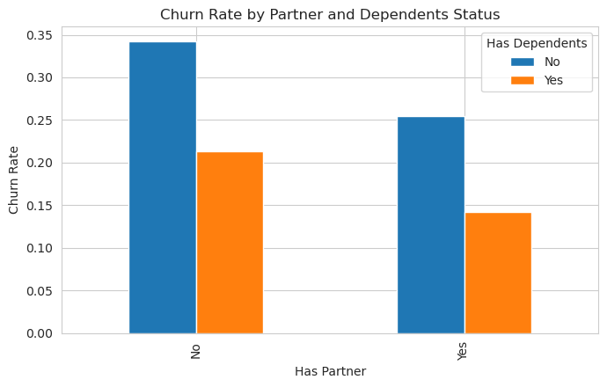
Customers with no partner and no dependents churn the most, around 34%.
Having a partner, dependents or both correlates with lower churn, likely because switching providers is a bigger disruption for a household than a single-person account.

Slide 6
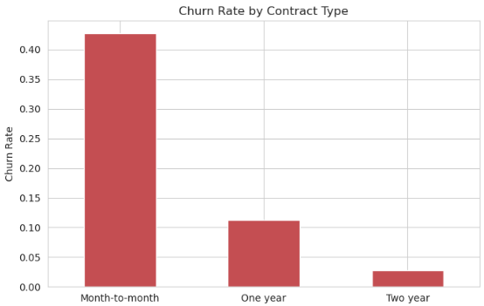
Does contract type influence retention?
This is the strongest single driver in the dataset.
Month-to-month customers churn at a dramatically higher rate than one-year or two-year contract holders, roughly 4x and 15x respectively.
Contract length acts as a built-in retention mechanism by raising the switching cost, making it the highest-leverage lever available to management.

Slide 7
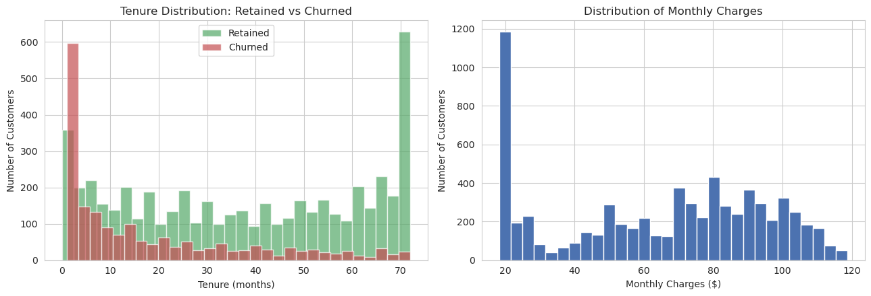
Does tenure affect loyalty?
Churned customers cluster heavily in the first few months, that is basically where most of the risk lives. Retained customers are all over the place, tenure-wise, with a big chunk of loyal long-timers around the 70-month mark. So, loyalty is not something that builds steadily over time, it is more like: survive the first few months and you are probably sticking around. That makes onboarding and the first 90 days the spot to focus retention effort.

Slide 8
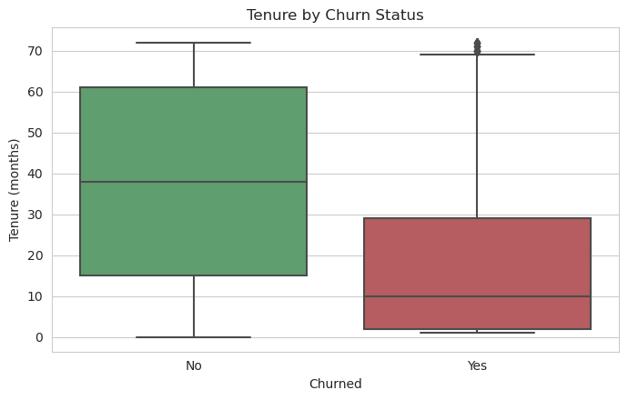
The median tenure for churned customers sits far lower than for retained ones, with the whole churned box crammed into the lower end of the range.
It backs up what the histogram showed, churn is front-loaded onto newer customers rather than spread evenly across account age.

Slide 9
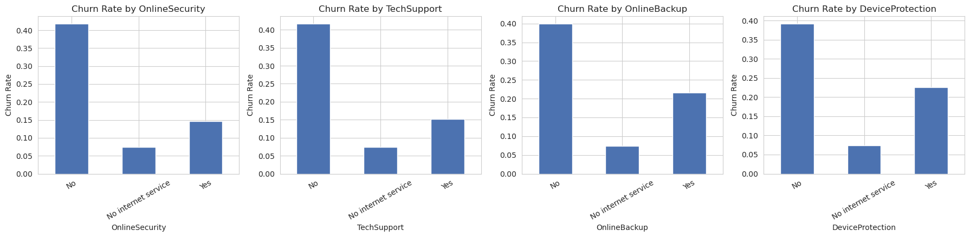
Which services influence churn?
Customers without OnlineSecurity or TechSupport churn about 3x more than those with it; OnlineBackup and DeviceProtection show a smaller gap, around 1.8x. Worth pushing these as retention tools, not just upsells.

Slide 10
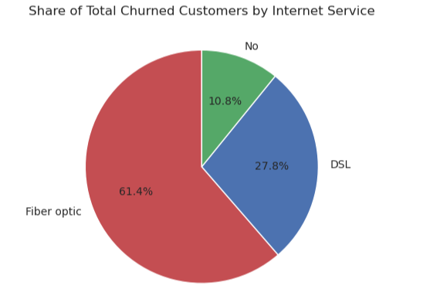
Fiber optic customers make up 61% of all churned customers, way more than their 44% share of the base.
DSL and no-internet customers churn proportionally less. This confirms fiber is the highest-risk segment overall, worth digging into pricing or reliability there.

Slide 11
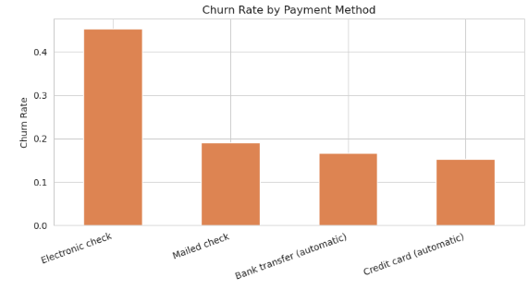
Which payment methods have higher churn?
Electronic check users churn at roughly 3x the rate of automatic payment methods, 45% vs 15-17% for bank transfer or credit card autopay.
Manual, non-automatic billing seems to be a proxy for less committed customers, pushing electronic check payers toward autopay could be a real retention win.

Slide 12
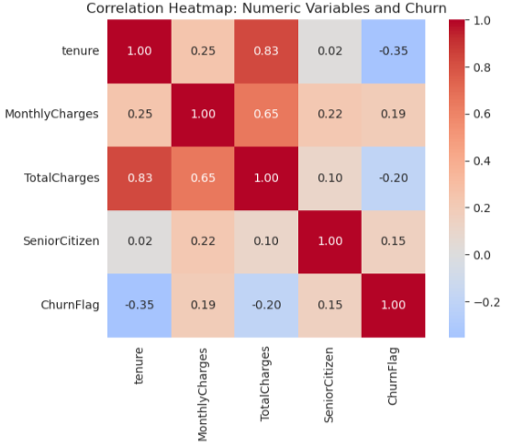
Tenure has the strongest relationship with churn, negative, meaning longer-tenured customers are less likely to leave.
MonthlyCharges shows a weaker positive link, higher bills, somewhat higher risk.
TotalCharges correlates strongly with tenure itself, so it is mostly a byproduct of how long someone has been a customer, not an independent churn driver.

Slide 13
What Actions Should Management Take?
Push month-to-month customers toward one/two-year contracts with incentives
Focus retention efforts on the first 90 days of tenure
Bundle OnlineSecurity and TechSupport free or discounted for at-risk segments
Investigate fiber optic churn drivers (pricing, reliability, competition)
Encourage electronic check payers to switch to autopay

