Slide 1
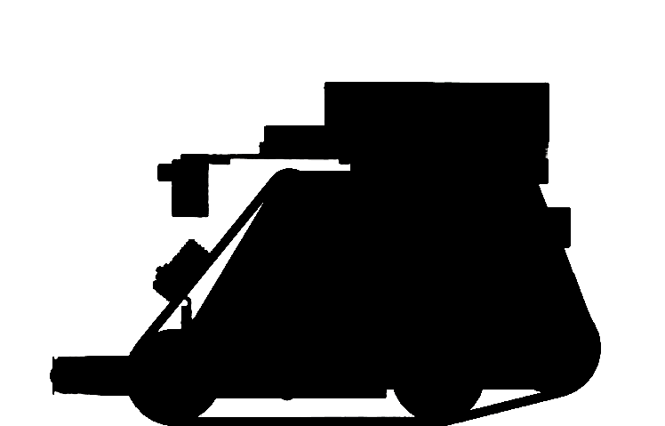
Group 10 Robot Navigation
Peter Nicholls
Notes:
- Hello everyone, as a member of Group 10, I’ve been involved in programming the robot, and one aspect has be on developing the robot navigation.

Slide 2
Methods of Navigation
“The process of moving to a known location within the arena”
Random
Back-tracking
Pre-planned (pathfinding)
Dijkstra's algorithm
Dynamic SWSF-FP
A* search algorithm
D* search algorithm
Notes:
For the purposes of this presentation, we will define ‘navigation’ as “The process of moving to a known location within the arena”.
This is similar, but not to be confused with the search algorithm – how it will find unknown points within the arena, i.e. the packages
Obviously this is important, as the robot must be able to navigate back to HQ, and comes in very handy if it sees a package but is unable to collect it at the time.
The random method is very effective due to its simplicity. This is where to return to base, the robot will move around avoiding obstacles until it returns to base. It is easy to implement and works most of the time, but is inefficient both time-wise and battery-wise.
Back-tracking is one step up from random in complexity and efficiency, as when it must return to base, it will follow the path it has taken. This can be done either using IMU and motor encoder readings, or wall following. This may be more efficient at returning to a past point, but is no good for going to known points that have not yet been traversed, and can fail atrociously.
Pre-planned are much more complex and are more processor intensive, but have many benefits. They can reduce the time to get to known locations, and reduce the power usage by going directly there. As the robot always knows where it is, it is unlikely to get stuck anywhere. All of these pathfinding algorithms are based on having a map of some sort split into nodes, and find a route from the ‘current’ node to the destination node.

Slide 3
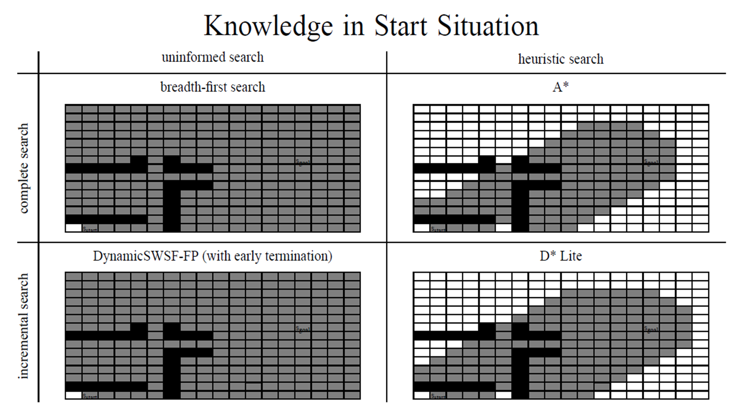
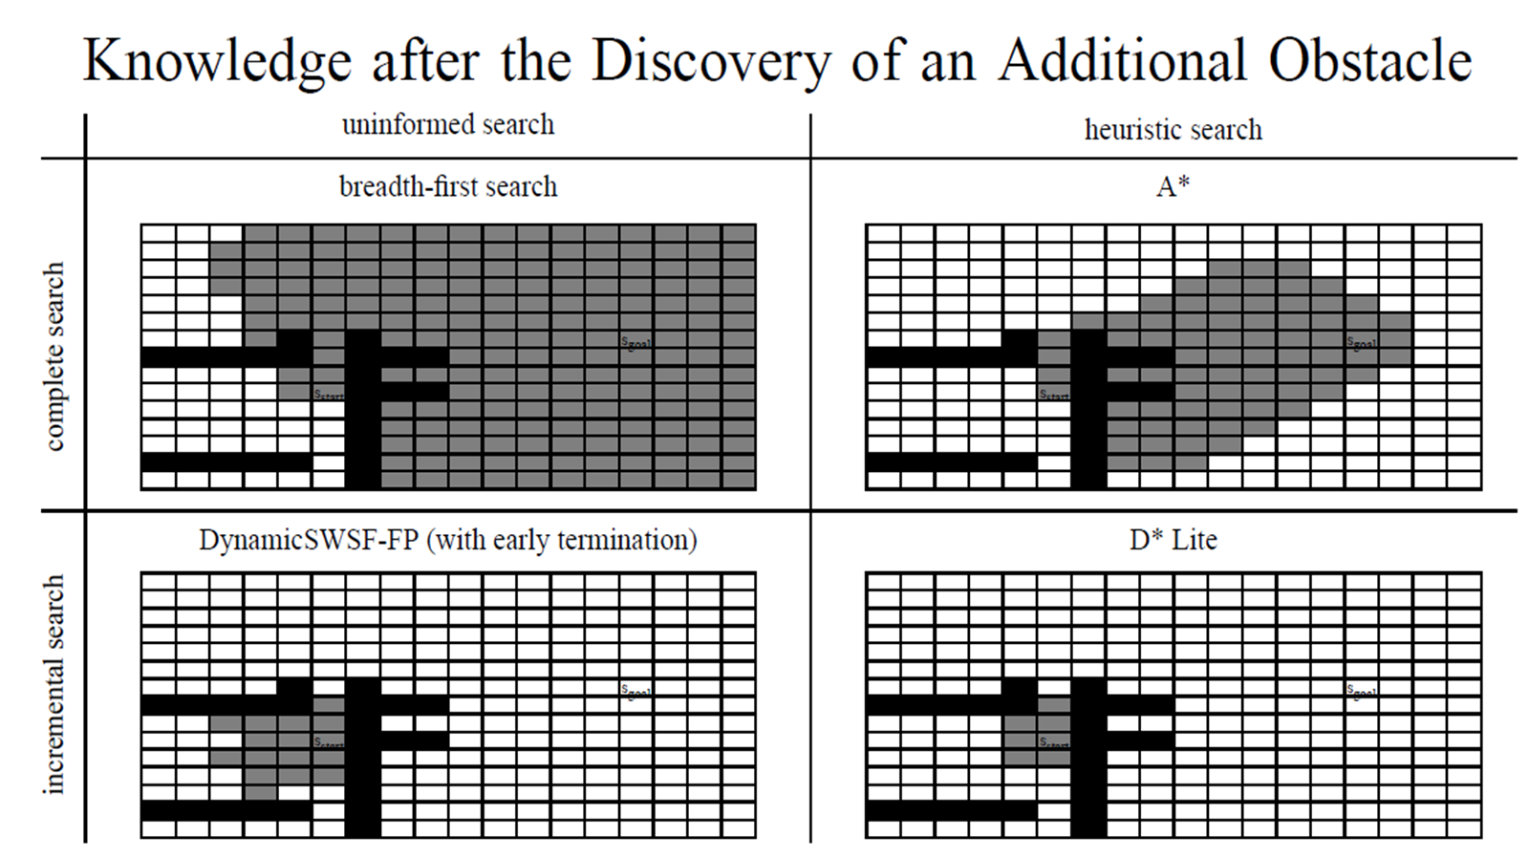
Pre-planned Navigation
Note there are two diagrams here, one under the other. To see them, play the slide
(Shift+F5, enter)
S. Koenig, M. Likhachev, “Fast Replanning for Navigation in Unknown Terrain” (2005)
Notes:
Dijkstra’s algorithm (or ‘Breadth-first search’ on this slide) is where it continually expands its search outwards until it finds the destination. All the algorithms can start at the current node, or from the destination node (as in this diagram), which is often slightly faster.
A-star is based on Dijkstra’s, except that nodes have a ‘heuristic’ value. This means that it has a list of the surrounding nodes, and looks at both how far away it is from the start and from the destination, and weights it based on a heuristic. As such, it will check the closer nodes first.
The problem with both of these methods is that it requires knowledge of the whole arena, a luxury our robots don’t have. If the robot sees something new, these first two methods have to check the entire map again. The next two algorithms are the same to start with, but are more efficient when the robot sees something new [TRANSITION].
Dynamic Strict Weakly Superior Function-Fixed Point (I’ll just call it ‘SWSF’ for short) is similar to the breadth-first search, except that it stores the distance of each node, and only changes the nodes affected by a new obstacle.
D-star is short for ‘Dynamic A-star’ as it only uses A-star once and then dynamically changes the node values as SWSF does. It was originally developed in 1994, but has had many variations and improvements, of which we’re looking at D-star lite, developed in 2002.
As you can see in the diagram, Dijkstra’s and A-star process a large number of nodes, whereas SWSF and D-star lite process a much smaller number. D-star lite can be up to 100x faster that Dijkstra’s, 3x faster than A-star and twice as fast as SWSF, depending on the size of the map.

Slide 4
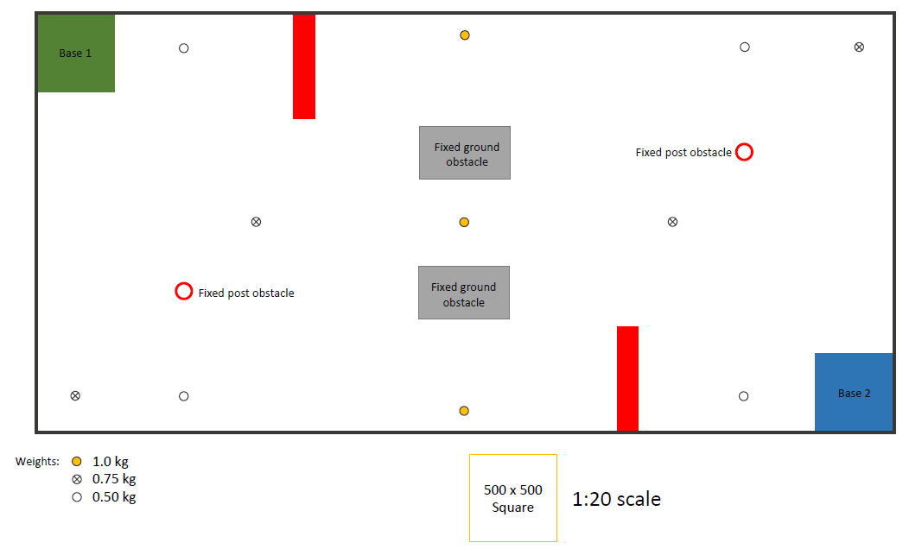
Navigation in Our Arena
From notes on ENMT301 course webpage
Notes:
When applying these algorithms to our robot, there is one fundamental component it requires – a map. Obviously the smaller the map is split up into, the slower it will be in processing, but the more efficient and accurate the paths will be. The map shown is one last year’s competition maps.
Initially, I tried having nodes half the size of the weights, so the weights could be placed on the map, but that lead to having an enormous number of nodes (nearly 30 000). Because this could not fit in the ram on the Arduino, I created an API to construct the map on an SD card. This lead to having issues with this number of nodes taking a very long time to read and write.
Several optimisations have been done, including to not store ‘empty’ nodes, which is most of the map. This still took too long.
Instead of doing half the weight size, it would be much faster to used half the robot size, since this is the size of gap the robot needs to fit through. The weights would instead be stored in a separate array to the map. [TRANSITION]
This diagram only has 231 nodes, or 76 if you don’t include blank space. As you can see, this has sufficient detail to have most of the map detail, and enough detail to create optimal paths and avoid walls.
In conclusion, while the random and back-tracking method may be simple and work, they take more time, more power and can be unreliable. As long there are a good variety of sensors, storing a map for pathfinding is a superior method of navigation which can be used in the context of our Robocup.
QUESTIONS?!!

