Slide 1


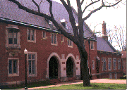
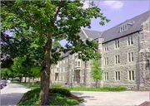
vs.
MAIN
HILLCREST
CAMPBELL

Slide 2

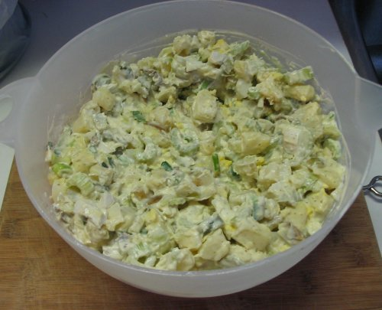

A Blanket
Potato Salad
Chicken
A Dead Lois
42
29
17
8
1
2
`
3
4
X
X
X
X
X
X
TRIPLE FAKE POINTS
P

Slide 3
Pink
Black
Maroon
Teal
21
19
12
9
Gray
Purple
Brown
Chartruse
7
6
4
2
1
5
2
6
`
3
7
4
8
X
X
X
X
X
X
1

Slide 4
Fireworks
Shooting Star
Plane
Blimp
21
17
14
8
Blimp
Sunset
Superman
Skywriting
6
5
4
3
1
5
2
6
`
3
7
4
8
X
X
X
X
X
X
2

Slide 5
Bollo’s
Duckpond
Starbucks
She-Sha
17
14
10
7
The Lyric
Hort. Gardens
6
2
1
5
2
6
`
3
4
X
X
X
X
X
X
3

Slide 6
Rocky
Star Wars
Back to the Future
Land Before Time
21
12
9
7
Lord of the Rings
Matrix
Aladdin
Mighty Ducks
8
6
5
4
1
5
2
6
`
3
7
4
8
X
X
X
X
X
X
4

Slide 7
Yen
Euro
Pound
Peso
36
29
14
10
Yuan
4
1
5
2
`
3
4
X
X
X
X
X
X
DOUBLE POINTS
5

Slide 8
Letters
Enter
Shift
Spacebar
26
17
12
9
Tab
Tilde
7
4
1
5
2
6
`
3
4
X
X
X
X
X
X
6

Slide 9
Doctor
Firefighter
Astronaut
Teacher
29
24
14
9
Cop
Vet
6
4
1
5
2
6
`
3
4
X
X
X
X
X
X
7

Slide 10
Spades
Poker/Hold ‘Em
Gin Rummy
Hearts
21
15
14
9
Solitaire
Go Fish
BS
Kings
7
6
4
2
1
5
2
6
`
3
7
4
8
X
X
X
X
X
X
8

Slide 11
Superman
Batman
Green Lantern
Spiderman
36
24
8
7
Quailman
Super Woman
6
4
1
5
2
6
`
3
4
X
X
X
X
X
X
TRIPLE POINTS
9

Slide 12
Commercials
Halftime
Food
Beer
65
12
9
7
Parties
4
1
5
2
`
3
4
X
X
X
X
X
X
10

Slide 13
Sneaker/Tennis
Sandal
High Heel/Stiletto
Boot
31
26
11
9
Flip Flop
Slippers
7
4
1
5
2
6
`
3
4
X
X
X
X
X
X
11

Slide 14
Wallet
Keys
Money/Change
Lip Balm
29
21
17
9
Phone
Hokie Passport
The One Ring
8
6
2
1
5
2
6
`
3
7
4
X
X
X
X
X
X
12

Slide 15
More Than Coffee
Mike’s Grill
Cabo Fish Taco
Gillie’s
14
10
9
8
Joe’s Diner
Backstreets
Macado’s
Boston Beanery
7
6
5
4
1
5
2
6
`
3
7
4
8
X
X
X
X
X
X
13

Slide 16
Bears
RAs
Weapons
17
14
12
9
Women Drivers
Nothing
Jack Dudley
6
5
4
1
5
Other Things w/Lasers
2
6
`
3
7
4
X
X
X
X
X
X
14

