Slide 1
Chat sessions example

Slide 2
Chatting with chat gpt3-5 models

Slide 3
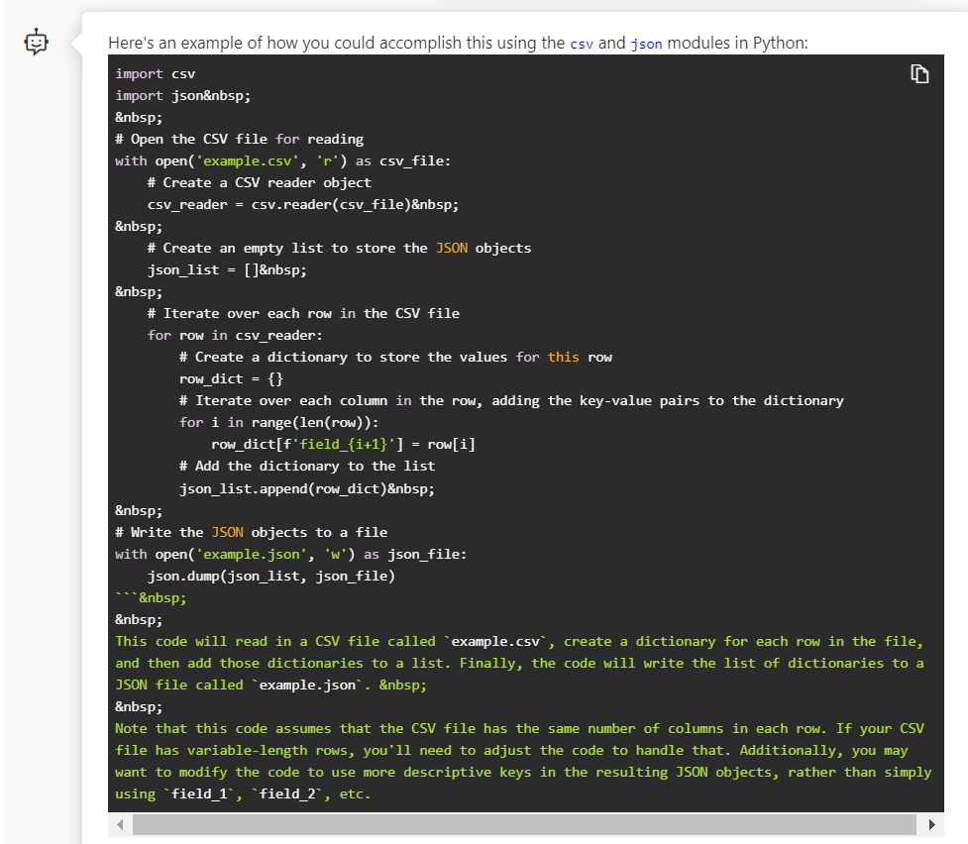
write python code to read csv file and save to json each row

Slide 4
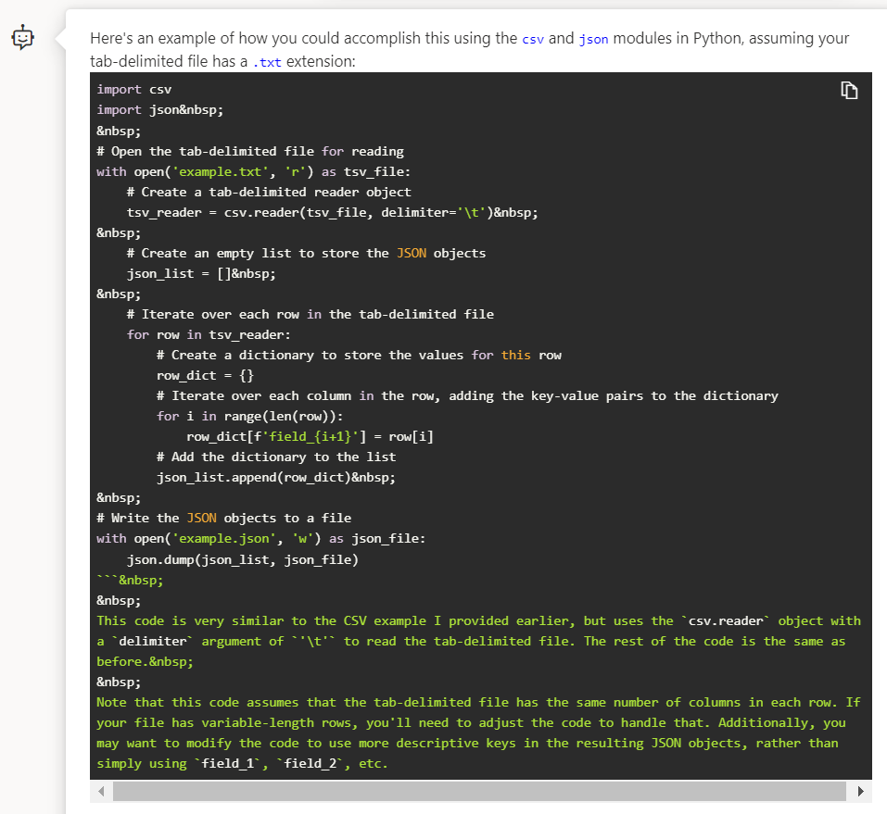
write python code to read tab delimited file and save to json each row

